Slide 1
Advanced SQL Queries
COMM3220: Data Management for Decision-Making
Kara Henderson | kar4g@virginia.edu

Slide 2
Today’s questions need new SQL patterns
• Which restaurants did Kara attend without Colin?
• Which restaurants did Logan and Kay both visit?
• Which categories have enough visits to be worth comparing?
• Which people attended the same lunch as Kara?
We already know how to join tables. Today we will compare result sets, filter groups, and create temporary named results.
COMM3220: Data Management for Decision-Making
2

Slide 3

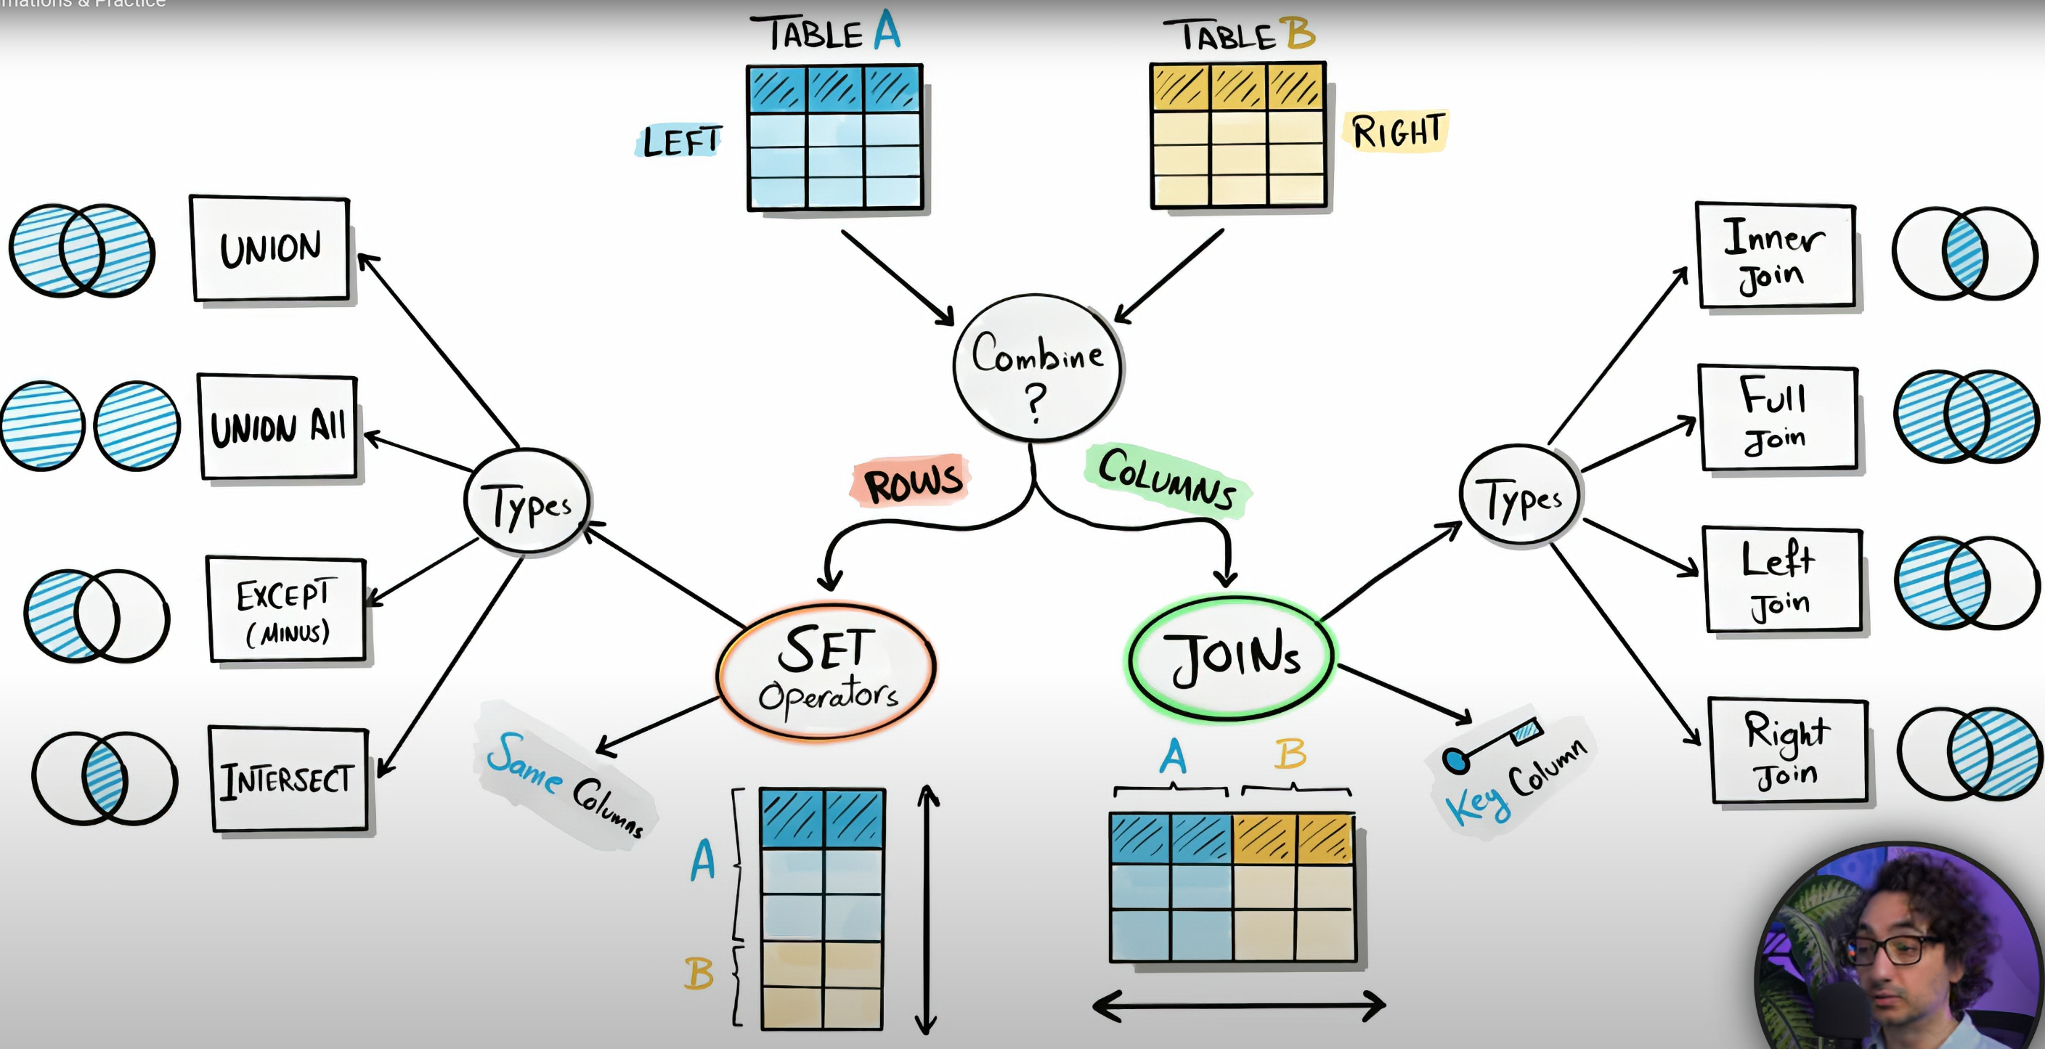

Notes:
INTERSECT returns distinct rows that are common to both SELECT queries
EXCEPT Returns rows from the first SELECT query that do not appear in the second.
Source: Data with Barat – You Tube + sg edits

Slide 4
Set operations compare two result sets
• Each query must return the same number of columns.
• Corresponding columns must have compatible data types.
• Column names in the final result come from the first query.
• Use ORDER BY only after the final query.
Query A
Kara’s restaurants
Query B
Colin’s restaurants
UNION = unique rows from A or B
UNION ALL = rows from A or B, shows duplicates if they exist
INTERSECT = rows in both A and B
EXCEPT = rows in A but not B
COMM3220: Data Management for Decision-Making
3

Slide 5
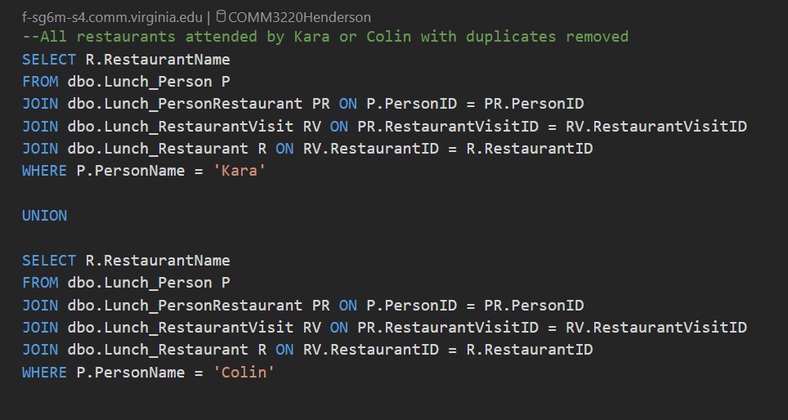
UNION removes duplicates. UNION ALL keeps them.
UNION
One copy of each restaurant
UNION ALL
Keeps repeated restaurant names. Useful when duplicates carry meaning.
COMM3220: Data Management for Decision-Making
4

Slide 6
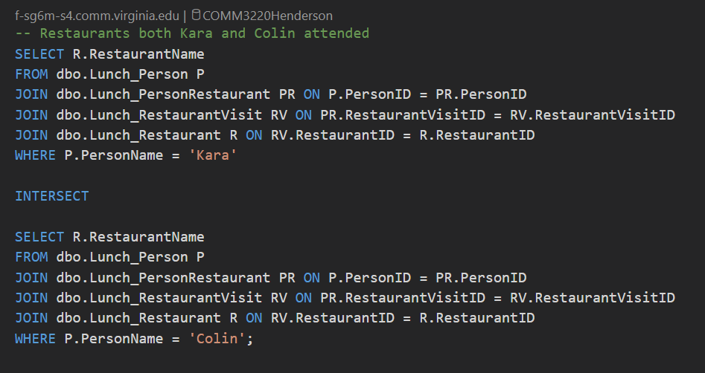
INTERSECT finds overlap. EXCEPT finds a difference.
Change INTERSECT to EXCEPT to return restaurants Kara attended without Colin.
Order matters for EXCEPT:
A EXCEPT B ≠ B EXCEPT A
COMM3220: Data Management for Decision-Making
5

Slide 7
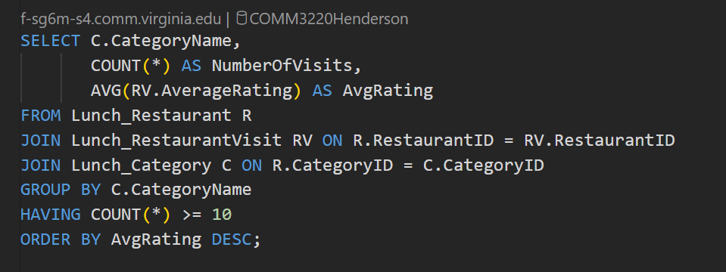
HAVING filters groups after aggregation
Clause | Filters | Aggregate functions?
WHERE | individual rows before GROUP BY | No
HAVING | groups after GROUP BY | Yes
Read it as: Keep only category groups with at least 10 visits.
COMM3220: Data Management for Decision-Making
6

Slide 8
WITH creates a named temporary result
A common table expression (CTE) exists only for the query that follows it.
A CTE improves readability when a query needs multiple steps.
Start with WITH, name the result, then use it like a table.
Used to use ‘subquery’ but no longer a best practice
WITH VisitAttendance AS (
SELECT RestaurantVisitID, COUNT(1) AS AttendeeCount
FROM dbo.Lunch_PersonRestaurant
GROUP BY RestaurantVisitID
)
SELECT R.RestaurantName, RV.VisitDate, VA.AttendeeCount
FROM VisitAttendance VA
JOIN dbo.Lunch_RestaurantVisit RV
ON VA.RestaurantVisitID = RV.RestaurantVisitID
JOIN dbo.Lunch_Restaurant R ON RV.RestaurantID = R.RestaurantID
WHERE VA.AttendeeCount >= 4
ORDER BY VA.AttendeeCount DESC;
Read it as: Keep only restaurant visits with 4 or more guests
COMM3220: Data Management for Decision-Making
7

Slide 10
A SELF JOIN compares rows within the same table
• Use two aliases for the same table.
• Match the aliases on a shared key.
• Use a condition such as < or <> to avoid pairing a row with itself or showing duplicate pairs.
SELECT P2.PersonName AS KaraLunchCompanion,
RV.VisitDate
FROM dbo.Lunch_PersonRestaurant PR1
JOIN dbo.Lunch_Person P1 ON PR1.PersonID = P1.PersonID
JOIN dbo.Lunch_PersonRestaurant PR2
ON PR1.RestaurantVisitID = PR2.RestaurantVisitID
JOIN dbo.Lunch_Person P2 ON PR2.PersonID = P2.PersonID
JOIN dbo.Lunch_RestaurantVisit RV
ON PR1.RestaurantVisitID = RV.RestaurantVisitID
WHERE P1.PersonName = 'Kara'
AND P2.PersonID <> P1.PersonID;
COMM3220: Data Management for Decision-Making
8

Slide 11
A CROSS JOIN creates every possible pairing
Categories
15 rows
Subcategories
23 rows
SELECT C.CategoryName,SC.SubcategoryName
FROM dbo.Lunch_Category C
CROSS JOIN dbo.Lunch_Subcategory SC
ORDER BY C.CategoryName, SC.SubcategoryName
15 × 23 = 345 possible category-subcategory pairs
• No ON condition. Every row on the left pairs with every row on the right.
• Useful for planning combinations, testing coverage, or generating a complete grid.
• Be careful. Row counts multiply quickly.
COMM3220: Data Management for Decision-Making
9

Slide 12
One question, three ways to think
Question
Which restaurants did Kara attend without Colin?
Set logic
Kara’s restaurant set EXCEPT Colin’s restaurant set
Data path
Person → PersonRestaurant → Visit → Restaurant
• Build each person’s result set with the same SELECT list.
• Use EXCEPT between those two SELECT statements.
• Use a CTE if repeating the four-table path makes the query hard to read.
COMM3220: Data Management for Decision-Making
10

Slide 13
Choose the pattern that matches the question
If you need to… | Use… | Key idea
Filter summary rows | HAVING | Filter groups after GROUP BY
Combine and de-duplicate | UNION | Set of values from either query
Keep repeated rows | UNION ALL | All rows from both queries
Find overlap | INTERSECT | Values present in both
Find one-sided results | EXCEPT | Values in first query only
Name an intermediate result | WITH | CTE used by one query
Compare table rows | SELF JOIN | Same table, two aliases
Generate combinations | CROSS JOIN | Every left/right pairing
COMM3220: Data Management for Decision-Making
11

Slide 14
Activity: 10 advanced queries
• Use the Lunch database and write one SELECT query per question.
• Record each prompt in a markdown cell, then write and run its query in a code cell.
• Return only requested fields. Give calculated fields meaningful aliases.
• The activity covers all eight patterns from today’s lesson.
Focus questions include:
Kara without Colin
Logan and Kay in common
Kara’s lunch companions
Every person-category pairing
COMM3220: Data Management for Decision-Making
12

