Slide 1
Information Technology in Finance
Class Introduction
Stefano Grazioli

Slide 2


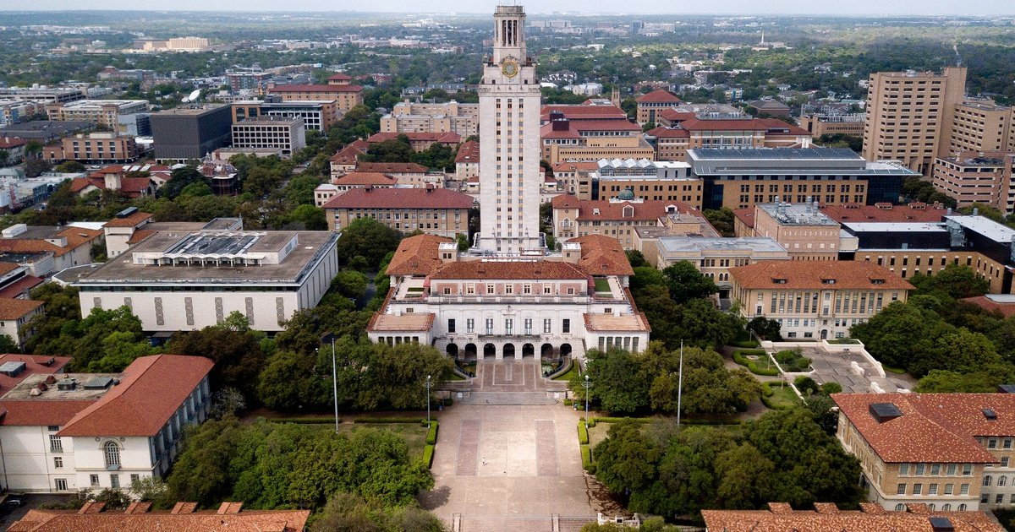




UT Austin
Milano, Italy
Bocconi University
UVA: Mendoza, Argentina
UVA: NoVA

Slide 3
What is the course about?
What skills will I learn that I can put on my CV?
What is the work that I need to do?
What is the Hedge Tournament?

Slide 4
Class Objectives
“I know how to use IT to solve practical financial problems.”
“I am comfortable around Excel, macros, VBA, and databases”
“I have acquired valuable skills
in state-of-the-art tools.”

Slide 5


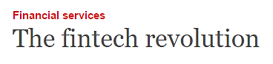

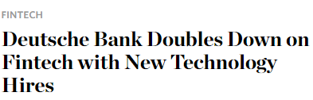
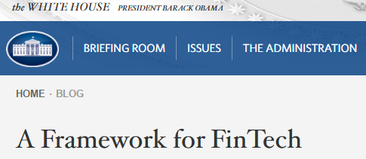

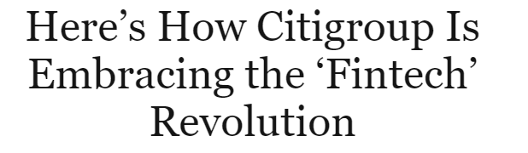

Finance and IT = Fintech

Slide 6
Aspects of Fintech
Fintech
Lending
Lending Club
Investment Management
JPMorgan
Payments
PayPal
InsurTech
Lemonade
RegTech
Deloitte

Slide 7
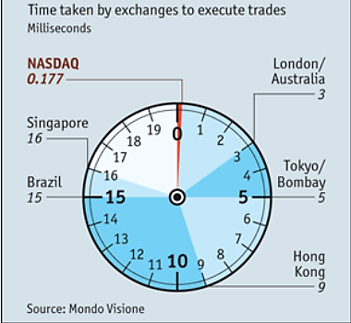

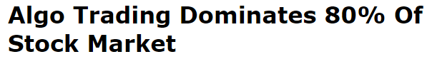
Algorithmic vs. High Frequency Trading (HFT)
60% of trades larger than $10 million in March 2020 were executed by an algorithm
- JP Morgan
Notes:
1,700

Slide 8
You will learn how to use technology to automate and support financial processes and decision making
Knowledge
of Technology
(databases, coding,
algorithms)
Knowledge
of Business
(Finance/Accounting
Teamwork/Leadership)
What you will learn
Automating business tasks
Automating Business Intelligence: extracting & analyzing information from enterprise databases
Financial engineering: designing & implementing financial strategies

Slide 9
What is this course about?
What skills will I learn that I can put on my CV?
What is the work that I need to do?
What is the Hedge Tournament?

Slide 10

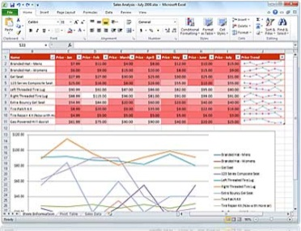




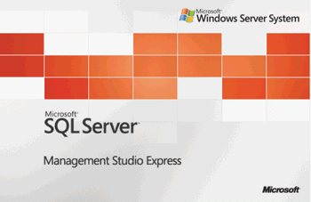

Specific Tools on your CV
Process automation tools: automating repetitive business analysis tasks
- Visual Basic for Applications, Excel Macros,
VSTO: Visual Studio Tools for Office
Automating Business Intelligence tools: extracting & analyzing information from enterprise databases
- Excel-databases, Azure Data Studio, SQL,
SQL Server, Pivot Tables
Financial Engineering tools: designing & implementing financial strategies
- Visual Studio, Hedge Tournament,
Advanced Excel
Pivot tables
Azure Data Studio

Slide 11
What is this course about?
What skills will I learn that I can put on my CV?
What is the work that I need to do?
What is the Hedge Tournament?

Slide 12
Learning by doing

Slide 13
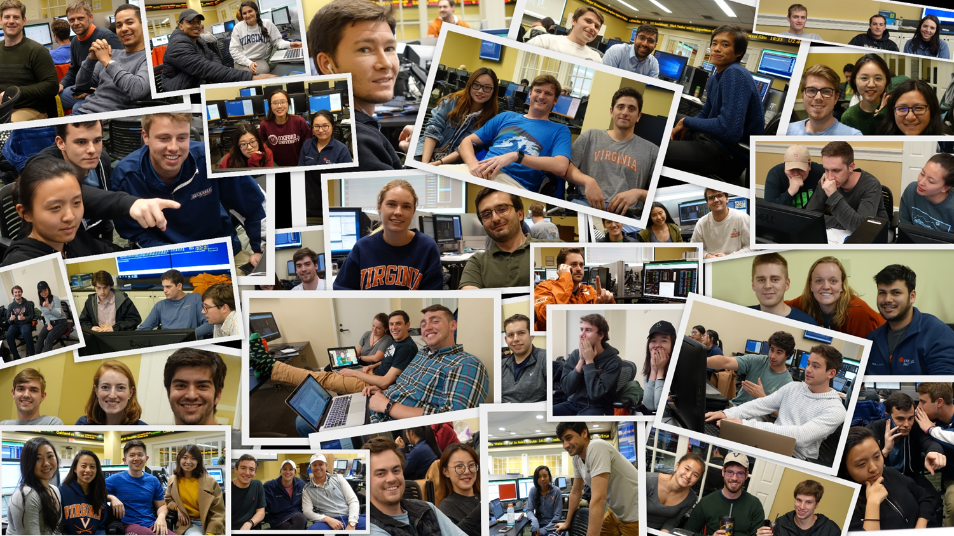
The Hedge Tournament

Slide 14
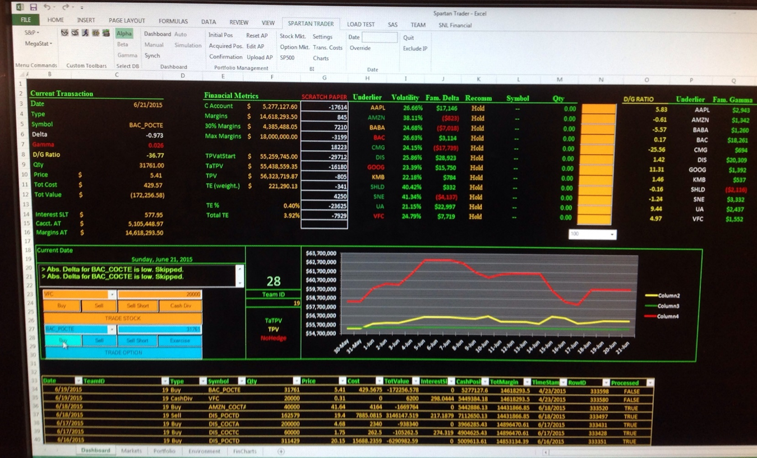

The Hedge Tournament
Hard skills
Experience with IT
project management
A differentiating story
to tell recruiters
Financial Markets
Your app
(gather, analyze, trade, control)
Financial
Data
Your portfolio performance
Your financial
decisions

Slide 15
What is this course about?
What skills will I learn that I can put on my CV?
What is the work that I need to do?
What is the Hedge Tournament?

Slide 16
Homework
What, already?

Slide 17
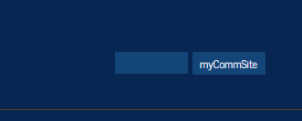
Two Web Sites
Public site
  Google ‘Stefano Grazioli’ and go from there
  Grading policies
  Office hours
Personal site
  Get your password today
Password only

Slide 18
Homework
VS is one of the most complex
and powerful software ever
built. Some struggle is inevitable.
Give yourself plenty of time
Enjoy problem solving
No copying/pasting code written by others: it is a honor violation.
Come and see me. Office hours on the web site.

Slide 19
WINIT
What Is New In Technology
Go to the class web site
for instructions
And the first volunteer is...

Slide 20


Slide 22
Our network
Microsoft
Appian
KPMG
Amazon Web Services
U.S. Air Force
US Navy
Freddie Mac
Verisign Inc
Ensemble Health Partners
University of Virginia
R2 Technology Solutions
Google
ICS-NETT
Two Roads Consulting
ICF
Deloitte
Rapid7
CGI Federal
Booz Allen Hamilton
CapTech Consulting
Department of VA
Vanguard
Capital One
Phase2 Technology
General Dynamics Information Technology
Federal Reserve Bank of Richmond
National Security Agency
DRT Strategies
Accenture Federal Services
LVY Consulting

