Slide 1
BI: Accessing
Enterprise Data
“Canned” queries using Excel, VBA, and SQL

Slide 2

Critical thinking
Going well
Easy meter
Stocks
MS Teams

Slide 3
Red words
DBMS
RDBMS
SQL
Difference between BI and Analytics?

Slide 4
Name, Academics
Feeling better about coding?
Things you like about the class
Things that can be improved

Slide 5
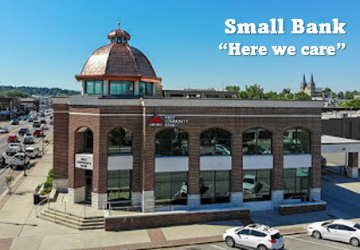
Homework
Automating Business Intelligence at SmallBank

Slide 6

"There's got to be a better way to do that!"
I like my new job at SmallBank, except that every day at the close of business I must access the bank DB and create dozens of updated lists of customers for management review. I hate it! It is a super-boring repetitive task.
Mmmm... maybe I can automate it....

Slide 7
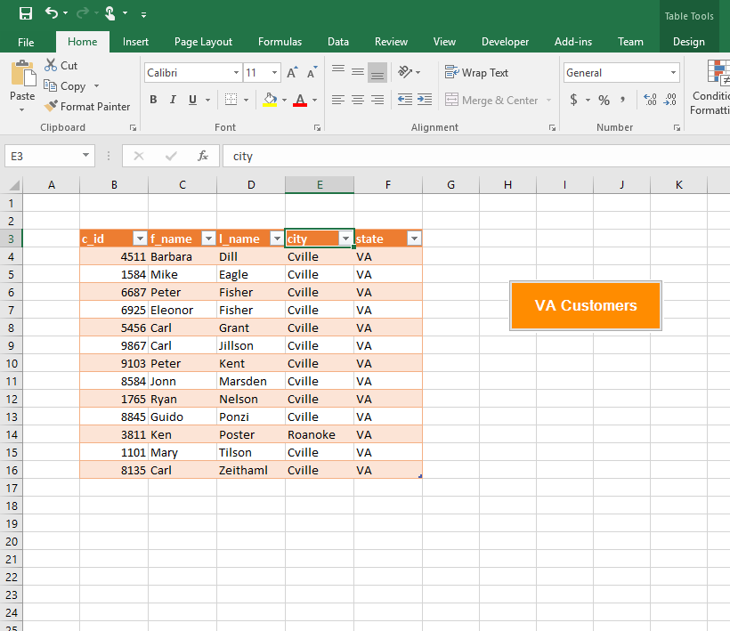
Demo
Canned queries
Picture shows the demo, not the homework

Slide 8
How do I access remote data and show them in Excel? A two-step process
Tables in a DB in the remote RDBMS
‘Tables’ in a DATASET
in your PC memory
VBA runs a SQL Query
more VBA commands
A listobject on a spreadsheet
Remote server / Cloud
Your PC

Slide 9

Database “Legos”
Standard software objects
stitched together
ADO.NET
ActiveX Data Object. It is a MSFT technology to manage enterprise data
(on your CV)

Slide 10
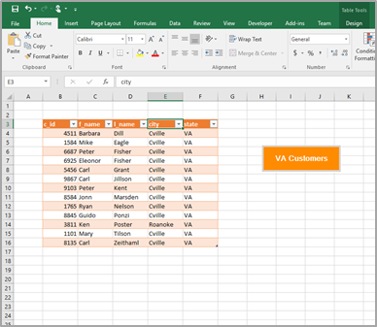
ADO architecture (6 “Legos”)
Remote
RDBMS
(DB with financial data)
Client
(your pc)
1. SqlConnection: given a connection string it will connect you to a DB
2. SqlCommand: stores your SQL query
Example connection string
"Data Source=f-sg6m-s4.comm.virginia.edu;
Initial Catalog=SmallBankDB;
Integrated Security=True"
DB server
Example query
Select *
from Customer
where state = ‘VA’
3. SqlAdapter: the ‘engine’ that moves the data. It fills a table in a dataset using the query in SqlCommand
4. DataSet that contains
5. DataTables
6. ListObject shows you the data in the DataTable

Slide 11
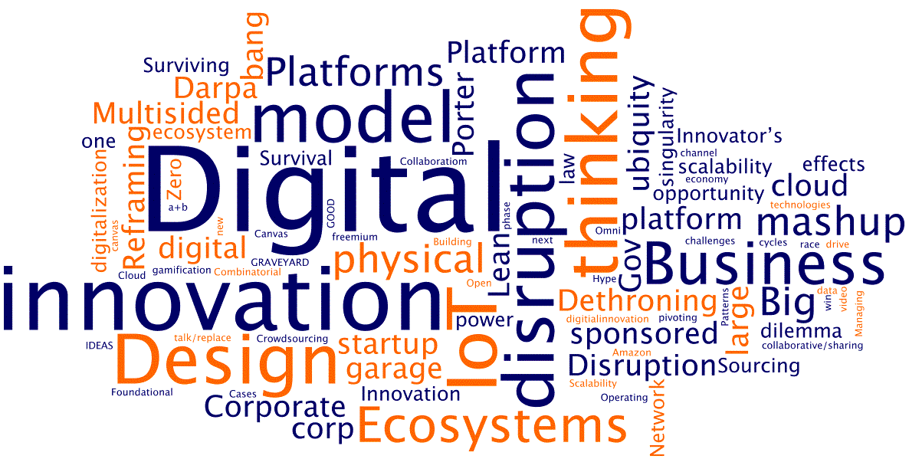
WINIT
What Is New
In Technology?

Slide 12
Suggestions
Make sure that you understand the ADO architecture diagram before coding.

Slide 14
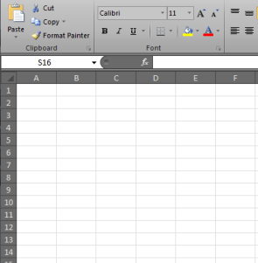
What are the differences?
Tables in a RDBMS on the network
In memory
DATASET
slower
faster
Speed | Fast | Faster | Slow
Volume | Very large | Medium | Small
Access | Medium | Difficult | Easy
Backup | Good | n/a | Manual
Security | Good | Excellent | Poor
Server
Your local machine

