Slide 1
Dynamic SQL Queries
Stefano Grazioli

Slide 2
Going well
Easy meter
It is time to start thinking about teams

Slide 3
(no team yet)
Name
Academics
Things you like about the class
Things that can be improved

Slide 4
Learning Objectives
BI: Automating SQL
  Static (‘Canned’) queries
  Dynamic queries
  Non-queries
Excel/VBA Object Model
Today

Slide 5
The Excel object model
And the dot notation

Slide 6
The Excel Object Model
Objects are software ‘bundles’ of methods and properties
Range("A1").value
Range("A1").clear()
property
method
dot notation
BUT we surely have multiple cells “A1” in our computers….

Slide 7
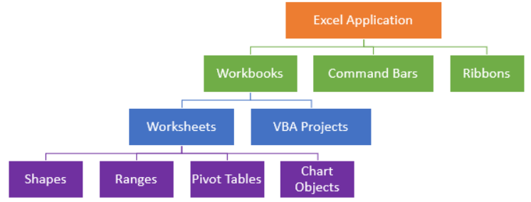
The Excel Object Model
VBA Objects are arranged in a hierarchy
Application.Workbooks.Item("MyWBook.xlsx").
Worksheets.Item(1).Range("A1")
Method to access an element
Excel itself
Collection (s)
Full names are rarely used
Notes:
Source: https://www.automateexcel.com/vba/object-model/

Slide 8
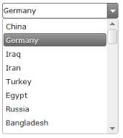
Combo boxes are objects
myCBox
myCBox.Text
Pick a country
myCBox.Items
myCBox.SelectedItem
myCBox.Items.Add(“Italy”)

Slide 9
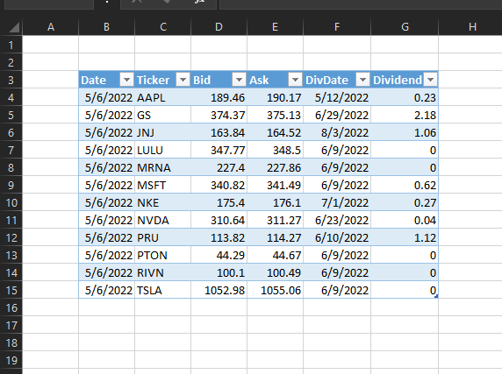
ListObjects are objects
myDataLO
mydataLO.DataRange
myDataLO.TableStyle = "TableStyleMedium3"

Slide 10
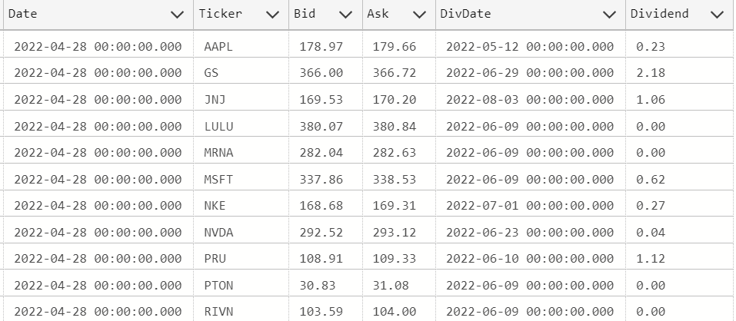
DataTables are objects
myStockDataTbl
myStockData.Rows
myDataSet.Tables(“MyStockDataTbl").Rows

Slide 12
Homework
h8

Slide 13

Gooood morning! That app you built is so useful! None of my managers uses the old client reports anymore. They ALL use your Excel app to check the lists of customers from the various states that we serve. Exceptionally well done!
I wonder if you could do something like that for our financial advisors... They often need to access historical stock data to answer customer questions... I bet that they would love it!
I am on it, Boss.

Slide 14
Static (‘Canned’) queries vs Dynamic SQL queries
mySQL = "SELECT * FROM StockMarket where date = '5/2/2023'"
mySQL = "SELECT * FROM StockMarket where date = '" + DateCBox.SelectedItem + "'"

Slide 15
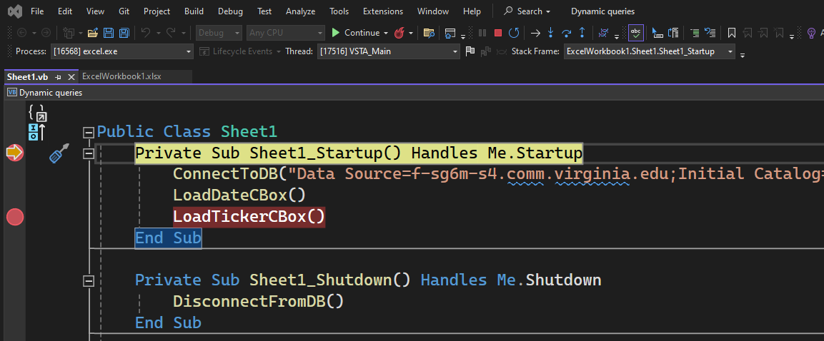
Breakpoints

Slide 16
Suggestions
Make sure that you understand the ADO architecture diagrams before coding.

