Slide 1
Data quality
Automating Data Wrangling / Data Cleaning

Slide 2
“Object reference not set to an instance…”
Easy Meter
Midterm (H10+H11)
  Zero collaboration
  No faculty help
  Clarification questions welcome.

Slide 3
Orange words
Non query

Slide 4
Learning objectives
Data quality
Ingesting csv files
Text manipulation

Slide 5
What is Data Quality?
The degree to which data is suitable for a business purpose
Accuracy, precision
Garbage in, garbage out

Slide 6

Why is Data Bad?
No one gets up in the morning
and says
“I’m going to make lots of errors today”
- Cathy Bessant
Source: T. Redman, Data Driven

Slide 7

Approaches to Data Quality
Find and Fix
Prevent at the source
Do nothing
Notes:
Do nothing 3m case

Slide 8
You do the talking
Name, major
Impression about VBA + Excel
Things you like about the class
Things that can be improved

Slide 9

Homework
Business Scenario:
Tesla’s Daily Cagr

Slide 10

Many of our customers invest for short amounts of time on Tesla. They sell their shares within a few days…. I wonder: do they make any money out of it?
I am on it, Boss.
… clean the data, first!
Consider it done.

Slide 11
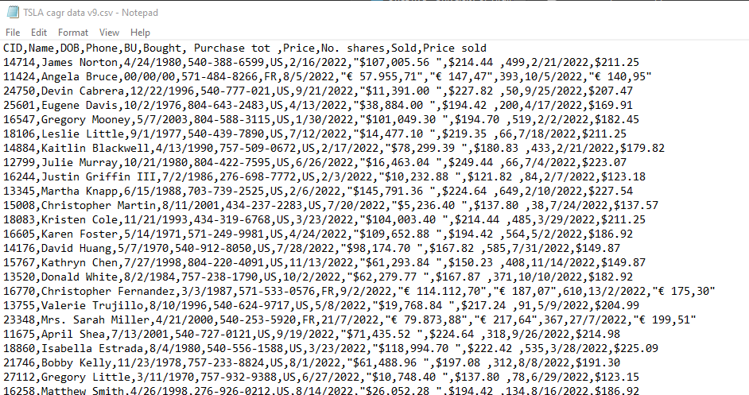
Daily Cagr for Tesla: example input

Slide 13
Text manipulation
used in data quality and beyond

Slide 14
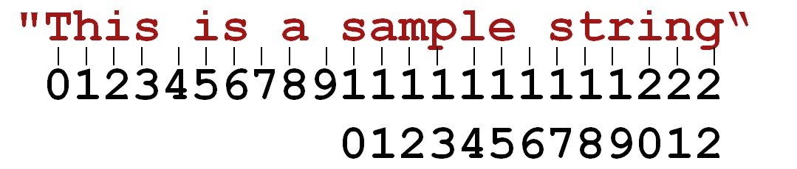
Strings and Characters
Dim myString As String =
“This is a sample string"
Dim myString2 As String = "s"
Dim myChar As Char = "s"c

Slide 15
Testing Numbers
Dim myString As String = "#2344-234-33-3"
Dim temp As String = ""
For Each x As Char In myString
If IsNumeric(x) Then
temp = temp + x
End If
Next
With strings, “+” does concatenation, not sum

Slide 16
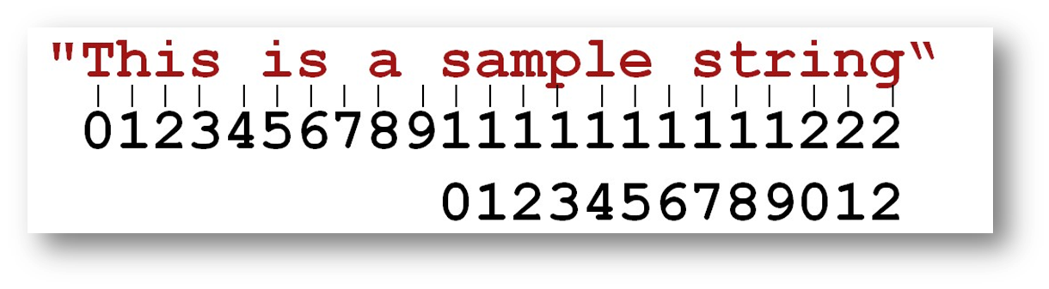
Inserting and Removing
Dim myStr As String = "This is a sample string"
myStr = myStr.Insert(4, "xyz")
myStr = myStr.Remove(4, 3) 'starting where,how many
myStr = myStr.Replace(" is", " was")
Notes:
Thisxyz is a sample string (the space is put a t the end of the insert)

Slide 17
Finding
Dim myStr As String = "This is a sample string"
Dim myPosition As Integer = 0
myPosition = myStr.IndexOf("s")

Slide 18
Composing text
Dim s As String = “4344562456”
Dim temp As String
temp = "Ph. " + s.Substring(0, 3) + " / " +
s.Substring(3, 3) + " " + s.Substring(6, 4)
' The above is an example that produces this:
‘ Ph. 434 / 456 2456
‘ or - same thing -
temp = String.Format("Ph. {0} / {1} {2}",
s.Substring(0, 3),
s.Substring(3, 3),
s.Substring(6, 4))

Slide 19
Trimming
myLenght = myString.Length
myNewString = myString.Trim()
myNewString = myString.TrimEnd()
myNewString = myString.TrimStart()

Slide 20
Suggestions
Give yourself plenty of time

