Slide 1

Financial Analytics
Stefano Grazioli

Slide 2
Easy meter

Slide 3

Financial Analytics
Financial analytics is the application of quantitative methods to financial problems:
QF, Financial Engineering are synonyms.
We focus on the IT
aspect of financial
analytics.
Learning by doing:
the Hedge Tournament

Slide 4
You do the talking
Name, major…
Comfort with VBA, Excel
Do you have a team?
Things you like about the class
Things that can be improved

Slide 5
The “Spartan” Trader
robotrader / algo-trader

Slide 6

Tournament objective
Given an illiquid portfolio of stocks and options, plus some cash,
invest the cash
to minimize the risk of losses.

Slide 7
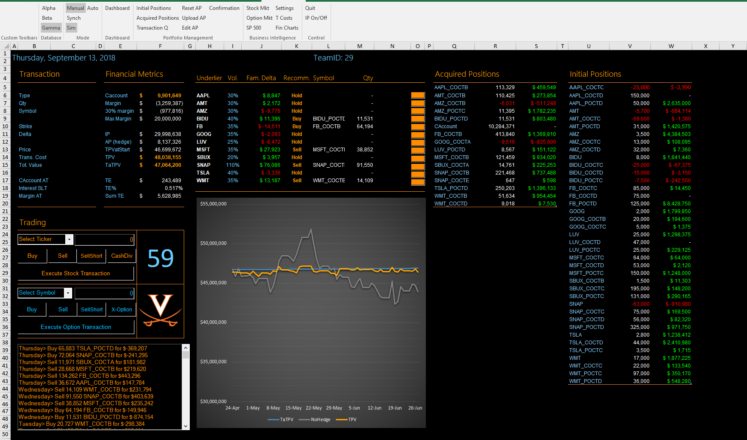

Slide 8
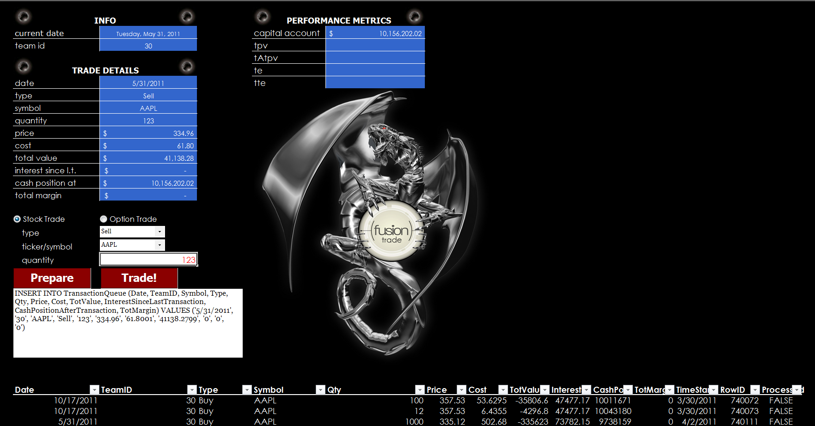

Slide 9
Spartan Trader functionality
Access
data
Trade
securities
Compute
metrics
Recommend
actions

Slide 10
Homework
All column names in all tables are to be considered orange words.

Slide 11
Data model
SERVER: f-sg6m-s4.comm.virginia.edu
Microsoft RDBMS sql server
Hedge
Tournament
ALPHA
Hedge
Tournament
BETA
Hedge
Tournament
GAMMA
Each database has a full instance of the tournament. Each has all the tables. Different instances = different data

Slide 12
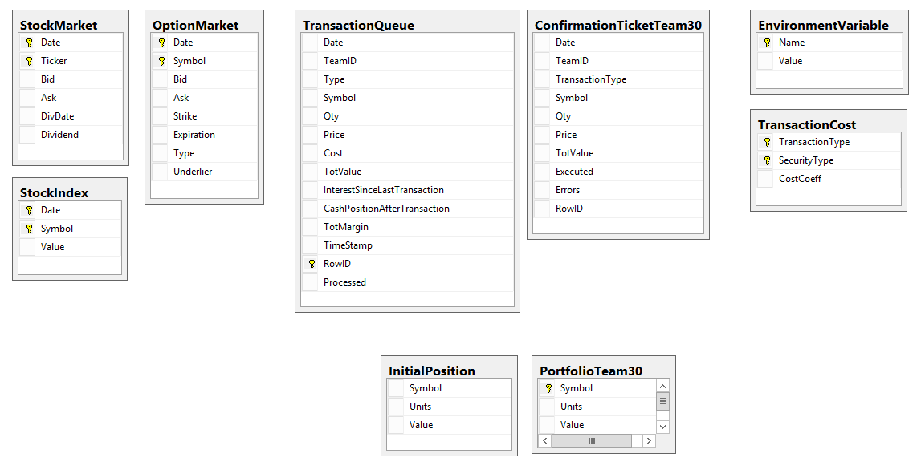
Datamodel is the same in the three DBs, but data may be different

Slide 13
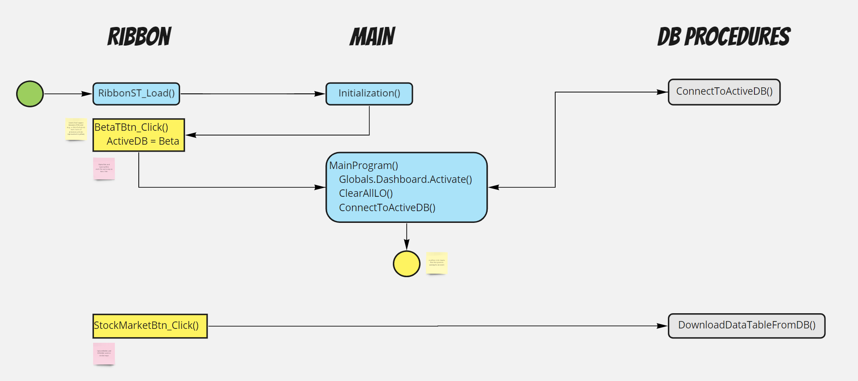

Slide 14
The rulebook
For the Hedge Tournament

Slide 16
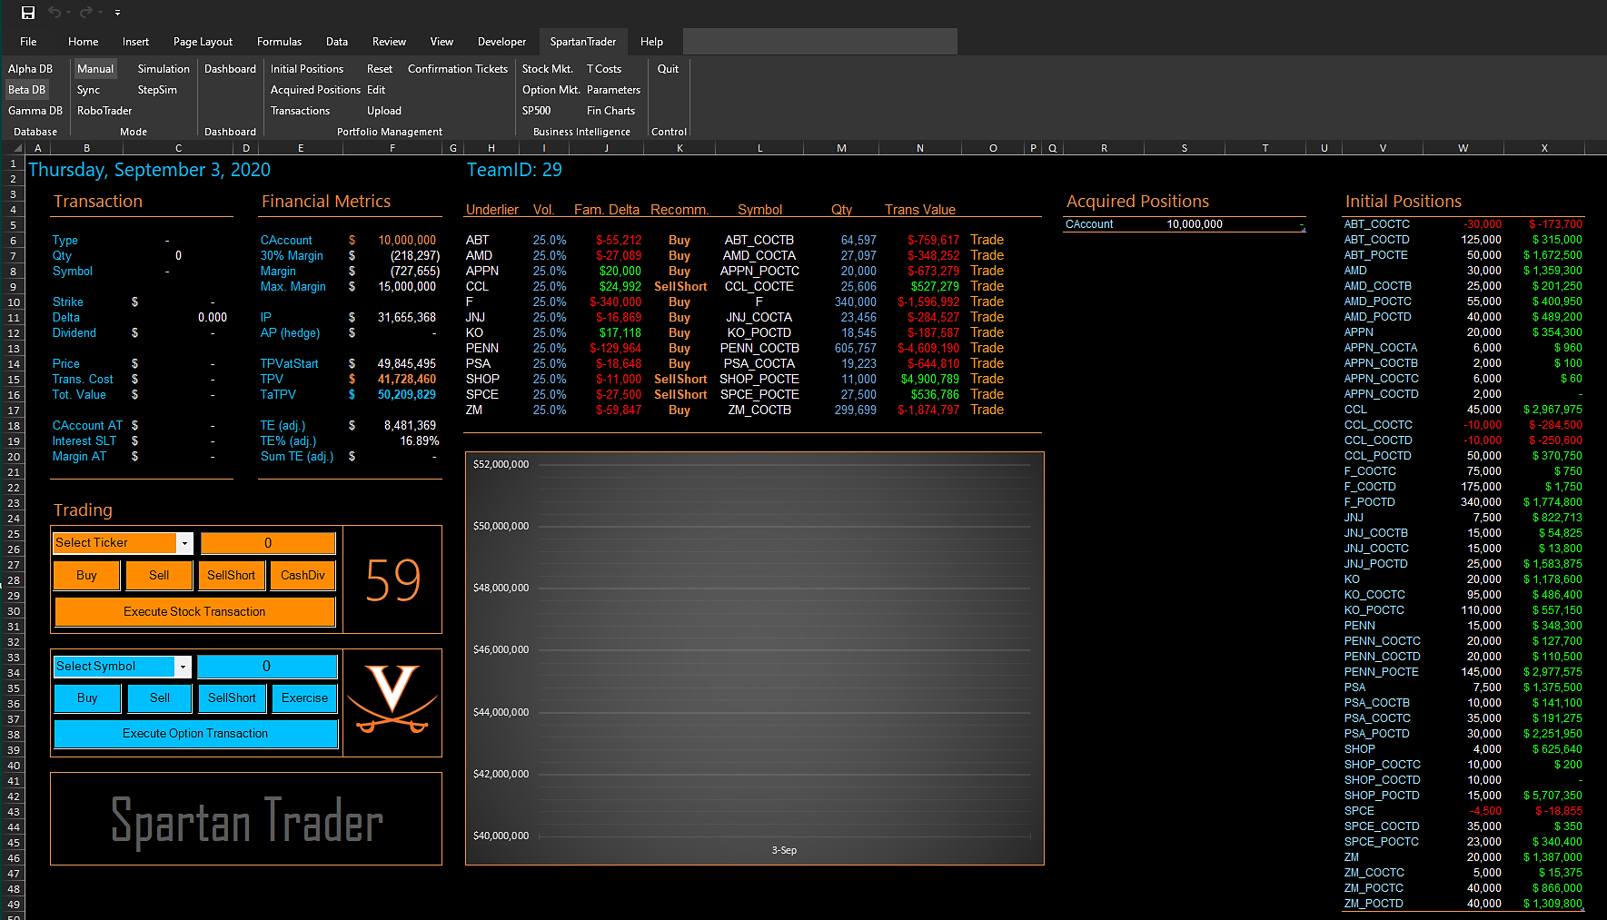

Slide 17
