Slide 1
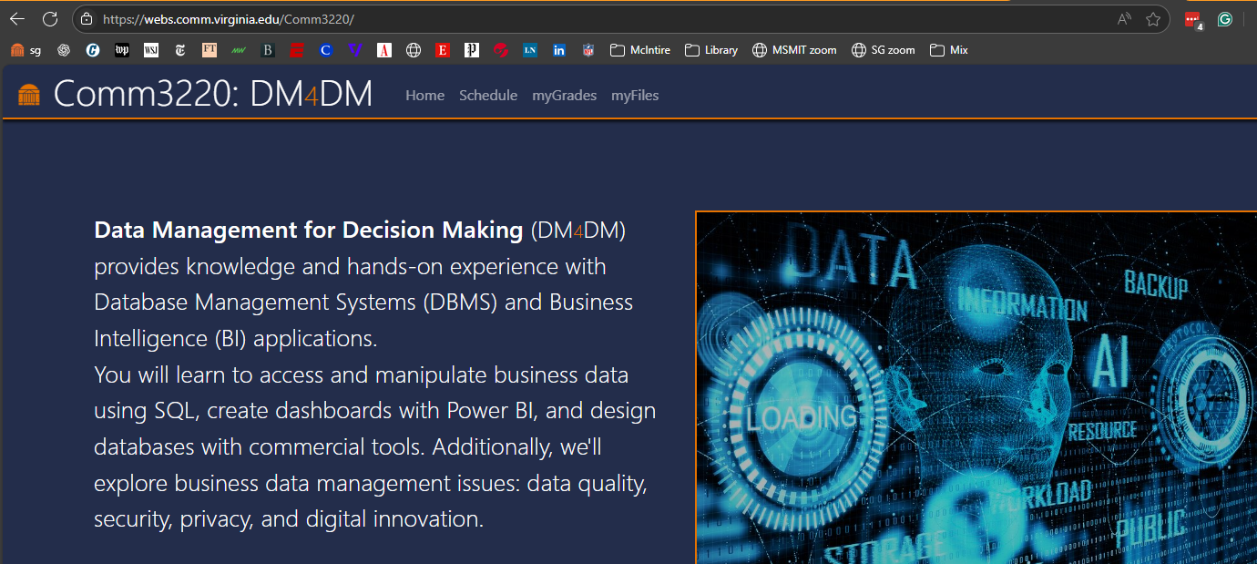
If you have not already done it….
Go to https://webs.comm.virginia.edu/Comm3220/
Click “myFiles”
Enter your UVA userID and “DM4DM” as password
Complete the registration to COMM 3200 (We do not use Canvas)

Slide 2

SQL
Single table operations
Notes:
A female UVA student coding in SQL

Slide 3

Critical Thinking
You need to be enrolled in SIS and in the Class site
Clear on the course goals?
Everybody on Teams?
Office hours linked from the website
Any questions?

Slide 4

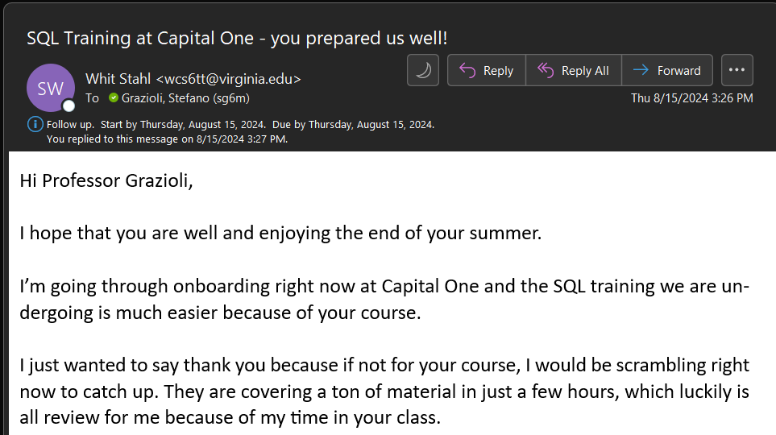

Slide 5
Our network, updated
Accenture Federal Services
AdrianGPT
American Red Cross
Analygence
ARES Corporation
Booz Allen Hamilton
C3 AI
Capital Edge Consulting
Chartway Federal Credit Union
Deloitte Consulting
Delta Airport Consultants
US Department of State
Equilibrium Technologies
Farm Credit of the Virginias
Founders Factory Africa
Freddie Mac
IBM
Lockheed Martin
Microsoft
Moody’s
National Veterinary Associates
Navy Federal Credit Union
Prime Technical Services
The Garcia Companies
The Providencia Group
US Air Force
US Navy
US Department of Housing and Urban Development
University of Virginia
US Army Intelligence and Security Command
VMD Corp

Slide 6
Orange Words
Database
DBMS
BI
SQL
Why do we need Data Management?

Slide 7
You do the talking
Name (enunciate)
Concentrations/tracks
Career goal
Confidence with information technology
What I am hoping to learn

Slide 8

Congratulations! You are hired at SmallBank
Miniproject #1

Slide 9
Your first meeting as an analyst with your Director of Finance
Welcome! So glad that you are here and can help us with our BI needs! I have so many business questions for you…
(1) I need an alphabetized list of our customers in Dallas: first names, last names and IDs
(2) Do we have loans above $200K? print out all the info we have. Order by principal, descending
(3) ….
Please access our SQL Server and create these reports for me…
I am on it, boss!
…good thing I took Comm3220...

Slide 10
That went well. Now what?
Figure out where is the data and how to get it (tools, servers, connections…)
Understand the data (names, meanings, organization)
Create SQL queries to get the answers

Slide 11

(1) ask about accessing the DB at your firm (the DB architecture)
SQL
ADS
You
(& me)
Your computer or a lab computer running Microsoft’s ADS: AZURE DATA STUDIO
Azure Cloud

Slide 12


Slide 13

(1) ask about accessing the DB at SmallBank
SQL
A program
A DB file(s)
COMM 3220
ADS
You
(& me)
World Wide Importers
SQL Server RDBMS
Your computer or a lab computer running Microsoft’s ADS: AZURE DATA STUDIO
SmallBank DB
Server
F-sg6m-s4.comm.virginia.edu
Azure Cloud

Slide 14
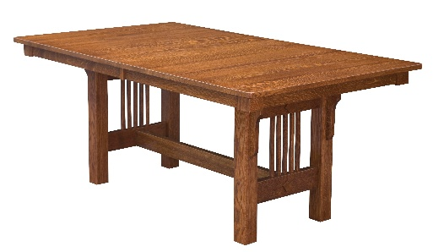


(2) ask about the Tables and the data dictionary
No, not these…..

Slide 15
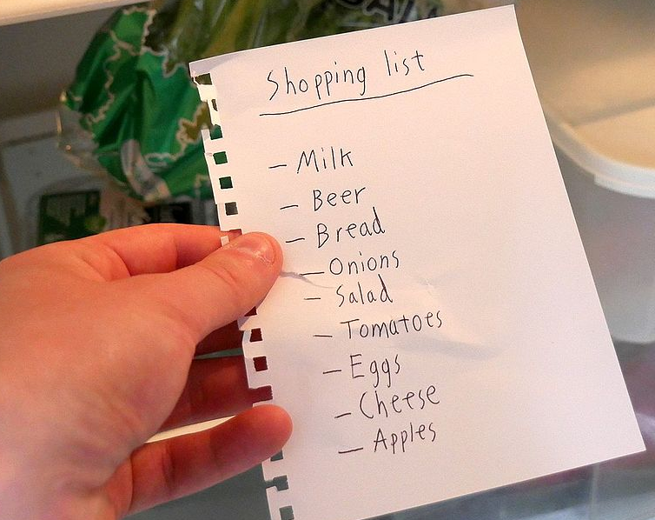
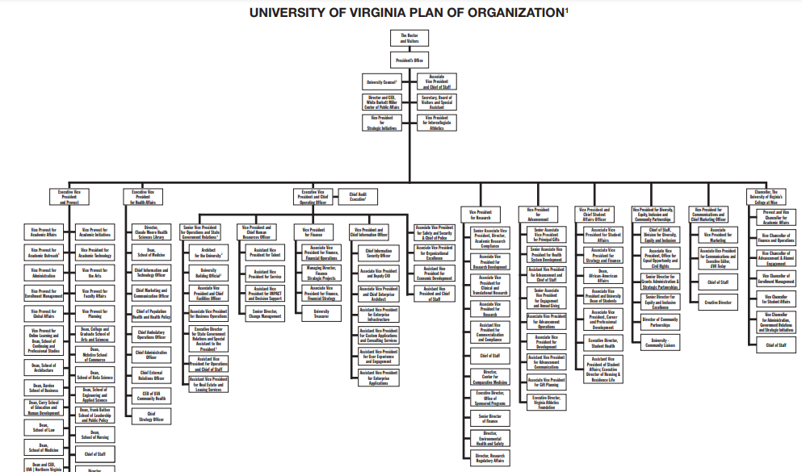
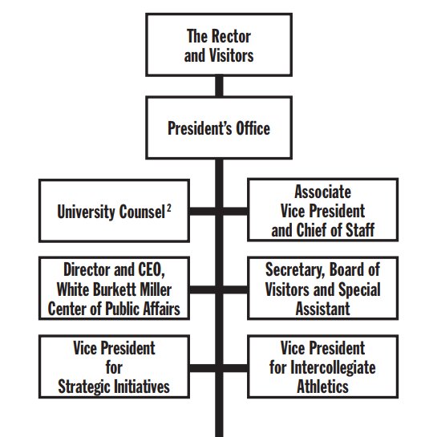
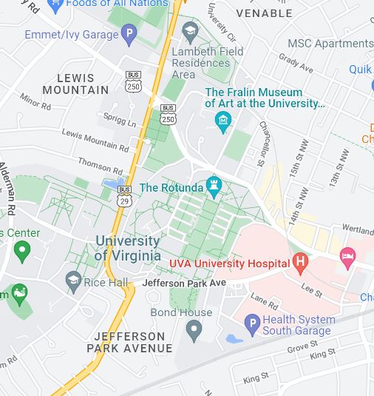
Different types of data require different representations

Slide 16
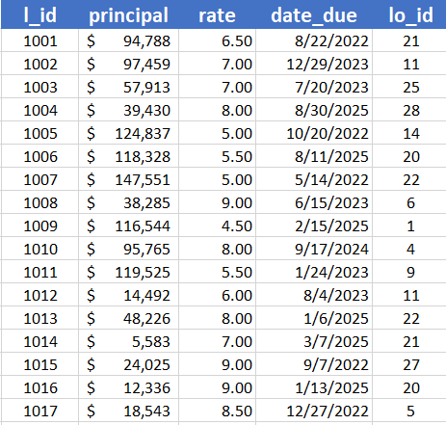
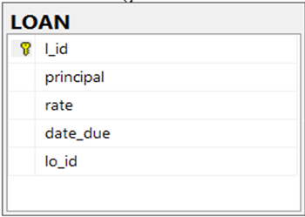
Tables are very commonly used representations for business data
Table Name
LOAN
Column or Field
Row or Record
Primary Key
Same as
Data Dictionary
L_id = loan id
Principal = amount borrowed
Rate = interest rate
Lo_id = id of the loan officer who manages the loan

Slide 17
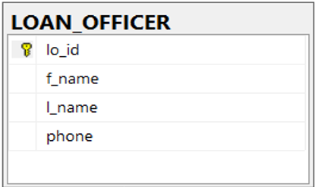
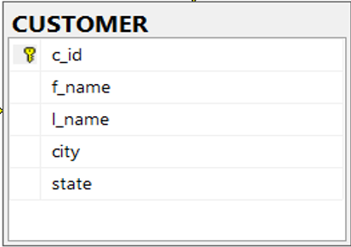
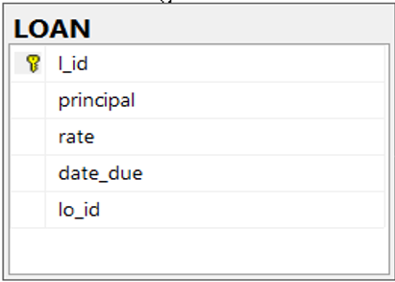
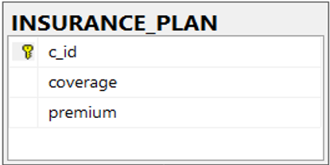
(2) Ask about the tables and the data dictionary (if available)
Data Dictionary
C_id = customer id
L_id = loan id
Principal = amount borrowed
Rate = interest rate
Lo_id = id of the loan officer who manages the loan
Coverage = Max amount insured
Premium = price of coverage

Slide 18
(3) understand the question
“I need an alphabetized list of our customers in Dallas: first names, last names and IDs”
“Do we have loans above $200K? print out all the info we have on the Loan table. Order by principal, descending”
….
Tip: visualize the answer

Slide 19
Next, query the DB using SQL
The standard computer language for organizing and accessing data

Slide 20
SQL is the language to work with tables and the data inside them
Structured Query Language is both a data definition (DDL) & data manipulation (DML) Language
1970s: Ted Codd creates SEQUEL: Structured English QUEry Language
commercialized SQL in 1979
1986 ISO/ANSI “standard”

Slide 21

An example
SELECT * FROM loan
WHERE principal > 200000
-- SQL is not case sensitive

Slide 22

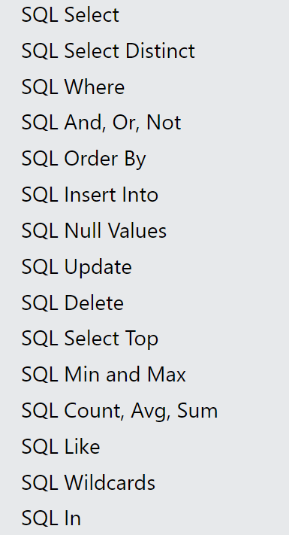
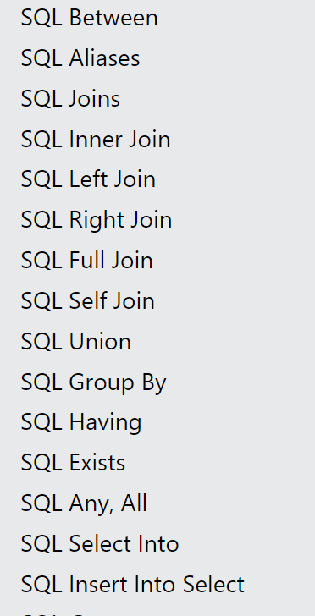


Keywords to learn
The homework covers these SQL commands. Go to https://www.w3schools.com/SQL/default.asp
and test the live examples to understand how they work.
explain the SQL command "select" to a business college student with a couple of examples

Slide 23
WINIT
What is new in IT
http://webs.comm.virginia.edu/Comm3220/Winit.html
The next volunteer is….

Slide 24

ADS Demo Instructions included with the first miniproject.

