Slide 1

Foreign keys
They are PKs in another table

Slide 2
Critical thinking
Congratulations on completing MP1!
GenAI and the future of work
Heads up: Next time, I may ask you to explain your code in class
Start looking for an optional partner for MP2 (Notflix)
Questions?

Slide 3
You do the talking
Name
Concentration, Track
Hardest thing in miniproject 1?

Slide 4
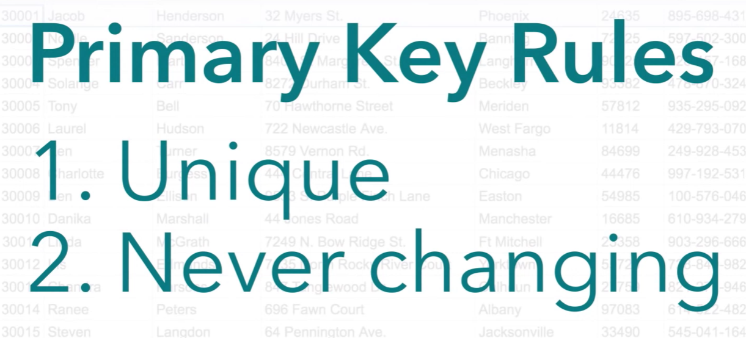



Critical thinking
Primary Keys should never change (best practice)
Changing a PK breaks the relationship with other tables that reference it via foreign keys. This can be complicated: risky and expensive, especially in large databases.
But they can be changed (bad idea, though)
It is allowed by SQL.
If a PK is based on real-world data (like a Social Security Number or email), you might need to change it due to corrections or updates in the real world.

Slide 5



Orange Words
Business data modeling
Entity
Instance
Relationship
Composite key
Foreign key
job interview…
job interview…

Slide 6

MP2

Slide 7

The interview with the CEO
"
Ms. Movee, please tell me how Notflix operates...”
Ms. Bella Moovee,
Notflix Founder & CEO

Slide 8
MP2 – Notflix ERD
1. Identify entities
2. Assign attributes and PKs
3. Draw relationships and cardinalities
4. Place FKs

Slide 9
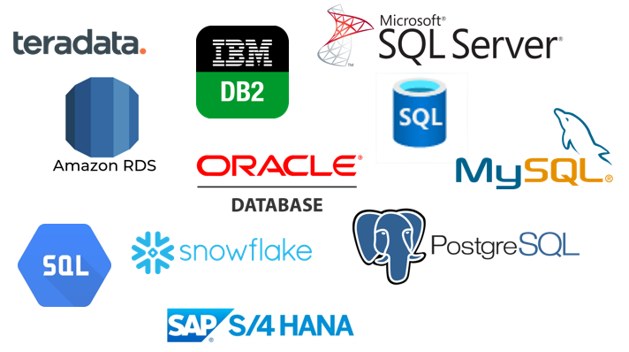
Recap: Relational Databases
Foreign Keys are the mechanism that relates information in different tables
Academically speaking, a “relation” is a table in a database, hence the term “relational databases”. It means databases that contain tables.

Slide 10
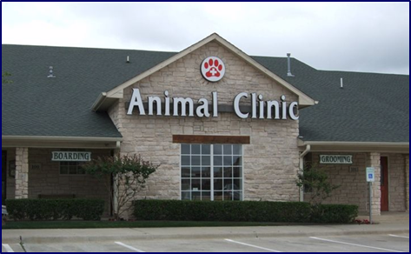
Recap: Foreign Keys (FK)
CustomerID | First | Last | Mobile
234 | Dorothy | Martin | 434-563744
235 | Joie | Haynes | 434-752422
236 | Anand | Aguillar | 434-950032
237 | Annie | Xiong | 434-237825
… | … | … | …
This attribute (column) is called a foreign key
PetID | Name | Species | CustomerID
P12 | Rocky | Dog | 236
P64 | Fluffy | Cat | 234
P82 | Odin | Cat | 235
P37 | Olaf | Cat | 237
P38 | Wally | Alligator | 235
A foreign key is a column in a table that is also a primary key in another table

Slide 11
Recap: placing FKs
Deciding where to place the Foreign Keys is sometimes non-intuitive and may lead to mistakes.
There are three simple rules for Foreign Key placement.
There are three types of relationships. If you can tell which type you have, then FK placement is straightforward.

Slide 12
To put the FKs in the right place when modeling your DB, begin by finding the type of each relationship
Three cases
  One to many
  One to one
  Many to many
Essential knowledge for Project 2

Slide 13
Three types of relationships
One-to-One
One-to-Many
Many-to-Many
One-to-One: instances in either entity have an association with at most one instance in the other entity.
What is the relationship between states and their state capitals?
State Capital
State
is located in

Slide 14
Three types of relationships
One-to-One
One-to-Many
Many-to-Many
One-to-Many: an instance in an entity may have an association with one or more instances in a second entity, but instances in the second entity can be associated with at most one instance in the first.
What is the relationship between a
customer and his/her pets?
VET CUSTOMER
PET
owns

Slide 15
Three types of relationships
One-to-One
One-to-Many
Many-to-Many
Many-to-Many: instances in either entity can be associated to one or more instances in the other entity.
What is the relationship between a person and the jobs she had in her life?
Person
JOB
worked as

Slide 16

Foreign Key Placement 1
This is a one-to-many relationship
CUSTOMER
ORDER
(PK) CID
First Name
Last Name
(PK) OrderNo
Date
ShipTo
Type
places
CUSTOMER
(FK) CID
CID | First Name | Last Name
6810 | Jennifer | Claggett
7220 | Mahi | Dillon
… | … | …
ORDER
OrderNo | Date | ShipTo | Type | CID
O-727 | 4/6/24 | 3, Maine Ave | Online | 7220
O-827 | 4/7/24 | In store | Store | 6810
O-829 | 4/7/24 | In store | Store | 6810
… | … | … | … | …

Slide 17
Rule for one-to-many relationships: copy the PK of the ‘one’ side as a FK on the ‘many’ side.
The ‘one’ side
It is a good idea to use for the FK the same name used for the PK in the other table, but it is not necessary: the DBMS can be instructed to do translations. For example we could have called it “CustNo” inside Order.
The ‘many’ side
CUSTOMER
ORDER
(PK) CID
First Name
Last Name
(PK) OrderNo
Date
ShipTo
Type
places
(FK) CID

Slide 18
Foreign Key placement 2
This is a one-to-one relationship
Three alternative solutions
State Capital
State
(PK) Capital Name
Population
(PK) State Code
State Name
Area
Nickname
is located in

Slide 19
Rule for one to one relationships: place the FK in either (not both) table or combine the tables.
State Capital
State
State Capital
State
(PK) Capital Name
Population
(PK) State Code
State Name
Area
Nickname
(PK) Capital Name
Population
is located in
(PK) State Code
State Name
Area
Nickname
is located in
(FK) State Code
(FK) Capital name
State
(PK) State Code
State Name
Area
Nickname
Capital Name
Population
Different methods and tools will recommend different solutions. They will all work. *

Slide 20
WINIT
What is new in IT

Slide 21

Foreign Key placement 3
This is a many-to-many
Where do we place the FKs?
CUSTOMER
MOVIE
(PK) CID
First name
…
(PK) ShowID
Title
…
FK here?
watched
CUSTOMER
FK here?
CID | First Name | …
C120 | Tom | …
C340 | Mary | …
C100 | Paul | …
… | … | …
SHOW
ShowID | Title | …
S35 | Mr. Magoo | …
S71 | Attack of the Crab Monsters | …
S44 | Santa Claus Conquers the Martians | …
S10 | The Killer Tire | …
… | … | …

Slide 22
Many-to-many
Why?
This will not work well
CUSTOMER
CID | First Name | ShowID
C120 | Tom | S44
C340 | Mary | S44
C700 | Paul | S35
… | … | …
SHOW
ShowID | Title | …
S35 | Mr. Magoo | …
S71 | Attack of the Crab monsters | …
S44 | Santa Claus Conquers the Martians | …
S10 | The killer tire | …
… | … | …

Slide 23
Many-to-many
Why?
This will not work well
CUSTOMER
CID | First Name | …
C120 | Tom | …
C340 | Mary | …
C700 | Paul | …
… | … | …
SHOW
ShowID | Title | CID
S35 | Mr. Magoo | C120
S71 | Attack of the Crab monsters | C120
S44 | Santa Claus Conquers the Martians | C120
S10 | The killer tire | C700
… | … | …

Slide 24
Many-to-many
Why?
This will not work well
CUSTOMER
CID | First Name | ShowID
C120 | Tom | S44
C340 | Mary | S44
C700 | Paul | S35
… | … | …
SHOW
ShowID | Title | CID
S35 | Mr. Magoo | C120
S71 | Attack of the Crab monsters | C120
S44 | Santa Claus Conquers the Martians | C120
S10 | Robert: the killer tire | C700
… | … | …

Slide 25
Association table
RDBMS cannot directly handle many-to-many relationships: only one-to-many.
MOVIES_WATCHED
This will work well
CID | ShowID
C120 | S44
C340 | S44
C700 | S35
C120 | S35
C120 | S71
C700 | S10
… | …
Composite PK: two or more columns that, when considered together, are unique and can act as the primary key.
CUSTOMER
SHOW
CID | First Name | …
C120 | Tom | …
C340 | Mary | …
C700 | Paul | …
… | … | …
ShowID | Title | …
S35 | Mr. Magoo | …
S71 | Attack of the Crab Monsters | …
S44 | Santa Claus Conquers the Martians | …
S10 | Robert: the Killer Tire | …
… | … | …

Slide 26
Association table (2nd take)
Two FKs
MOVIES_WATCHED
ViewingID | CID | ShowID
1 | C120 | S44
2 | C340 | S44
3 | C700 | S35
4 | C120 | S35
5 | C120 | S71
6 | C700 | S10
7 | … | …
An alternative technique without a composite PK
This will work well
CUSTOMER
SHOW
CID | First Name | …
C120 | Tom | …
C340 | Mary | …
C700 | Paul | …
… | … | …
ShowID | Title | …
S35 | Mr. Magoo | …
S71 | Attack of the Crab monsters | …
S44 | Santa Claus Conquers the Martians | …
S10 | Robert: the killer tire | …
… | … | …

Slide 27



Notes:
https://www.bing.com/search?q=rubber+by+quentin+duieux&form=ANNH01&refig=6a944d8fbbb444dca6ffb59564ba347c&pc=EDGEDSE

Slide 28
Rule for Many-to-many: create an association table that contains the PKs of the contributing tables as FKs (two versions)
Difference between the two solutions:
‘Two composite keys’ solution does not allow for repetitions (can be good or bad)
‘Single primary key’ solution allows for repetitions.
MOVIES_WATCHED
CID | ShowID
C120 | S44
C340 | S44
C700 | S35
C120 | S35
C120 | S71
C700 | S10
… | …
CUSTOMER
CID | First Name | …
C120 | Tom | …
C340 | Mary | …
C700 | Paul | …
… | … | …
SHOW
ShowID | Title | …
S35 | Mr. Magoo | …
S71 | Attack of the Crab Monsters | …
S44 | Santa Claus Conquers the Martians | …
S10 | Robert: the Killer Tire | …
… | … | …

Slide 29
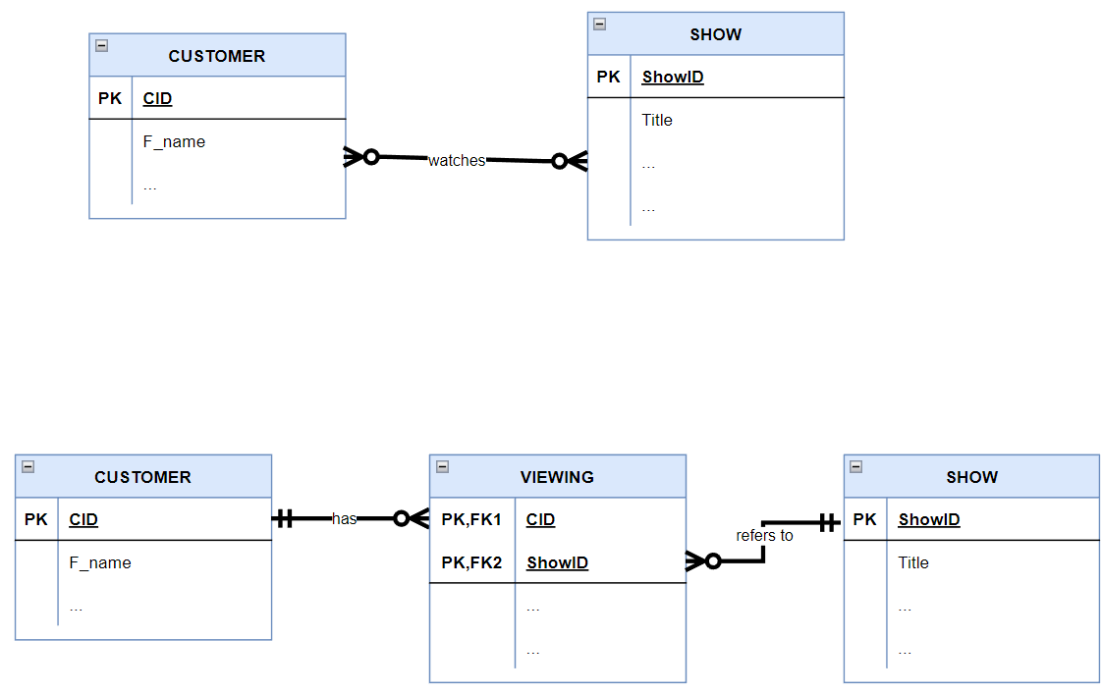
Association table example
Same concepts, just different format
Many to many becomes…
Composite key
May/may not have attributes

Slide 30
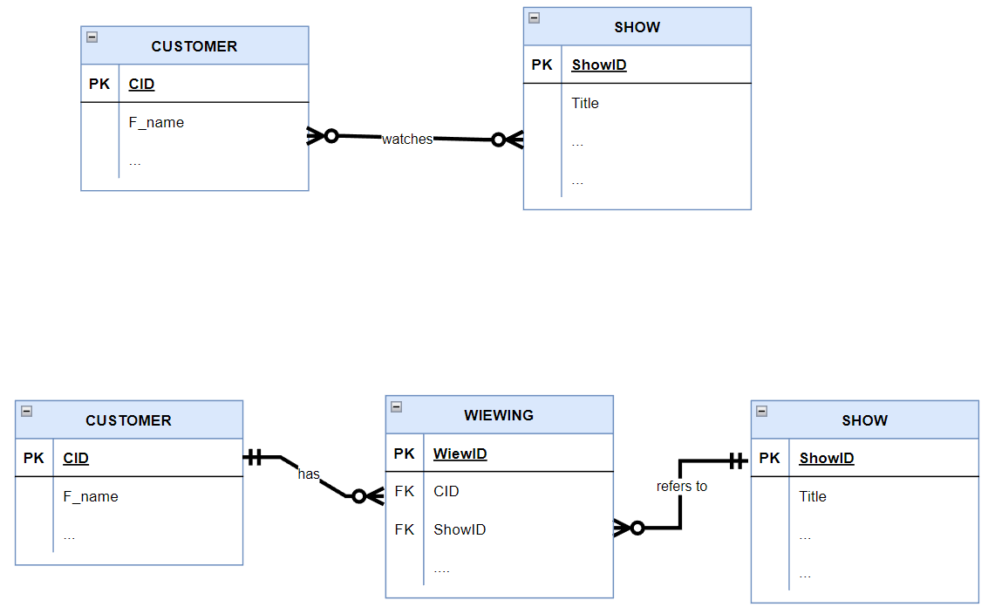
Association table (2nd take)
Same concepts, just different format
Many to many becomes…
May/may not have attributes
No Composite key: One PK and Two FKs

Slide 31
Summary: ERD rules
PK: All entities (tables) have a unique identifier (PK)
An entity must have more than one instance
If an attribute has attributes, it becomes an entity
One-to-many: place the PK of the ‘one’ side as a FK on the ‘many’ side
One-to-one:
If the lower bounds are both 1s, merge all attributes into a single table. Pick a name for the new table. Pick one of the two identifiers as PK
If one lower bound is a 0, take the identifier of the other side and post it as an FK to the 0 side
If both lower bounds are 0s, create a new table (‘intersection’ or ‘association’ table). The identifiers in the two contributing entities are the keys in the new table. Alternatively, post the other table’s PK as an FK in the side that has fewer nulls.
Many-to-many: create an association table that contains the PKs of the contributing tables as FKs (two versions)

Slide 32
Cardinality: the full story
Cardinality is the minimum and maximum number of instances in one entity that relate to the second entity.
Minimum:
called the lower bound
Maximum
called the upper bound
One
Zero
One
Many
Read: “one and only one” | Read: “at least one and possibly many”
Read: “zero or one” | Read: “either zero or many”

Slide 33
Examples
Read: “one and only one” | Read: “at least one and possibly many”
Read: “zero or one” | Read: “either zero or many”
1
5
Customer
2
4
Loan Officer
3
is assigned to
7
10
9
8
6
Customer
Loan Officer
is assigned to
CUSTOMER
LOAN OFFICER
is assigned to
A lower bound of 1 means that the instance is mandatory, 0 means that it is optional.

Slide 34

https://draw.io/

