Slide 1
SQL: The joins
Central SQL concept &
Prep for MP3

Slide 2
Critical Thinking
Questions on MP2?

Slide 3
The Orange Words
Relational database
Relation
Cardinality
Association Table
PROJECT
CONSULTANT
has

Slide 4

1. What is the total lent to Peter Parker?
2. Explain step-by step how you found out
LOAN |  |  |  |  | CUST_IN_LOAN |  |  | CUSTOMER
l id | principal | rate | date due |  | l id | c id |  | c id | f name | l name | city | state
2 | $1,000,000 | 7% | 2026 |  | 2 | c334 |  | c295 | Lex | Luthor | New York | NY
3 | $1,000,000 | 10% | 2027 |  | 3 | c410 |  | c335 | Bruce | Wayne | New York | NY
4 | $3,500,000 | 5% | 2028 |  | 4 | c334 |  | c347 | Bruce | Wayne | Austin | TX
6 | $1,000,000 | 7% | 2028 |  | 6 | c410 |  | c334 | Peter | Parker | New York | NY
8 | $2,000,000 | 5% | 2027 |  | 8 | c334 |  | c400 | Barbara | Gordon | New York | NY
9 | $500,000 | 4% | 2026 |  | 9 | c335 |  | c410 | Lois | Lane | Austin | TX
10 | $2,000,000 | 5% | 2027 |  | 6 | c411 |  | c411 | Clark | Kent | Austin | TX
 |  |  |  |  | 10 | c347
 |  |  |  |  | 10 | c295

Slide 5

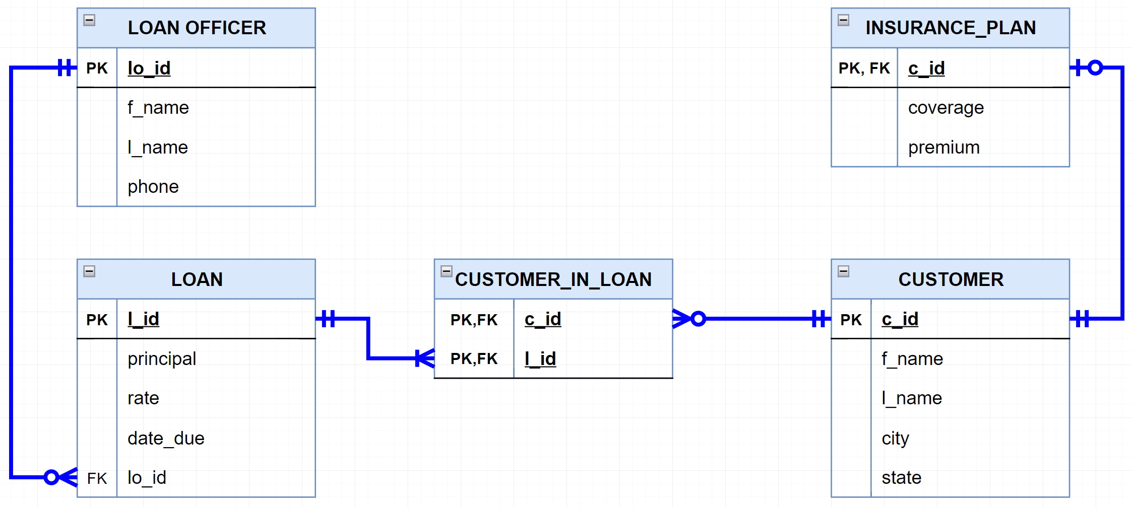
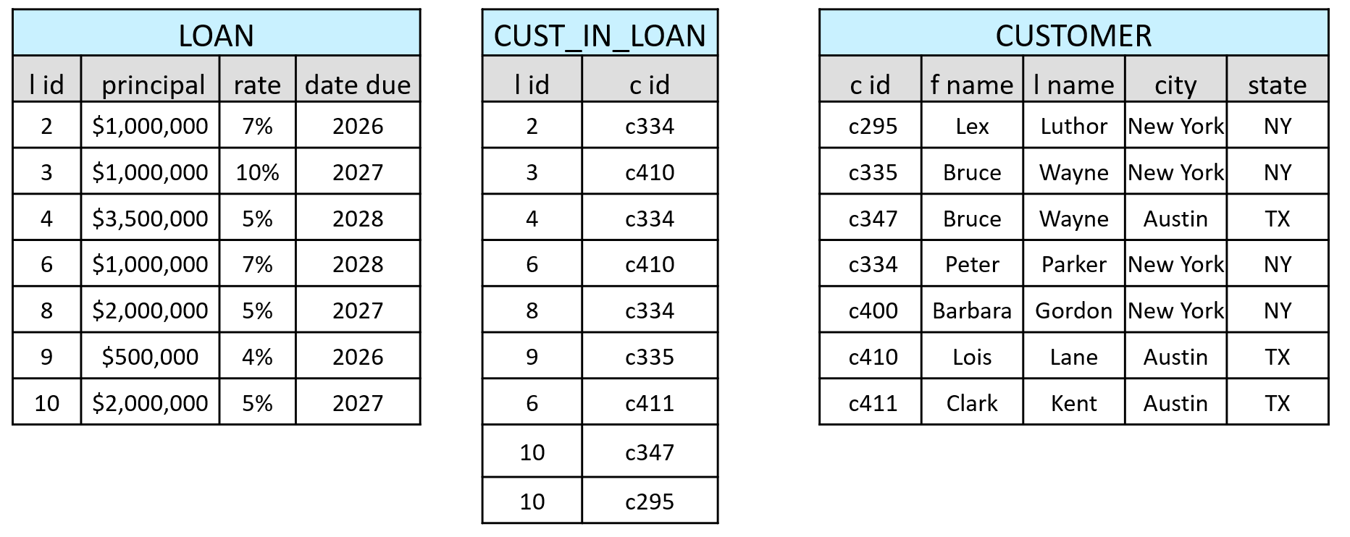
Same, using an ERD
What is the total lent to Peter Parker?
has
has

Slide 6

The SmallBank Database
Can you place four ‘FK’ labels in the right locations?
Can you read it?
purchases
manages
has
has
FK

Slide 7
Joins are commonsense
Show me the loan officers and the loans that they manage
How do I tell SQL to connect these tables?...

Slide 8
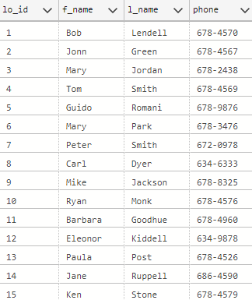
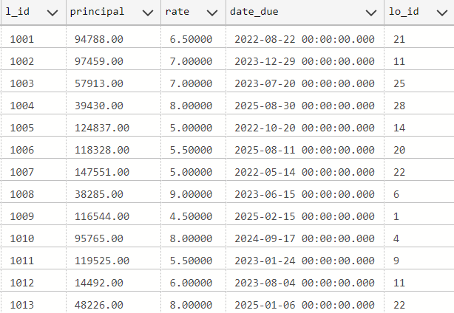
How to JOIN two tables
Each loan officer manages many loans (one to many)
LOAN OFFICER
LOAN
FK

Slide 9
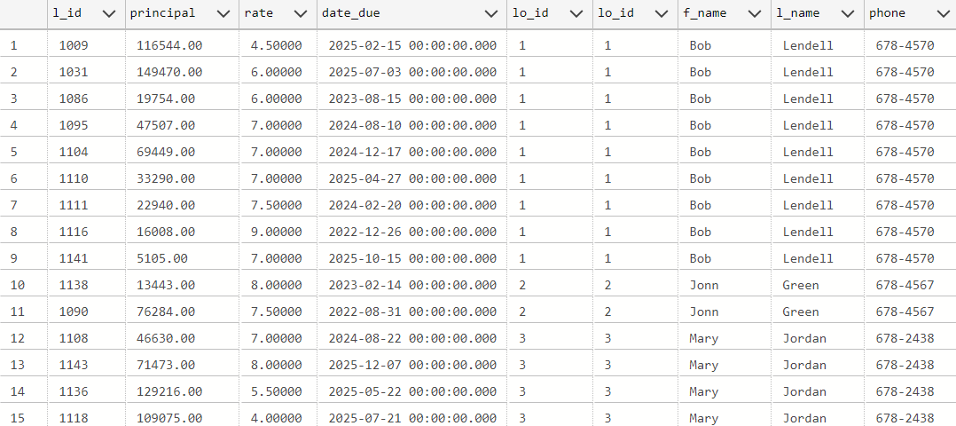

How to JOIN two tables
Select * from LOAN_OFFICER, LOAN
where LOAN_OFFICER.lo_id = LOAN.lo_id
THIS IS FROM LOAN
THIS IS FROM LOAN OFFICER

Slide 10
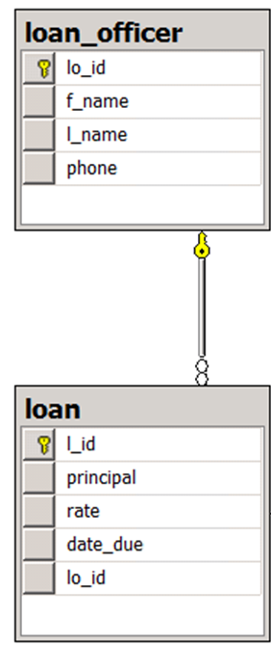
Alternative syntax
Select *
from LOAN_OFFICER
join LOAN
on LOAN_OFFICER.lo_id = LOAN.lo_id

Slide 11
You do the talking
Name
Concentration, majors, minors
Use of GenAI?
How was MP1? First impressions about SQL?

Slide 12
WINIT
What is new in IT

Slide 13
Joins are commonsense
1. Visualize the answer
2. Is the necessary data there?
3. What are the steps to find it?
What is the average rate of the loans managed by Jane Ruppell?

Slide 14
SQL Join
What is the average rate of the loans managed by Jane Ruppell?
Select avg(rate)
from LOAN
join LOAN_OFFICER
on LOAN_OFFICER.lo_id = LOAN.lo_id
where LOAN_OFFICER.f_name = 'Jane’
and LOAN_OFFICER.l_name = 'Ruppell’
RISK: There might be more than one Jane Ruppell

Slide 15
SQL join – take 2
What is the average rate of the loans managed by Jane Ruppell?
Select avg(rate)
from LOAN, LOAN_OFFICER
where LOAN_OFFICER.f_name = 'Jane'
and LOAN_OFFICER.l_name = 'Ruppell’
and LOAN_OFFICER.lo_id = LOAN.lo_id
Assumes that J. Ruppel is unique. What if it is not?

Slide 16
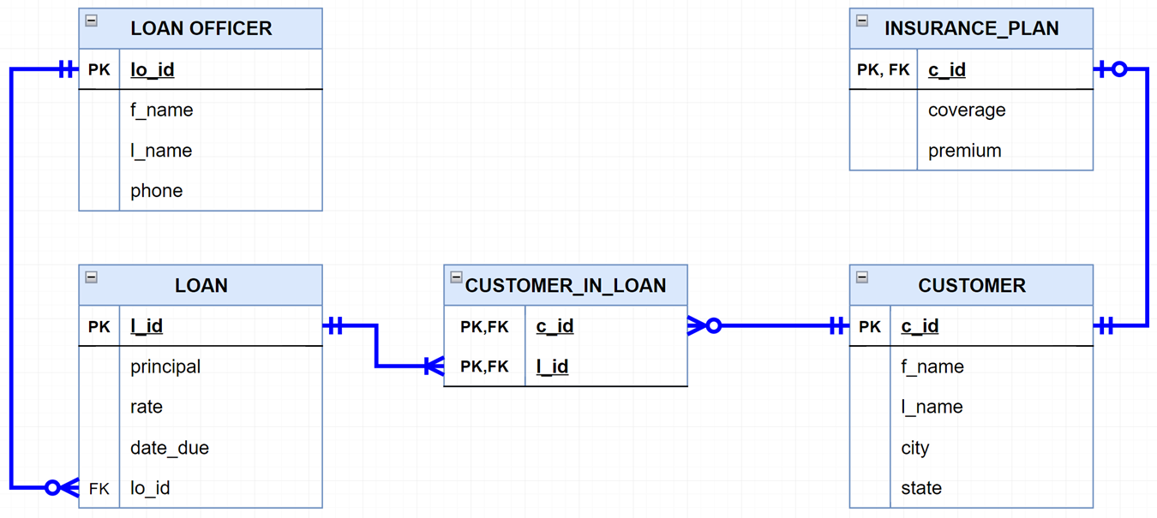
Joins are commonsense
If I give you c_id ‘c010’, can you give me the names and phone numbers of the loan officers for that client?

Slide 17
SQL join
If I give you c_id ‘c010’, can you give me the phone numbers of the loan officers for that client?
Select distinct lo.f_name, lo.l_name, phone
from customer_in_loan cil
join loan l
on cil.l_id = l.l_id
join loan_officer lo
on l.lo_id = lo.lo_id
where cil.c_id = 'c010'

Slide 18
SQL join
If I give you c_id ‘c010’, can you give me the phone numbers of the loan officers for that client?
Select distinct lo.f_name, lo.l_name, phone
from customer_in_loan cil, loan l, loan_officer lo
where cil.c_id = ’c010’
and cil.l_id = l.l_id
and l.lo_id = lo.lo_id

Slide 19
Joins are commonsense
Show me how many customers are insured by City

Slide 20

SQL Join
Select count(*), city
from customer c
join insurance_plan ip
on c.c_id=ip.c_id
group by city

Slide 21
SQL join
Show me how many customers are insured by City
Select count(*), city
from customer c, insurance_plan ip
where c.c_id = ip.c_id
group by city

Slide 22
COUNT can be tricky
Count(*) counts the number of records
Count(city) counts the number of non-null cities
Count(DISTINCT cities) counts the number of unique cities.
Sometimes these are not the same. Make sure you pick the right one.
Notes:
Not nulls

