Slide 1
SQL: joins practice
Prep for MP3

Slide 2
Critical Thinking
Assignment #1 went well: 89/100
DB updated (added data)
Send to me -not the TA- questions about homework or grading
Non-Comm: labs & permissions
Late enroll: permissions
WINIT: email / Teams the .pptx

Slide 3

Congratulations!
You got your first promotion at SmallBank
Miniproject #3

Slide 4
You are now a Senior Business Analyst at SmallBank
Congratulations! Your SQL work in the previous project got you your first promotion, and now we have even more challenging BI tasks for you…
Please access our MS SQL Server and create these reports for me…
Mmmm… these reports require correlating data that is stored in different tables in the DB.
Yep!
I am on it, boss!

Slide 5
You do the talking
Name
Concentration, Track
How hard was MP2 (Notflix)?
Things that you like about the class
Things that can be improved

Slide 6

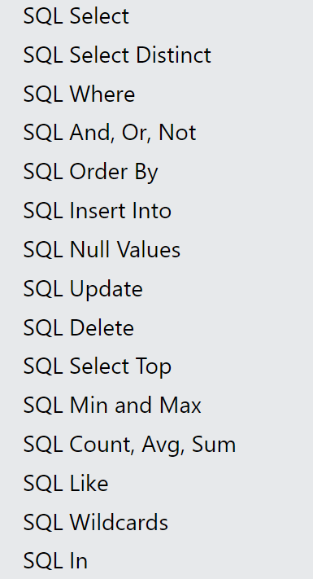
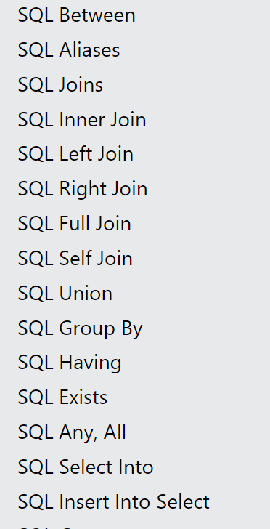
Keywords to learn
The homework covers these SQL commands. Go to https://www.w3schools.com/sql/default.asp
and test the live examples to understand how they work.

Slide 7
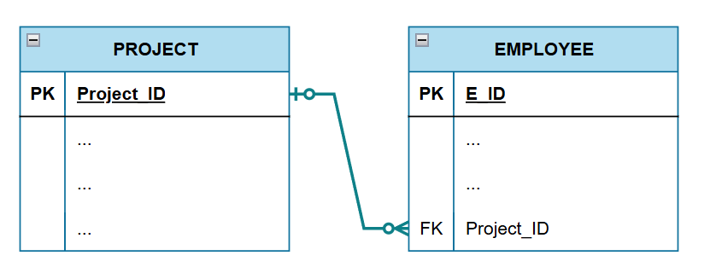
Seven types of joins:
Projects and Employees example
Project with one or more employees
Employee with no project
Project with no employees
“left” side
“right” side
Projects
Employees
Let’s assume that a project may have no, one, or many employees, and that an employee may have at most one project

Slide 8
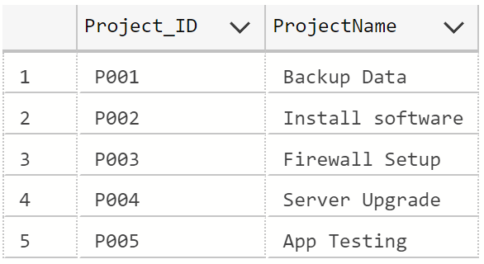
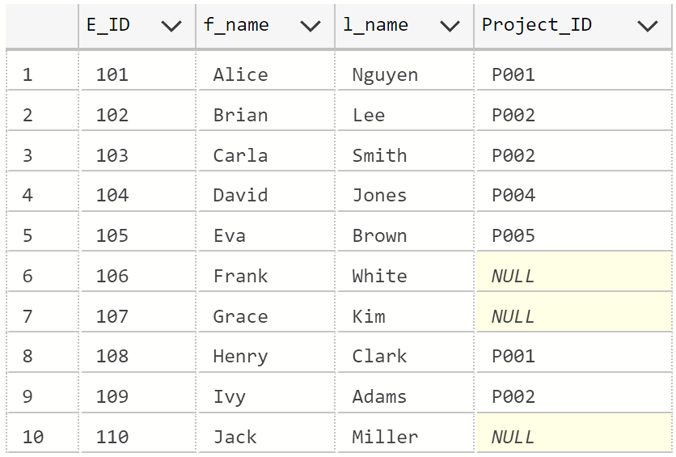
DM4DM – Joins Examples
PROJECT
EMPLOYEE
A project may have no, one, or many employees, and an employee may have at most one project.

Slide 9
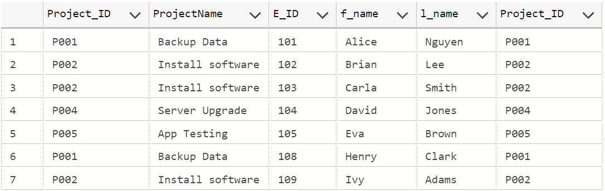
“Show me all the Projects and their Employees”
(no Projects without Employees, and no Employees without Projects)
Projects
Employees
SELECT *
FROM project p
JOIN employee e
ON p.Project_ID = e.Project_ID
Most common case (aka INNER JOIN)

Slide 10
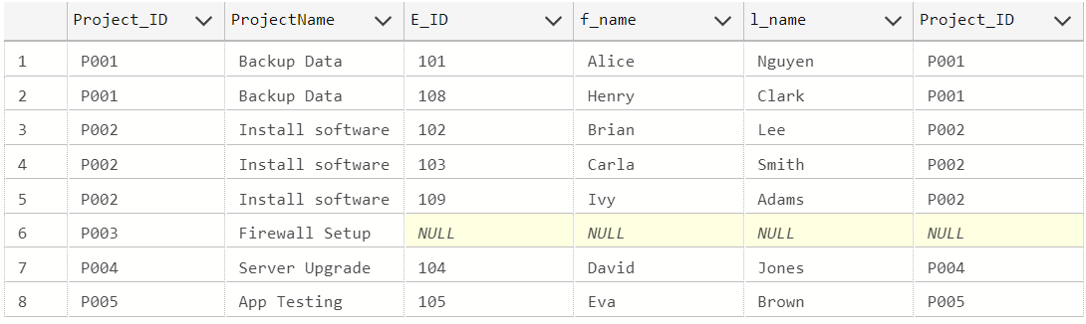
“Show me all the Projects and their Employees”
Projects
Employees
SELECT *
FROM project p
LEFT JOIN employee e
ON p.Project_ID = e.Project_ID

Slide 11
“Show me all the Projects that do not have Employees”
Projects
Employees
SELECT *
FROM project p
LEFT JOIN employee e
ON p.Project_ID = e.Project_ID
WHERE e.Project_ID is null

Slide 12
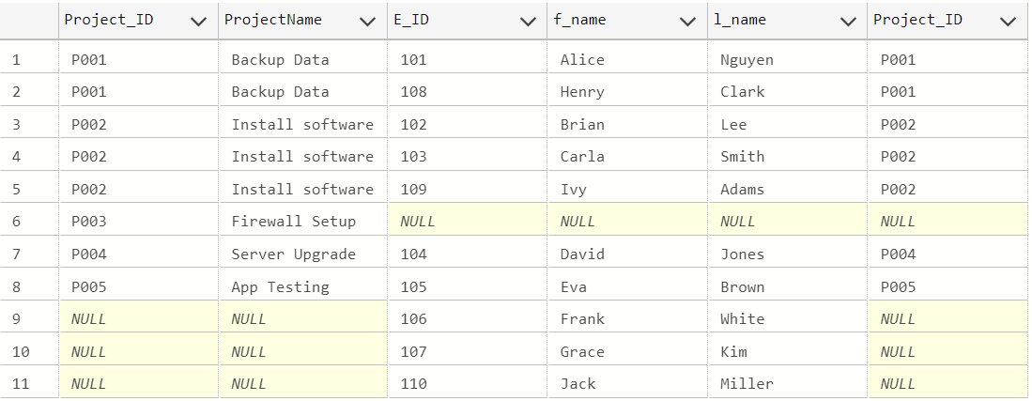
“Show me all the Projects and all the Employees”
Projects
Employees
SELECT *
FROM project p
FULL JOIN employee e
ON p.Project_ID = e.Project_ID

Slide 13
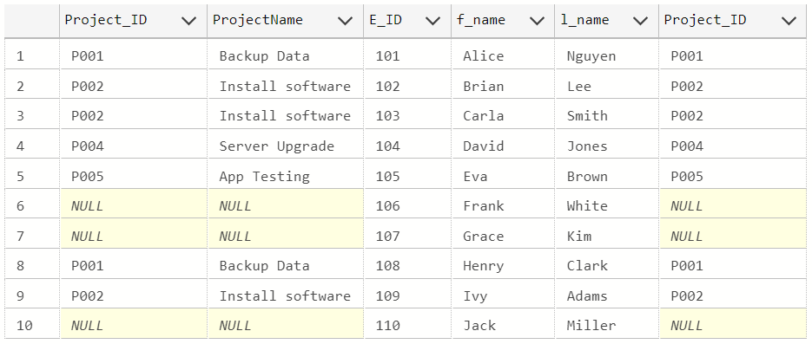
“Show me all the Employees and their Projects”
Projects
Employees
SELECT *
FROM project p
RIGHT JOIN employee e
ON p.Project_ID = e.Project_ID
You can always turn a right join into a left join and vice versa.

Slide 14
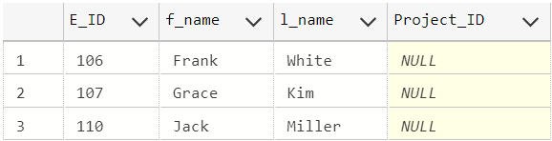
“Show me all the Employees who do not have a Project”
Projects
Employees
SELECT *
FROM employee e
WHERE e.Project_ID is null
This is not a join.

Slide 15
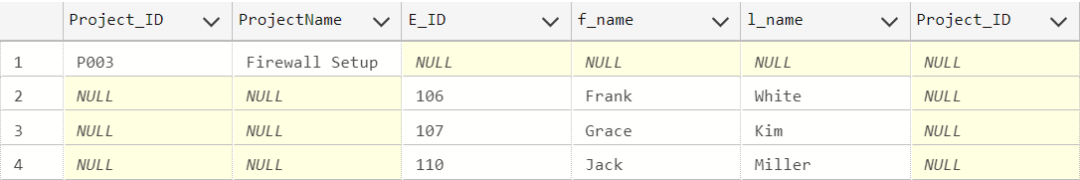
“Show me all the Projects with no Employees and the Employees with no Projects”
Projects
Employees
SELECT *
FROM project p
FULL JOIN employee e
ON p.Project_ID = e.Project_ID
WHERE p.Project_ID is NULL
OR e.Project_ID is NULL

Slide 16
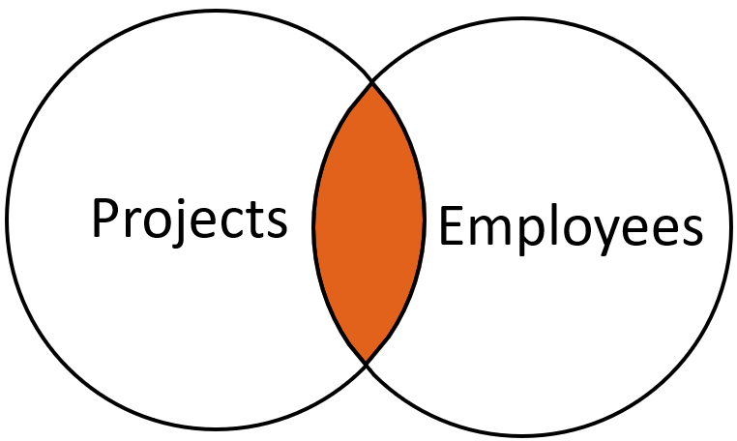
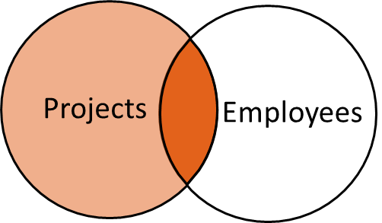
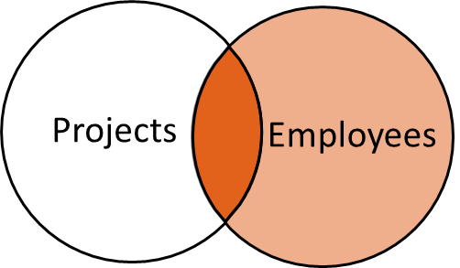
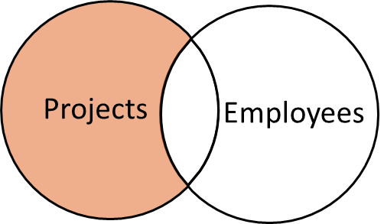
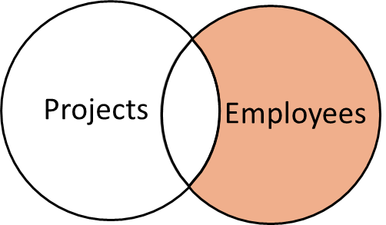
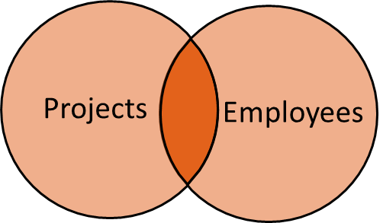
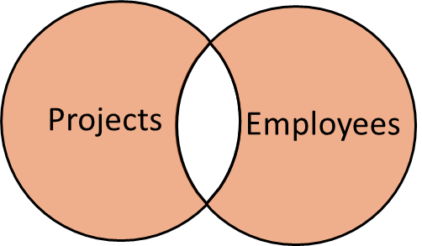
Show me all the Projects and their Employees
(no Projects without Employees and no Employees without Projects)
Most common case (aka INNER JOIN)
SELECT * FROM Project p
JOIN Employee e
ON p.Project_ID = e.Project_ID
Show me all the Projects and their available Employee data
Show me all the Employees and their available Project data
Show me all records in A and those in B that correspond to a record in A
SELECT * FROM Project p
LEFT JOIN Employee e
ON p.Project_ID = e.Project_ID
Show me all records in B, and those in A that correspond to a record in B
SELECT * FROM Project p
RIGHT JOIN Employee e
ON p.Project_ID = e.Project_ID
Show me all records in A that do not correspond to a record in B
SELECT * FROM Project p
LEFT JOIN Employee e
ON p.Project_ID = e.Project_ID
WHERE e.Project_ID is NULL
Show me all records in B that do not correspond to a record in A
SELECT * FROM Employee e
WHERE e.Project_ID is NULL
Show me all the Projects that do not have an Employee
Show me all the Employees that do not have a Project
Show me all the Projects and all the Employees
Show me all records in A that do not
correspond to a record in B. Same
for B.
SELECT * FROM Project p
FULL JOIN Employee e
ON p.Project_ID = e.Project_ID
WHERE C.CustID is NULL OR P.CustID is NULL
Show me all records in A and all records in B
SELECT * FROM Project p
FULL JOIN Employee e
ON p.Project_ID = e.Project_ID
Show me all the Projects with no Employees and all the Employees with no Project

Slide 17
WINIT
What is new in IT

Slide 18
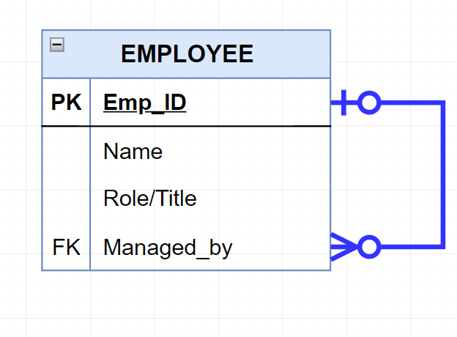
Self join: When a table is joined to itself
Example: list all the employees and their managers (assuming that managers are employees and there is a field called “Managed by”)
SELECT *
FROM Employee e
WHERE e.Managed_by = e.Emp_id
SELECT *
FROM Employee e1
LEFT JOIN Employee e2
ON e1.Managed_by = e2.emp_id
These are not the same. The first lists only employees who have a manager (an ‘inner’ join), and the second lists everybody
Notes:
Not the same

Slide 19
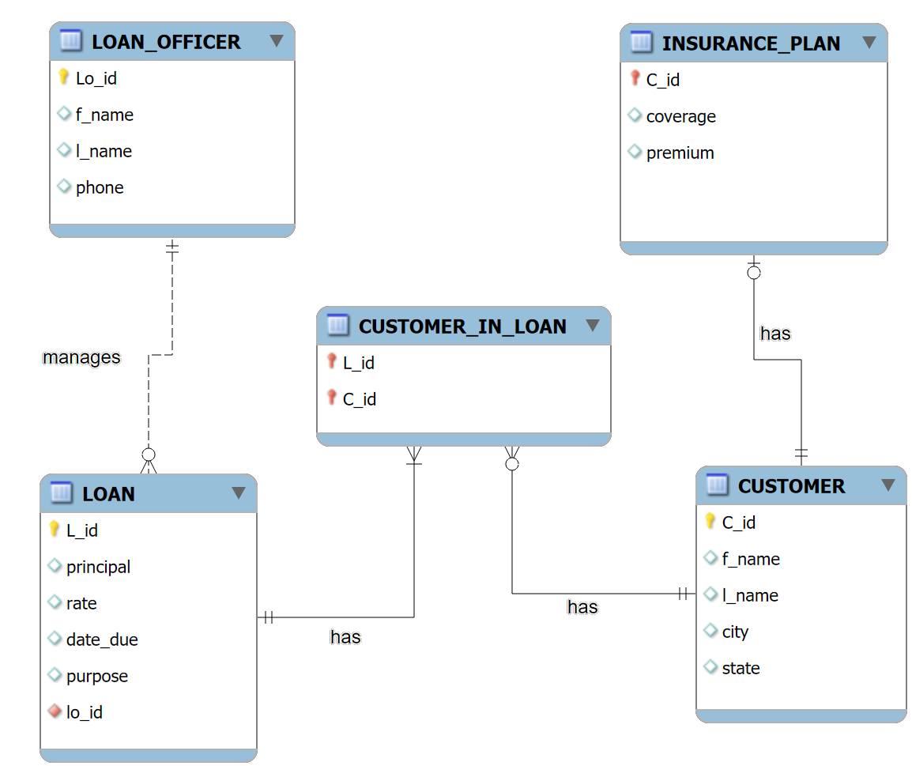
The SmallBank Database

Slide 20
Optional Practice Queries
QP1: Who are our top 10 percent customers in terms of total interest paid (= rate x principal)? Show them and their total interest. Rank them.
QP2: How much interest (= rate/100 x principal) will we earn from loans due in 2026? and in 2027?
QP3: List any Customer who has no loans and no insurance plan
QP4: List all the Customers who have never borrowed from us
QP5: List the Loan officers who have no customers in Dallas, TX
QP6: What is our exposure (sum of loans) in Virginia? Show city by city.
QP7: Is there a loan officer who manages no loans?

