Slide 1

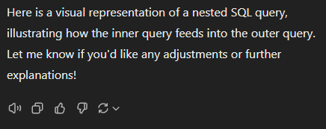
SQL: nested queries, union queries, & ‘Having’
Prep for MP3

Slide 2
Critical Thinking
Office hours on the home page
  Come and see me if you need help
Do we need to go to a lab for quizzes?

Slide 3
Orange Words
Join vs. Left join
Join vs. Full join

Slide 4

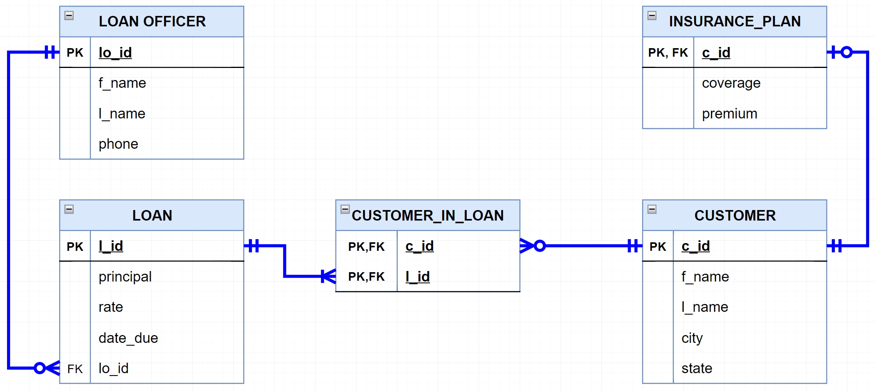
Nested queries
?
Find loans below $75,000
Find below-average loans
SQL
SQL
Notes:
Source: vector stock

Slide 5
“Find below-average loans”
select avg(principal)
from LOAN
select *
from LOAN
where principal < 96574.07
select *
from LOAN
where principal > (select avg(principal)
from LOAN)
Inner query
Outer query
Doing it in two steps will not work well

Slide 6
“Find below-average loans”

Slide 7
Nested queries are queries placed inside another query
Use them when you want to retrieve some data
based on the result of another query
Sometimes there are alternative ways to write them.
SQL
SQL
Notes:
Source: vector stock

Slide 8
Nested queries
?
Show all customers from Richmond, VA
Show all customers from the city
that has the
most customers
SQL
SQL
Notes:
Source: vector stock

Slide 9
“Show all customers from the city that has the most customers”
Select top 1 city
from CUSTOMER
group by city
order by count(*) desc
select *
from Customer
where city = 'Charlottesville’
select *
from Customer
where city = (Select top 1 city
from CUSTOMER
group by city
order by count(*) desc)
Inner query
Outer query
Doing it in two steps will not work well

Slide 10
Nested queries
?
List all loans we have, except the three largest and the three smallest
SQL
SQL
Notes:
Source: vector stock

Slide 11
“List all the loans we have, except the three largest and the three smallest”
Select * from LOAN
where l_id NOT IN (Select top 3 l_id from LOAN
order by principal DESC )
and l_id NOT IN (Select top 3 l_id from LOAN
order by principal ASC )

Slide 12
WINIT
What is new in IT

Slide 13
Group by and Having
“Show the total managed by each loan officer”

Slide 14
“Show the total managed by each loan officer”
Select lo.lo_id, lo.l_name, sum(principal),
from Loan_Officer lo
Left join Loan l
on lo.lo_id = l.lo_id
group by lo.lo_id, lo.l_name

Slide 15
Group by and Having
“Show the loan officers who manage in total more than $2m each”

Slide 16
“Show the loan officers who manage in total more than $2m each”
Select lo.lo_id, lo.l_name, sum(principal)
from Loan_Officer lo
Left join Loan l
on lo.lo_id = l.lo_id
group by lo.lo_id, lo.l_name
having sum(principal) > 2000000
Add all columns that are not in an aggregated function (e.g., ‘sum’) and that are in the select

Slide 17
Group by and Having
Group by aggregates rows that have the same values in specified columns. It’s often used with COUNT(), SUM(), AVG(), etc.
Having filters these groupings
Where filters rows

Slide 18

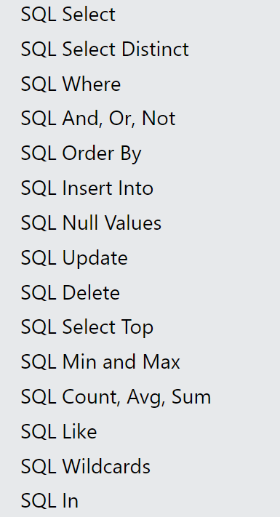
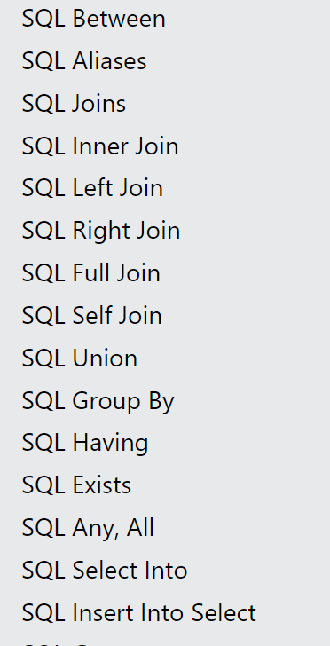
Keywords to learn
Go to https://www.w3schools.com/sql/default.asp
and test the live examples to understand how they work.
Notes:
INTERSECT returns distinct rows that are common to both SELECT queries
EXCEPT Returns rows from the first SELECT query that do not appear in the second.

Slide 19
You do the talking
Name
Concentration, Track
How challenging was MP2?
Things that you like about the class
Things that can be improved

Slide 20

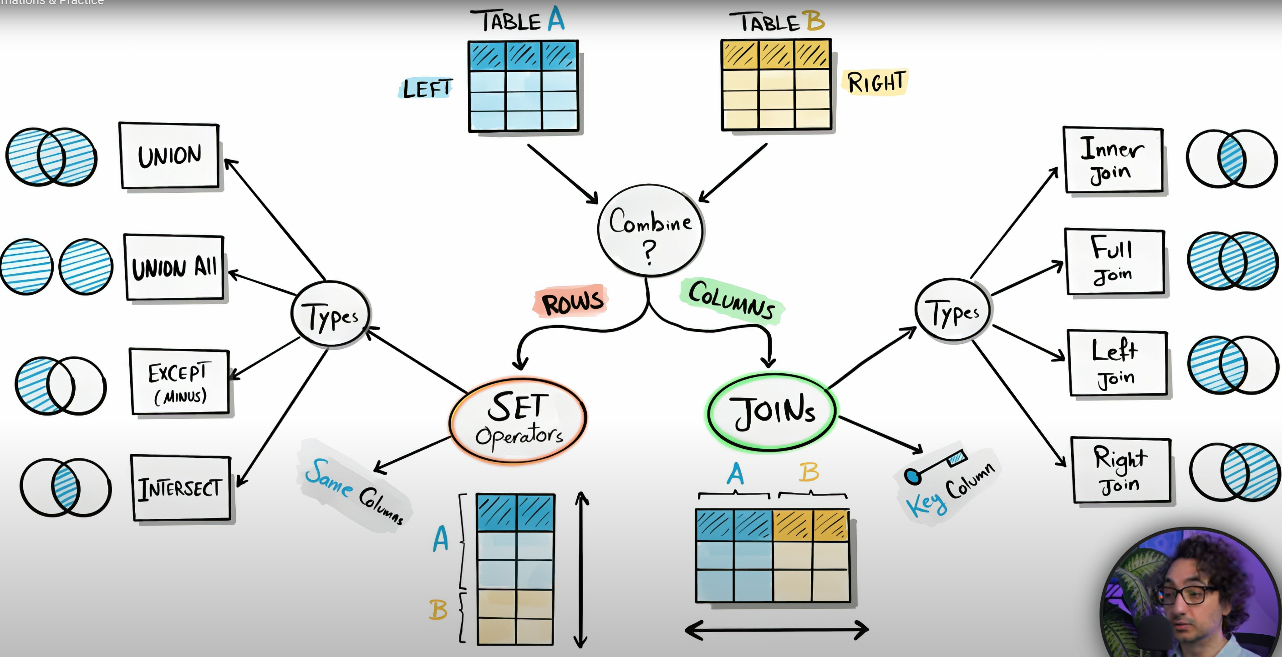

Notes:
INTERSECT returns distinct rows that are common to both SELECT queries
EXCEPT Returns rows from the first SELECT query that do not appear in the second.
Source: Data with Barat – You Tube + sg edits

Slide 21
Union statement
Allows you to append rows returned by two or more queries
Query 1: “Show Leo’s cats”
Query 2: “Show Leo’s dogs”
Query 1 UNION Query 2
CATS
DOGS
PETS
ID | Name | Fur color
C1 | Olaf | Brown
C2 | Felix | White
ID | Name | Fur color
D1 | Sandy | Black
D2 | Mortimer | Gold
D3 | Fido | Brown
ID | Name | Fur color
C1 | Olaf | Brown
C2 | Felix | White
D1 | Sandy | Black
D2 | Mortimer | Gold
D3 | Fido | Brown
UNION
Notes:
Source: vector stock

Slide 22
Union Example
Select ID, Name, Fur_color
From CAT
Where Owner = ‘Leo’
UNION
Select ID, Name, Fur_color
From DOG
Where Owner = ‘Leo’
ID | Name | Fur color
C1 | Olaf | Brown
C2 | Felix | White
D1 | Sandy | Black
D2 | Mortimer | Gold
D3 | Fido | Brown
UNION only return distinct rows. If you want to see all rows use UNION ALL
The joined tables must have the same number of columns and compatible column content
ORDER BY, if needed, must be placed at the very end of the SELECTs

Slide 23

Union Example
“Show me three customers from Cville, three from Dallas, and three from Richmond”

Slide 24
Keywords to learn
Go to https://www.w3schools.com/sql/default.asp
and test the live examples to understand how they work.

Slide 25
More Practice Queries (new)
Q1: List all customers who borrowed above our average loan
Q2: List all customers from Dallas and Richmond who borrowed above the average loan for that city
Q3: List the customers that have the max number of loans at the Bank
Q4: Which are out top three and bottom three loans in terms of principal?

Slide 26
The SmallBank Database

