Slide 1
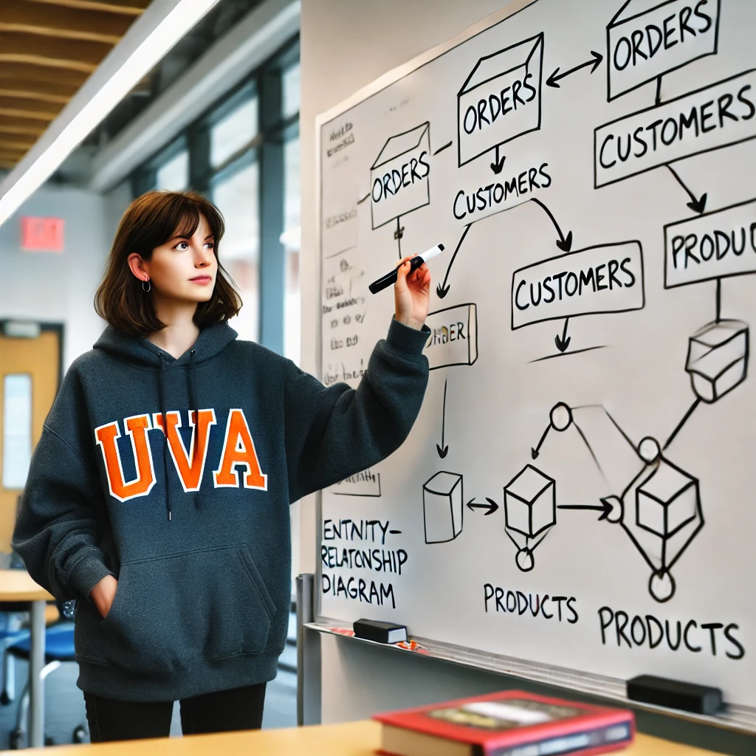
SQL Practice
Stefano Grazioli

Slide 2
Critical thinking
MP2 – ERD went well: ~90/100
Questions: office hours RRH 335 or https://webs.comm.virginia.edu/Grazioli/OfficeHours.html
Next Monday: SQL in-class test
Pledged, Individual, Open book/GenAI in RRH 317A LAB
Your computer or the lab computer. Make sure that you can connect
Some time pressure – ok not to finish them all/ no penalty for being wrong.
On SmallBankDB. One column added to LOAN (“purpose”)
Team formation
MP4 is individual, but MP5 is done in teams of three

Slide 3
You do the talking
Name
Year, Concentration, Track…
How hard was SmallBank MP2? What was the most challenging aspect?
Things I like about the class
Things that can be improved

Slide 4
Orange Words
Union statement
Nested query
Having vs group by

Slide 5
WINIT
What is new in IT

Slide 6

About SQL, I am still unclear on…

Slide 7
Optional Practice Queries
QP1: Who are our top 10 percent customers in terms of total interest (= rate x principal)? Show them and their total interest. Rank them.
QP2: How much interest (= rate/100 x principal) will we earn from loans due in 2026? and in 2027?
QP3: List any Customer who has one or more loans and no insurance plan
QP4: List all the Customers who have never borrowed from us
QP5: List the Loan officers who do not have customers in Dallas, TX
QP6: What is our exposure (sum of loans) in Virginia? Show city by city.
QP7: Is there a loan officer who manages no loans?
QP8: List all loans that are above our average loan. Show the customer's first and last name. Order by c_id
QP9: List all customers from Dallas and Richmond who borrowed above the average loan for that city
QP10: List the customers that have the max number of loans at the Bank
QP11: Which are out top three and bottom three loans in terms of principal?

