Slide 1
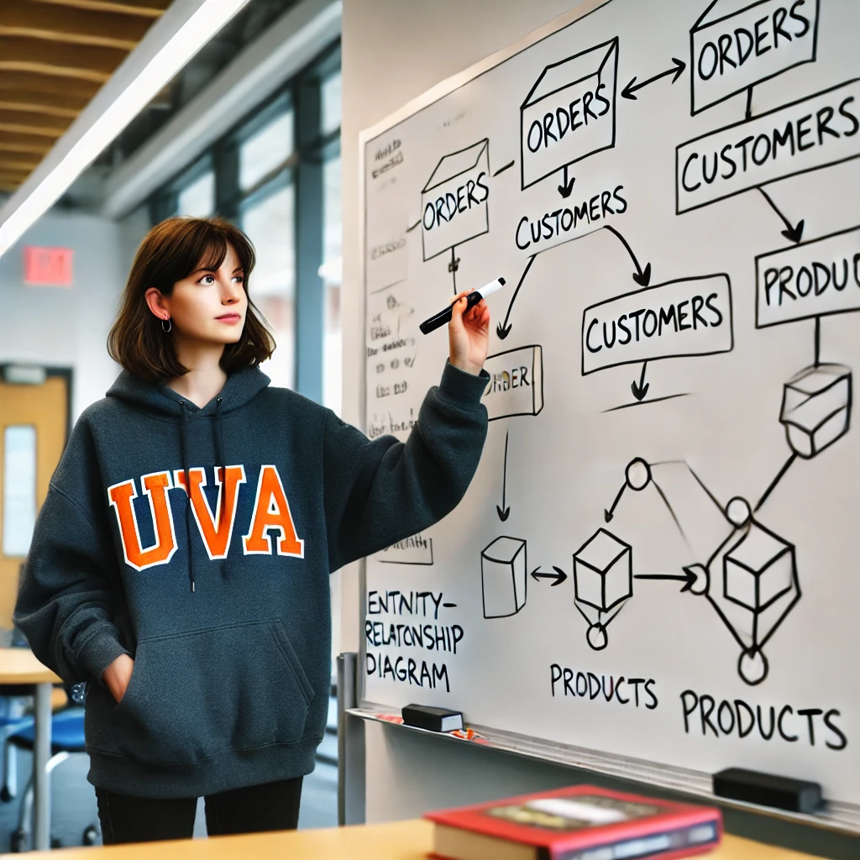
SQL Practice II
Stefano Grazioli

Slide 2
Critical thinking
MP3 – SQL went well: ~92/100
Questions: office hours RRH 335 or https://webs.comm.virginia.edu/Grazioli/OfficeHours.html
Next Monday: SQL test RRH 317A LAB
Team formation (teams of 3)
Fri/Sat I am full-time in DC.

Slide 3
You do the talking
Name
Year, Concentration, Track…
How hard was SmallBank MP3? What was the most challenging aspect?
Things I like about the class
Things that can be improved

Slide 4
Debugging MP3
In business, when you are asked to alphabetize or sort names, it usually means alphabetize by last name first, and within that by first name.
Order by
Notes:
Two obs: distincts and cust/all cust

Slide 5
Debugging MP3
Q1: List our customers, where they live, their loan officers, and their phones. Alphabetical by city and then by customer. Column names specify who is who.
DISTINCT
Notes:
Two obs: distincts and cust/all cust

Slide 6
Debugging MP3
Q10: How many of our Charlottesville customers are not insured?
LEFT JOIN
Notes:
Two obs: distincts and cust/all cust

Slide 7
Debugging MP3
Q6: Who are our top quartile borrowers? Show customers and total borrowed. Order by principal, largest on top.
SELECT TOP 25 PERCENT
Notes:
Two obs: distincts and cust/all cust

Slide 8
WINIT
What is new in IT

Slide 9
About SQL, I am still unclear on…

Slide 10

Optional Practice Queries
QP1: Who are our top 10 percent customers in terms of total interest (= rate x principal)? Show them and their total interest. Rank them.
QP2: How much interest (= rate/100 x principal) will we earn from loans due in 2026? and in 2027?
QP3: List any Customer who has one or more loans and no insurance plan
QP4: List all the Customers who have never borrowed from us
QP5: List the Loan officers who do not have customers in Dallas, TX
QP6: What is our exposure (sum of loans) in Virginia? Show city by city.
QP7: Is there a loan officer who manages no loans?
QP8: List all loans that are above our average loan
QP9: List all customers from Dallas and Richmond who borrowed above the average loan for that city
QP10: List the customers that have the max number of loans at the Bank
QP11: Which are out top three and bottom three loans in terms of principal?

