Slide 1

Practice with business data modeling
(MP4 and MP5)
Stefano Grazioli

Slide 2
Critical thinking
Quiz 1 survey – GenAI use
Intro to MP4 + practice

Slide 3
You do the talking
Name
Year, Concentration, Track…
How do I feel about my SQL skills?
How do I use GenAI?
Things I like about the class
Things that can be improved

Slide 4

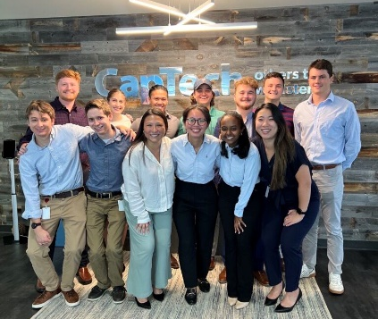

Your next project as a consultant
Welcome... to your next job (MP#4)
Notes:
Real consulting company, but the project is fictional.

Slide 5


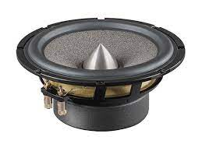
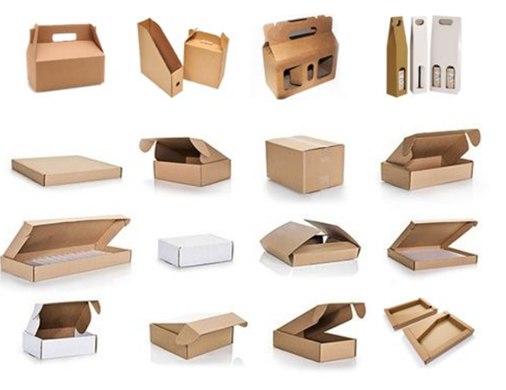
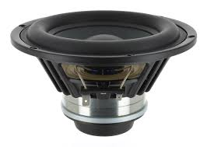
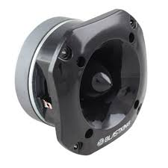
Mini project 4:
DigiSonos and UBC go invoiceless
B2B

Slide 6
How does invoiceless work?
Info flow in orange
Goods flow in blue
1. Purchase order
2a. Goods
2b. Packing ‘slip’ or ‘list’
3. Returned goods
Purchasing Dept.
Receiving Dept.
Accounts payable Dept.
4.Payment
Sales Dept.
Shipping Dept.
Accts. receivable Dept.
5. Reconciliation

Slide 7
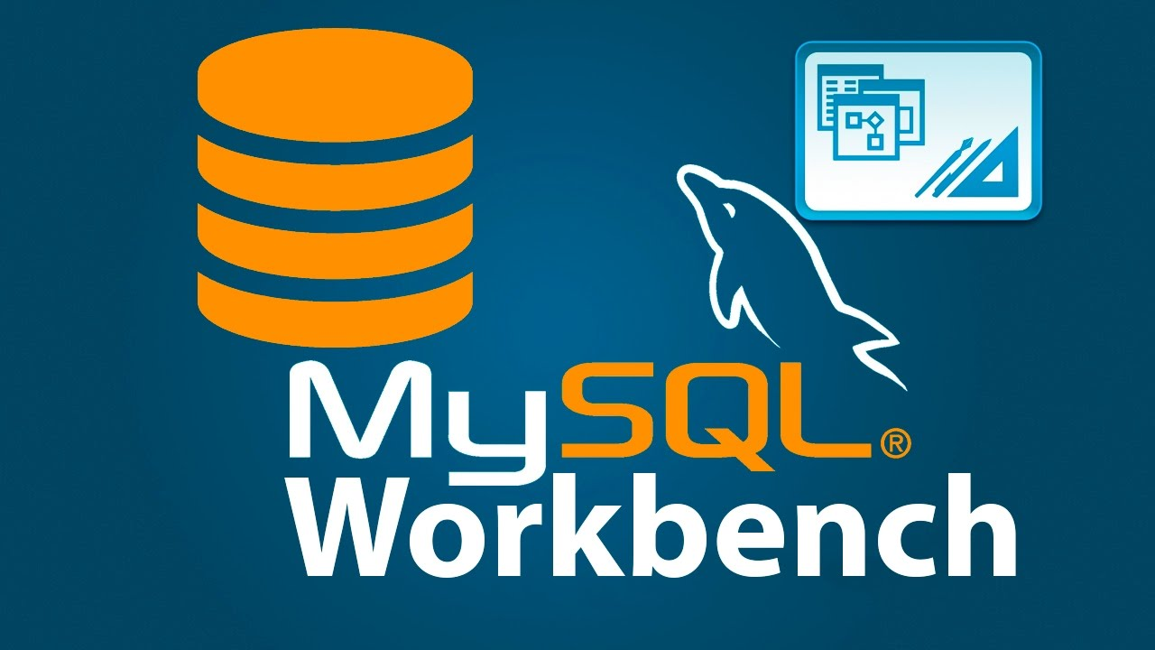
Website has all the details
The department you are supporting (e.g. ‘sales’) sent you a memo
Mandatory tool is
MySQLWorkbench
(there is a video)

Slide 8
WINIT
What is new in IT

Slide 9
Practice for MP4
This is design,
not math.
Focus on organizing
the data that your users need
to do their job

Slide 10
Multi-Valued Attributes become an additional entity
ACME keeps track of its customers. Each customer has a customerID, name, address, and one phone number. However, they often have several different addresses where they may take delivery.

Slide 11
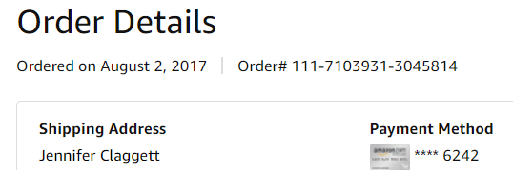
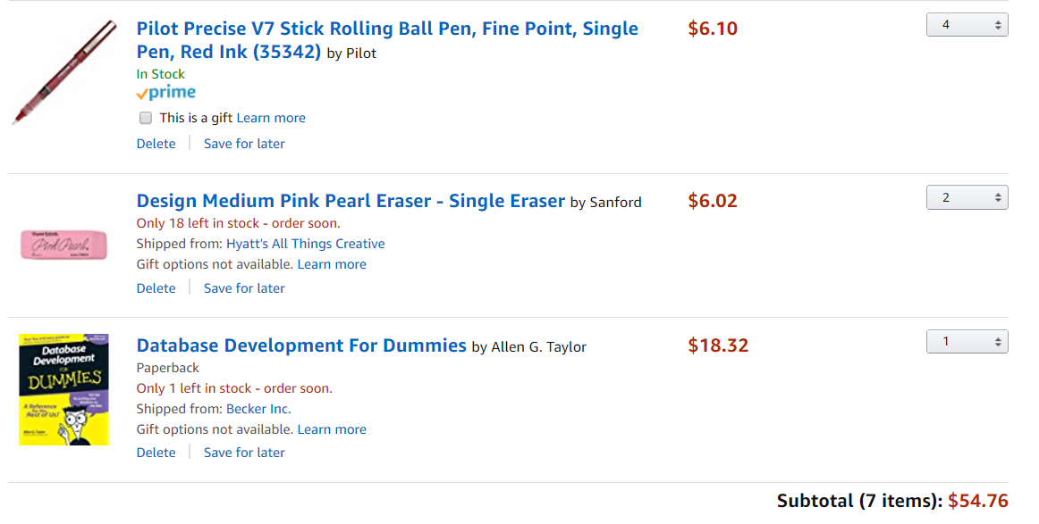
One order with three line-items
Order
Common part
(“Order Header”)
Ordered on August 13 2025
Jennifer Claggett
Rose Ct. 224, Atlanta GA
$2.00
Ordered items (“Line items”)
Geniuses
for
Geniuses
$38.36

Slide 12
Order-Line Item-Product Tables
 | CUSTOMER
 | C_id | F_name | L_name
 | c009 | Jennifer | Claggett
 | c234 | Peter | Gray
 | ORDER |  |  |  | LINE_ITEM |  |  |  | PRODUCT
 | Order# | Date | C_id |  | Order# | SKU | Qty |  | SKU | Description | Stock | MSRP
 | 111 | 8/13/2025 | c009 |  | 111 | PEN-532 | 4 |  | PEN-532 | Pilot precise v7 red | 300 | $2.00
 | 112 | 8/13/2025 | c234 |  | 111 | ERS-192 | 2 |  | ERS-192 | Design Medium Eraser | 50 | $6.02
 | 113 | 8/14/2025 | c009 |  | 111 | BK-543 | 1 |  | BK-543 | DB development | 12 | $18.32
 |  |  |  |  | 112 | PEN-532 | 10 |  | BK-283 | IT Strategy | 2 | $72.30
 |  |  |  |  | 112 | BK-283 | 1 |  | PEN-533 | Pilot precise v7 black | 5 | $1.50
 |  |  |  |  | 113 | PEN-533 | 2

Slide 13
Order–Line Item–Product is a common pattern
Orders include multiple products and their corresponding quantities. Orders have a number and a date. Products have a SKU and a MSRP/fixed/non-negotiable price.
MSRP = manufacturer’s suggested retail price

Slide 14

How does this change my database design?
Orders include many products and the ordered quantities. Orders have a number and a date. Products have a SKU, a name, and a MSRP (i.e., fixed/non-negotiable) price. MSRP changes in time. Prices of items are negotiated order by order.

Slide 15
How does this change my database design?
The salesperson may also apply a discount to the whole order. Since that’s a lot of discretionary power, ACME wants to know which salesperson sold each order.

Slide 16
Takeaways
Review of the main components of the ERD modeling technique
Hands-on practice
… now that you are an expert,
you are ready for MP4!

