Slide 1

Practice with business data modeling (MP4 and MP5)
Stefano Grazioli

Slide 2
Critical thinking
Any questions on data modeling/ERD?
Check carefully the last part of the MySQLWorkbench video: Identifying/non identifying relationships.

Slide 3

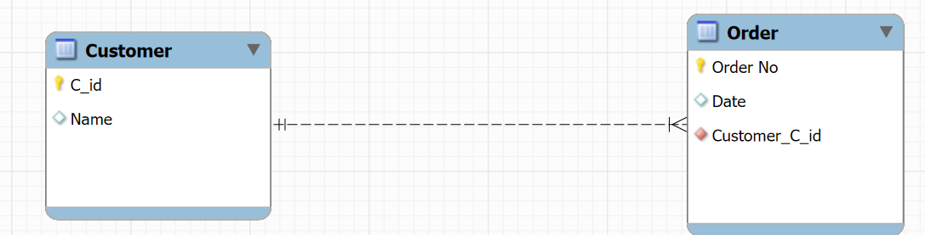

Identifying vs. non identifying relationships
This is NON-IDENTIFYING: the FK (customer_C_id) is not transformed into a composite primary key. This is the most common case. Identifying Order does not require knowing Customer.
This is IDENTIFYING: the FK (Book_ISBN) is transformed into a composite primary key. Identifying the Chapter requires knowing which book. This is because many books have a chapter “1”, so you also need the book’s ISBN. The most common use of identifying relationships is in association tables.

Slide 4
You do the talking
Name
Year, Concentration, Track…
Am I more confident with SQL?
How do I use GenAI?
Things I like about the class
Things that can be improved

Slide 5
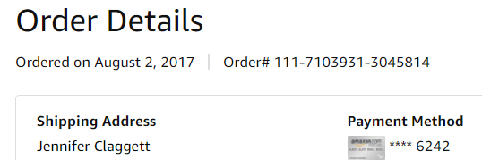
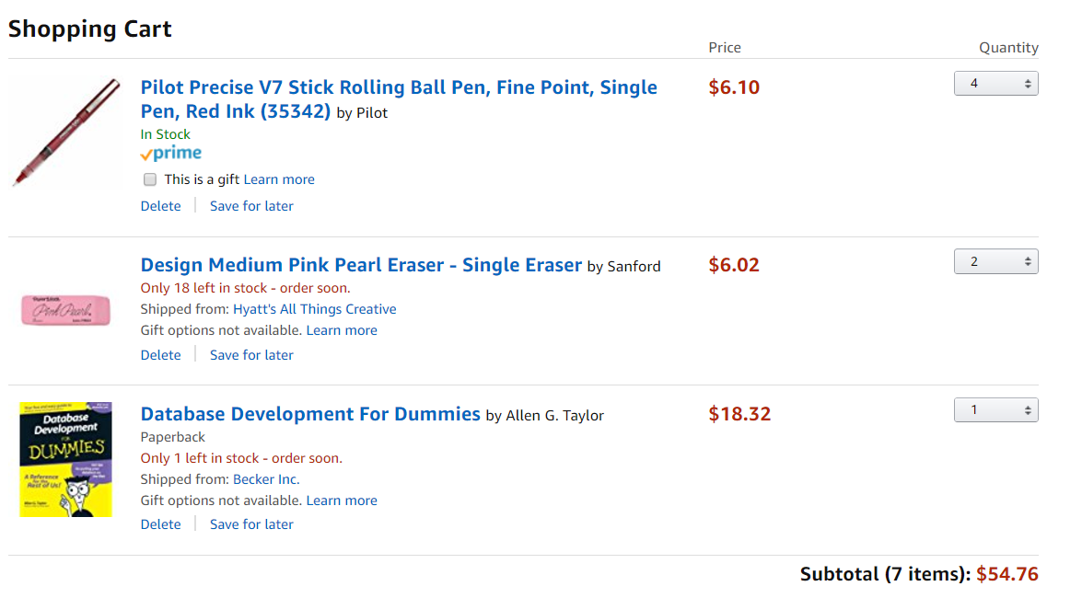
Remember Jennifer’s order?
Order
Common part (“Order Header”)
Ordered on August 13 2025
Jennifer Claggett
Rose Ct. 224, Atlanta GA
$2.00
Ordered items (“Line items”)
Geniuses
for Geniuses
$38.36

Slide 6


Shipments
3 (of 4)
2 (of 2)
0 (of 1)
Customer
A ‘shipment’

Slide 7
The printout that summarizes the shipment info is often called a “Packing list” (or BOL)
Packing List Date Shipped: August 15, 2025 Shipment ID# 523423 (OrderNo 111-71039310-3045814)
PRODUCT | ORDERED | SHIPPED
Pilot Red Pens | 4 | 3
Pink Eraser | 2 | 2
Database for Geniuses | 1 | 0
Common part (“Header”)
Shipped items in the box (“Line items”)

Slide 8
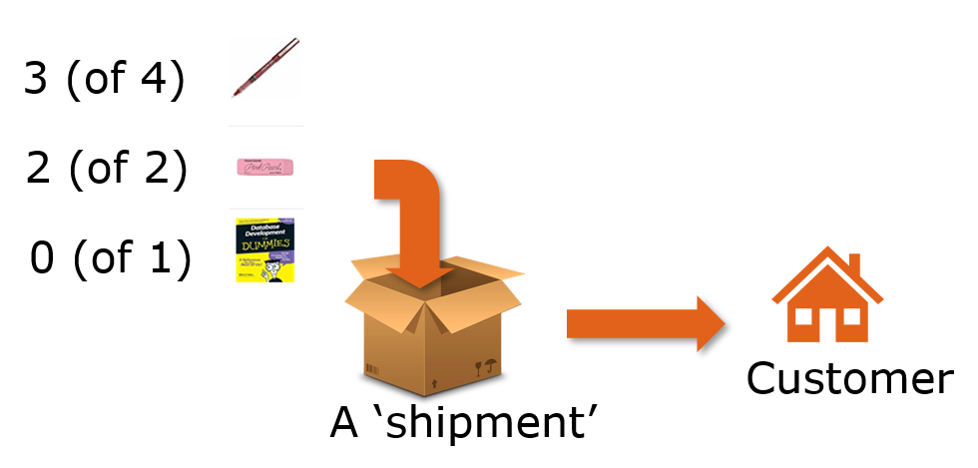
Common patterns
Sometimes, we do not have enough inventory to fulfill an order, so we ship what we can and later send additional shipments to fill the remaining part of the order.

Slide 9
WINIT
What is new in IT

Slide 10
Relationships
Customers pay us (electronically) as soon as they receive the goods we ship to them as detailed in the packing slip. We keep track of these payments.

Slide 11
Relationships and Processes
Orders at ACME that receive a discount larger than 50% must be approved by a manager.

Slide 12
Calculated fields are not stored
Since that’s a lot of discretionary power, ACME wants to keep up with which salesperson sold each order, and to be able to calculate the total discount(s) at the order or customer level.

Slide 13
DB design principles (MP4)
If it is a process (e.g., a decision) do not represent it.
But you might need to keep track that it happened, its outcome, or who did it
If it can be calculated, do not represent it
Unless explicitly asked
Notes:
Example: AGE

