Slide 1


Database integration
B2B
MiniProject #5

Slide 2
Critical thinking
Please hand-in MP4
Zoom/MS Teams anytime if you need help

Slide 3
MP5 – DB integration
How many order tables?
How many product tables?
We have created data silos!
  Natural evolution of DB technology
  Inefficient: data duplication
  Inefficient: data inconsistencies
  Inefficient: data is not shared

Slide 4
MP5 – DB integration
No worries. We will fix it!
MP5 has two steps
  As a team of three:
  Consolidate the ERDs for your company
  As a team of six:
  Identify the flows of data between the two companies

Slide 5

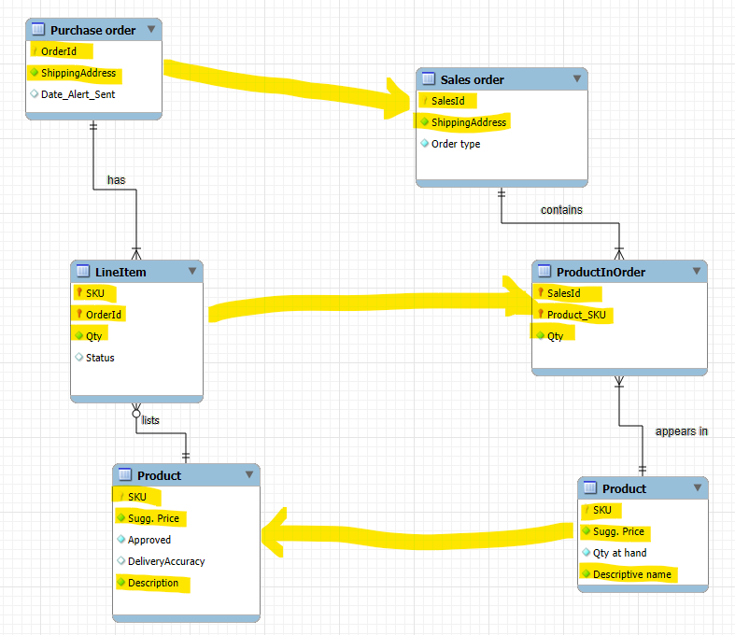

Modeling data flows (fragment)
(2)
(2)
The two DataBases are physically and logically separate
(1)

Slide 6
Solutions shown in class are distributed via Teams
to avoid interfering with other classes doing a similar exercise

