Slide 1
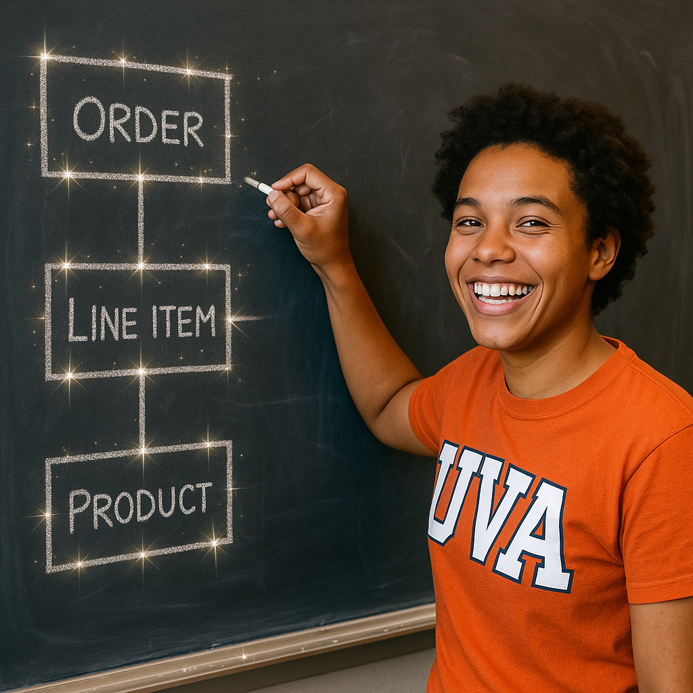
Good DB designs
Using Normalization

Slide 2
Critical thinking
Questions on MP5?

Slide 3
Critical thinking: SQL Quiz
N=26
83% used GenAI to prepare
100% used GenAI during the quiz
52% used GenAI to write an initial draft of most queries
100% felt GenAI helped them produce better answers
100% plan to use GenAI again
96% think allowing GenAI was a good idea

Slide 4
Critical thinking: SQL Quiz
Having GenAI draft the whole query does not improve grades
Consider writing your own draft of all/the hardest queries and having the GenAI check
Asking GenAI for specific issues (e.g., syntax) works better if you have some foundational understanding

Slide 5
You do the talking
Name
Year, Concentration, Track…
Am I more confident with SQL?
Course goals wrt GenAI clear?
Things I like about the class
Things than can be improved

Slide 6
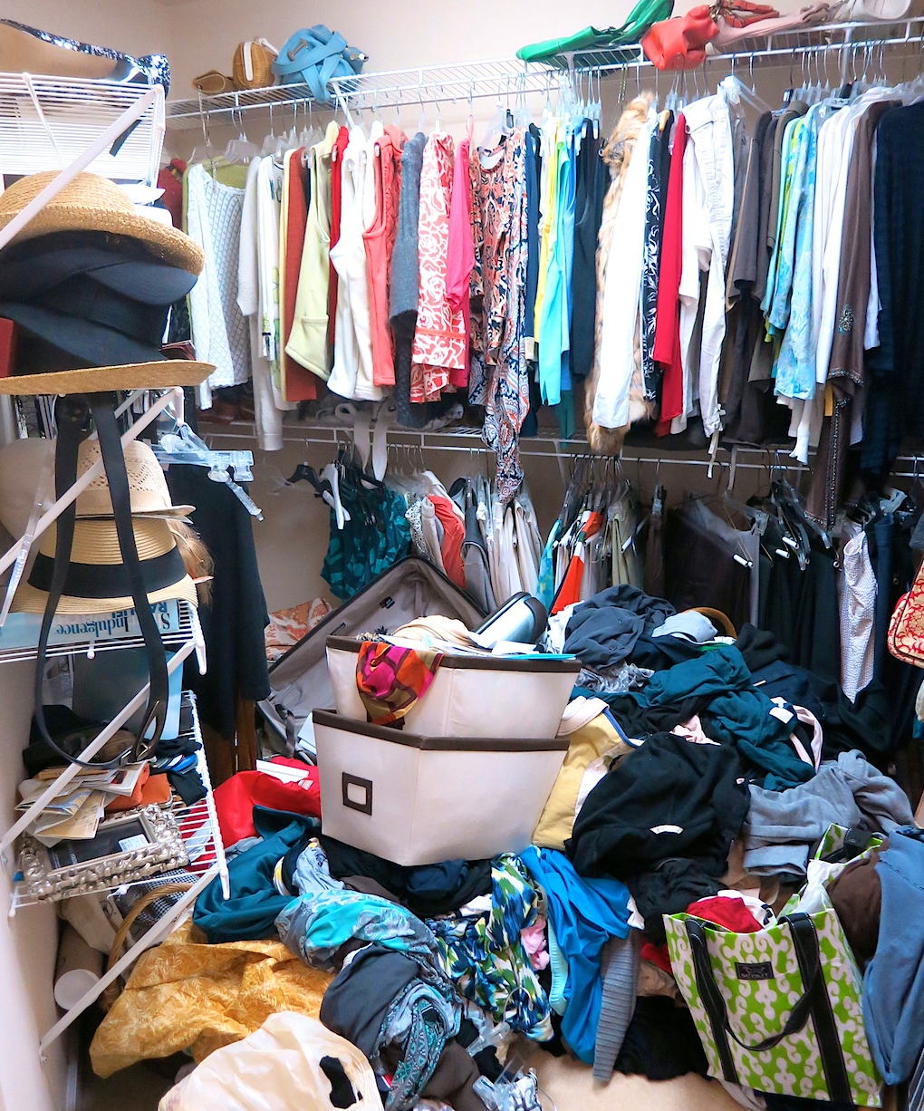
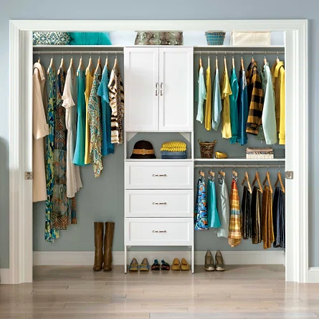
Why do we care about good data modeling?
Bad data organization: data is hard to find and manage. It is easy to make unforced mistakes called ‘data anomalies’
Good data organization: data is easier to find, update, and delete

Slide 7

The Pressly Ad Agency Story: fixing a bad DB design
(inspired by the Jukic et al. book)
Base case for MP6

Slide 8
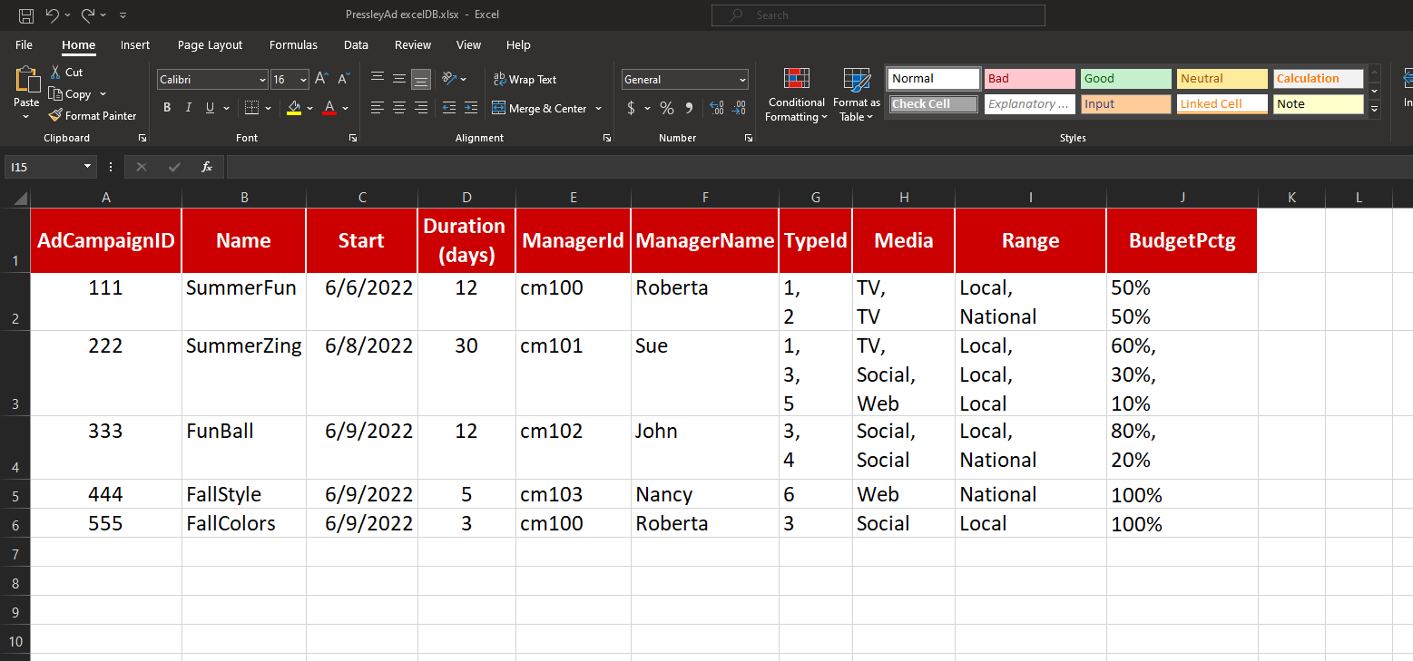
Pressly Ad started with Excel…
But…as the company grew, more people started using the spreadsheet concurrently, copies not fully updated were emailed around, data got deleted accidentally, more security was needed because not everybody should be able to change data…
Management at PresslyAd decided they needed a DB. They hired a consultant…

Slide 9
The consultant put the Pressly Ad data in a DB ‘as-is’…
EPIC FAIL!
BIG_TABLE
AdCampaignId | Name | Start | Duration (days) | ManagerId | ManagerName | TypeId | Media | Range | BudgetPctg
111 | SummerFun | 6/6/22 | 12 | cm100 | Roberta | 1, 2 | TV, TV | Local, National | 50%, 50%
222 | SummerZing | 6/8/22 | 30 | cm101 | Sue | 1, 3, 5 | TV, Social, Web | Local, Local, Local | 60%, 30%, 10%
333 | FunBall | 6/9/22 | 12 | cm102 | John | 3, 4 | Social, Social | Local, National | 80%, 20%
444 | FallStyle | 6/9/22 | 5 | cm103 | Nancy | 6 | Web | National | 100%
555 | FallColors | 6/9/22 | 3 | cm100 | Roberta | 3 | Social | Local | 100%
Select * from BIG_TABLE where Media = ‘TV’
Select BudgetPctg from BIG_TABLE where Name = ‘SummerZing’ and Media = ‘Social’

Slide 10
Normalization = better design
Is the table in First Normal Form?
yes
Is the table in Second Normal Form?
Yes
Is the table in Third Normal Form?
Yes
A better design. Yay!
Test: Is each row unique, and do all cells contain ‘one value’?
Fix: create additional rows and/or Identifiers

Slide 11

Is this table in 1st NF?
Test: Is each row unique, and do all cells contain ‘one value’?
Not in FIRST nf
Fix: create additional rows and/or Identifiers
AdCampaignId | Name | Start | Duration (days) | ManagerId | ManagerName | TypeId | Media | Range | BudgetPctg
111 | SummerFun | 6/6/22 | 12 | cm100 | Roberta | 1, 2 | TV, TV | Local, National | 50%, 50%
222 | SummerZing | 6/8/22 | 30 | cm101 | Sue | 1, 3, 5 | TV, Social, Web | Local, Local, Local | 60%, 30%, 10%
333 | FunBall | 6/9/22 | 12 | cm102 | John | 3, 4 | Social, Social | Local, National | 80%, 20%
444 | FallStyle | 6/9/22 | 5 | cm103 | Nancy | 6 | Web | National | 100%
555 | FallColors | 6/9/22 | 3 | cm100 | Roberta | 3 | Social | Local | 100%

Slide 12
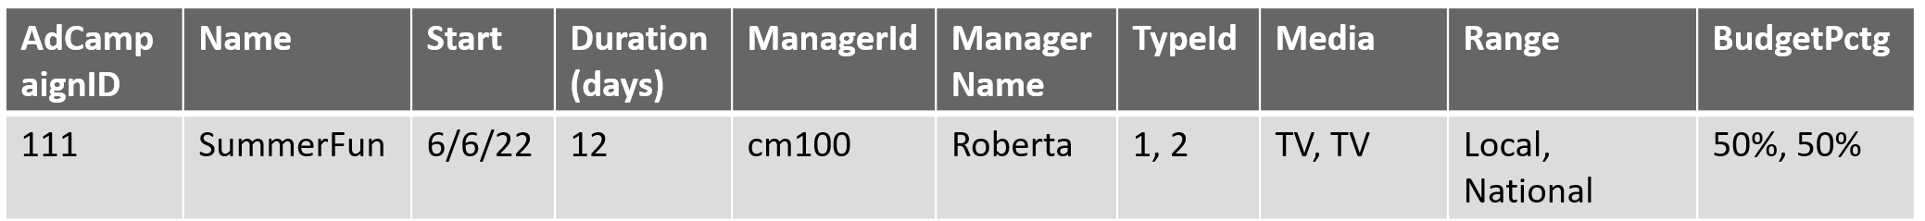
Getting it into 1st NF
BETTER DESIGN
BIG_TABLE
AdCampaignId | Name | Start | Duration (days) | ManagerId | ManagerName | TypeId | Media | Range | BudgetPctg
111 | SummerFun | 6/6/22 | 12 | cm100 | Roberta | 1 | TV | Local | 50%
111 | SummerFun | 6/6/22 | 12 | cm100 | Roberta | 2 | TV | National | 50%
222 | SummerZing | 6/8/22 | 30 | cm101 | Sue | 1 | TV | Local | 60%
222 | SummerZing | 6/8/22 | 30 | cm101 | Sue | 3 | Social | Local | 30%
222 | SummerZing | 6/8/22 | 30 | cm101 | Sue | 5 | Web | Local | 10%
333 | FunBall | 6/9/22 | 12 | cm102 | John | 3 | Social | Local | 80%
333 | FunBall | 6/9/22 | 12 | cm102 | John | 4 | Social | National | 20%
444 | FallStyle | 6/9/22 | 5 | cm103 | Nancy | 6 | Web | National | 100%
555 | FallColors | 6/9/22 | 3 | cm100 | Roberta | 3 | Social | Local | 100%
Wait… what is the PK here?
Select * from BIG_TABLE where Media = ‘TV’
Select BudgetPctg from BIG_TABLE where Name = ‘SummerZing’ and Media = ‘Social’
Test: Is each row unique, and do all cells contain ‘one value’?

Slide 13
1NF is better, but not perfect: frequent column-group repetitions are symptoms of questionable design. Can you see any?
BIG_TABLE
AdCampaignId | Name | Start | Duration (days) | ManagerId | ManagerName | TypeId | Media | Range | BudgetPctg
111 | SummerFun | 6/6/22 | 12 | cm100 | Roberta | 1 | TV | Local | 50%
111 | SummerFun | 6/6/22 | 12 | cm100 | Roberta | 2 | TV | National | 50%
222 | SummerZing | 6/8/22 | 30 | cm101 | Sue | 1 | TV | Local | 60%
222 | SummerZing | 6/8/22 | 30 | cm101 | Sue | 3 | Social | Local | 30%
222 | SummerZing | 6/8/22 | 30 | cm101 | Sue | 5 | Web | Local | 10%
333 | FunBall | 6/9/22 | 12 | cm102 | John | 3 | Social | Local | 80%
333 | FunBall | 6/9/22 | 12 | cm102 | John | 4 | Social | National | 20%
444 | FallStyle | 6/9/22 | 5 | cm103 | Nancy | 6 | Web | National | 100%
555 | FallColors | 6/9/22 | 3 | cm100 | Roberta | 3 | Social | Local | 100%

Slide 14
Why is this still a bad design? 1. Insertion anomalies
AdCampaignId | Name | Start | Duration (days) | ManagerId | ManagerName | TypeId | Media | Range | BudgetPctg
111 | SummerFun | 6/6/22 | 12 | cm100 | Roberta | 1 | TV | Local | 50%
111 | SummerFun | 6/6/22 | 12 | cm100 | Roberta | 2 | TV | National | 50%
222 | SummerZing | 6/8/22 | 30 | cm101 | Sue | 1 | TV | Local | 60%
222 | SummerZing | 6/8/22 | 30 | cm101 | Sue | 3 | Social | Local | 30%
222 | SummerZing | 6/8/22 | 30 | cm101 | Sue | 5 | Web | Local | 10%
333 | FunBall | 6/9/22 | 12 | cm102 | John | 3 | Social | Local | 80%
333 | FunBall | 6/9/22 | 12 | cm102 | John | 4 | Social | National | 20%
444 | FallStyle | 6/9/22 | 5 | cm103 | Nancy | 6 | Web | National | 100%
555 | FallColors | 6/9/22 | 3 | cm100 | Roberta | 3 | Social | Local | 100%
???? |  |  |  |  |  | 7 | Influencer | National
We want to store a new campaign Type (7, Influencer, National) which has not been used yet.
What happens if we then count(distinct *) AdCampaigns?

Slide 15
Why is this still a bad design? 2. Deletion anomalies
AdCampaignId | Name | Start | Duration (days) | ManagerId | ManagerName | TypeId | Media | Range | BudgetPctg
111 | SummerFun | 6/6/22 | 12 | cm100 | Roberta | 1 | TV | Local | 50%
111 | SummerFun | 6/6/22 | 12 | cm100 | Roberta | 2 | TV | National | 50%
222 | SummerZing | 6/8/22 | 30 | cm101 | Sue | 1 | TV | Local | 60%
222 | SummerZing | 6/8/22 | 30 | cm101 | Sue | 3 | Social | Local | 30%
222 | SummerZing | 6/8/22 | 30 | cm101 | Sue | 5 | Web | Local | 10%
333 | FunBall | 6/9/22 | 12 | cm102 | John | 3 | Social | Local | 80%
333 | FunBall | 6/9/22 | 12 | cm102 | John | 4 | Social | National | 20%
444 | FallStyle | 6/9/22 | 5 | cm103 | Nancy | 6 | Web | National | 100%
555 | FallColors | 6/9/22 | 3 | cm100 | Roberta | 3 | Social | Local | 100%
What happens if we delete Campaign 444?

Slide 16
Why is this still a bad design? 3. Update anomalies
AdCampaignId | Name | Start | Duration (days) | ManagerId | ManagerName | TypeId | Media | Range | BudgetPctg
111 | SummerFun | 6/6/22 | 12 | cm100 | Roberta | 1 | TV | Local | 50%
111 | SummerFun | 6/6/22 | 12 | cm100 | Roberta | 2 | TV | National | 50%
222 | SummerZing | 6/8/22 | 30 | cm101 | Sue | 1 | TV | Local | 60%
222 | SummerZing | 6/8/22 | 30 | cm101 | Sue | 3 | Social | Local | 30%
222 | SummerZing | 6/8/22 | 30 | cm101 | Sue | 5 | Web | Local | 10%
333 | FunBall | 6/9/22 | 12 | cm102 | John | 3 | Social | Local | 80%
333 | FunBall | 6/9/22 | 12 | cm102 | John | 4 | Social | National | 20%
444 | FallStyle | 6/9/22 | 5 | cm103 | Nancy | 6 | Web | National | 100%
555 | FallColors | 6/9/22 | 3 | cm100 | Roberta | 3 | Social | Local | 100%
// 45
What happens if we want to change the duration of ‘SummerZing’ to 45 days and so we run UPDATE Big_table SET Duration = 45 WHERE name = ‘SummerZing’ and TypeId = 1

Slide 17
Why is this still a bad design? Duplications!
AdCampaignId | Name | Start | Duration (days) | ManagerId | ManagerName | TypeId | Media | Range | BudgetPctg
111 | SummerFun | 6/6/22 | 12 | cm100 | Roberta | 1 | TV | Local | 50%
111 | SummerFun | 6/6/22 | 12 | cm100 | Roberta | 2 | TV | National | 50%
222 | SummerZing | 6/8/22 | 30 | cm101 | Sue | 1 | TV | Local | 60%
222 | SummerZing | 6/8/22 | 30 | cm101 | Sue | 3 | Social | Local | 30%
222 | SummerZing | 6/8/22 | 30 | cm101 | Sue | 5 | Web | Local | 10%
333 | FunBall | 6/9/22 | 12 | cm102 | John | 3 | Social | Local | 80%
333 | FunBall | 6/9/22 | 12 | cm102 | John | 4 | Social | National | 20%
444 | FallStyle | 6/9/22 | 5 | cm103 | Nancy | 6 | Web | National | 100%
555 | FallColors | 6/9/22 | 3 | cm100 | Roberta | 3 | Social | Local | 100%
// 45
We will see that good design can make the DB smaller and reduce anomalies.

Slide 18

Normalization, step two
Is the table in First Normal Form?
yes
Is the table in Second Normal Form?
Yes
Is the table in Third Normal Form ?
Yes
Likely a good design. Yay!
Test: Is each row unique, and do all cells contain ‘one value’*?
Test: Does this table have a composite primary key, and some of its columns are dependent only on part of the composite key?
Fix: treat each violation as a multivalued attribute and create an additional table
Fix: split table into separate tables according to these dependencies

Slide 19
Is this table in 2nd Normal form?
AdCampaignId | Name | Start | Duration (days) | ManagerId | ManagerName | TypeId | Media | Range | BudgetPctg
111 | SummerFun | 6/6/22 | 12 | cm100 | Roberta | 1 | TV | Local | 50%
111 | SummerFun | 6/6/22 | 12 | cm100 | Roberta | 2 | TV | National | 50%
222 | SummerZing | 6/8/22 | 30 | cm101 | Sue | 1 | TV | Local | 60%
222 | SummerZing | 6/8/22 | 30 | cm101 | Sue | 3 | Social | Local | 30%
222 | SummerZing | 6/8/22 | 30 | cm101 | Sue | 5 | Web | Local | 10%
333 | FunBall | 6/9/22 | 12 | cm102 | John | 3 | Social | Local | 80%
333 | FunBall | 6/9/22 | 12 | cm102 | John | 4 | Social | National | 20%
444 | FallStyle | 6/9/22 | 5 | cm103 | Nancy | 6 | Web | National | 100%
555 | FallColors | 6/9/22 | 3 | cm100 | Roberta | 3 | Social | Local | 100%
Test: Does this table have a composite primary key, and some of its columns are dependent only on part of the composite key?
Fix: split the table according to these groupings

Slide 20
Normalizing to 2NF
AdCampaignId | Name | Start | Duration (days) | ManagerId | ManagerName | TypeId | Media | Range | BudgetPctg
111 | SummerFun | 6/6/22 | 12 | cm100 | Roberta | 1 | TV | Local | 50%
111 | SummerFun | 6/6/22 | 12 | cm100 | Roberta | 2 | TV | National | 50%
222 | SummerZing | 6/8/22 | 30 | cm101 | Sue | 1 | TV | Local | 60%
222 | SummerZing | 6/8/22 | 30 | cm101 | Sue | 3 | Social | Local | 30%
222 | SummerZing | 6/8/22 | 30 | cm101 | Sue | 5 | Web | Local | 10%
333 | FunBall | 6/9/22 | 12 | cm102 | John | 3 | Social | Local | 80%
333 | FunBall | 6/9/22 | 12 | cm102 | John | 4 | Social | National | 20%
444 | FallStyle | 6/9/22 | 5 | cm103 | Nancy | 6 | Web | National | 100%
555 | FallColors | 6/9/22 | 3 | cm100 | Roberta | 3 | Social | Local | 100%
TypeId | Media | Range
1 | TV | Local
2 | TV | National
3 | Social | Local
5 | Web | Local
4 | Social | National
6 | Web | National
In
SECOND nf
AdCampaignId (FK) | TypeId (FK) | BudgetPctg
111 | 1 | 50%
111 | 2 | 50%
222 | 1 | 60%
222 | 3 | 30%
222 | 5 | 10%
333 | 3 | 80%
333 | 4 | 20%
444 | 6 | 100%
555 | 3 | 100%
AdCampaignId | Name | Start | Duration (days) | ManagerId | ManagerName
111 | SummerFun | 6/6/22 | 12 | cm100 | Roberta
222 | SummerZing | 6/8/22 | 30 | cm101 | Sue
333 | FunBall | 6/9/22 | 12 | cm102 | John
444 | FallStyle | 6/9/22 | 5 | cm103 | Nancy
555 | FallColors | 6/9/22 | 3 | cm100 | Roberta
Split according to the partial functional dependencies (when a column is dependent on part of a composite key), and eliminate duplications.

Slide 21
Is the 2NF DB better?
AdCampaignId | Name | Start | Duration (days) | ManagerId | ManagerName | TypeId | Media | Range | BudgetPctg
111 | SummerFun | 6/6/22 | 12 | cm100 | Roberta | 1 | TV | Local | 50%
111 | SummerFun | 6/6/22 | 12 | cm100 | Roberta | 2 | TV | National | 50%
222 | SummerZing | 6/8/22 | 30 | cm101 | Sue | 1 | TV | Local | 60%
222 | SummerZing | 6/8/22 | 30 | cm101 | Sue | 3 | Social | Local | 30%
222 | SummerZing | 6/8/22 | 30 | cm101 | Sue | 5 | Web | Local | 10%
333 | FunBall | 6/9/22 | 12 | cm102 | John | 3 | Social | Local | 80%
333 | FunBall | 6/9/22 | 12 | cm102 | John | 4 | Social | National | 20%
444 | FallStyle | 6/9/22 | 5 | cm103 | Nancy | 6 | Web | National | 100%
555 | FallColors | 6/9/22 | 3 | cm100 | Roberta | 3 | Social | Local | 100%
TypeId | Media | Range
1 | TV | Local
2 | TV | National
3 | Social | Local
5 | Web | Local
4 | Social | National
6 | Web | National
90 cells
AdCampaignId (FK) | TypeId (FK) | BudgetPctg
111 | 1 | 50%
111 | 2 | 50%
222 | 1 | 60%
222 | 3 | 30%
222 | 5 | 10%
333 | 3 | 80%
333 | 4 | 20%
444 | 6 | 100%
555 | 3 | 100%
AdCampaignId | Name | Start | Duration (days) | ManagerId | ManagerName
111 | SummerFun | 6/6/22 | 12 | cm100 | Roberta
222 | SummerZing | 6/8/22 | 30 | cm101 | Sue
333 | FunBall | 6/9/22 | 12 | cm102 | John
444 | FallStyle | 6/9/22 | 5 | cm103 | Nancy
555 | FallColors | 6/9/22 | 3 | cm100 | Roberta
30+18+27=75 cells
& most anomalies eliminated!

Slide 22
WINIT
What is new in IT

Slide 23
Normalization
Is the table in First Normal Form?
yes
Is the table in Second Normal Form?
Yes
Is the table in Third Normal Form ?
Yes
A better design. Yay!
Test: Is each row unique, and do all cells contain ‘one value’*?
Test: Does this table have a composite primary key, and some of its columns are dependent only on part of the composite key?
Test: Does the table have non-key columns dependent on another non-key column?
Fix: treat each violation as a multivalued attribute and create an additional table
Fix: split table into separate tables according to these dependencies
Fix: split table into separate tables according to these dependencies

Slide 24
What is a Candidate key?
A Candidate key is a column (or a group of columns) that is not a key, but could be
TypeId | Media | Range
1 | TV | Local
2 | TV | National
3 | Social | Local
5 | Web | Local
4 | Social | National
6 | Web | National
AdCampaignId (FK) | TypeId (FK) | BudgetPctg
111 | 1 | 50%
111 | 2 | 50%
222 | 1 | 60%
222 | 3 | 30%
222 | 5 | 10%
333 | 3 | 80%
333 | 4 | 20%
444 | 6 | 100%
555 | 3 | 100%
AdCampaignId | Name | Start | Duration (days) | ManagerId | ManagerName
111 | SummerFun | 6/6/22 | 12 | cm100 | Roberta
222 | SummerZing | 6/8/22 | 30 | cm101 | Sue
333 | FunBall | 6/9/22 | 12 | cm102 | John
444 | FallStyle | 6/9/22 | 5 | cm103 | Nancy
555 | FallColors | 6/9/22 | 3 | cm100 | Roberta

Slide 25
What is a non-key?
A non-key column is a column that is neither a key, nor a Candidate key
TypeId | Media | Range
1 | TV | Local
2 | TV | National
3 | Social | Local
5 | Web | Local
4 | Social | National
6 | Web | National
AdCampaignId (FK) | TypeId (FK) | BudgetPctg
111 | 1 | 50%
111 | 2 | 50%
222 | 1 | 60%
222 | 3 | 30%
222 | 5 | 10%
333 | 3 | 80%
333 | 4 | 20%
444 | 6 | 100%
555 | 3 | 100%
AdCampaignId | Name | Start | Duration (days) | ManagerId | ManagerName
111 | SummerFun | 6/6/22 | 12 | cm100 | Roberta
222 | SummerZing | 6/8/22 | 30 | cm101 | Sue
333 | FunBall | 6/9/22 | 12 | cm102 | John
444 | FallStyle | 6/9/22 | 5 | cm103 | Nancy
555 | FallColors | 6/9/22 | 3 | cm100 | Roberta

Slide 26
Normalizing to 3NF
CAMPAIGN_TYPE
Test: Does the table have non-key columns dependent on another non-key column?
TypeId | Media | Range
1 | TV | Local
2 | TV | National
3 | Social | Local
5 | Web | Local
4 | Social | National
6 | Web | National
Fix: split the table according to these groupings
BUDGET_ALLOCATION
AdCampaignId (FK) | TypeId (FK) | BudgetPctg
111 | 1 | 50%
111 | 2 | 50%
222 | 1 | 60%
222 | 3 | 30%
222 | 5 | 10%
333 | 3 | 80%
333 | 4 | 20%
444 | 6 | 100%
555 | 3 | 100%
AD_CAMPAIGN
AdCampaignId | Name | Start | Duration (days) | ManagerId | ManagerName
111 | SummerFun | 6/6/22 | 12 | cm100 | Roberta
222 | SummerZing | 6/8/22 | 30 | cm101 | Sue
333 | FunBall | 6/9/22 | 12 | cm102 | John
444 | FallStyle | 6/9/22 | 5 | cm103 | Nancy
555 | FallColors | 6/9/22 | 3 | cm100 | Roberta
When a non-key column is functionally dependent
on one or more non-key columns, we have a transitive functional dependency

Slide 27
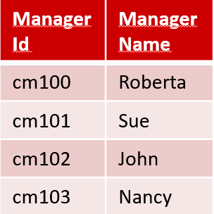
Normalizing to 3NF
CAMPAIGN_TYPE
From 75 cells to 78. Mmmm… should we do this? (Hint: yes! Still better than 90)
TypeId | Media | Range
1 | TV | Local
2 | TV | National
3 | Social | Local
5 | Web | Local
4 | Social | National
6 | Web | National
In
Third nf
BUDGET_ALLOCATION
AdCampaignId (FK) | TypeId (FK) | BudgetPctg
111 | 1 | 50%
111 | 2 | 50%
222 | 1 | 60%
222 | 3 | 30%
222 | 5 | 10%
333 | 3 | 80%
333 | 4 | 20%
444 | 6 | 100%
555 | 3 | 100%
AD_CAMPAIGN
MANAGER
AdCampaignId | Name | Start | Duration (days) | ManagerId | ManagerName
111 | SummerFun | 6/6/22 | 12 | cm100 | Roberta
222 | SummerZing | 6/8/22 | 30 | cm101 | Sue
333 | FunBall | 6/9/22 | 12 | cm102 | John
444 | FallStyle | 6/9/22 | 5 | cm103 | Nancy
555 | FallColors | 6/9/22 | 3 | cm100 | Roberta
(FK)
(PK)

Slide 28

Is this (3NF) good design?
Smaller DB
No anomalies = fewer errors

Slide 29
No more insertion anomalies
BUDGET_ALLOCATION
In
Third nf
AD_CAMPAIGN
AdCampaignId (FK) | TypeId (FK) | BudgetPctg
111 | 1 | 50%
111 | 2 | 50%
222 | 1 | 60%
222 | 3 | 30%
222 | 5 | 10%
333 | 3 | 80%
333 | 4 | 20%
444 | 6 | 100%
555 | 3 | 100%
AdCampaignId | Name | Start | Duration (days) | ManagerId (FK)
111 | SummerFun | 6/6/22 | 12 | cm100
222 | SummerZing | 6/8/22 | 30 | cm101
333 | FunBall | 6/9/22 | 12 | cm102
444 | FallStyle | 6/9/22 | 5 | cm103
555 | FallColors | 6/9/22 | 3 | cm100
CAMPAIGN_TYPE
TypeId | Media | Range
1 | TV | Local
2 | TV | National
3 | Social | Local
5 | Web | Local
4 | Social | National
6 | Web | National
7 | Influencer | National
MANAGER
What happens if we create a new campaign Type (7, Influencer, National) which has not been used yet, but we want to store it?

Slide 30
No more deletion anomalies
BUDGET_ALLOCATION
In
Third nf
AD_CAMPAIGN
AdCampaignId (FK) | TypeId (FK) | BudgetPctg
111 | 1 | 50%
111 | 2 | 50%
222 | 1 | 60%
222 | 3 | 30%
222 | 5 | 10%
333 | 3 | 80%
333 | 4 | 20%
444 | 6 | 100%
555 | 3 | 100%
AdCampaignId | Name | Start | Duration (days) | ManagerId (FK)
111 | SummerFun | 6/6/22 | 12 | cm100
222 | SummerZing | 6/8/22 | 30 | cm101
333 | FunBall | 6/9/22 | 12 | cm102
444 | FallStyle | 6/9/22 | 5 | cm103
555 | FallColors | 6/9/22 | 3 | cm100
CAMPAIGN_TYPE
TypeId | Media | Range
1 | TV | Local
2 | TV | National
3 | Social | Local
5 | Web | Local
4 | Social | National
6 | Web | National
MANAGER
What happens if we delete Campaign 444?

Slide 31
No more update anomalies
BUDGET_ALLOCATION
In
Third nf
AD_CAMPAIGN
AdCampaignId (FK) | TypeId (FK) | BudgetPctg (FK)
111 | 1 | 50%
111 | 2 | 50%
222 | 1 | 60%
222 | 3 | 30%
222 | 5 | 10%
333 | 3 | 80%
333 | 4 | 20%
444 | 6 | 100%
555 | 3 | 100%
AdCampaignId | Name | Start | Duration (days) | ManagerId (FK)
111 | SummerFun | 6/6/22 | 12 | cm100
222 | SummerZing | 6/8/22 | 30 | cm101
333 | FunBall | 6/9/22 | 12 | cm102
444 | FallStyle | 6/9/22 | 5 | cm103
555 | FallColors | 6/9/22 | 3 | cm100
CAMPAIGN_TYPE
45
TypeId | Media | Range
1 | TV | Local
2 | TV | National
3 | Social | Local
5 | Web | Local
4 | Social | National
6 | Web | National
MANAGER
What happens if we want to change the duration of ‘Summer Zing’ to 45 days?

Slide 32
Takeaways….
Good DB design is important because poorly designed databases have data duplications and may lead to mistakes called ‘data anomalies’.
Normalization is a method to improve DB design
Five NFs, only the first three are commonly used in business practice.

Slide 33
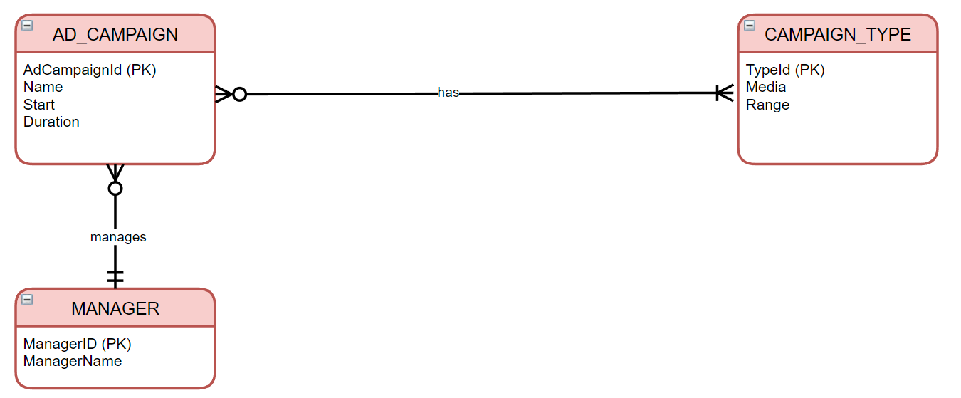
Problems could have been avoided by doing good modeling since the beginning…
Many to many

Slide 34
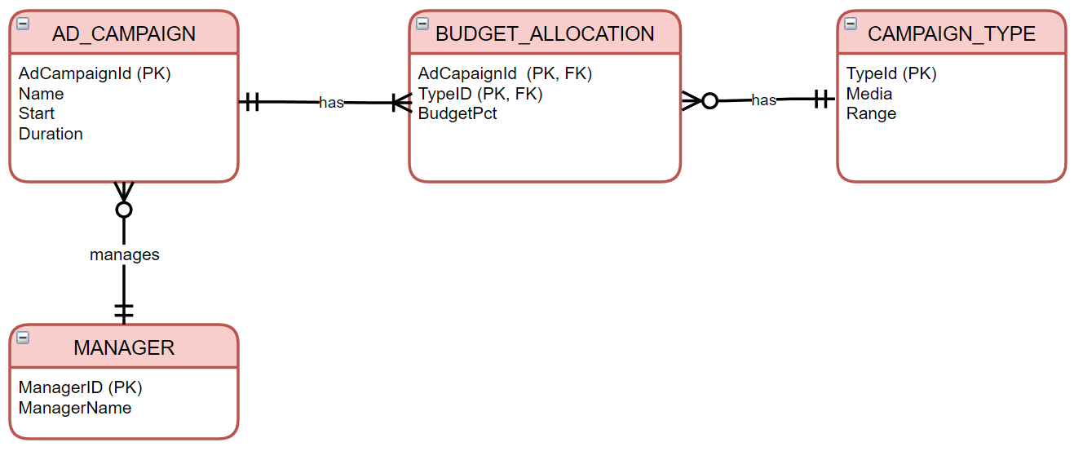
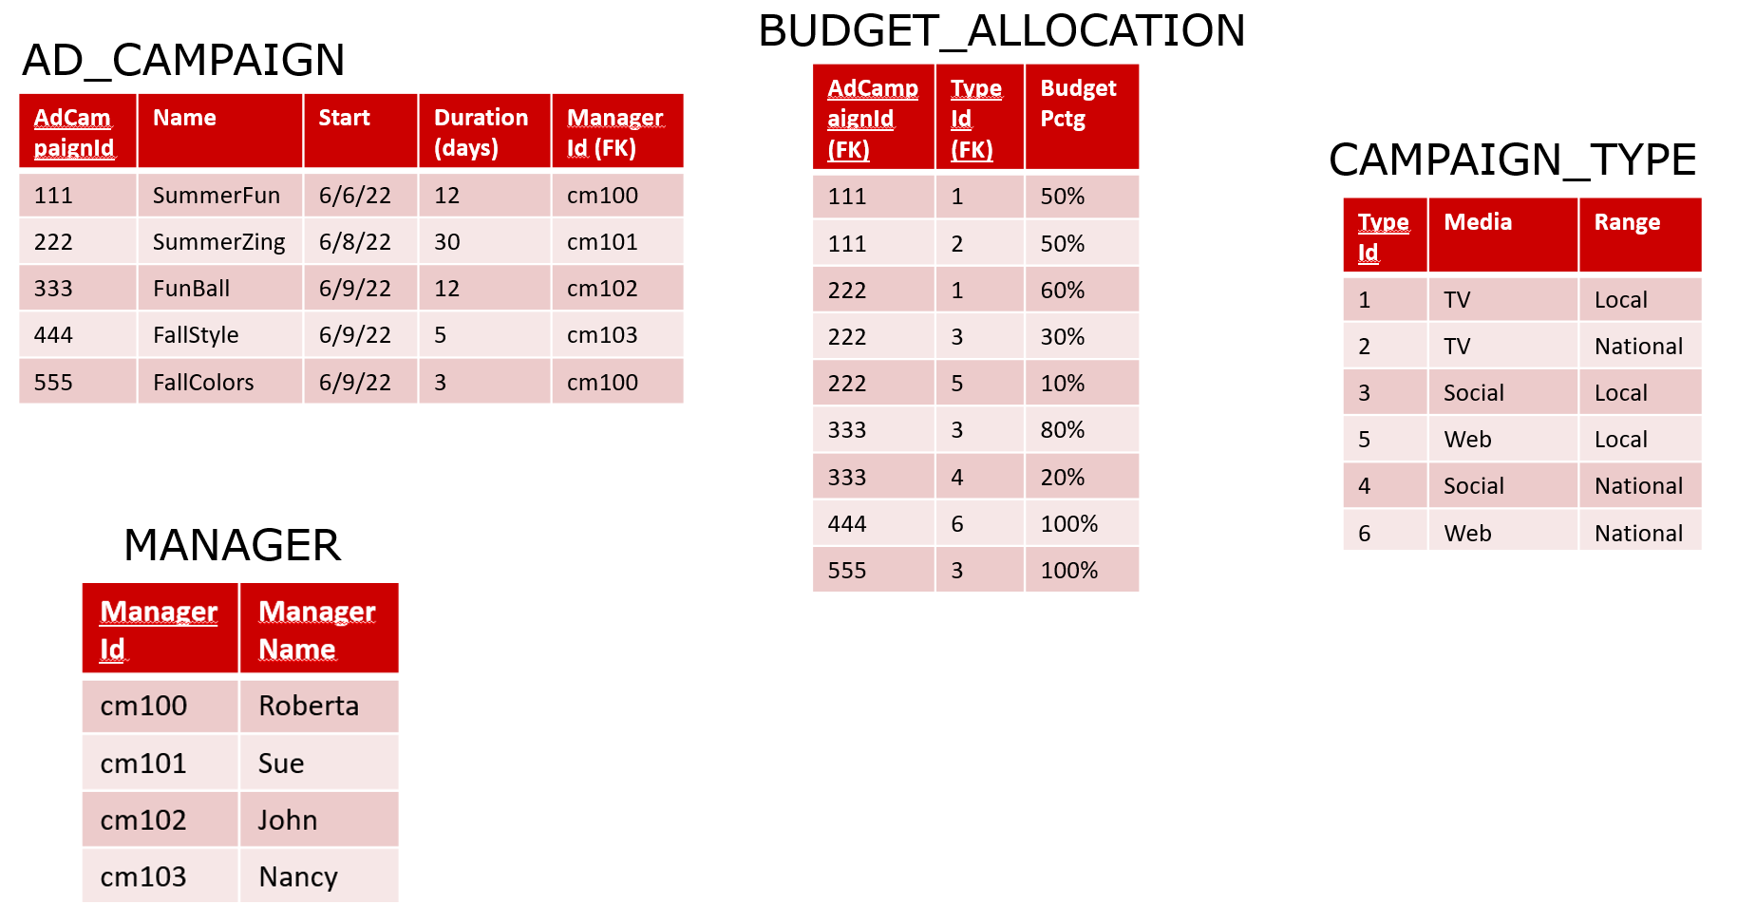
Problems could have been avoided by doing good modeling since the beginning…
In
Third nf

