Slide 1
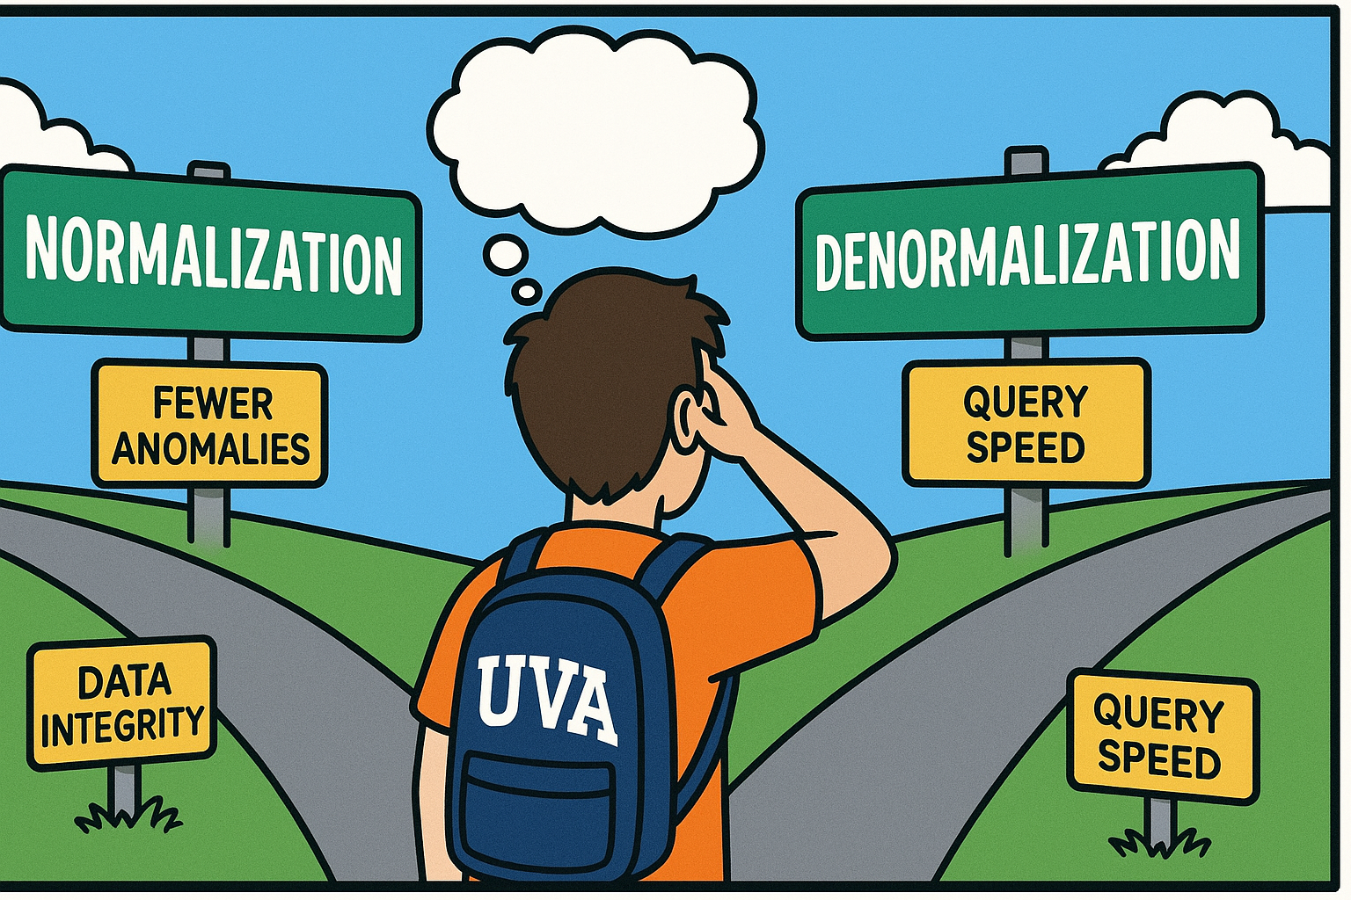
Good DB designs
Good thing I took COMM 3220…
Denormalization

Slide 2
Critical Thinking
MP4 went well – mean 91.8

Slide 3
Orange words
What is normalization?
Insertion anomaly?
Deletion anomaly?
Update anomaly?
Candidate key?

Slide 4
You do the talking
Name, major…
Comfort with technology?
Things you like about the class
Things that can be improved

Slide 5

Normalization & Denormalization at the Pressley Ad Agency
MP6 (inspired by the Jukic et al. book)

Slide 6
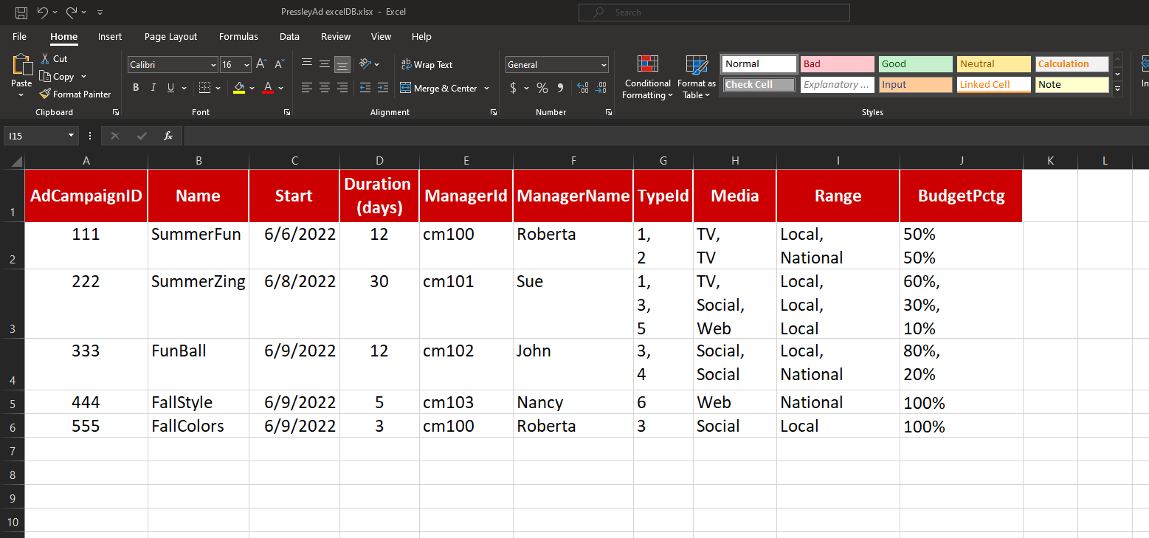
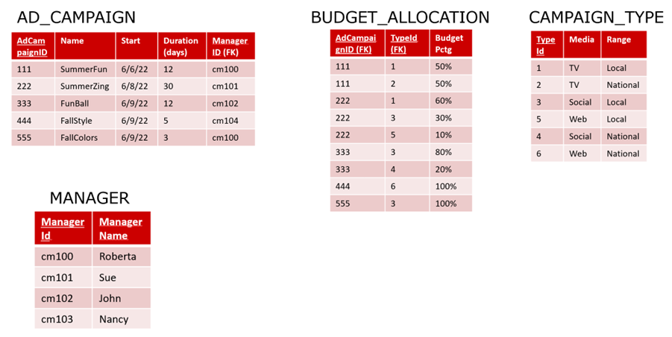
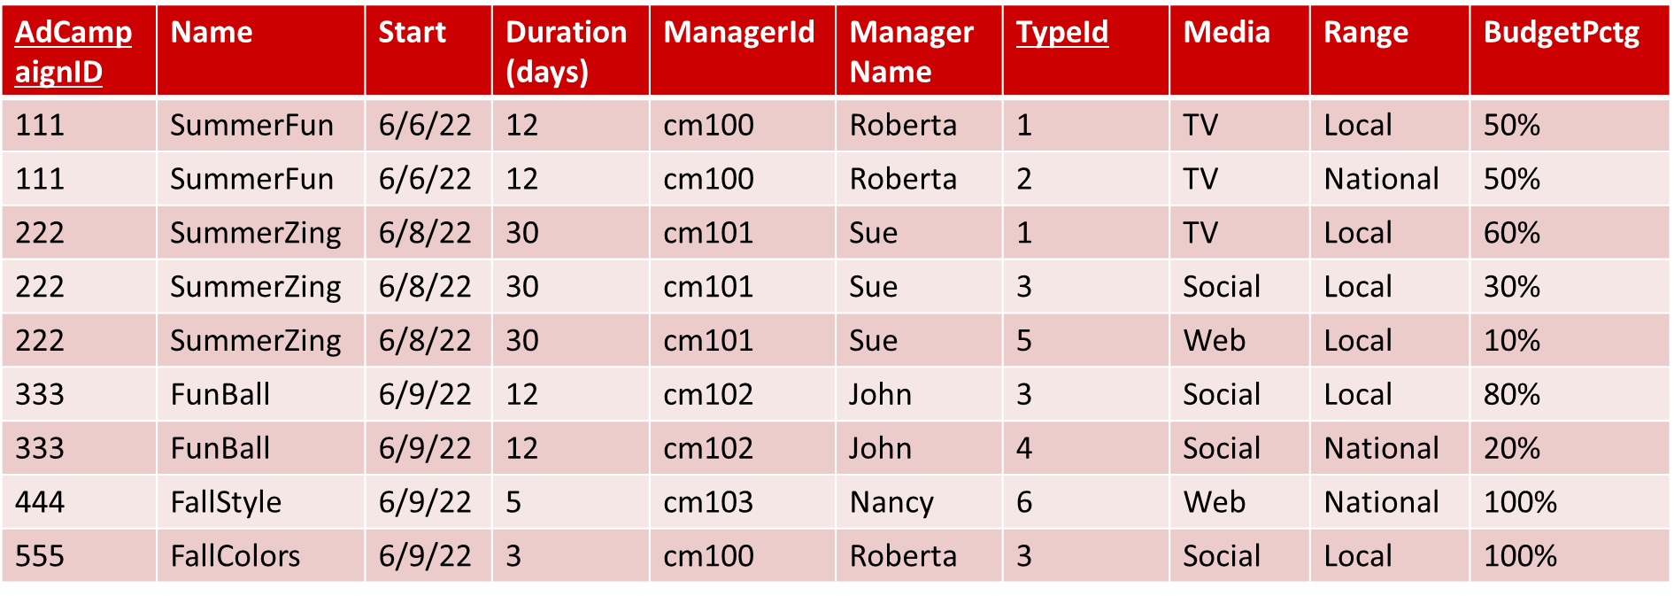
From last time…normalization
1. Started with Excel
3. Had to work hard (normalization) to fix it
2. Built the Big_Table (BAD!)
Success?
Not quite….

Slide 7

After the firing of the consultant and the development of a normalized database, Pressly managers and analysts were not happy with the new DB…
I hate foreign keys!
I cannot find my data!
Too many tables!
Where is my Excel?
Joins are the enemy of the people!
SQL is too complicated!
…and this is when they called YOU

Slide 8

Welcome to Pressly! I am so glad that you joined us. The last consultant we hired was a DISASTER! I told HR to hire from UVA, but no! They wanted to save money and hired somebody from some other college…. BIG MISTAKE! The DB she built was just a dump of the Excel spreadsheet we used to track campaigns. Nothing worked the way it was supposed to. What a waste of money!
I see… just copying an Excel spreadsheet into a DB is not a good practice.
I would use stronger words than ‘not a good practice’. Well… I want you to fix it.
I can do that.
BUT I also want to preserve the old spreadsheet look. Too many employees are confused by how DBs work. Multiple tables, keys, joins… that’s complicated stuff! The managers want to see their data in the old format, as a single table of information.
Ah! They want a personalized VIEW!
I am on it, Boss!

Slide 9
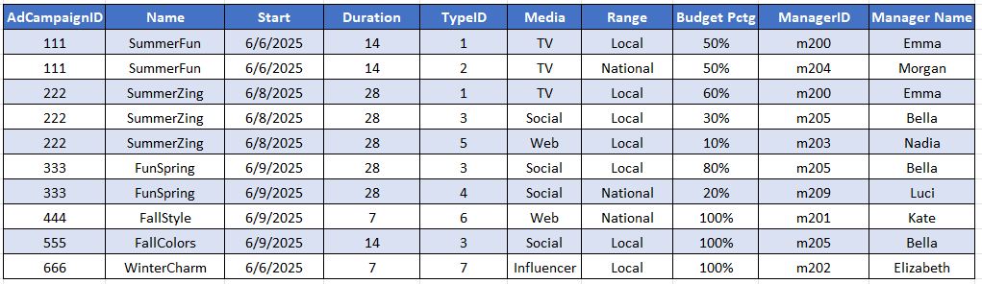
MP6 – work to do
Start with this
and normalize it
Build the
normalized tables in COMM 3220DB
Build a denormalized VIEW that reproduces the original table.

Slide 10
WINIT
What is new in IT

Slide 11


Data management
TABLE
RECORD
Create
Alter
Drop
Insert
Delete
Update
DEMO
This is a clickable link

Slide 12
Examples DB table creation
DROP TABLE IF EXISTS xyx8b.LOAN;
DROP TABLE IF EXISTS xyx8b.CUSTOMER_IN_LOAN;
CREATE TABLE xyx8b.LOAN (
l_id integer primary key not null,
principal money,
rate decimal(8,5) DEFAULT 0.015,
date_due datetime,
purpose varchar(20),
lo_id integer,
foreign key (lo_id) references xyx8b.LOAN_OFFICER(lo_id));
CREATE TABLE xyx8b.CUSTOMER_IN_LOAN (
c_id char(5),
l_id integer,
primary key (l_id, c_id),
foreign key (l_id) references xyx8b.LOAN(l_id),
foreign key (c_id) references xyx8b.CUSTOMER(c_id));
INSERT INTO xyx8b.LOAN VALUES (1144, 53481.79, 7, '20-Jul-2025','Home', 4);
INSERT INTO xyx8b.CUSTOMER_IN_LOAN VALUES ('c057', 1001);
Critical: ALWAYS use your userId as part of the table name. We are all in the same DB and we cannot all use just LOAN…
COMMON DATA TYPES IN THE SQL SERVER
integer = integer
decimal(X,Y) = decimal with max total X digits, and Y digits after the decimal point
Varchar(X) = text of variable length up to X
characters
Money
Datetime = yyyy-mm-dd hh:mm:ss.000
Bit = true/false
Composite PK
Critical: the order of the data must be the same as the order of the columns in the table

Slide 13
What is a DB ‘view’?
A view is the result of a stored query. It looks like a table, but it is not stored in the DB as a table. It is stored as a query (for efficiency).
Users experience it as a regular select-only table, which simplifies the use of the DB.
Also privacy and security of data.

Slide 14
Example DB view
When selected, this view shows the top three customers at the bank.
CREATE VIEW xyx8b.Top_Three_Loan_Officers AS
SELECT TOP 3 f_name, l_name, lo.lo_id
FROM LOAN_OFFICER lo, LOAN l
WHERE lo.lo_id = l.lo_id
GROUP BY f_name, l_name, lo.lo_id
ORDER BY sum(principal) desc
SELECT * from xyx8b.Top_Three_Loan_Officers
DROP VIEW xyx8b.Top_Three_Loan_Officers
This is the command to create the view. Critical: ALWAYS use your userId as part of the view name. We are all in the same DB and we cannot duplicate names.
This is the query that is executed every time the view is invoked
This visualizes the data
This deletes the view

Slide 15
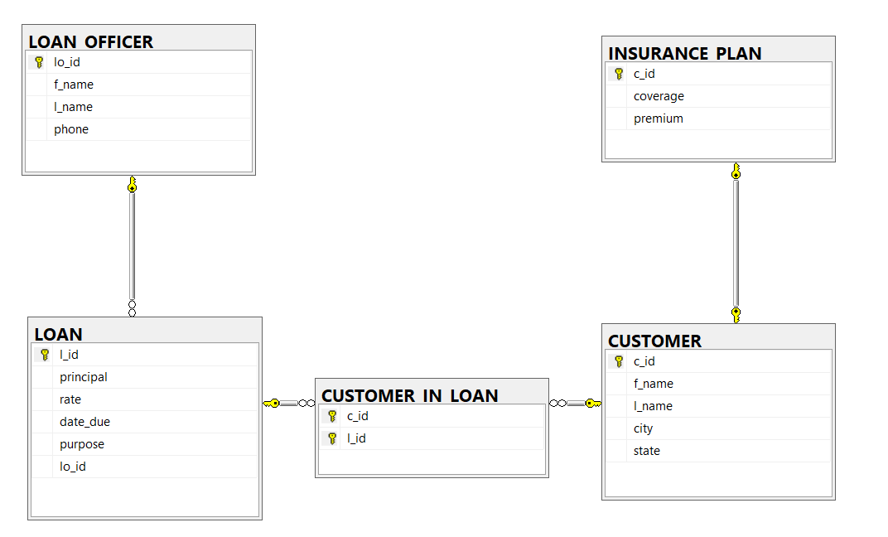
Tables on the SQL Server

Slide 16
Insert, update and delete
-- These are examples: do not run them. Xyz9 is not a real userid. Check the W^3 site or my intro to SQL
INSERT INTO xyz9.Customer VALUES ('c006','Alainah','Spratt','Richmond','VA’)
-- Inserting the same record twice will result in an error. You cannot enter twice the same PK.
update xyz9.CUSTOMER
set city = 'Charlottesville'
where c_id = 'c999'
-- without the ‘where’, ALL records are changed. There is no undo. Hopefully, you are backed up…
Delete from xyz9.CUSTOMER
where c_id = 'c999'
-- again, without the ‘where’ ALL records will be deleted. There is no undo. Hopefully, you are backed up…

