Slide 1
Business Intelligence
The second ‘DM’ in ‘DM4DM’
Part II of the course

Slide 2
Critical thinking
Hand in MP5
Questions on MP6 (Pressly)?
Pressly is due next Tue (more time)
Starting the second part of the course: Business Intelligence

Slide 3
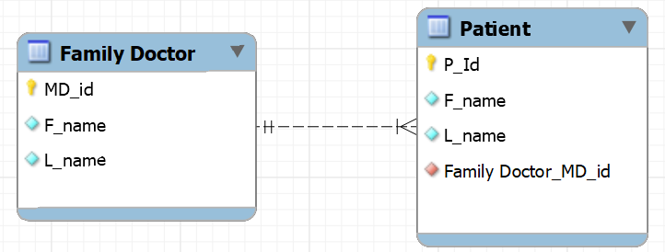
Creating and deleting tables with FKs
TABLE CREATION
Must create Doctor first – why?
TABLE DELETION
Must delete Patient first – why?

Slide 4
You do the talking
Name, major…
Most challenging aspect of MP4/5?
Things you like about the class
Things that can be improved

Slide 5
Orange words
View
Denormalization

Slide 6

Business Intelligence in one slide
BI Objective:
To support decision making by
transforming raw data into
actionable insights.
Data Modeling:
Understanding the meaning of the data and organizing them for use
Data Collection:
Gathering data from various sources like operational DBs, financial/accounting systems, and external platforms.
BI Definition:
BI is the overall processes and tools that organizations use to collect, analyze, and present business data to make informed decisions.
Data Analysis:
BI focuses on description and diagnosis
I am taking a class on Business Analytics… what is the difference?
Reporting & Visualization: Presenting findings through dashboards, charts, and reports.

Slide 7
Business Intelligence vs Analytics
Business intelligence:
focuses on description and diagnosis
Business Analytics
focuses on
prediction and prescription

Slide 8

Transactions,BI,or BA?
BI: description
and diagnosis
BA: prediction
and prescription
A retail chain’s regional managers check a weekly dashboard of sales, inventory turnover, and shrinkage by store.
A hospital’s CFO drills down from a spike in quarterly costs to find that it came mainly from overtime in two surgical units.
A customer transfers $500 from checking to savings through a mobile banking app.
An airline adjusts seat prices continuously based on remaining capacity, booking pace, competitor fares, and days until departure.
A telecom company scores each subscriber monthly on their likelihood of canceling in the next 90 days and routes high-risk customers to a retention team.
A student registers for three courses. The registration system checks seat availability, then confirms enrollment.
A bank’s compliance team receives a standard monthly report listing all transactions above regulatory reporting thresholds.

Slide 9
Transactions,BI,or BA?
BI: description
and diagnosis
BA: prediction
and prescription
A consumer goods firm uses historical sales, promotions, weather, and holidays to forecast demand by SKU for the next 12 weeks.
A customer buys groceries at a self-checkout. The point-of-sale system records the sale, decrements inventory, and processes the card payment.
A logistics company computes the delivery routes that minimize fuel and labor cost, subject to time windows and truck capacity.
A university’s admissions office compares this year’s application volumes with the previous five years, broken down by program and geography.
A credit card issuer flags each transaction in real time with a probability that it is fraudulent.
An airline agent rebooks a passenger onto a later flight after a cancellation and issues a new boarding pass.
A software company’s executives review a scorecard showing actual quarterly ARR, churn, and customer acquisition cost against targets.

Slide 10
TP, BI, or BA?
Start with the question.
Your question decides how the data should be organized and which tools to use.

Slide 11
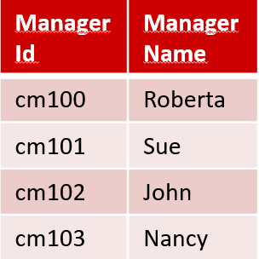
Which DB is better/faster?
Normalized vs. Denormalized data
Ad Campaign ID | Type Id | Budget in millions
111 | 1 | $ 5
111 | 2 | $ 5
222 | 1 | $ 6
222 | 3 | $ 3
222 | 5 | $ 10
333 | 3 | $ 8
333 | 4 | $ 2
444 | 6 | $ 10
555 | 3 | $ 10
AdCampaign ID | Name | Start | Duration (days) | ManagerId | Manager Name | TypeId | Media | Range | Budget in millions
111 | SummerFun | 6/6/22 | 12 | cm100 | Roberta | 1 | TV | Local | $ 5
111 | SummerFun | 6/6/22 | 12 | cm100 | Roberta | 2 | TV | National | $ 5
222 | SummerZing | 6/8/22 | 30 | cm101 | Sue | 1 | TV | Local | $ 6
222 | SummerZing | 6/8/22 | 30 | cm101 | Sue | 3 | Social | Local | $ 3
222 | SummerZing | 6/8/22 | 30 | cm101 | Sue | 5 | Web | Local | $ 1
333 | FunBall | 6/9/22 | 12 | cm102 | John | 3 | Social | Local | $ 8
333 | FunBall | 6/9/22 | 12 | cm102 | John | 4 | Social | National | $ 2
444 | FallStyle | 6/9/22 | 5 | cm103 | Nancy | 6 | Web | National | $ 10
555 | FallColors | 6/9/22 | 3 | cm100 | Roberta | 3 | Social | Local | $ 10
TypeId | Media | Range
1 | TV | Local
2 | TV | National
3 | Social | Local
5 | Web | Local
4 | Social | National
6 | Web | National
AdCampaignID | Name | Start | Duration (days) | ManagerID (FK)
111 | SummerFun | 6/6/22 | 12 | cm100
222 | SummerZing | 6/8/22 | 30 | cm101
333 | FunBall | 6/9/22 | 12 | cm102
444 | FallStyle | 6/9/22 | 5 | cm103
555 | FallColors | 6/9/22 | 3 | cm100
Change ‘SummerZing’ into ‘SummerFlash’

Slide 12
Which DB is better/faster?
Normalized vs. Denormalized data
Ad Campaign ID | Type Id | Budget in millions
111 | 1 | $ 5
111 | 2 | $ 5
222 | 1 | $ 6
222 | 3 | $ 3
222 | 5 | $ 10
333 | 3 | $ 8
333 | 4 | $ 2
444 | 6 | $ 10
555 | 3 | $ 10
AdCampaign ID | Name | Start | Duration (days) | ManagerId | Manager Name | TypeId | Media | Range | Budget in millions
111 | SummerFun | 6/6/22 | 12 | cm100 | Roberta | 1 | TV | Local | $ 5
111 | SummerFun | 6/6/22 | 12 | cm100 | Roberta | 2 | TV | National | $ 5
222 | SummerZing | 6/8/22 | 30 | cm101 | Sue | 1 | TV | Local | $ 6
222 | SummerZing | 6/8/22 | 30 | cm101 | Sue | 3 | Social | Local | $ 3
222 | SummerZing | 6/8/22 | 30 | cm101 | Sue | 5 | Web | Local | $ 1
333 | FunBall | 6/9/22 | 12 | cm102 | John | 3 | Social | Local | $ 8
333 | FunBall | 6/9/22 | 12 | cm102 | John | 4 | Social | National | $ 2
444 | FallStyle | 6/9/22 | 5 | cm103 | Nancy | 6 | Web | National | $ 10
555 | FallColors | 6/9/22 | 3 | cm100 | Roberta | 3 | Social | Local | $ 10
TypeId | Media | Range
1 | TV | Local
2 | TV | National
3 | Social | Local
5 | Web | Local
4 | Social | National
6 | Web | National
AdCampaignID | Name | Start | Duration (days) | ManagerID (FK)
111 | SummerFun | 6/6/22 | 12 | cm100
222 | SummerZing | 6/8/22 | 30 | cm101
333 | FunBall | 6/9/22 | 12 | cm102
444 | FallStyle | 6/9/22 | 5 | cm103
555 | FallColors | 6/9/22 | 3 | cm100
What is Roberta total budget?

Slide 13
Which DB is better/faster?
Normalized vs. Denormalized data
Ad Campaign ID | Type Id | Budget in millions
111 | 1 | $ 5
111 | 2 | $ 5
222 | 1 | $ 6
222 | 3 | $ 3
222 | 5 | $ 10
333 | 3 | $ 8
333 | 4 | $ 2
444 | 6 | $ 10
555 | 3 | $ 10
AdCampaign ID | Name | Start | Duration (days) | ManagerId | Manager Name | TypeId | Media | Range | Budget in millions
111 | SummerFun | 6/6/22 | 12 | cm100 | Roberta | 1 | TV | Local | $ 5
111 | SummerFun | 6/6/22 | 12 | cm100 | Roberta | 2 | TV | National | $ 5
222 | SummerZing | 6/8/22 | 30 | cm101 | Sue | 1 | TV | Local | $ 6
222 | SummerZing | 6/8/22 | 30 | cm101 | Sue | 3 | Social | Local | $ 3
222 | SummerZing | 6/8/22 | 30 | cm101 | Sue | 5 | Web | Local | $ 1
333 | FunBall | 6/9/22 | 12 | cm102 | John | 3 | Social | Local | $ 8
333 | FunBall | 6/9/22 | 12 | cm102 | John | 4 | Social | National | $ 2
444 | FallStyle | 6/9/22 | 5 | cm103 | Nancy | 6 | Web | National | $ 10
555 | FallColors | 6/9/22 | 3 | cm100 | Roberta | 3 | Social | Local | $ 10
TypeId | Media | Range
1 | TV | Local
2 | TV | National
3 | Social | Local
5 | Web | Local
4 | Social | National
6 | Web | National
AdCampaignID | Name | Start | Duration (days) | ManagerID (FK)
111 | SummerFun | 6/6/22 | 12 | cm100
222 | SummerZing | 6/8/22 | 30 | cm101
333 | FunBall | 6/9/22 | 12 | cm102
444 | FallStyle | 6/9/22 | 5 | cm103
555 | FallColors | 6/9/22 | 3 | cm100
Assign John to ‘SummerZing’

Slide 14
Which DB is better/faster?
Normalized vs. Denormalized data
Ad Campaign ID | Type Id | Budget in millions
111 | 1 | $ 5
111 | 2 | $ 5
222 | 1 | $ 6
222 | 3 | $ 3
222 | 5 | $ 10
333 | 3 | $ 8
333 | 4 | $ 2
444 | 6 | $ 10
555 | 3 | $ 10
AdCampaign ID | Name | Start | Duration (days) | ManagerId | Manager Name | TypeId | Media | Range | Budget in millions
111 | SummerFun | 6/6/22 | 12 | cm100 | Roberta | 1 | TV | Local | $ 5
111 | SummerFun | 6/6/22 | 12 | cm100 | Roberta | 2 | TV | National | $ 5
222 | SummerZing | 6/8/22 | 30 | cm101 | Sue | 1 | TV | Local | $ 6
222 | SummerZing | 6/8/22 | 30 | cm101 | Sue | 3 | Social | Local | $ 3
222 | SummerZing | 6/8/22 | 30 | cm101 | Sue | 5 | Web | Local | $ 1
333 | FunBall | 6/9/22 | 12 | cm102 | John | 3 | Social | Local | $ 8
333 | FunBall | 6/9/22 | 12 | cm102 | John | 4 | Social | National | $ 2
444 | FallStyle | 6/9/22 | 5 | cm103 | Nancy | 6 | Web | National | $ 10
555 | FallColors | 6/9/22 | 3 | cm100 | Roberta | 3 | Social | Local | $ 10
TypeId | Media | Range
1 | TV | Local
2 | TV | National
3 | Social | Local
5 | Web | Local
4 | Social | National
6 | Web | National
AdCampaignID | Name | Start | Duration (days) | ManagerID (FK)
111 | SummerFun | 6/6/22 | 12 | cm100
222 | SummerZing | 6/8/22 | 30 | cm101
333 | FunBall | 6/9/22 | 12 | cm102
444 | FallStyle | 6/9/22 | 5 | cm103
555 | FallColors | 6/9/22 | 3 | cm100
Create a new campaign type 7, Influencer, National

Slide 15
Which DB is better/faster?
Normalized vs. Denormalized data
Ad Campaign ID | Type Id | Budget in millions
111 | 1 | $ 5
111 | 2 | $ 5
222 | 1 | $ 6
222 | 3 | $ 3
222 | 5 | $ 10
333 | 3 | $ 8
333 | 4 | $ 2
444 | 6 | $ 10
555 | 3 | $ 10
AdCampaign ID | Name | Start | Duration (days) | ManagerId | Manager Name | TypeId | Media | Range | Budget in millions
111 | SummerFun | 6/6/22 | 12 | cm100 | Roberta | 1 | TV | Local | $ 5
111 | SummerFun | 6/6/22 | 12 | cm100 | Roberta | 2 | TV | National | $ 5
222 | SummerZing | 6/8/22 | 30 | cm101 | Sue | 1 | TV | Local | $ 6
222 | SummerZing | 6/8/22 | 30 | cm101 | Sue | 3 | Social | Local | $ 3
222 | SummerZing | 6/8/22 | 30 | cm101 | Sue | 5 | Web | Local | $ 1
333 | FunBall | 6/9/22 | 12 | cm102 | John | 3 | Social | Local | $ 8
333 | FunBall | 6/9/22 | 12 | cm102 | John | 4 | Social | National | $ 2
444 | FallStyle | 6/9/22 | 5 | cm103 | Nancy | 6 | Web | National | $ 10
555 | FallColors | 6/9/22 | 3 | cm100 | Roberta | 3 | Social | Local | $ 10
TypeId | Media | Range
1 | TV | Local
2 | TV | National
3 | Social | Local
5 | Web | Local
4 | Social | National
6 | Web | National
AdCampaignID | Name | Start | Duration (days) | ManagerID (FK)
111 | SummerFun | 6/6/22 | 12 | cm100
222 | SummerZing | 6/8/22 | 30 | cm101
333 | FunBall | 6/9/22 | 12 | cm102
444 | FallStyle | 6/9/22 | 5 | cm103
555 | FallColors | 6/9/22 | 3 | cm100
What is the total budget for national campaigns?

Slide 16
What have we learned?
Question | Type | Best way to store the data
Change ‘SummerZing’ to ‘SummerFlash’ | TP | Normalized
Roberta’s total budget? | BI | Denormalized
Assign John to ‘SummerZing’ | TP | Normalized
Create a new Campaign Type | TP | Normalized
Total Budget for National campaigns? | BI | Denormalized
The way data is organized
makes certain tasks easier
and others more difficult.
Therefore, pick the right data organization for the task you have to do.

Slide 17
What is New in IT

Slide 18
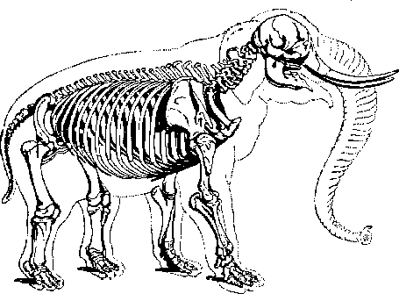
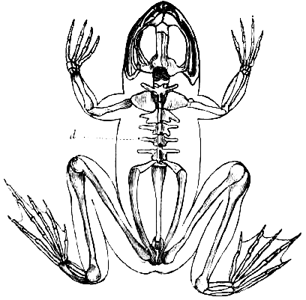
The data model is the skeleton of your database
Good for jumping,
not so good for carrying weight
Good for carrying weight,
not so good for jumping
Which is the best skeleton?

Slide 19
There is no ‘best’ DB design. The best design depends on what you need to do.
Normalized: best if you do a lot of
fast, short, single-row operations, when data quality (fewer anomalies) is very important, and you want smaller DBs.
Best for business transactions
Denormalized: easier to understand for users and best for avoiding joins that slow down your system if you have lots of data to aggregate/analyze:
Best for BI and BA

Slide 20
Denormalized relational databases are called
Data Warehouses.
Best for BA/BI tasks.
Notes:
Ralph Kimball described the DW more simply: a copy of transaction data structured specifically for query and analysis. His emphasis is on dimensional modeling and on ease of use for business users.

Slide 21

Two ways to organize your data
Normalized Denormalized
Better data quality: no insert, update & delete anomalies
Less data duplication
Faster single-table answers
Fewer joins = faster answers to complex queries
Required input to stat. software
Easier to understand for users
Notes:
If time
Local Vet invoices
Capital one future rate prediction
Mastercard pos
Met life insurance customer analysis

Slide 22
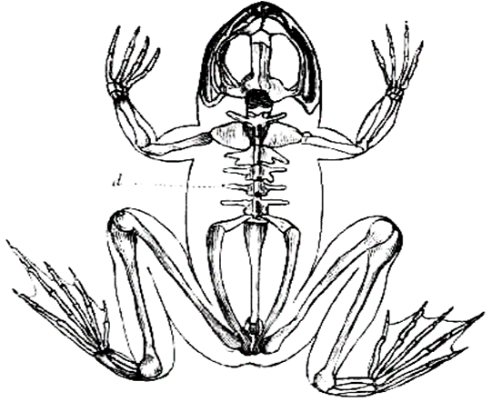
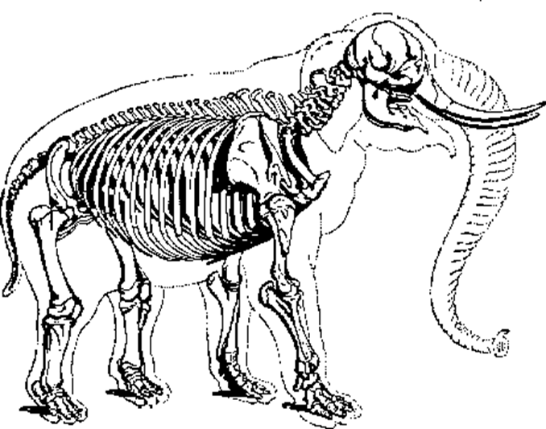
Interview question: are there different types of DBs? Why? Which one would you pick?
Likely best tool
Operations, Transactions
“Short” queries, data integrity, efficiency
Normalized Relational DBMS
Needs of the business:
OPS?BI?BA?
Business intelligence & Analytics with structured data
Data Warehouse (DW):
Intentionally Denormalized Relational DBMS
Comm 3220 so far
Business Intelligence,
Business Analytics
“Long” queries,
trade redundancy
for speed
Analytics with unstructured data
Non relational databases (‘NoSQL’, data lakes)
Data lakes and DW are merging in a new technology called Data Lakehouse

Slide 23
Often, organizations build both:
Transactional DBs for operations, then copy part of that data into Data Warehouses for BA/BI tasks.
Notes:
Ralph Kimball described the DW more simply: a copy of transaction data structured specifically for query and analysis. His emphasis is on dimensional modeling and on ease of use for business users.

Slide 24
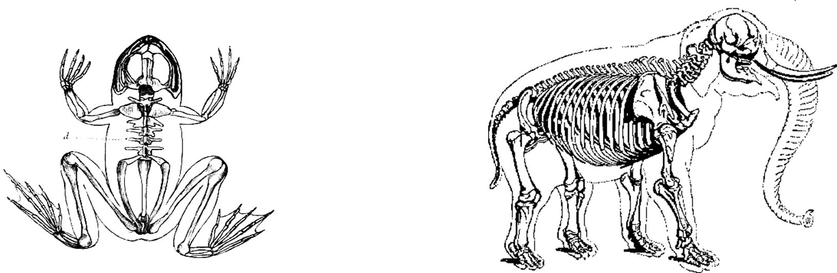
Takeaways
BI is the processes and tools that organizations use to collect, analyze, and present business data in order to make informed decisions.
It is not as simple as: “Normalized = good; Denormalized = bad”
It depends on the needs of the business.
BI and BA often require intentionally denormalized relational DBs called Data Warehouses.

