Slide 1
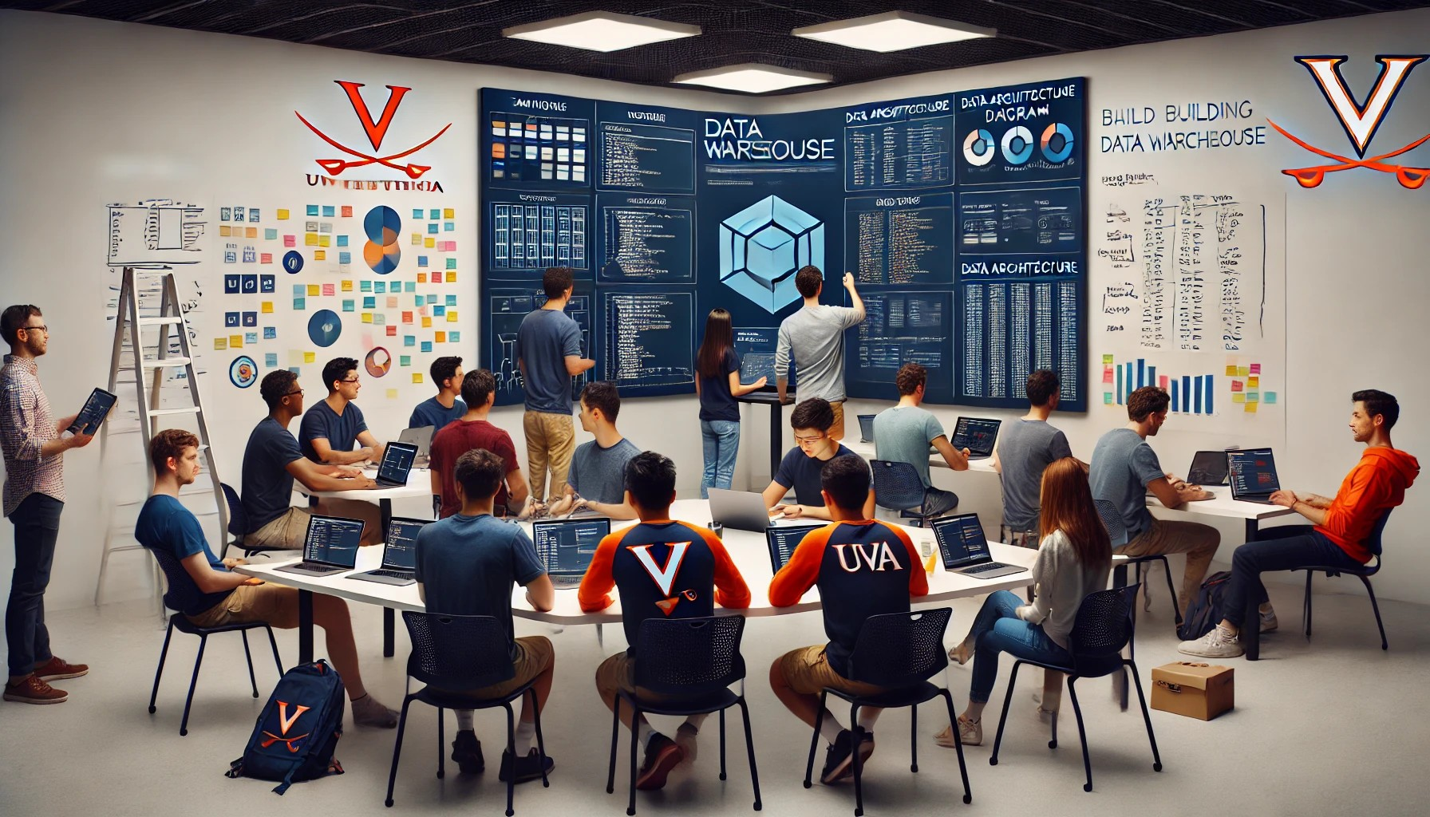


Building a DW
The ‘REI_not’ case

Slide 2
Critical Thinking
MP5 on Wed

Slide 3
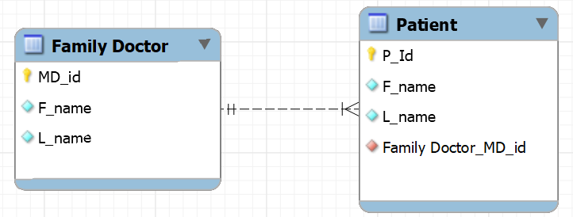
Creating and deleting tables with FKs
TABLE CREATION Must create Doctor first – why?
TABLE DELETION Must delete Patient first – why?

Slide 4
Orange words
Pro/cons of normalized DBs
Pro/cons of denormalized DBs
Which one is better?

Slide 5
You Do The Talking
Name
Concentrations, etc…
Hardes thing about MP6 (Pressly)?
Things that I like about the class
Things that can be improved

Slide 6
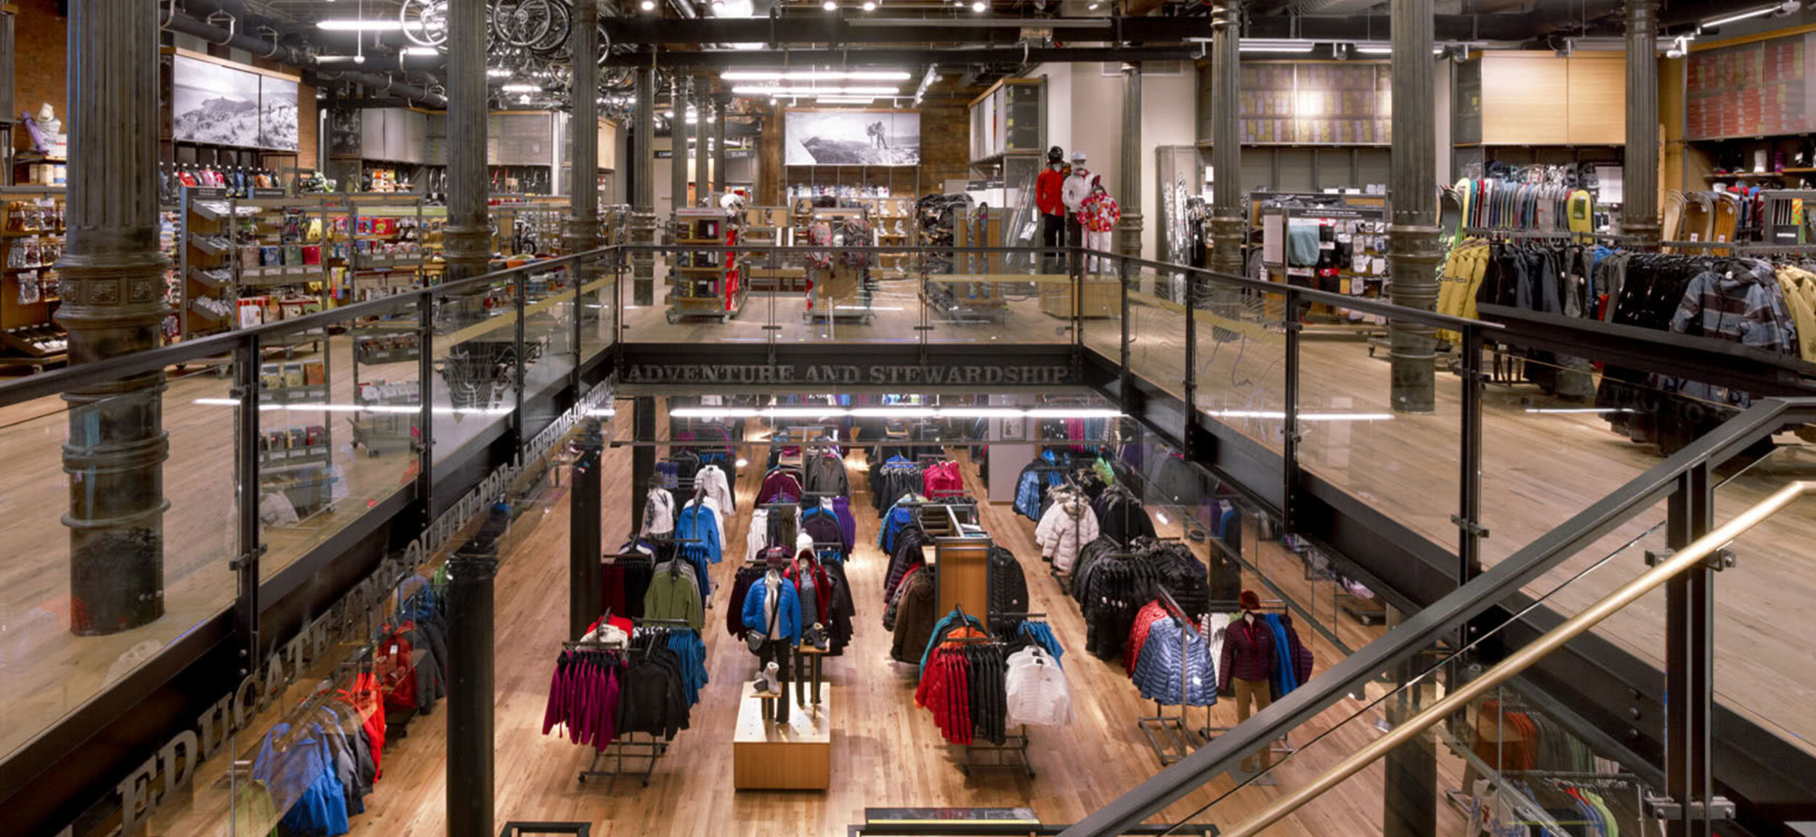

Richmond flagship store

Slide 7
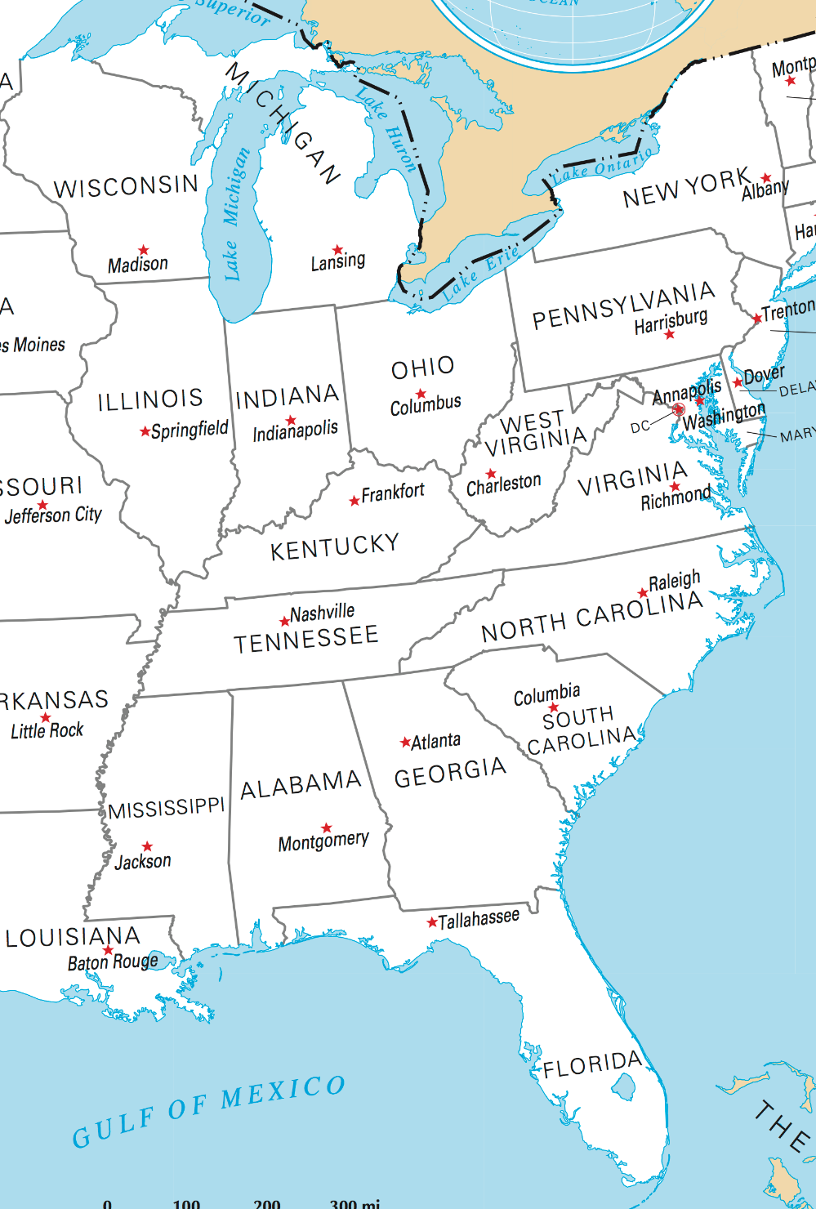

The REI_not retail company
$30mil+ camping supplies start-up
Three locations
Six main products: Tents (2), Backpacks (1), Hiking boots (2), and Hiking socks (1)

Slide 8
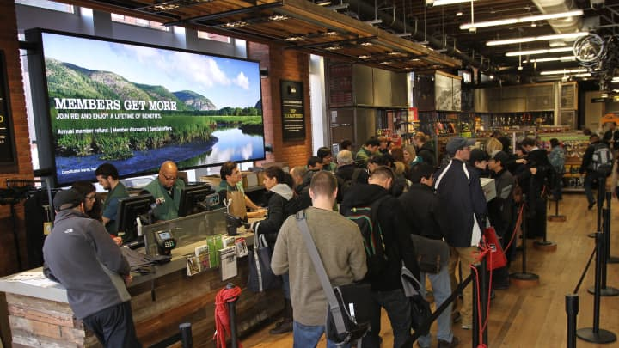
Interviews and documents led to a narrative to build a DB
“Customers buy goods at the store. We look up their membership numbers, and then record items, prices, and date.”
“Only members can buy. If a customer is not a member, we issue a free membership.”
“We constantly update our inventory levels based on sales.”
“We keep track of suppliers and products categories.

Slide 9
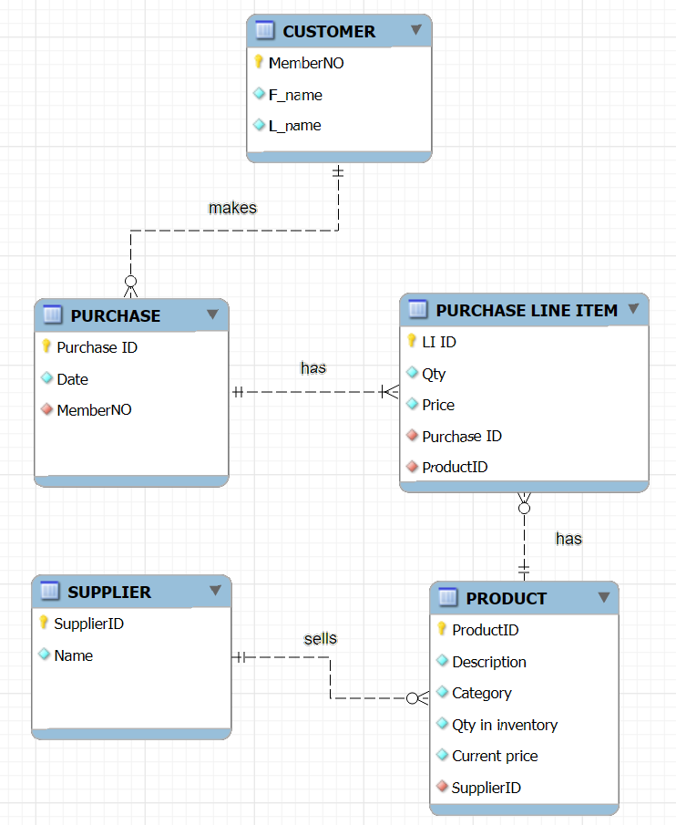

Draft design for a store DB
City: Richmond/Charleston/Atlanta
Size in Square feet
Csystem: cashier, self, hybrid
Layout: modern or traditional

Slide 10
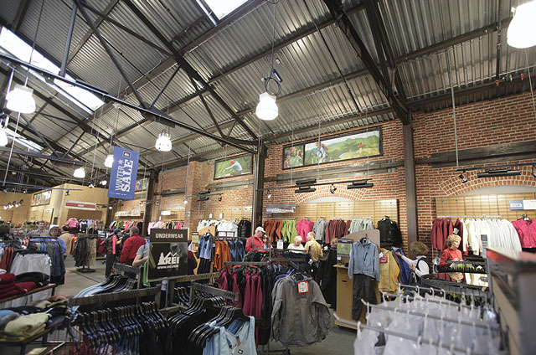

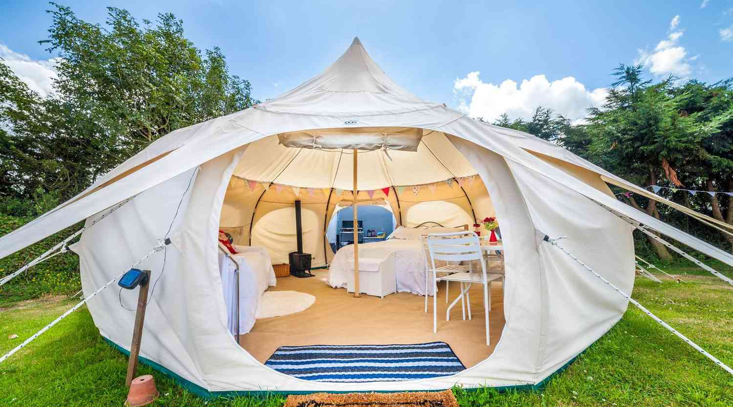
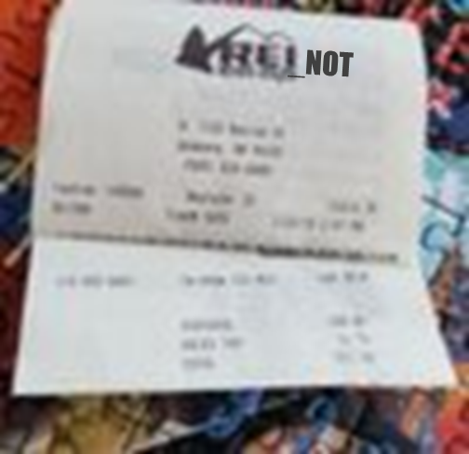
Sample operational queries
Is Stephen Strange a member?
Create a new customer
What is the price of a “Galaxy” tent?
Dr. Strange’s buys a Galaxy tent and 10 hiking socks.
Decrease inventory based on Dr. Strange’s purchase

Slide 11

BI at REI_not: Current state
The company built the Richmond DB first, and then copied it for the Atlanta and Charleston stores.
Richmond Store
Local DB
Store 1
Atlanta Store
Local DB
Store 2
Local DB
Store 3
Charleston
Store

Slide 12
WHAT IS NEW IN IT?

Slide 13
Problems at REI_not: reporting and analytics are broken
What is going on?

Slide 14


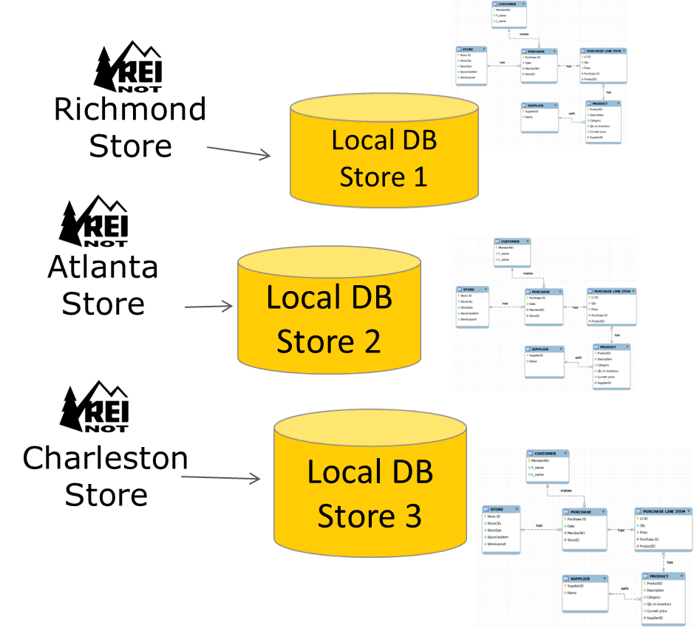
Sample questions from HQ
Revenue by store for the year?
Revenue by product in Q3?
Tent sales by store?
Revenue by store layout (traditional vs modern)
Sales by store by month

Slide 15
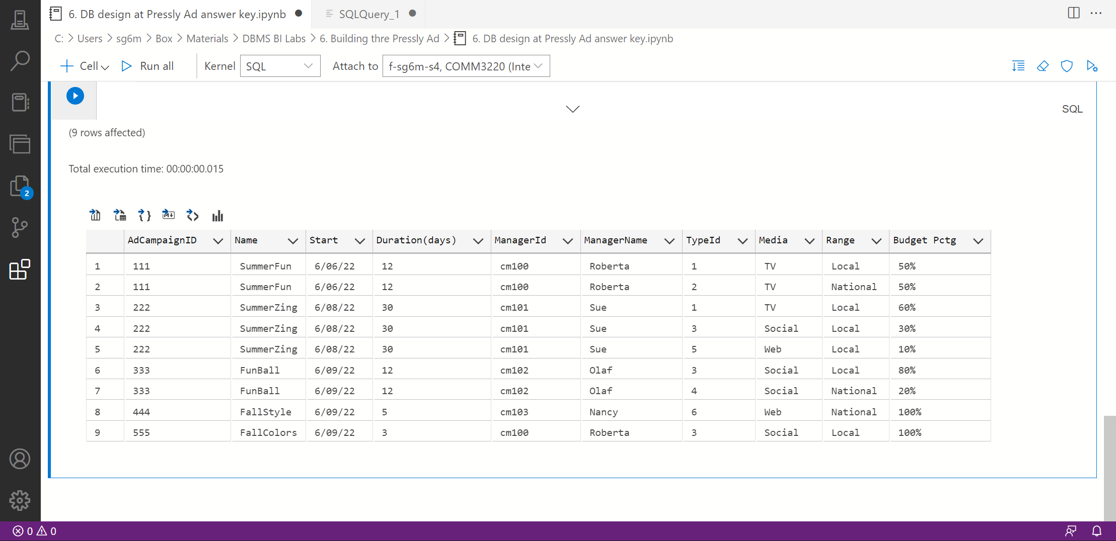

REI_not analysts use ADS to produce Excel files with single-store answers and email them to HQ
Save results as Excel

Slide 16



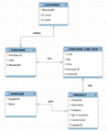
BI at REI_not: Current state
Richmond Store
Local DB
Store 1
Reports, visualizations…
Atlanta Store
Local DB
Store 2
Local DB
Store 3
Managers &
Decision makers
Charleston
Store

Slide 17
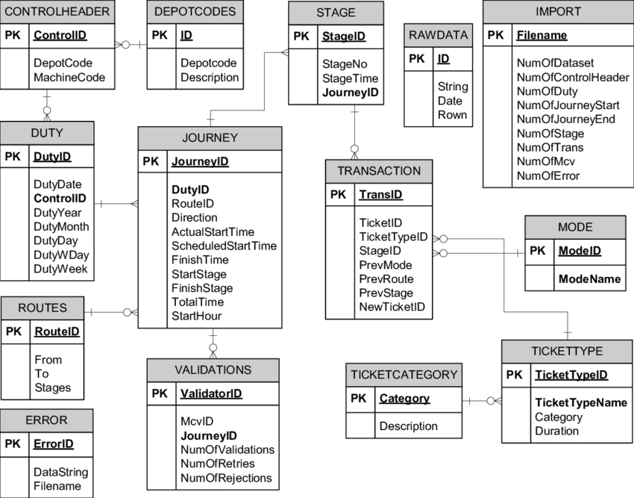

BI at REI_not: Future state (MP7)
Richmond Store
Local DB
Store 1
Data Warehouse for the whole REI_not
Reports, visualizations…
BI/Analytics technologies
ETL technologies
Atlanta Store
Extract
Transform (i.e., clean)
Load
Query
Report
Analyze
Visualize
Local DB
Store 2
Charleston
Store
Local DB
Store 3
Managers &
Decision makers
NORMALIZED, 3NF, OPERATIONS
DENORMALIZED, BUSINESS INTELLIGENCE, DECISION MAKING

