Slide 1
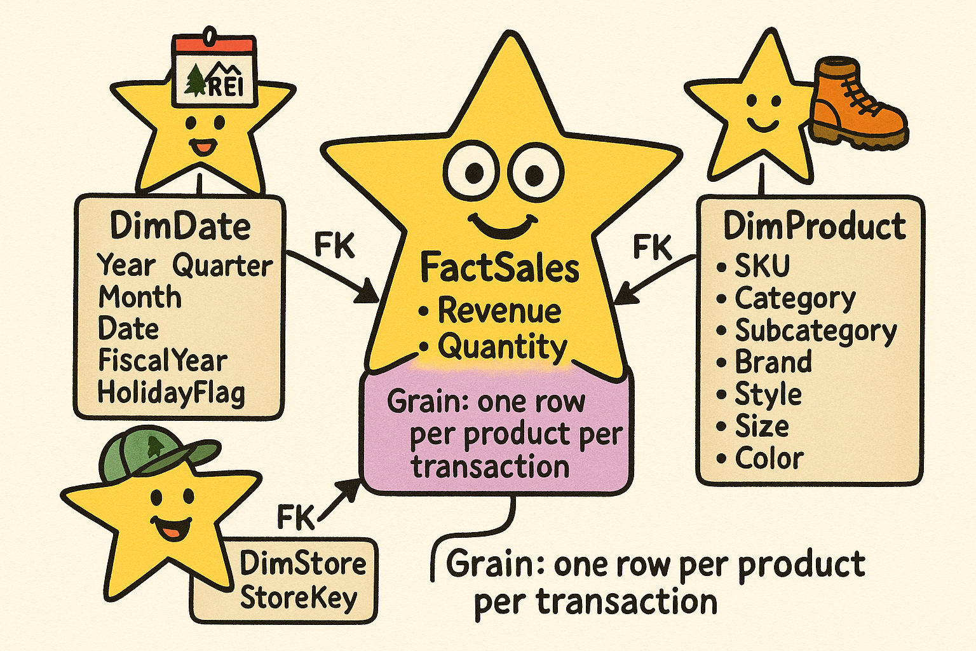

Star
Schema
The REI_not Data Warehouse

Slide 2
Critical Thinking
MP5 (Team): mean 90.6
Common error patterns
  Not reading the instructions
  Not understanding the difference between identifying/non-identifying relationships -> too many keys!
  TIP for MP7 – REI_not: do not rely
  too much on genAI. Verify!

Slide 3
You Do The Talking
Name
Concentrations…
Comfort with ERD
Use of GenAI?
Things that I like about the class
Things that can be improved

Slide 4
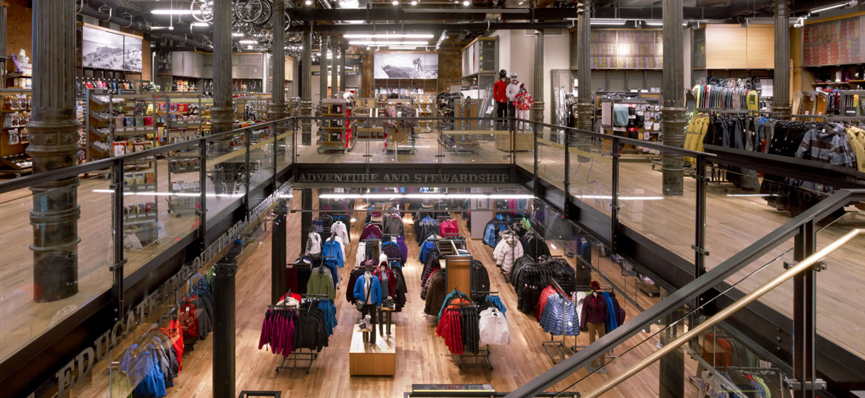

Richmond
flagship store

Slide 5





BI at REI_not: Current state
Richmond Store
Local DB
Store 1
Reports, visualizations…
Atlanta Store
Local DB
Store 2
Charleston
Store
Local DB
Store 3
Managers &
Decision makers

Slide 6
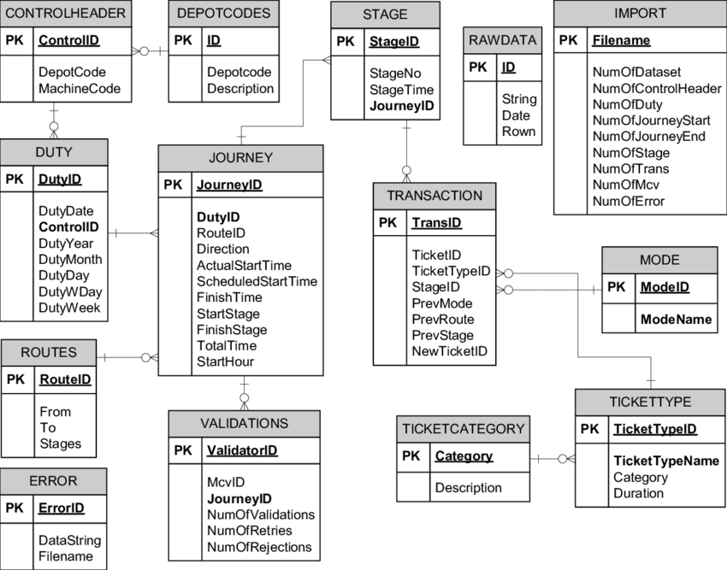

BI at REI_not: The initial proposal
Richmond Store
Local DB
Store 1
Reports, visualizations…
Normalized Database
for the whole REI_not
BI/Analytics technologies
ETL technologies
Atlanta Store
Extract
Transform
(i.e., clean)
Load
Query
Report
Analyze
Visualize
Local DB
Store 2
Charleston
Store
Local DB
Store 3
Managers &
Decision makers
City: Richmond/Charleston/Atlanta
Size in Square feet
Csystem: cashier, self, hybrid
Layout: modern or traditional

Slide 7
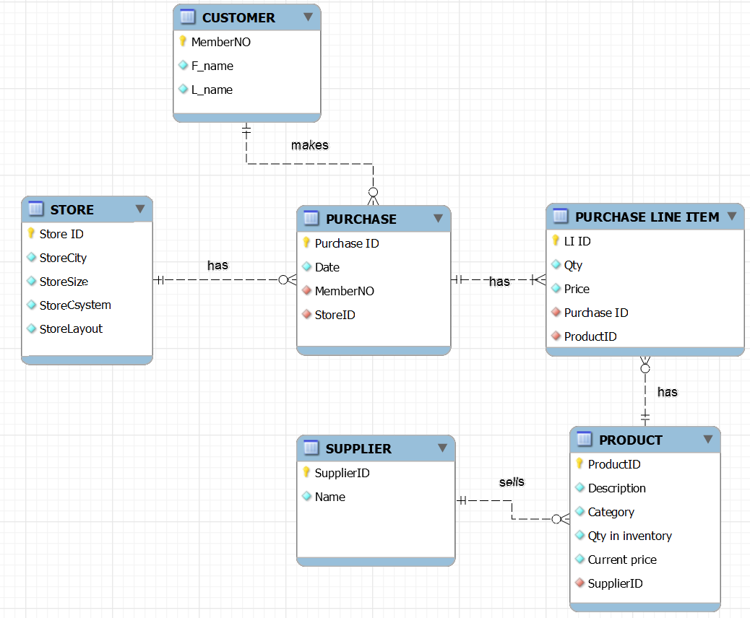

A normalized design for the HQ DB was proposed…
Rejected by HQ:
TOO MANY JOINS MADE THE QUERIES too slow!
Are we selling more backpacks in our traditional stores or in our modern ones?
City: Richmond/Charleston/Atlanta
Size in Square feet
Csystem: cashier, self, hybrid
Layout: modern or traditional

Slide 8
A different design technique: the Star Schema

Slide 9
BI at REI_not: Future state
Richmond Store
Local DB
Store 1
Reports, visualizations…
Data Warehouse for the whole REI_not
BI/Analytics technologies
ETL technologies
Atlanta Store
Extract
Transform
(i.e., clean)
Load
Query
Report
Analyze
Visualize
Local DB
Store 2
Charleston
Store
Local DB
Store 3
Managers &
Decision makers
Your job in MP7

Slide 10
First, identify facts and dimensions from the queries of interest
Sales by month
Costs by store
Salary by quarter
Quantities by state by quarter
Sales of a specific product
Profit by category
Are we selling more backpacks in our traditional stores or in our modern ones?
FACTS
DIMENSIONS

Slide 11
Building a DW: facts and dimensions
A dimension is a category that organizes your data (the facts).
It answers questions like by who, by what, by where, by when, and by how
Each dimension is a table that has a primary key that links to a foreign key in the fact table
Examples:
    Time Dimension: when sales occurred: by year, month, or day.
    Location Dimension: where the sales happened: by city or zip.
    Product Dimension: breaks down products by brand or category.

Slide 12

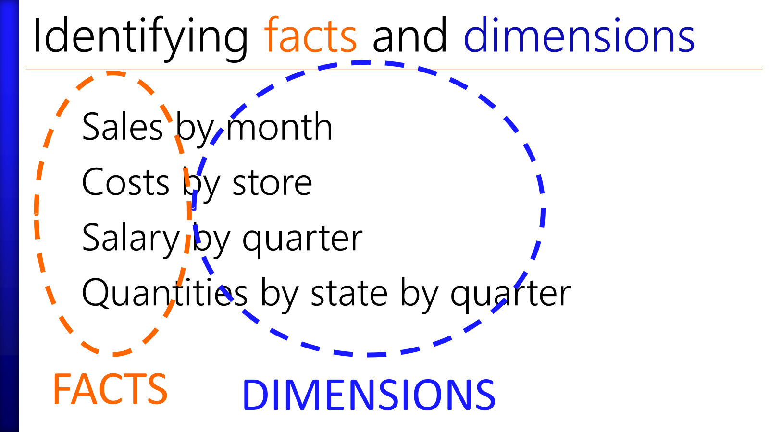
You find facts and dimensions
1) Are we selling more backpacks in our traditional stores or in our modern ones?
2) Show the total revenue from all boots models by store and city.
3) What is the monthly revenue from our 'camping' product category?
4) Show the revenue per square foot in each of our stores and cities

Slide 13
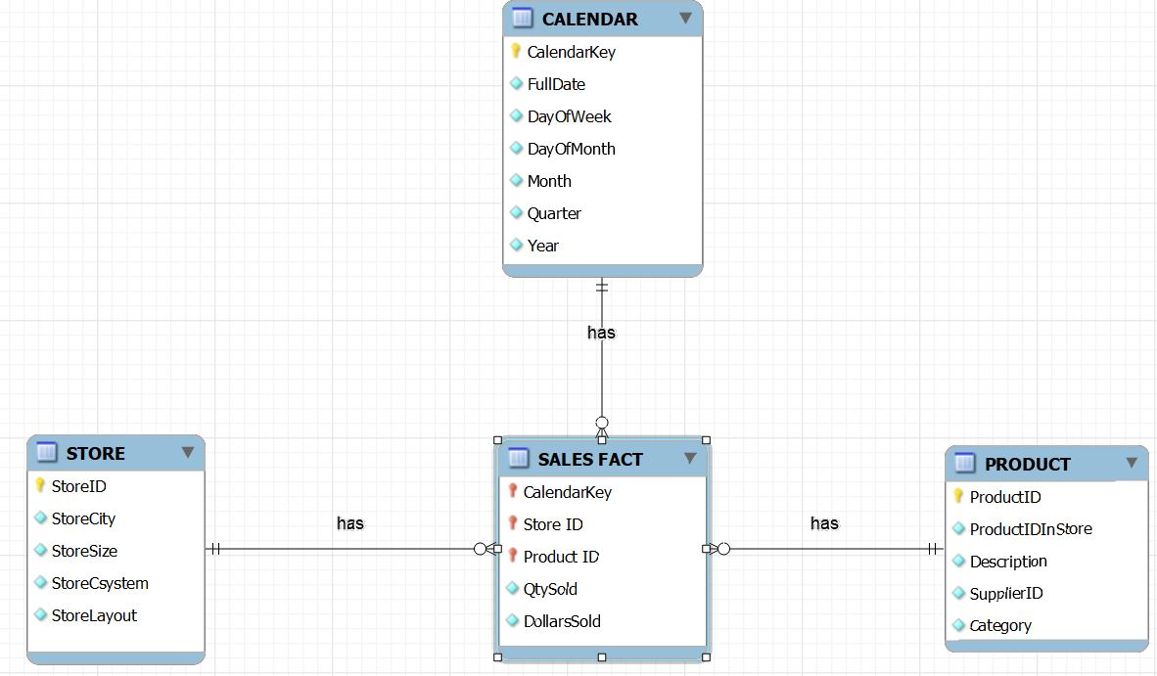
1) Are we selling more backpacks in our traditional stores or in our modern ones?
2) Show the total revenue from all boots models by store and city.
3) What is the monthly revenue from our 'camping' product category?
4) Show the revenue per square foot in each of our stores and cities
DIMENSION
Not a 1-1 translation of the operational ERD: some fields/data might be ignored (e.g. inventory, customer) or simplified (e.g., supplier), or rolled up (e.g., by month).
DIMENSION
DIMENSION
FACTS

Slide 14
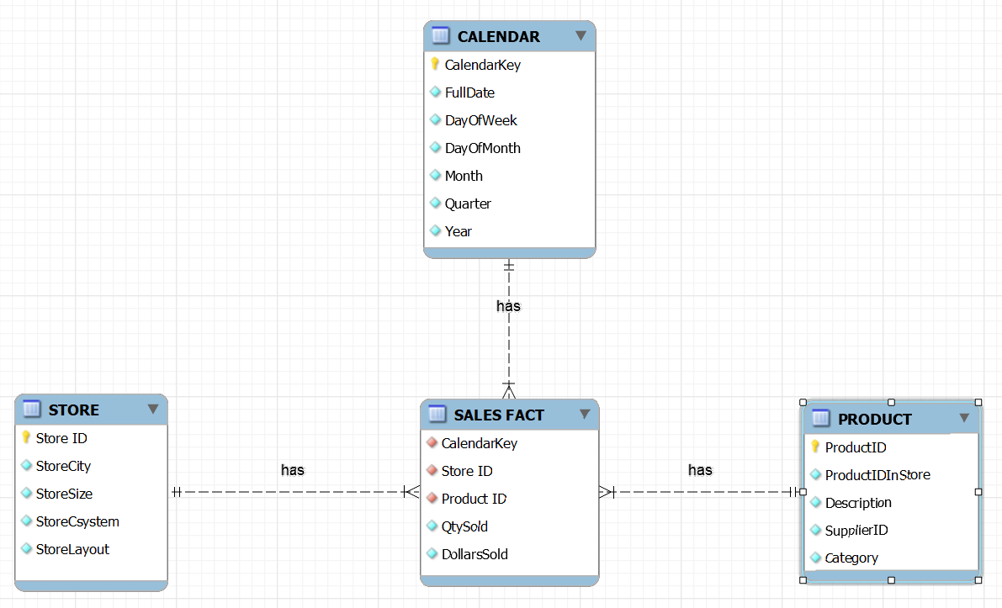
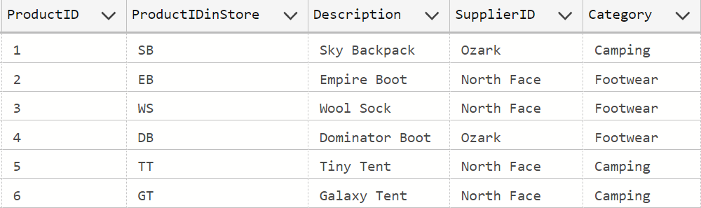
The Table PRODUCT is a dimension

Slide 15
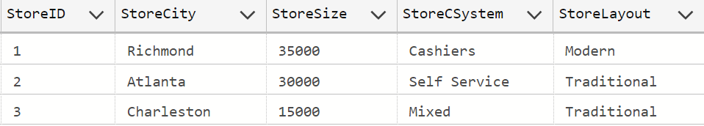
The Table STORE is a dimension

Slide 16
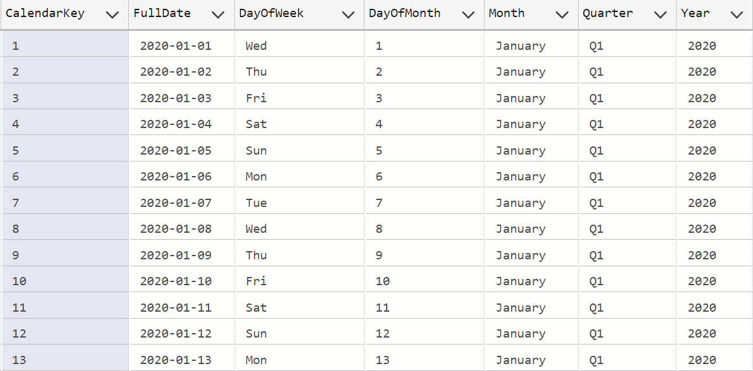
The Table CALENDAR is a dimension
Notice the repetitions:
Star schema dimensions are denormalized to speed up queries (Selects)

Slide 17
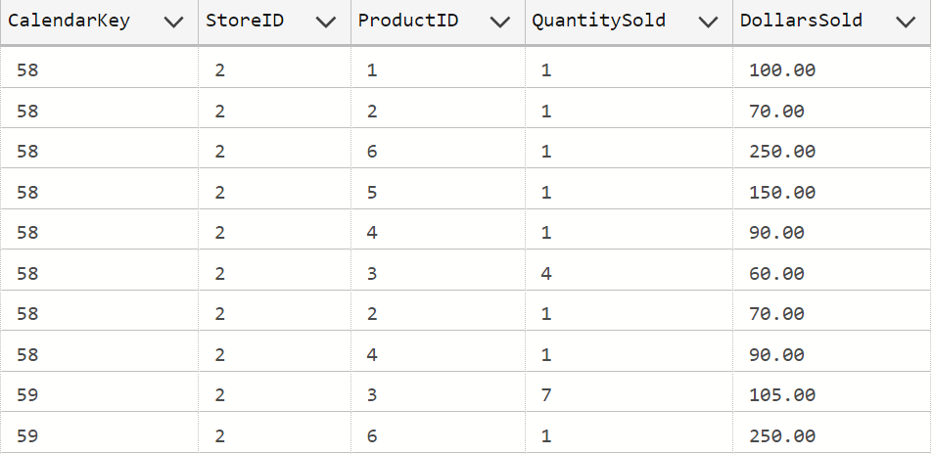
SALES_FACT is the fact table (fragment)
The center of the Star schema (the fact table) is normalized. This table is usually HUGE

Slide 18
Star Schema DW design for REI_not
DIMENSIONS
The points of the star schema are tables that contain attributes in frequently-used ‘group by’ or filters (e.g.,
where Month = ‘May’)

Slide 19
Star Schema DW design for REI_not
The core of the star schema is the table that contains the facts: the data from which the answers to business questions are built e.g.. qty, revenue.

Slide 20

What about CUSTOMER information?
DIMENSION
Not a 1-1 translation of the operational ERD: some fields/data might be ignored (e.g. inventory, customer) or simplified (e.g., supplier), or rolled up (e.g., by month).
DIMENSION
DIMENSION
FACTS

Slide 21
WINIT

Slide 22
Querying the DW for the REI_not Company
Demo

Slide 23
Practice DW queries
Q1: Revenue by store (city)?
Q2: Revenue by product in Q3?
Q3: Tent sales by store?
Q4: Revenue by store layout (traditional, modern)
Q5: Sale by store by month

Slide 25
Star Schema DW design for REI_not
DIMENSION
Not a 1-1 translation of the operational ERD: some fields/data might be ignored (e.g. inventory, customer) or simplified (e.g., supplier), or rolled up (e.g., by month).
DIMENSION
DIMENSION
FACTS

