Slide 1
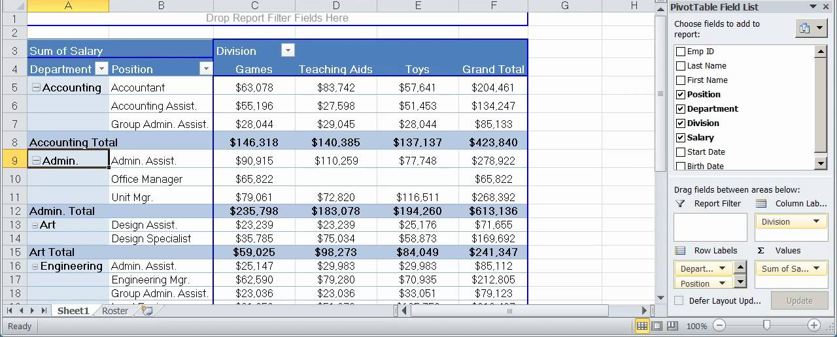
Granularity, Snowflake, Pivot
Business Intelligence concepts and tools

Slide 2
Critical Thinking
You are doing better than previous classes
Trusting too much in your GenAI cost you
Traceability at work

Slide 3
You Do The Talking
Name
College, major…
Amount of work in this course?
Feel you understand DW vs. Operational DB?
Things that I like about the class
Things that can be improved

Slide 4
Orange words
Dimension in a DW
Fact

Slide 5

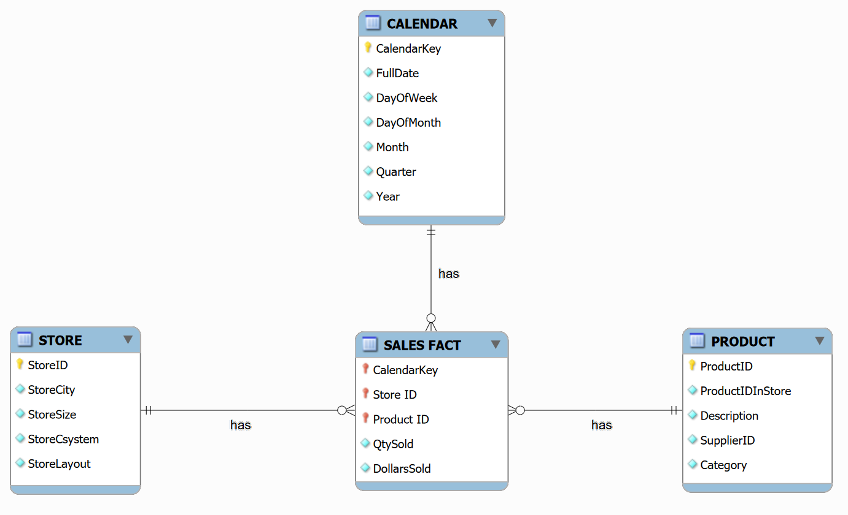
Do all fields in an operational DB get transferred to a DW?

Slide 6

Spot the differences

Slide 7

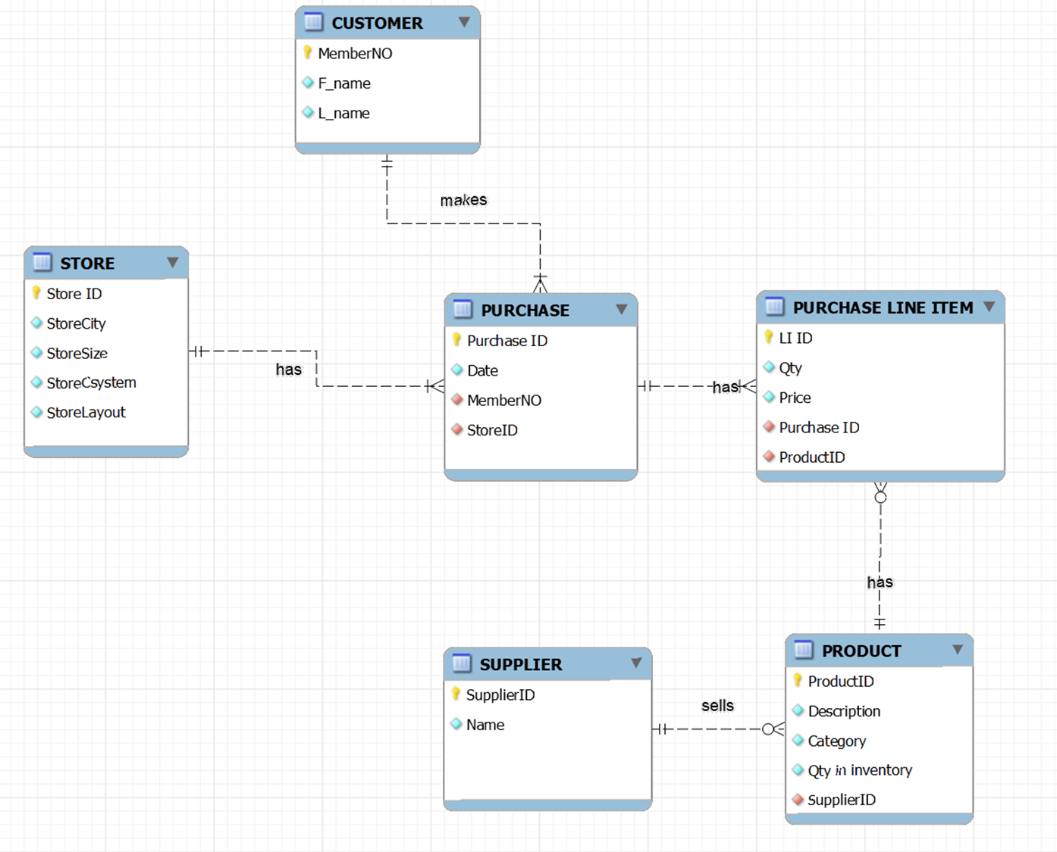
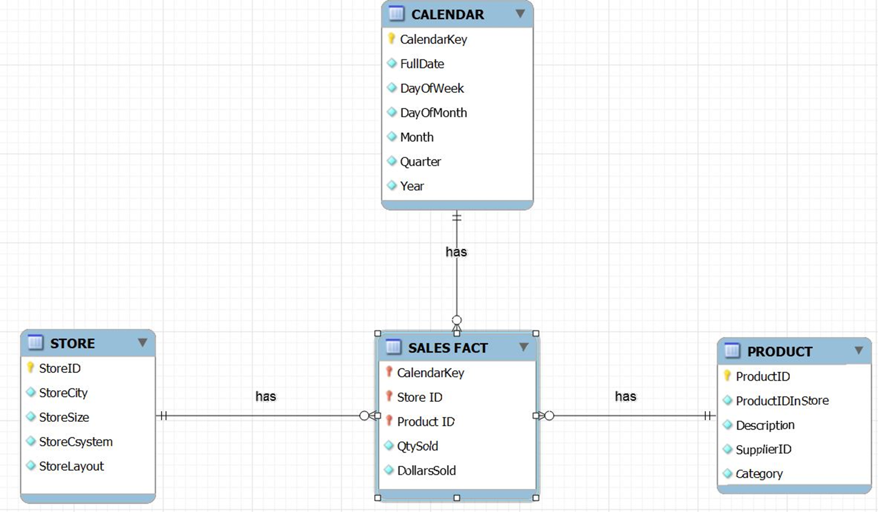
‘Same’ data, two designs: operational and analytical databases (DW) at REI_not
REI_not Operations
REI_not
Data Warehouse
ETL, ELT, API, ESB

Slide 8





MP7 REI_not (and interview talking points)
More transactional…
…more analytical
Hard part: 80 % of time and costs
Fun Part
STORE1
DATA
BI Reports for decision making
BI/Analytics technologies
REI_not Richmond
Query
Report
Analyze
Visualize
Data Warehouse
at the REI_not HQ
ETL technologies
Extract
Transform
(i.e., clean)
Load
STORE2
DATA
REI_not
Atlanta
STORE3
DATA
REI_not CEO
REI_not Charleston
YOU: BI & analytics consultants/analysts,
Notes:
Data warehousing includes two parts – getting data in, and getting data out. Getting data in is the hard part – it includes taking data from source systems, transforming the data, and loading it into an integrated data store. Getting data in is 80 % of time and resources, and 50% of unexpected costs.
Getting data out is the fun part – it include the BI tools that casual and power users use to access the data warehouse data. When users use the data, they can deliver value to the organization.
The data store in the middle can be an enterprise data warehouse, a data warehouse with dependent data marts, independent data marts, or a federated database environment. Typically, the independent data mart approach is least effective.

Slide 9
One table is usually way bigger than the others…
which one?

Slide 10
Which tables are fairly stable, and which grows continuously?

Slide 11
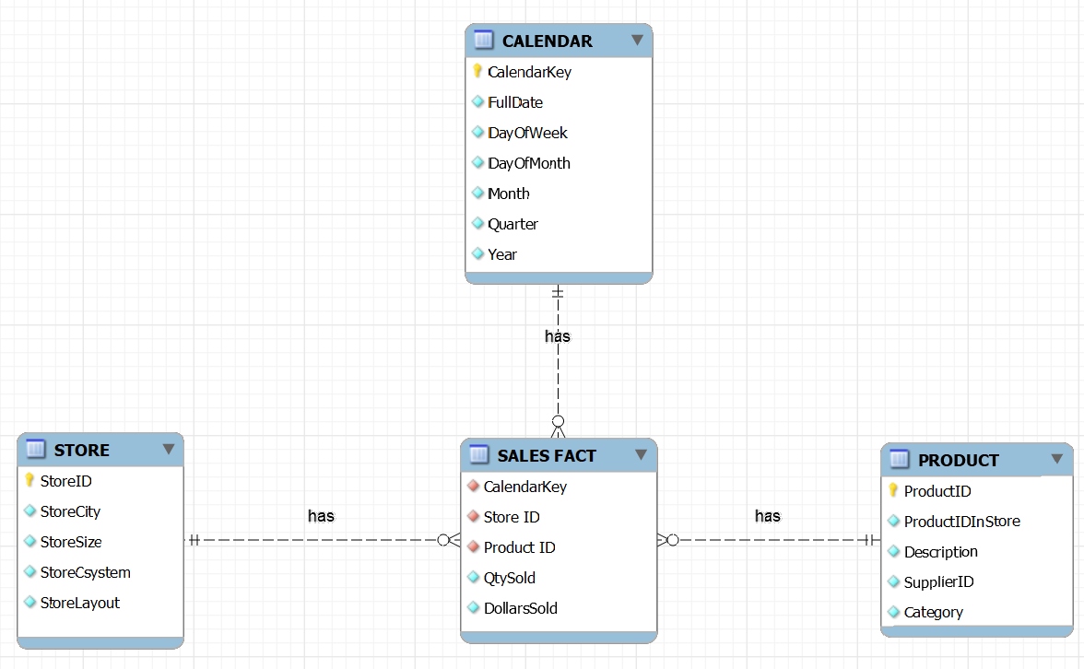
Granularity: A neat trick
At the REI_not headquarters…
The fact table is becoming too big! We will need to buy a bigger computer for our DW. The budget is $220K. That’s a lot of money I would prefer to spend elsewhere!
5 years
I have an idea. Why don’t we ask the stores to report weekly sales rather than daily sales…
Huh? How would it work?
Every Monday each store would report the ‘qty sold’ and ‘dollars sold’ for each product for the previous week.
Interesting… I can see the potential, BUT also the pitfalls…
250
5,000
Let’s think it through, Boss…
Notes:
356x5x5000x250 = 2,281,250,000
/7 =325,892,000

Slide 12

Aggregated fact tables make granularity tradeoffs
Granularity is the scope of the data (by day, by week, by county, by state….)
Granularity tradeoffs:
  Space and speed
  Costs to gather and store
  Analysis and reporting
Fact tables about the same facts with different levels of granularity may coexist in the same DW

Slide 13
DW Snowflake Design
An alternative DW design technique

Slide 14

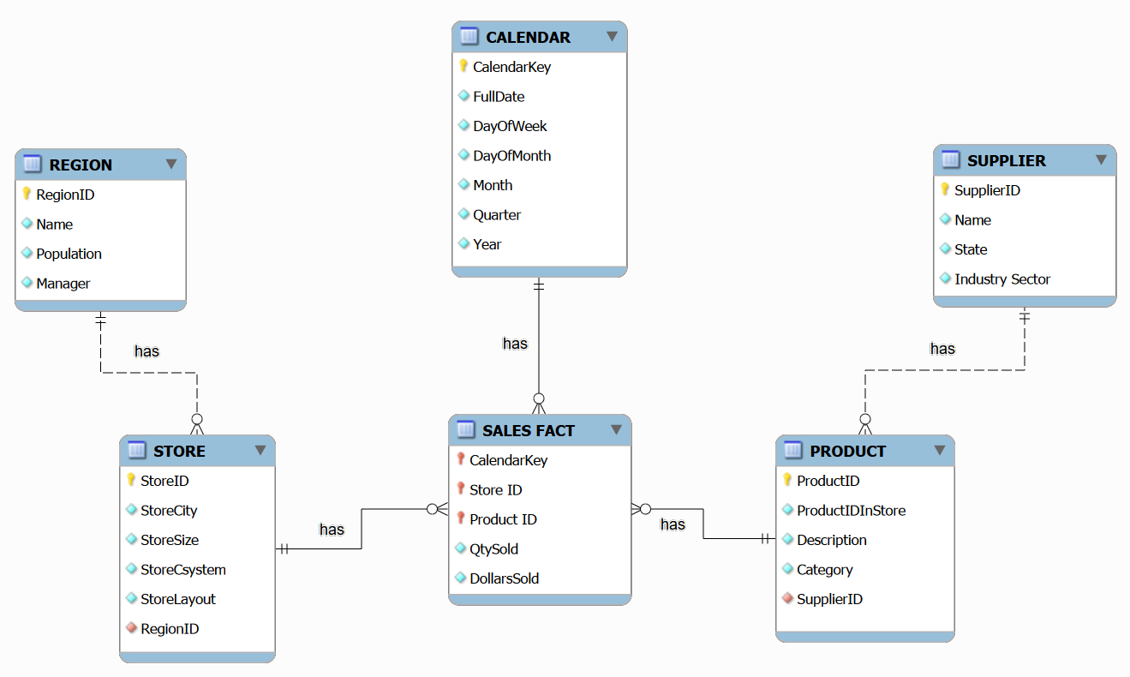
Snowflake Schema
The Snowflake schema design partly normalizes a star schema design

Slide 15
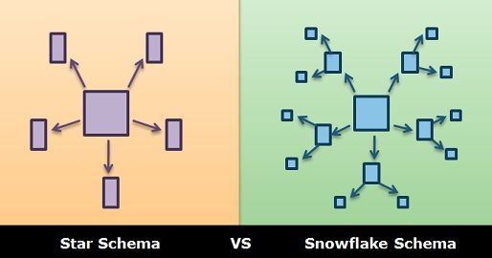
Snowflake schemas
Partly normalized
Typically, smaller footprint but slower (more joins)
Source: https://techdifferences.com/difference-between-star-and-snowflake-schema.html

Slide 16
Takeaway: Designing a DW
Step 1
Identify the questions and what you need to know to create the answers: the facts.
Example: Revenue by store? Revenue by product in Q3 for the whole company? Tent sales by store? Revenue by store layout? …sales, profits, costs, counts...
Step 2
Find out the dimensions along which the facts could be analyzed and their granularity
Example: Time (day, week, quarter), geography (store, state, city…)
Step 3
Draw a Star or Snowflake ERD.

Slide 17
Summary: DW Design principles
Not all fields in the operational DB need to be transferred to the DW: depends on the business needs
Dimension tables are way smaller (shorter) than the facts table
Dimension tables are fairly stable, fact tables grow continuously
Typically, DW are updated by appending new data (few/no updates and deletes: mostly inserts)
Dimension tables can be denormalized (star and snowflake)

Slide 18
MP8
BI at ACME Global
Another promotion, another project…

Slide 19


Welcome to ACME Global!
Your career is unstoppable!
Now you are a BI/Finance consultant at ACME Global, a large company with a global presence.
It is year-end and your boss, the Controller, wants to analyze the differences between budgeted costs and actual costs. This is called a Variance Analysis.
ACME

Slide 20
MP8 (and interview talking points)
More transactional…
…more analytical
N. America
DATA
Data Warehouse
ACME
S. America
DATA
BI/Analytics technologies
BI Reports for decision making
Use both SQL and Excel Pivot tables to answer global BI questions
ETL technologies
Use SQL to integrate the 5 ACME region tables into a single VIEW
ACME
Extract Actual and Budgeted expenditures
Pacific Rim
DATA
ACME
Europe
DATA
ACME
ACME global leadership
Asia
DATA
ACME
YOU: BI & analytics consultants/analysts,

Slide 21
MP8
Variance analysis demo
SQL SERVER > EXCEL >PIVOT

Slide 22
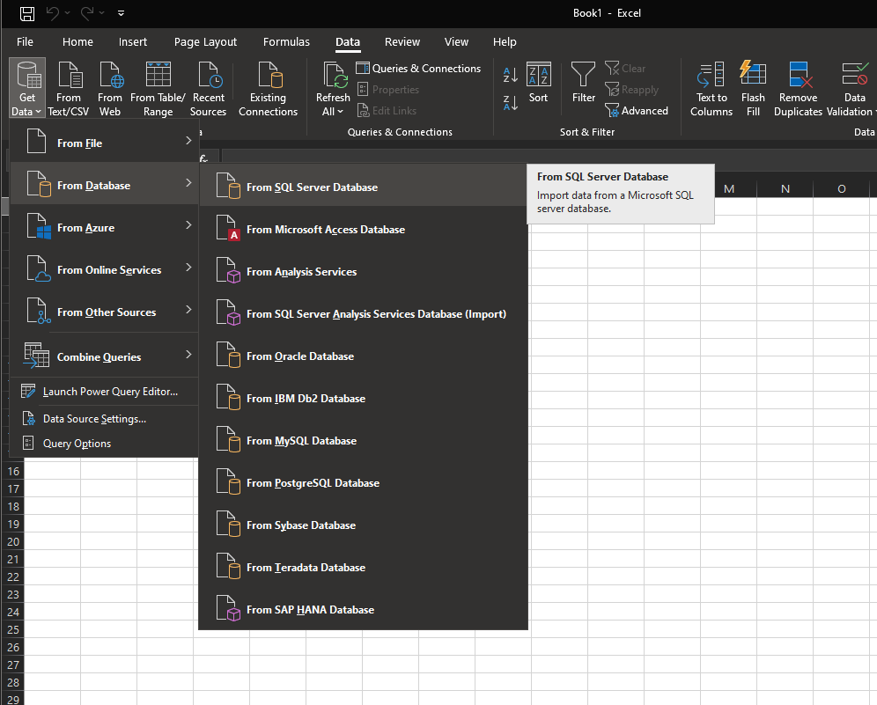
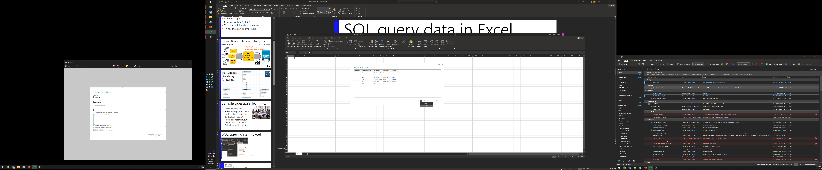
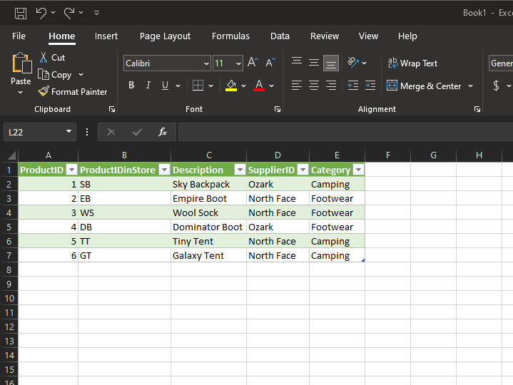
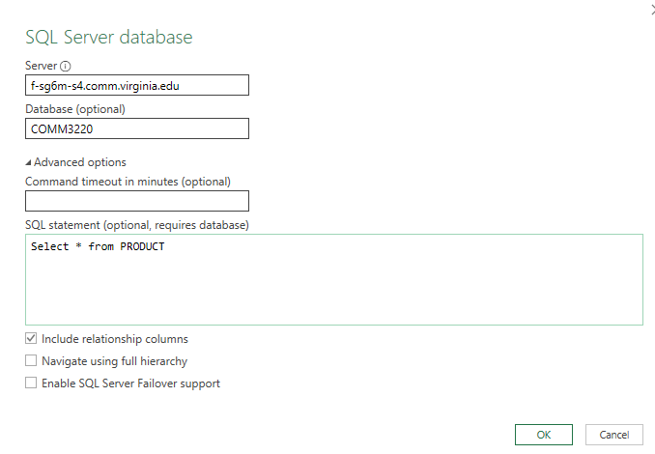
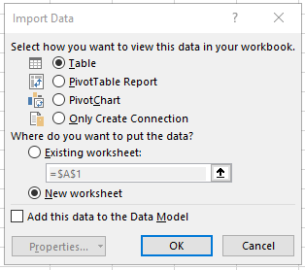

Many people do not know how to use Excel to view SQL query data from a database
1
2
3
4
7
5
6
Computer may ask for your DATABASE userId and Password
8

Slide 23
What is New in Information Technology

Slide 24
Pivot Tables are BI tools
A Pivot Table is a data analysis tool. It is used to "slice and dice" data, and drill up/down.
Pivot tables work by grouping and ungrouping data contained in a table according to various dimensions, e.g., time, location, department, product….
Superpower of Pivot Tables that SQL cannot easily do:
the pivot. Pivot tables can easily turn cell contents into column names.

