Slide 1

BI workflows:
Power BI
Stefano Grazioli

Slide 2
Critical Thinking
Fixed DW ERDs (identifying / non-identifying)

Slide 3
Orange Words
What is granularity in a DW?
What are the granularity tradeoffs?
What is a snowflake schema?
True/false: dimension tables grow faster than the fact table

Slide 4
You Do The Talking
Name
College, major…
Hardest thing so far? (and how can Prof. help)
Course goals still clear?
Things that I like about the class
Things that can be improved

Slide 5
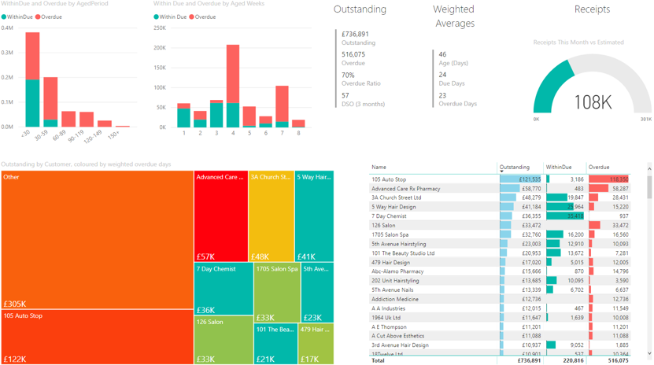
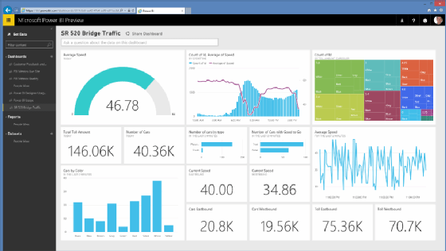
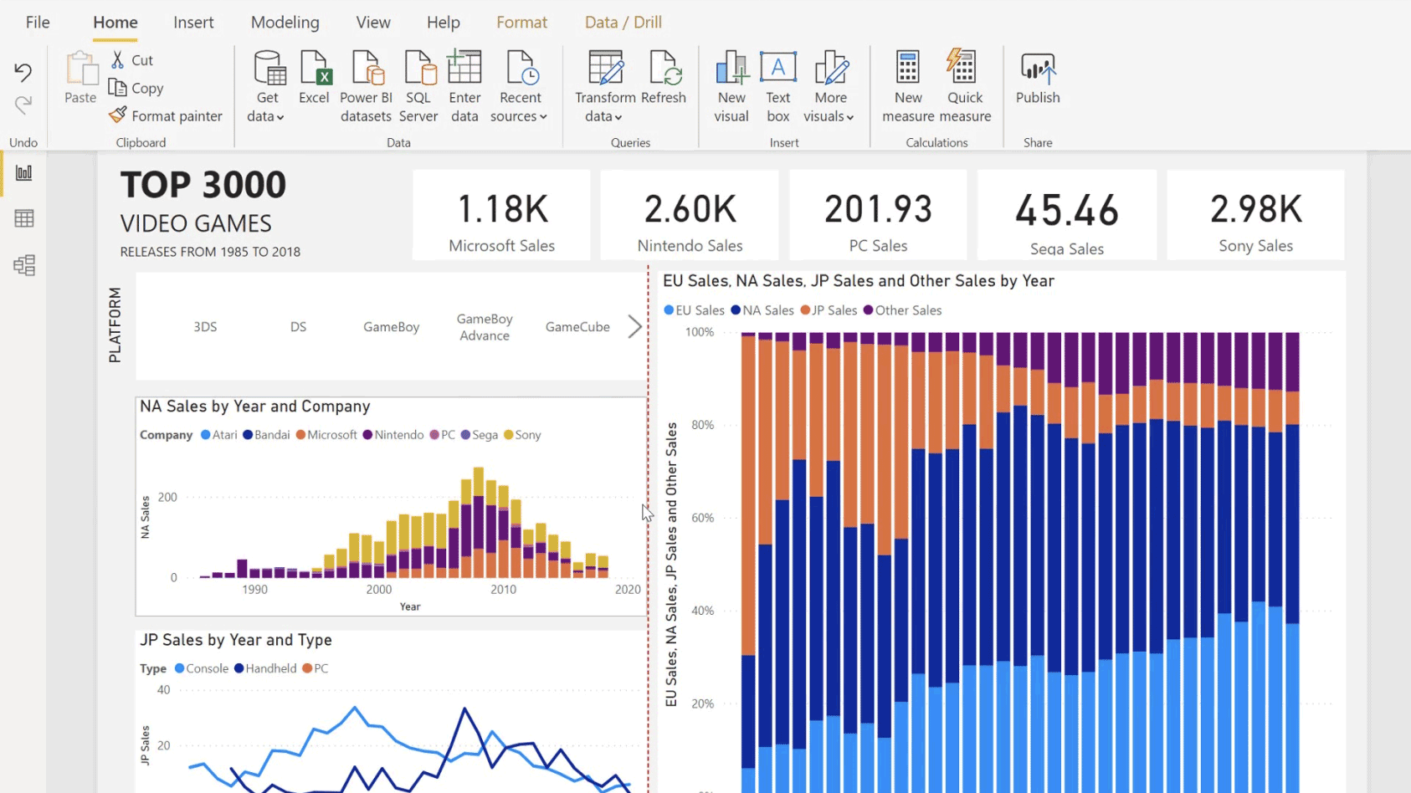
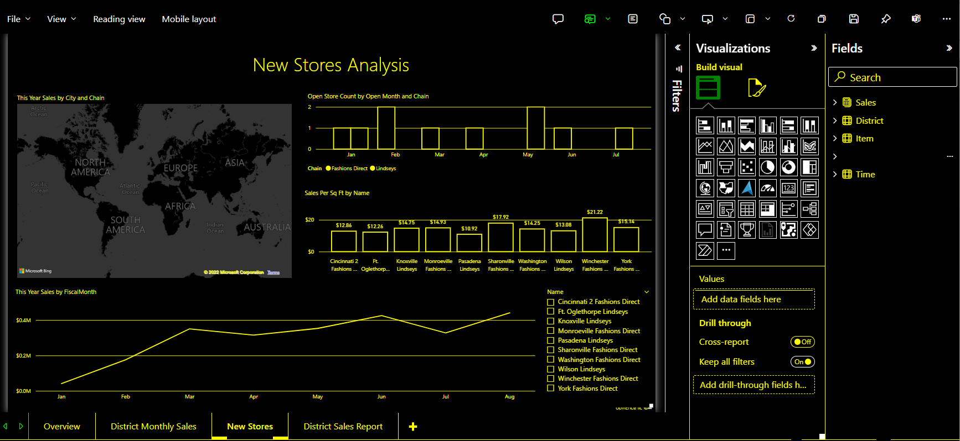
“PowerPoint for your data”
Source: Microsoft

Slide 6

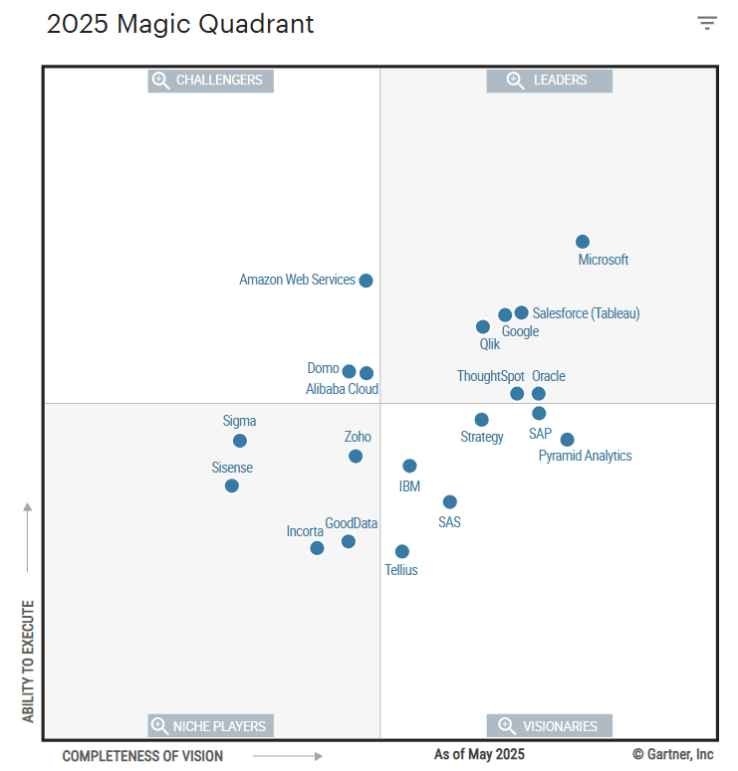

97% of the Fortune 500 uses Power BI (MSFT 2021)
Professional, ‘repeated’ production of BI reports, real-time dashboard
(Power BI)

Slide 7
BI quick demo
The Movie Dashboard

Slide 8
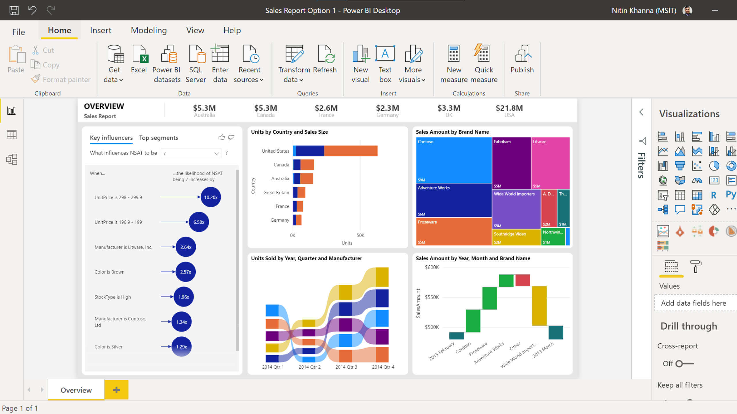
Source: Microsoft

Slide 9
BI workflow: quick example
SMALLBANK DB

Slide 10
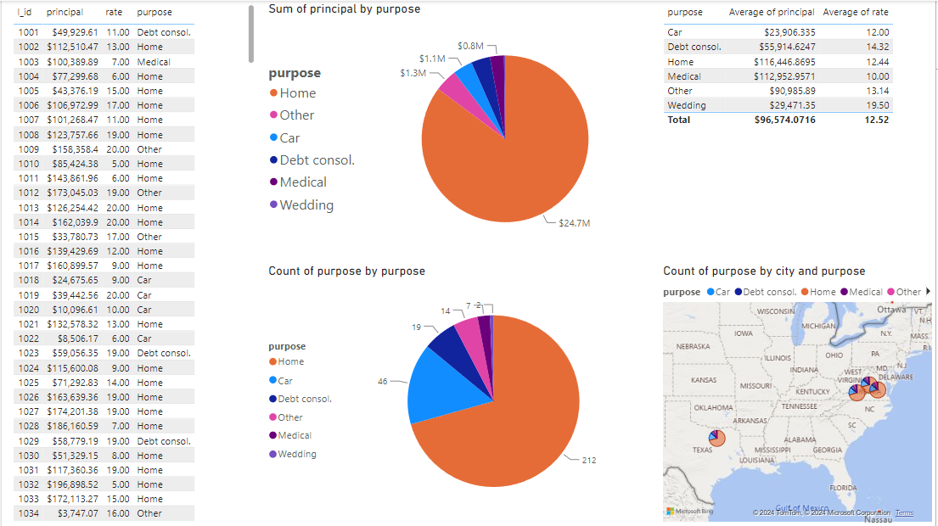

Slide 11
What is New in Information Technology

Slide 12


