Slide 1

BI workflows:
Power BI
Stefano Grazioli

Slide 2
Critical Thinking
MP7 REI_not almost done.

Slide 3
You Do The Talking
Name
College, major…
Hardest thing so far?
Things that I like about the class
Things that can be improved

Slide 4
BI Workflows

Slide 5
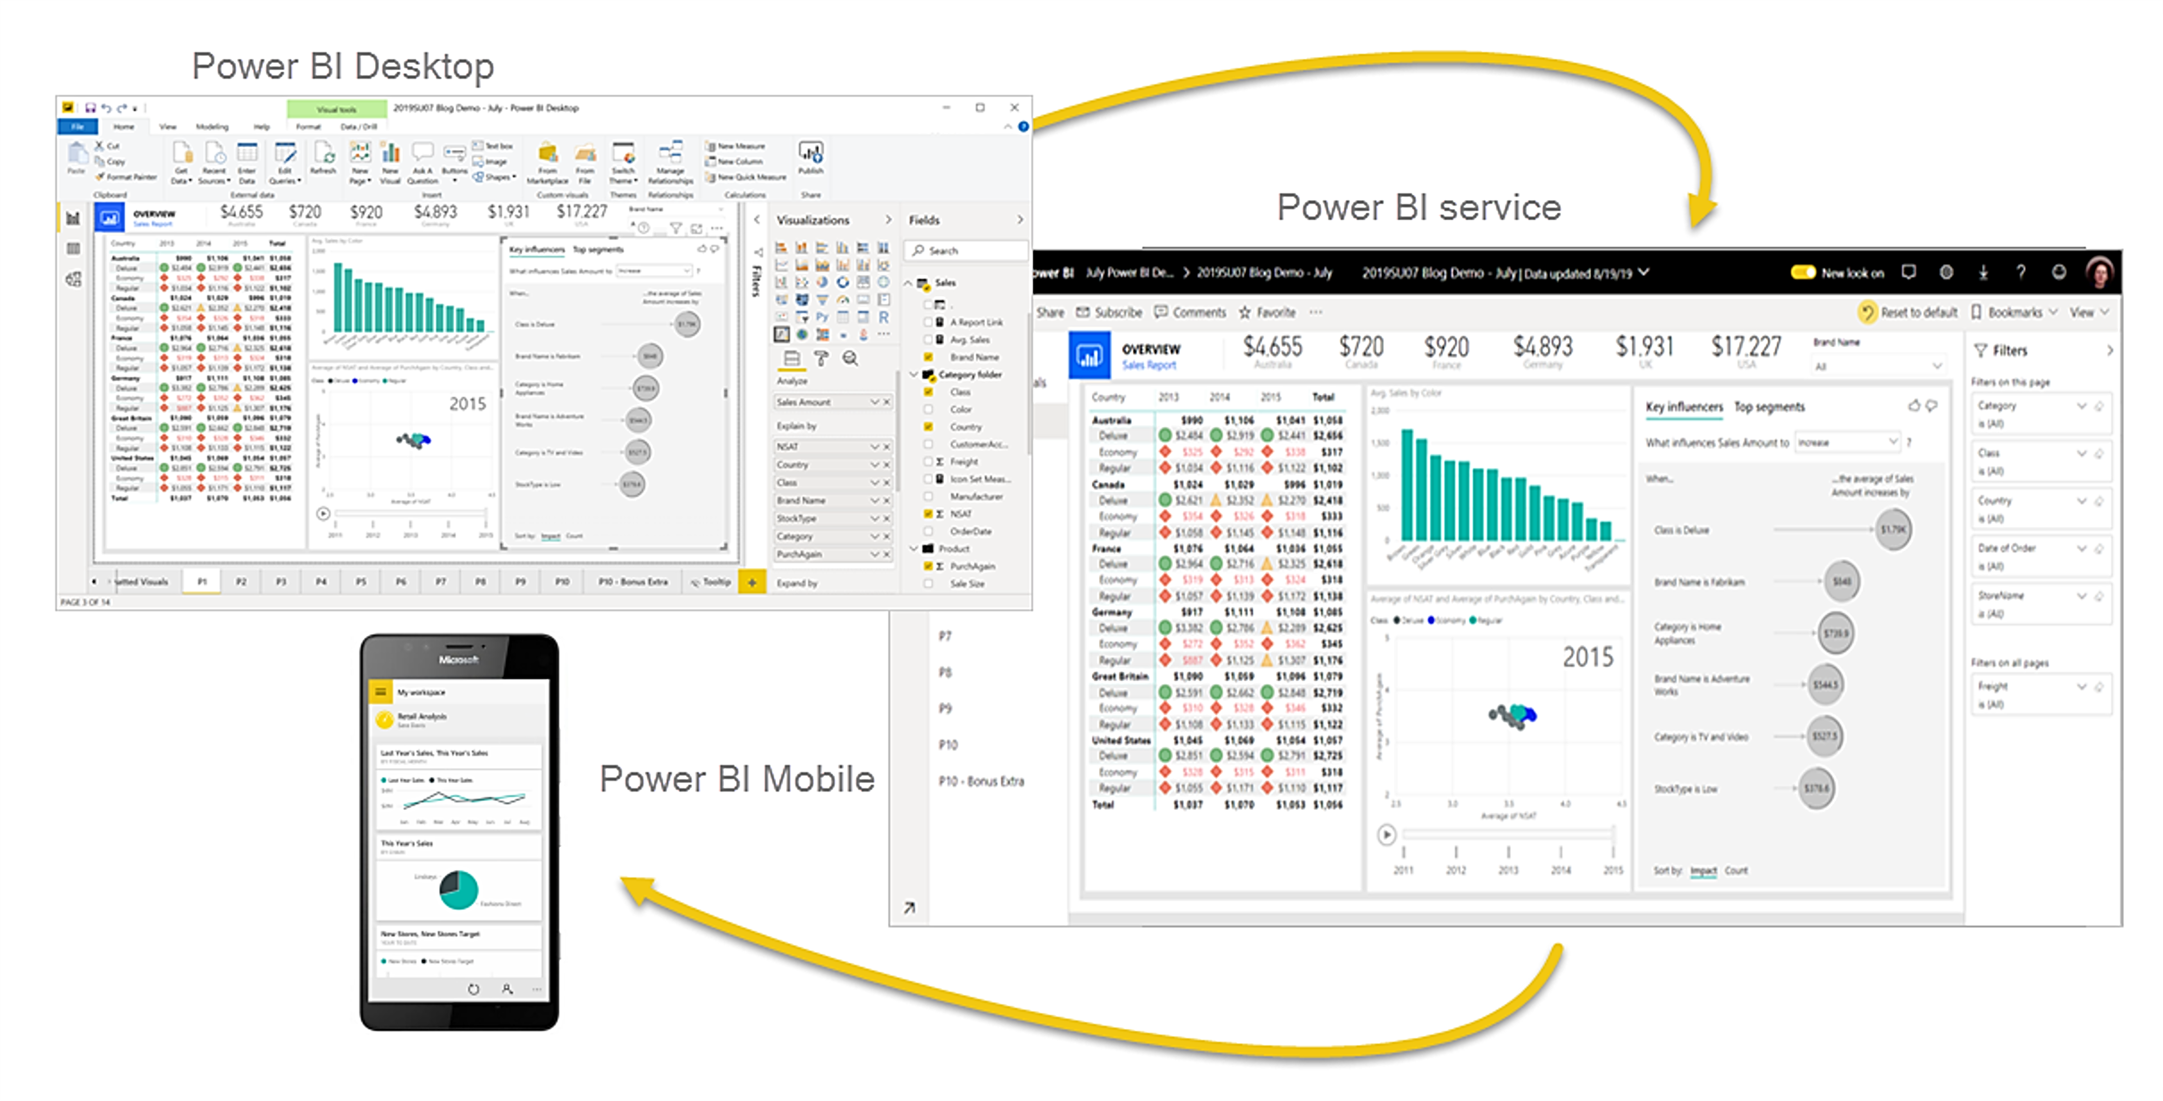
Three ways to consume the results of BI work
Power BI Desktop
Power BI Web
Power BI Mobile

Slide 6

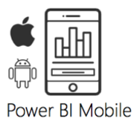


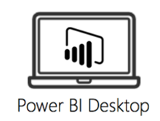
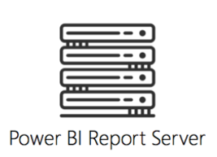


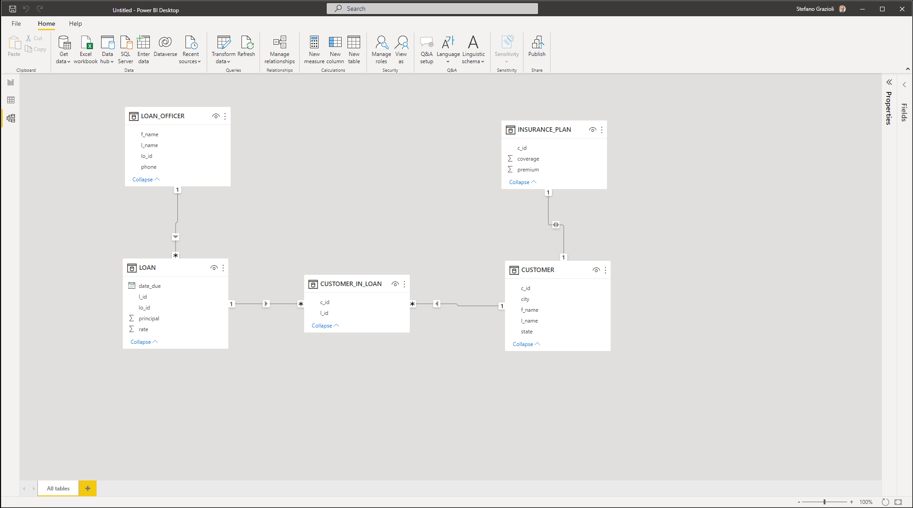

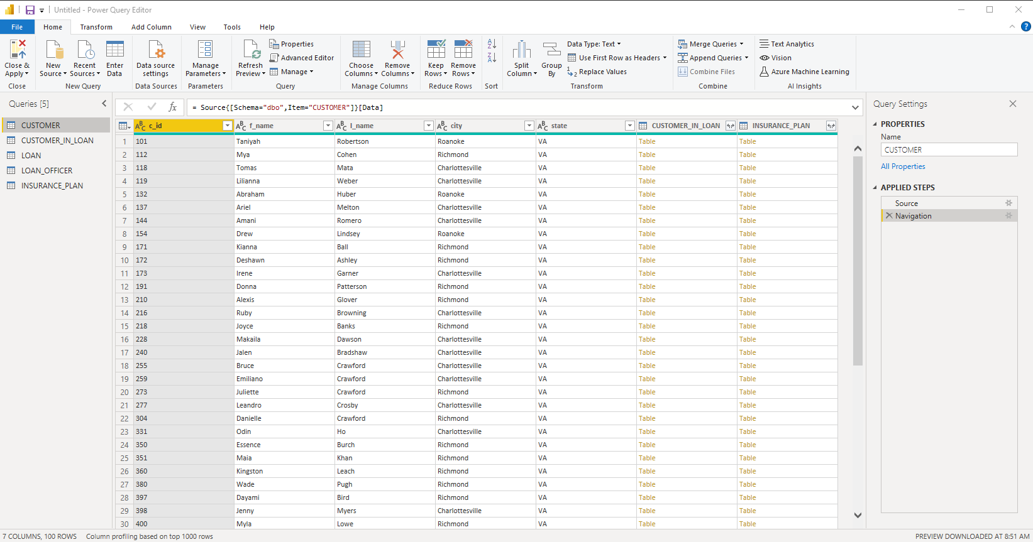

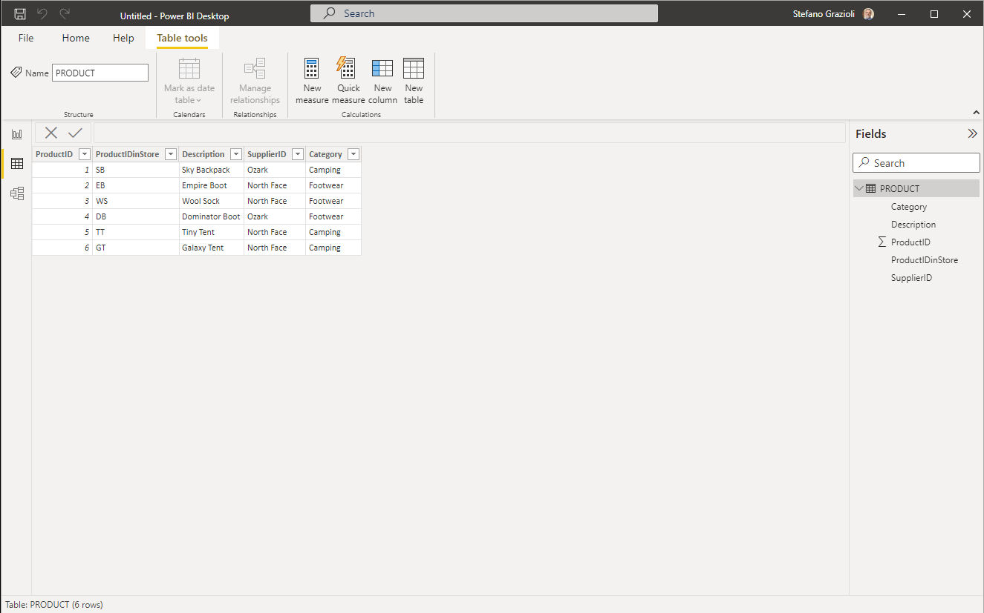
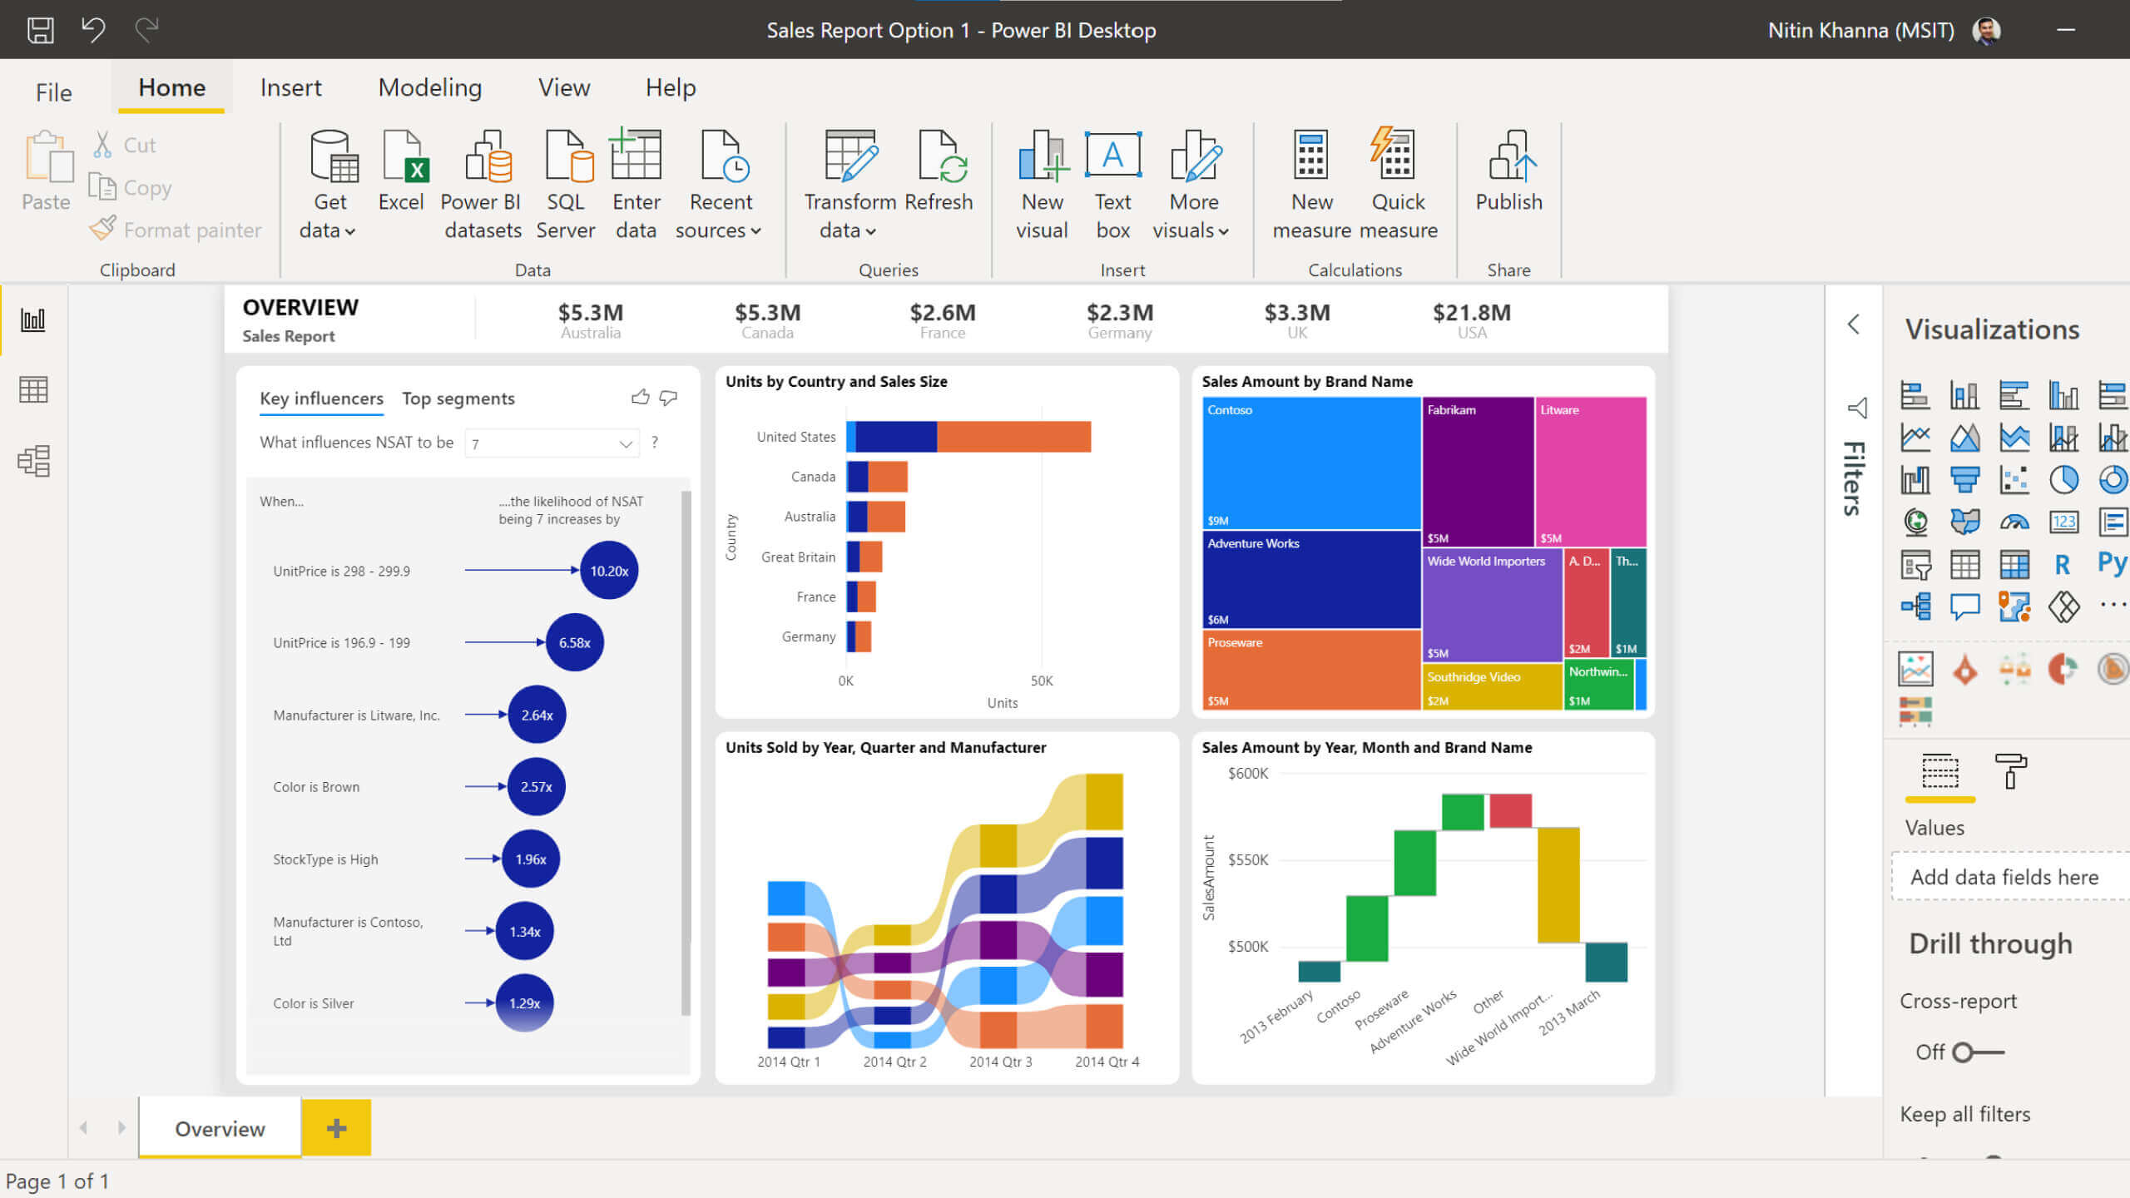



The BI workflow using Power BI
Extract
Transform (clean)
Load
Model
with relations
Analyze Visualize
Publish
Web, Mobile,
& Desktop Report
Data sources
Raw data
Cleandata
Report
Website
“Model”
…
“Power Query”
extracts and transforms data to be loaded into the “Model”
“Data”
“Report”

Slide 7
Non-standard definitions
Query: a series of steps that produce a PowerBI table from one or more data sources
Model: tables with relations (ERD)
Report: a set of visualizations
Measure: the result of a formula (DAX), think of it as a real or virtual column.

Slide 8






Learning resources
Additional/optional resources to learn Power BI
Power BI reference manual
Linked pics. If UVA is not listed, use your UVA email

Slide 9
What is New in Information Technology

Slide 10
Data wrangling at Nolex Luxury Watches
Mini-Project 9

Slide 11

Luxury watches
Three new stores
  LaGuardia
  DeGaulle
  Fiumicino
CDO wants to know how they are doing: a sales report
The stores sent the BI reports
BUT

Slide 12
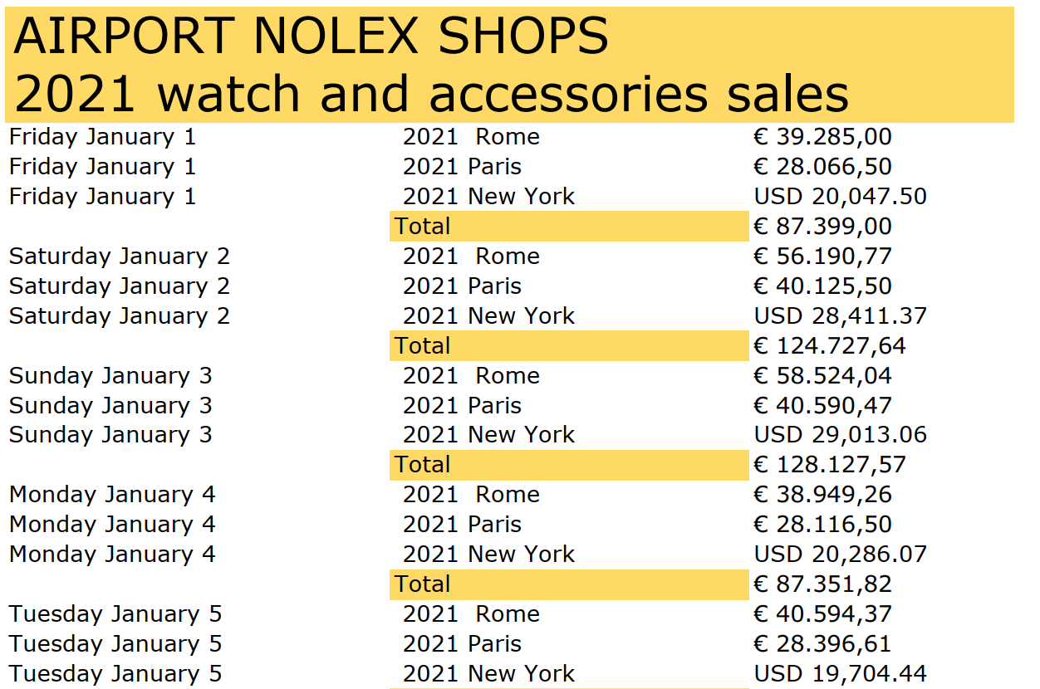
And it is a pdf!

Slide 13
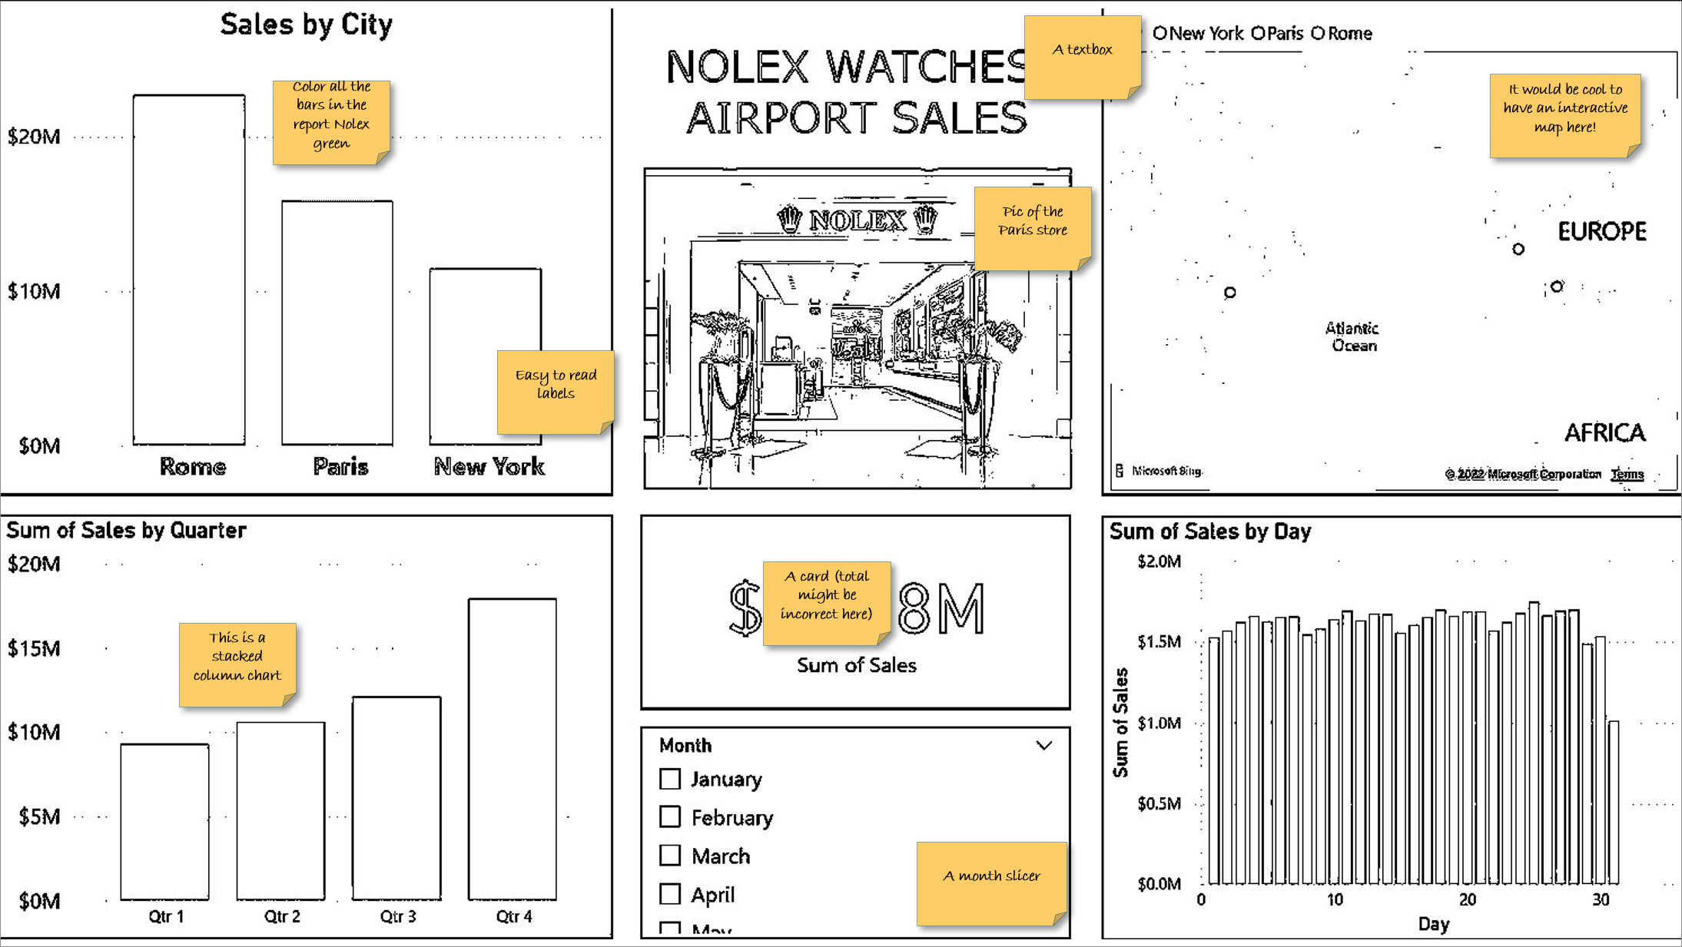
Order the Y axis right!

Slide 14
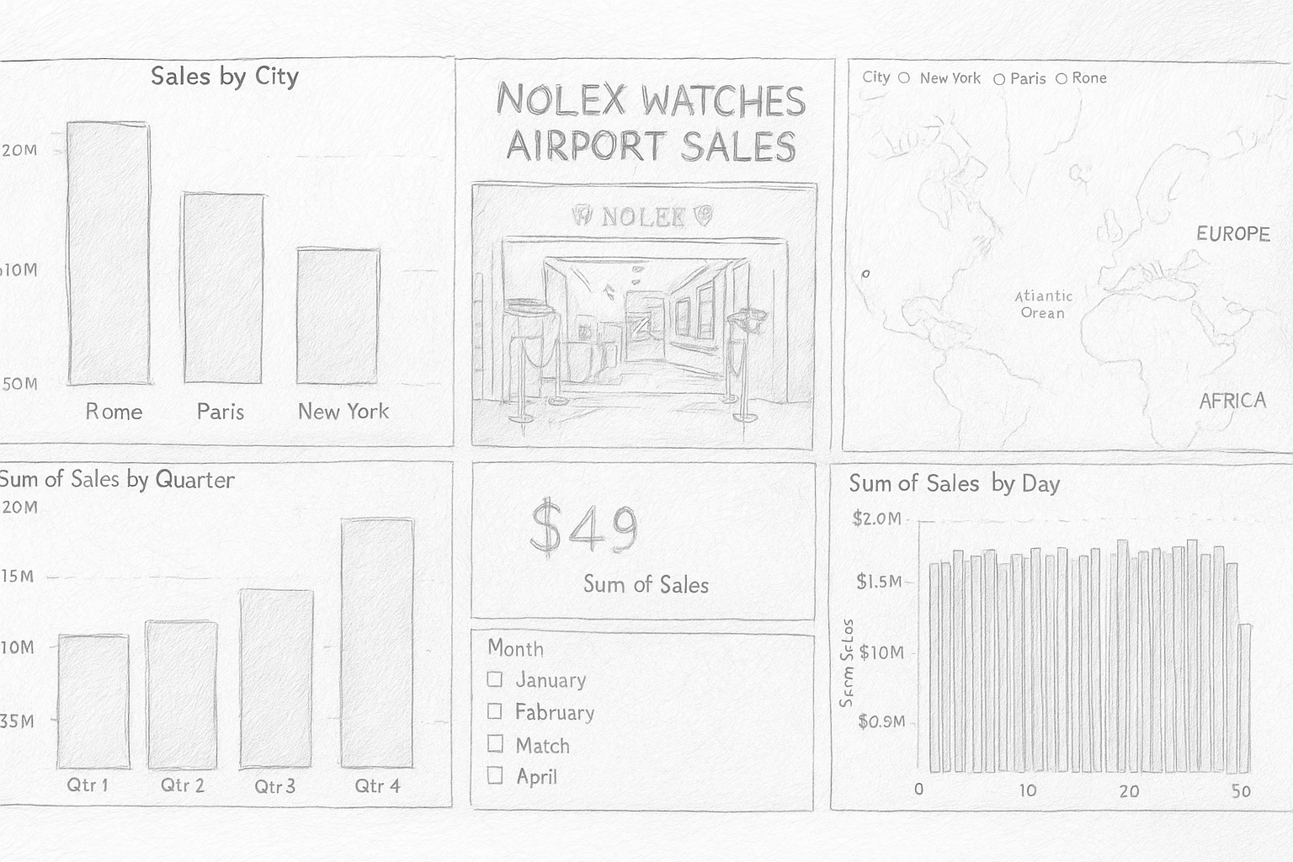

dark green letters
Interactive map
All bars in all charts are dark green
Pic of the Paris store
Add $ signs where needed
All charts are interactive
Sun if sales in million + one decimal
Order the Y axis right!
A slicer
$ 0.0M

Slide 15

Sometimes Power BI is like a faithful, eager-to-please-you dog…
… in its desire to help you, it may mess up your work.
Notes:
Source: web

