Slide 1

BI reports with
Power BI
Stefano Grazioli

Slide 2
Critical Thinking
How do we catch GenAi mistakes?

Slide 3
You Do The Talking
Name
College, major…
Impression on Pivot Tables?
Are you getting better at using GenAi with Data?
Favorite GenAI?
Things that I like about the class
Things that can be improved

Slide 4
Quick demo
Filters and cross-filters:
similar names, very different functionalities

Slide 5
WINIT
WHAT IS NEW IN IT

Slide 6
BI Workflows

Slide 7




Data Marts (interview question)
Operational Data
A data mart is a subset of a data warehouse that is focused on a subject area: a business line, department, or function.
Usually a Data Mart is a RDBMS.
Operational Data
CUSTOMER Data Mart
BI/Analytics technologies
BI Reports for decision making
ETL:
Extract
Transform
(i.e., clean)
Load
Data Warehouse
PRODUCT Data Mart
Query
Report
Analyze
Visualize
ETL
Operational Data
ORDER
Data Mart
Operational Data
YOU: BI & analytics consultants and analysts

Slide 8
Data Marts (alternative architecture)
Operational Data
…are typically smaller DWs, limited to one subject area
Operational Data
CUSTOMER Data Mart
BI/Analytics technologies
BI Reports for decision making
ETL:
Extract
Transform
(i.e., clean)
Load
Data Warehouse
Query
Report
Analyze
Visualize
PRODUCT Data Mart
ETL
Operational Data
ORDER
Data Mart
Operational Data
YOU: BI & analytics consultants and analysts

Slide 9
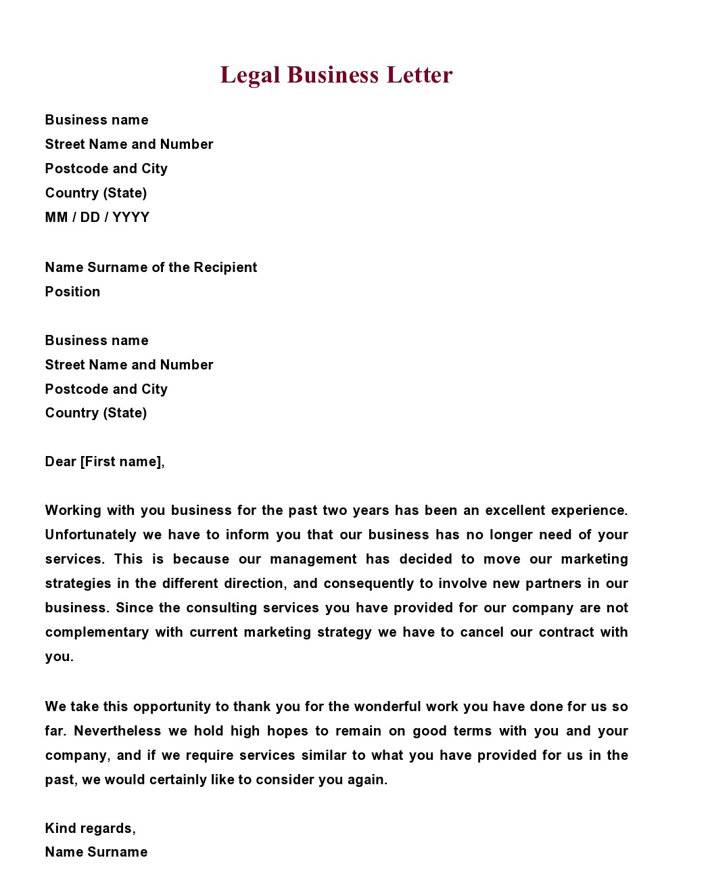

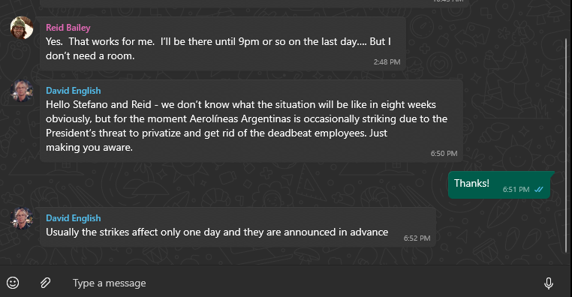

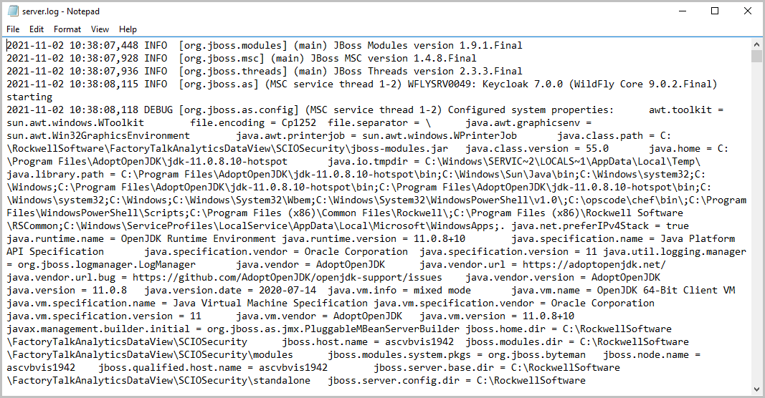

But wait! A lot of the world info is not in tables…
UNSTRUCTURED / SEMISTRUCTURED DATA

Slide 10

Adding structure (labels) is possible, but

Slide 11

Data Lakes (interview question)
A data lake is a large, centralized repository that stores vast amounts of raw data in its native format until it's needed for processing and analysis. Schema on Read.
Operational Data
Web, Social, Pics, Videos
Operational Data
Big data
BI/Analytics technologies
BI Reports for decision making
No ETL:
just
Load
Data Lake
Not/Not fully structured or normalized
Schema on read
Query
Report
Analyze
Visualize
Operational Data
Operational Data
YOU: BI & analytics consultants and analysts

Slide 12
Data LakeHouses (interview question)
A data lakehouse is a large, centralized repository that combines the functionality of a data lake and a data warehouse.
Both schema on write and on read.
Operational Data
Web, Social, Pics, Videos
Operational Data
BI/Analytics technologies
BI Reports for decision making
Both ETL and just
Load
Data LakeHouse =
DL + DW
Schema
on write and on read
Query
Report
Analyze
Visualize
Operational Data
Operational Data
YOU: BI & analytics consultants and analysts

Slide 13
Types of DBMS
More organization for your data
Operational (normalized) DB
Data Warehouses
Data Mart
Data Lakehouse
Data Lake
Less organization

