Slide 1

BI reports with Power BI
Indexes and datatypes Real world case of Power BI use

Slide 2
Critical Thinking
Acme Global/Pivot tables went well 93/100
When to use Pivot tables?
When you have many rows of detailed data and you want totals, counts, or averages by category (or by two categories)
When you need flexibility and quick changes
When you don’t want to write SQL or Excel formulas (e.g., =sumif)

Slide 3
Orange words
More organization for your data
Data Warehouses
Data Mart
Data Lake
Data Lakehouse
Less organization

Slide 4
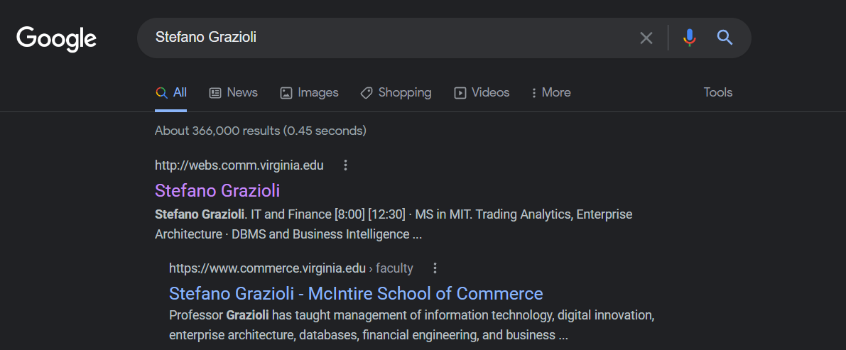
Searching in large datasets

Slide 5
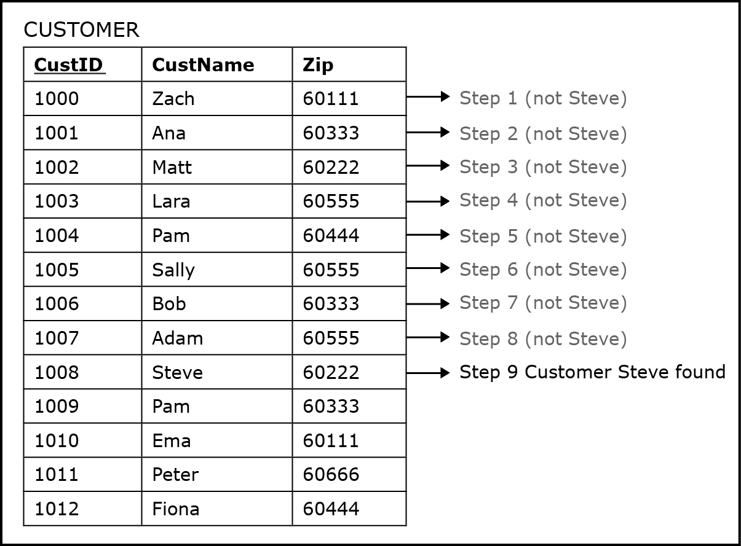

Looking for “Steve”
How many steps?
Notes:
Linear search o(n)
Binary search o(log n)

Slide 6
Looking for “Customer 1008”
How many steps if we are taking advantage of the fact that PK is always sorted?
1. Pick the midpoint of the total set of rows. 1006 is smaller than 1008, so the target must be below
3. Pick the midpoint of the new set of rows. Found Customer 1008 in three steps!
2. Pick the midpoint of the new set of rows. 1010 is larger than 1008, so the target must be above

Slide 7
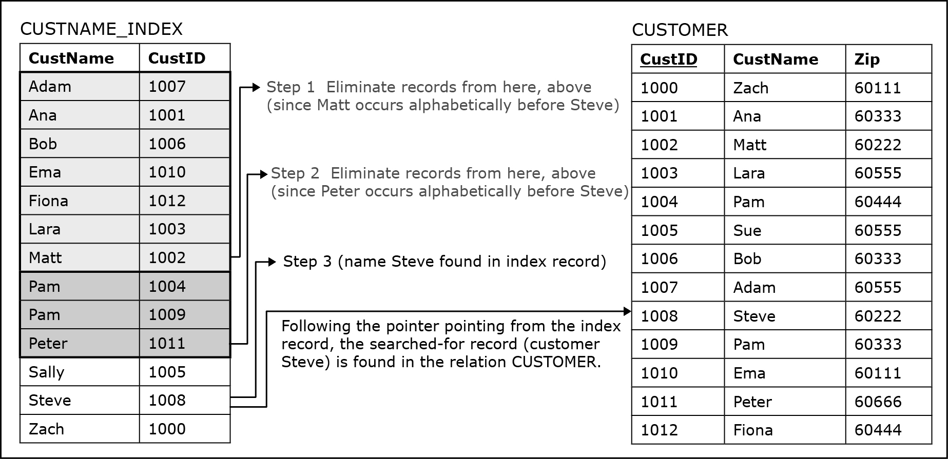
Looking for “Steve” (take 2)
CUSTOMER_INDEX
An index is a separate file built by the DBMS in advance to speed up searches
Cust Name | CustID
Adam | 1007
Ana | 1001
Bob | 1006
Ema | 1010
Fiona | 1012
Lara | 1003
Matt | 1002
Pam | 1004
Pam | 1009
Peter | 1011
Sally | 1005
Steve | 1008
Zach | 1000
1. Cut the set in half. Alphabetically Matt comes before Steve, so Steve must be below
2. Sally comes before Steve, so Steve must be below
4. Found Steve! Now I know he is Cust_ID 1008 and can look for him in the CUSTOMER table
3. Zach comes after Steve, so Steve must be above
How many steps?

Slide 8
Looking for “Steve” (take 3)
addr
address
address
address
address
address
address
address
address
address
address
address
table CUSTOMER.
address
address
How many steps?

Slide 9
Indexes
are mechanisms to speed up search (select)
Trade offs: insert time vs. select time, disk space vs. search speed
CREATE INDEX custname_index ON customer(custname);

Slide 10
You Do The Talking
Name
College, major…
Impression on Power BI?
Favorite GenAI?
Things that I like about the class
Things that can be improved

Slide 11
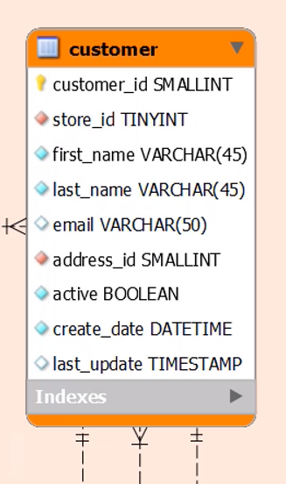
Datatypes
INT
Tell the DBMS the kind of information that is stored in a column.
One per column, in CREATE TABLE
Examples: int, date, datetime, money, char, varchar(), image…
Full list of Datatypes in Transact-SQL (MSFT dialect of SQL) and MySQL
INT
INT

Slide 12
WINIT
What is new in IT

