Slide 1


Exploring a realistic case
The Comm3220 DM4DM Capstone

Slide 2
Critical Thinking
Intro to Wide World Importers, our Capstone case
Realistic
Database for the SQL quiz II
Context for MP #10
12/1 SQL Quiz in Shumway LAB 230 test it and let me know!

Slide 3
You Do The Talking
Name
College, major…
Favorite GenAI?
Hardest thing so far in the course?
Things that I like about the class
Things that can be improved

Slide 4
Orange words
Index
Datatype

Slide 5
What is New in IT

Slide 6
World Wide Importers
Capstone project (Quiz II & MP10)
Base Case from Microsoft, 2023 edited by Stefano Grazioli
Notes:
Fictional but realistic business case

Slide 7
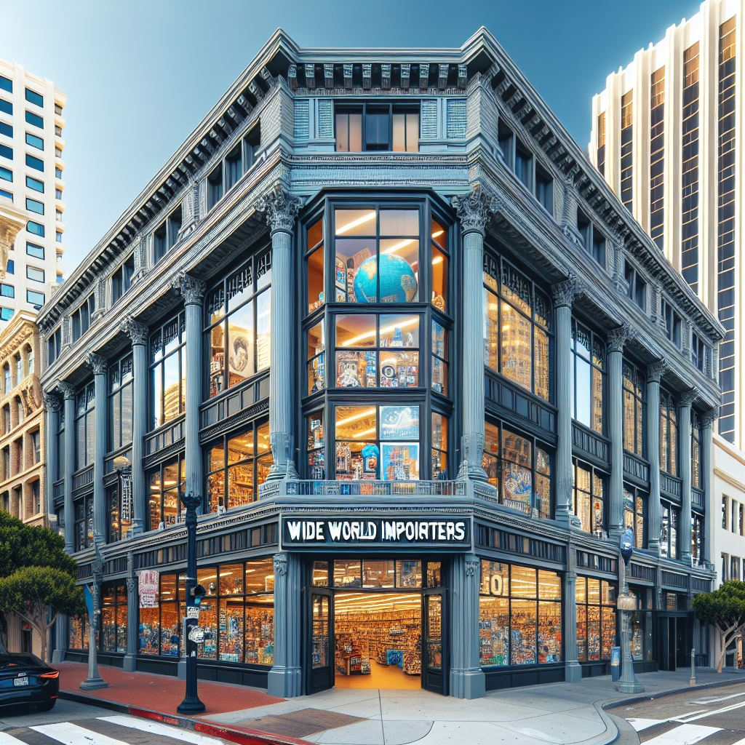
Navigating large databases
Wide World Importers (WWI) is a wholesale novelty goods importer and distributor operating in the San Francisco Bay Area.
WWI's customers are US specialty stores, supermarkets, computing stores, tourist attraction shops, and some individuals.
WWI also sells to other US wholesalers via agents who promote the WWI products.
WWI buys goods from suppliers and other novelty wholesalers.
WIDE WORLD IMPORTERS

Slide 8
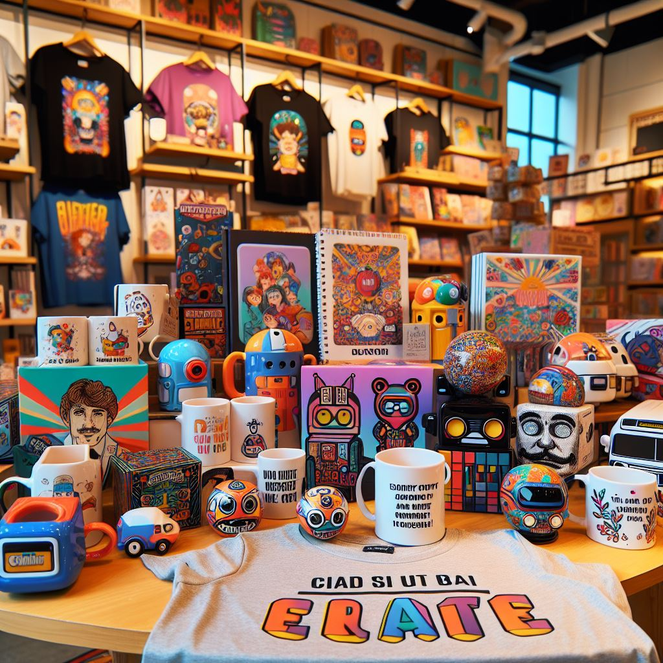
The novelty items for sale: toys, mugs, t-shirts etc.
WWI also purchases large volumes of packaging materials and sells them to its customers.

Slide 9
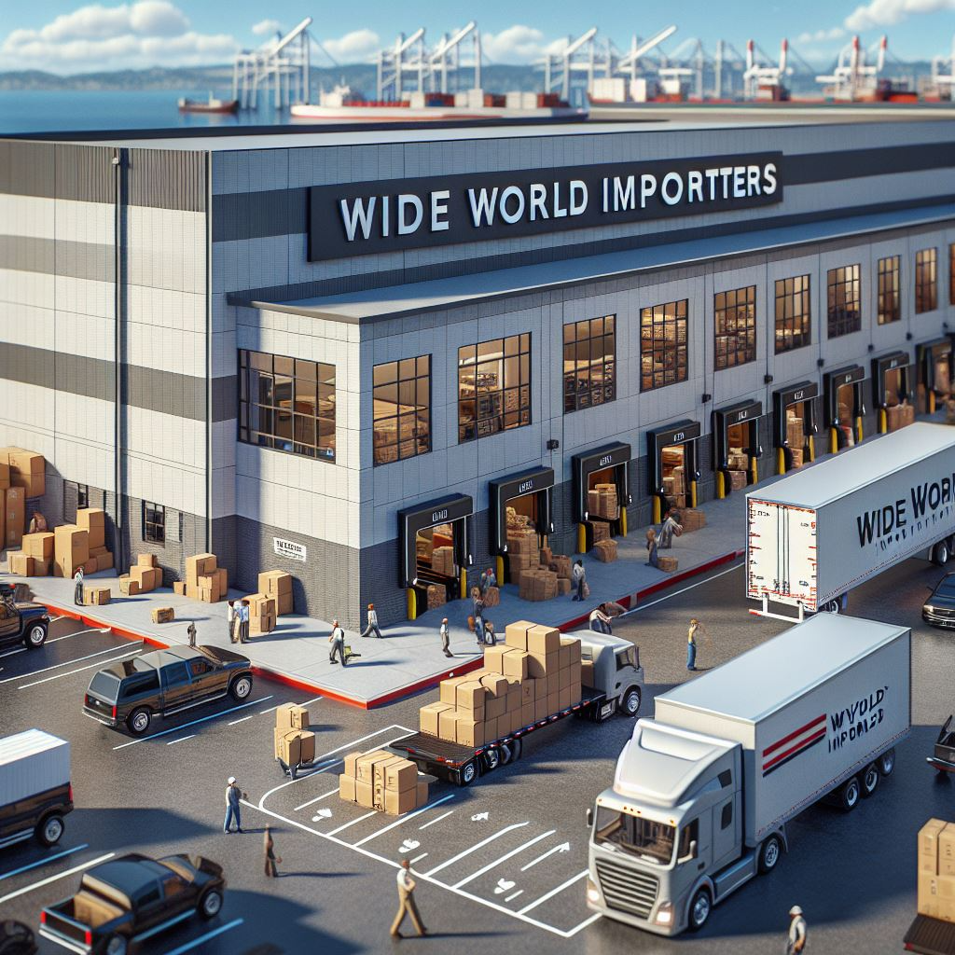

WWI stocks the goods in its warehouse
To meet food handling requirements, WWI must monitor the temperature in its chiller room. Its trucks that have chiller sections. (out of scope for COMM 3220)

Slide 10
Operating Model
WWI purchases goods from suppliers.
Suppliers send the items, WWI stocks them in the warehouse
Customers order items from WWI
WWI fills the customer order with stock items in the warehouse. When they don't have sufficient stock, they order additional stock
Some customers don't want to wait. WWI sends what’s available and backorders the reminder
WWI invoices customers for the stock items
WWI delivers stock items to customers either via their vans, or other freight methods.
Customers pay invoices to WWI.
WWI pays suppliers for items that were on purchase orders.

Slide 11
WWI built a database to run its business…
Expected features of this database? Make a list.
Notes:
Relational
Has indexes
Normalized
Large
Structured

Slide 12
Operating Model
WWI purchases goods from suppliers.
Suppliers send the items, WWI stocks them in the warehouse
Customers order items from WWI
WWI fills the customer order with stock items in the warehouse. When they don't have sufficient stock, they order additional stock
Some customers don't want to wait. WWI sends what’s available and backorders the reminder
WWI invoices customers for the stock items
WWI delivers stock items to customers either via their vans, or other freight methods.
Customers pay invoices to WWI.
WWI pays suppliers for items that were on purchase orders.
Identify a few entities.

Slide 13

WWI contracted the pros at Microsoft to design and build their database….

Slide 14
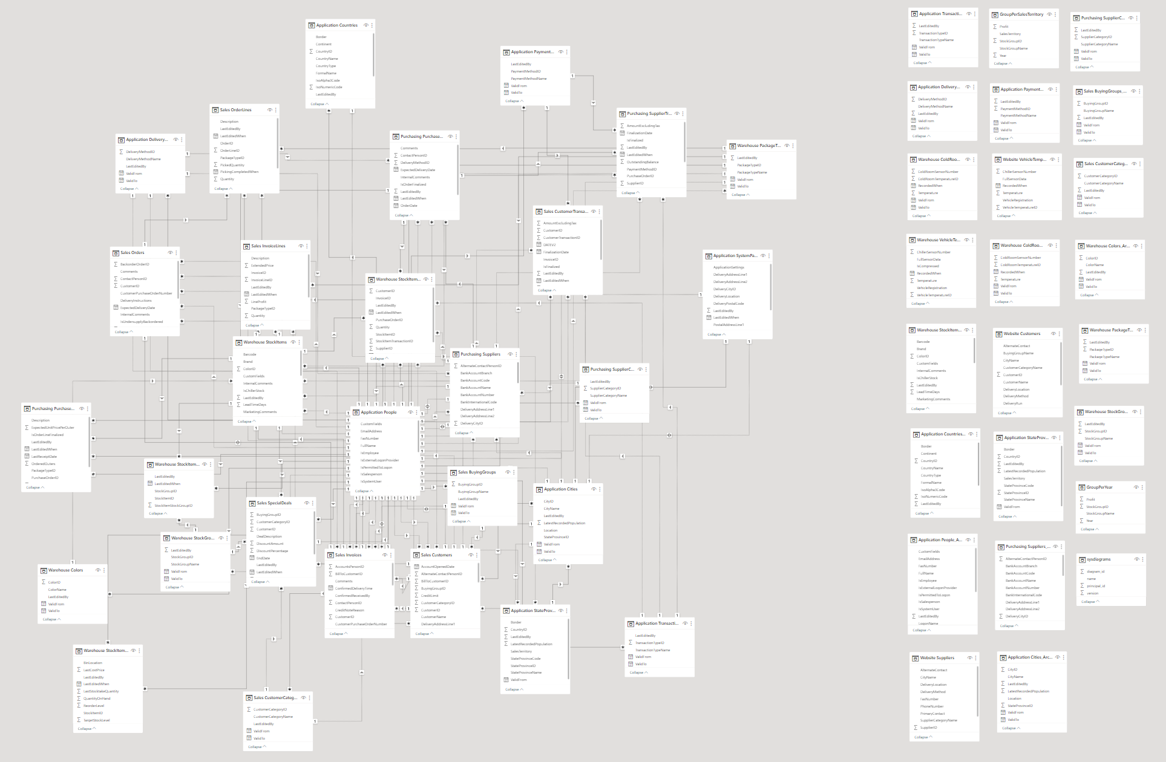
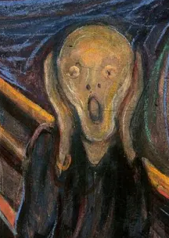
Comm 3220 student

Slide 15
How to navigate large databases
Fear not – you got this.

Slide 16

That went well. Now what?
Figure out where the data is and how to get it (tools, servers, connections…)
Understand the data (names, meanings, organization)
Create SQL queries to get the answers
From Monday, September 1st (Your first job at Smallbank)

Slide 17

1. Figure out where the data is and how to get it
Server: f-sg6m-s4.comm.viriginia.edu
Pwd: your SQL Server pwd
Tools: PowerBI, ADS
WWImportersDB
Use the lab computers because of their larger screens
Make sure you can access the DB

Slide 18
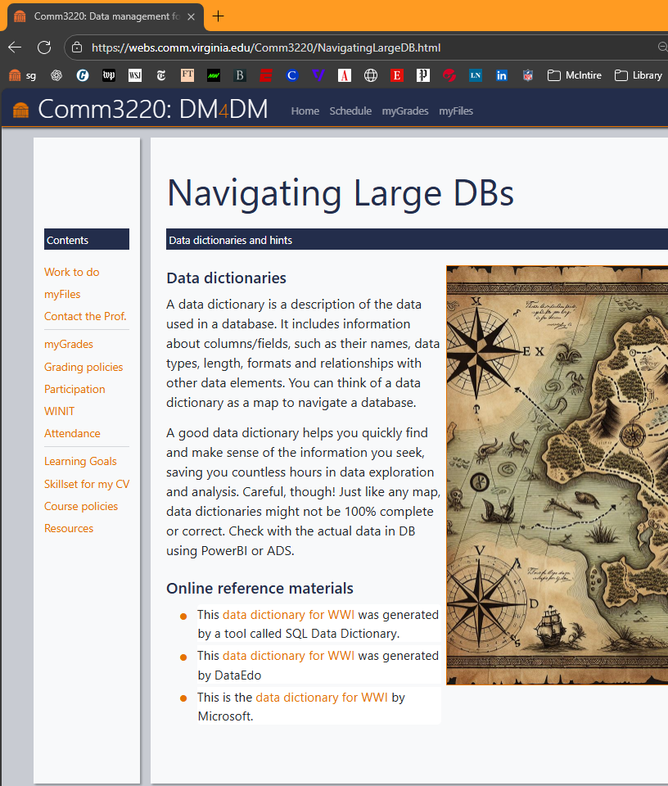
2. Understand the data (names, meanings, organization)
https://webs.comm.virginia.edu/Comm3220/NavigatingLargeDB.html
This is the hardest part of the WWI capstone
Use ADS and Power Bi
Browse the dictionaries
Explore!

Slide 19

3. Write your queries
How many customers do we have by state? Show their number descending and the state

Slide 20
Practice Queries I (next time)
How many customers do we have per state? Show the number descending and the state
List the products and their categories
What is the revenue so far in 2016?
List revenues for the Chocolate frogs, delivery state by delivery state (order by revenue, largest on top)
Who is our supplier for the Halloween Skull Masks (id 146-149)?
What is the revenue by category (all data)?
Who is 'LG' (these are initials) that wants us to deliver in Marion Hill? Full name and phone number.
What is the gross margin by customer? [ask your AI what gross margin is]
List in decreasing order the percent of total ‘profit’ we got in 2015 from each product (percent of total profit = profit from that product / total profit)

