Slide 1


Quiz II review

Slide 2
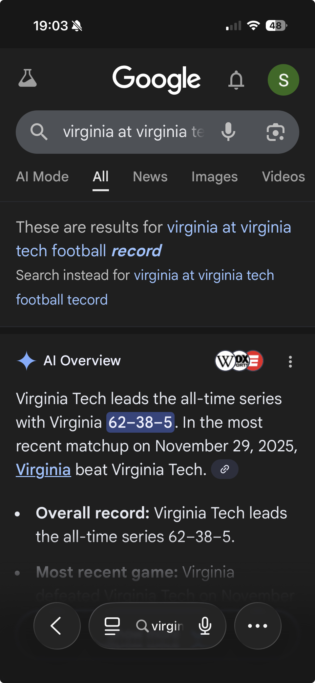

Slide 3
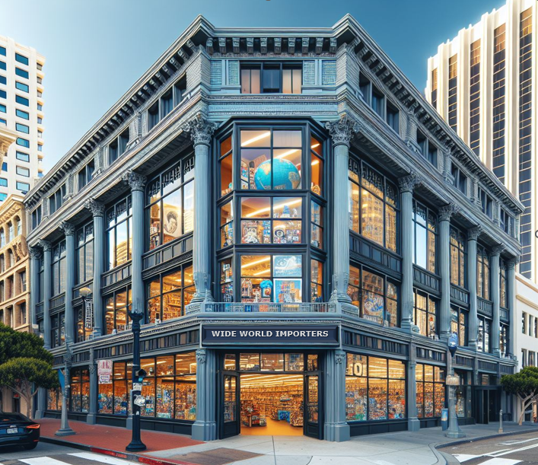
MP10 – the last!
Due on Tue 12/9 at midnight
Similar to Nolex
Give yourself plenty of time

Slide 5
SQL Quiz II
Similar to the previous quiz, but with a larger, more realistic DB.
No insert, update, delete, create tables or views
Unless necessary, use invoice data rather than order data when both are available
Formatting is required (not shown in the sample queries)
Union, subqueries may be necessary

Slide 6
SQL Quiz II
Make sure you can connect while in Shumway Lab 230
Most students will use the big screen in the lab computers to explore the DB with Power BI, and run queries from their own laptops.
You can do as you prefer

Slide 7
SQL Quiz II
Task
Create an ADS notebook alternating the number (e.g., Q7 no need to copy the text) of the questions and the SQL query that produces the corresponding answer when run. OK if you do not do them all. Do as many as you can.
Criteria (same as for QUIZ I)
Read carefully what is being asked. Your SQL must produce the correct answer and no unneeded extra data. If you are asked for a date, return a date, for a number, return a number, etc.
One query per question. Simple queries are better.
If a question does not ask for specific columns, provide them all, except duplicates
If asked to show data about a person or an item, always show their ID in addition the their name. For cities, use id and name.
Do not show duplicated records or columns
All result columns must have an easy-to-understand name
All dollar figures are formatted with ‘$’ and commas, no decimals (unless required). Integers have commas and no decimals. Percentages have 1 decimal, interest rates have 3.

Slide 8
Practice Queries I
Solutions provided in ADS for this set “Practice queries I” only
How many customers do we have per state? Show the number descending and the state
List the products and their categories. Order by product ID and Category ID
What is the revenue so far in 2016?
List revenue for the Chocolate frogs by delivery state (order by revenue, largest on top)
Who is our supplier for the Halloween Skull Masks (id 146-149)?
What is the revenue by category (all data)? <- Challenging!
Who is 'LG' (these are initials) that wants us to deliver in Marion Hill? Full name and phone number.
What is the gross margin by customer? Order by gross margin. [ask your AI what gross margin is]
List in decreasing order the percent of total ‘profit’ we got in 2015 from each product (percent of total profit = profit from that product / total profit)

Slide 9
Practice Queries II
What is the revenue by year? (only compute 2013-15: we do not have all the data for 2016)
Who are our top ten customers by invoiced revenue in 2015?
Who is our main supplier? Use the cost data from the customer invoice (cost = revenue – profit)
Are we losing money on any of our products? How much per product? Do the analysis year by year. Order by year and then by loss.
What is the gross margin quarter by quarter (all data)? order by year and quarter
How many "Plush Shark Slippers" across colors and sizes did we sell in total in 2015?
List the profits from our product categories in descending order << challenging! See the suggested solutions
What is the revenue by month in 2016 in Texas. Order by month.
What are the top ten products (by revenue) we sold in Texas?

Slide 10
Practice Queries III
List our three most successful products by revenue in 2015 in Virginia and the three in Maryland
For the top item above, list revenue and the total quantities sold in each of the available years
What happened to the product above in 2016? Show revenue month by month, ordered by month (chronologically).
What is the total cost by supplier? Use the invoice numbers from the customer invoice.
What is the revenue by year? (only compute 2013-15: we do not have all the data for 2016)
Are there suppliers with whom we made no business transactions? Sort alphabetically.

