Slide 1

Financial Analytics
Stefano Grazioli

Slide 2
Going overall well
Perceived difficulty
Starting with H13 you may submit as a Team if you have a teamID
Check your teamID
Submitting hmwk as a team

Slide 3
You do the talking
Name, major…
Comfort with finance?
Use of GenAI in the course?
Do you have a team?
Things you like about the class
Things that can be improved

Slide 4

Financial Analytics
Financial analytics is the application of quantitative methods to financial problems: FA, QF, Financial Engineering are synonyms. We focus on the IT aspect of financial analytics. Learning by doing: the Hedge Tournament

Slide 5

Tournament objective: hedging risk
Given an illiquid portfolio of stocks and options, plus some cash,
invest the cash in other stocks and options to minimize the risk of losses.

Slide 6
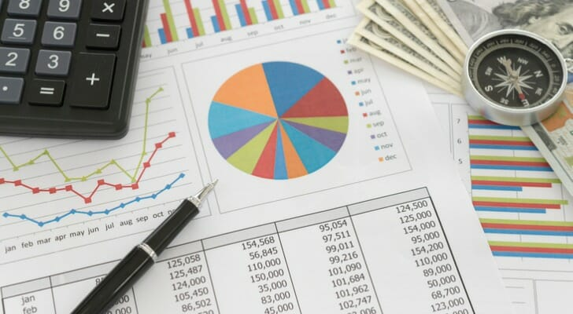
Your portfolio
Cash (Capital account)
Stocks and Options
Initial Positions (IP, illiquid) and Acquired position (AP, liquid)
Long/short positions

Slide 7
Orange words
Pivot table
When to use of pivot table?

Slide 8
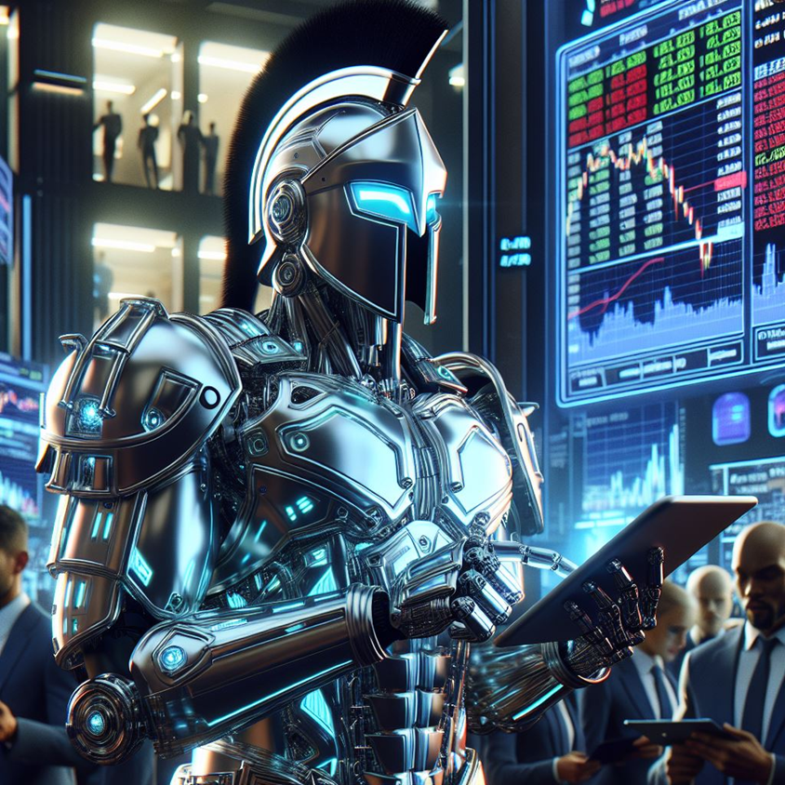
The Spartan Trader
Robotrader / algo-trader / homework

Slide 9
Spartan Trader functionality
Access
data
Compute
metrics
Trade
securities
Recommend
actions

Slide 10
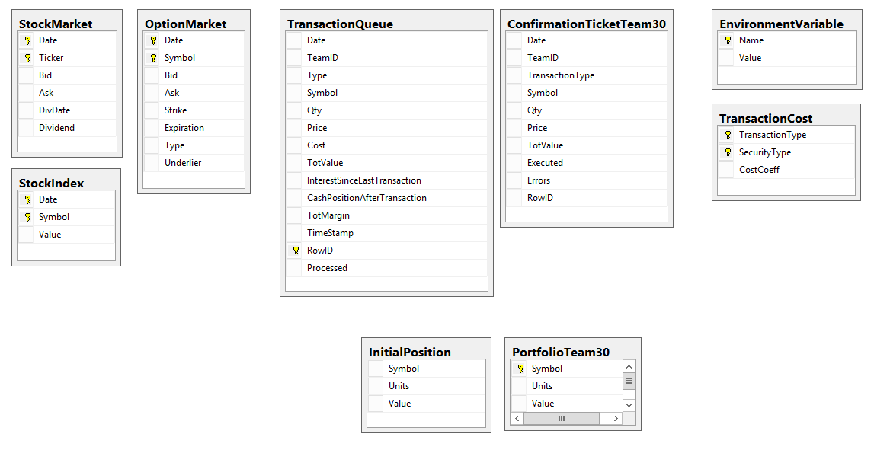
HT datamodel
Automate the access to these tables for H13
Automate the access to these tables for H14

Slide 11
The Datamodel is the same in the three DBs, but data may be different
SERVER: f-sg6m-s4.comm.virginia.edu
Microsoft RDBMS sql server
Hedge Tournament ALPHA
Hedge Tournament BETA
Hedge Tournament GAMMA
Each database has a full instance of the tournament. Each has all the tables. Different instances = potentially different data

Slide 12
Architectural principles
‘Thin code’ manages the user interface, visualizes
Coordinates activities
Business logic
Data access
Hedge Tournament ALPHA
Compliance Engine
DB Manager
Code behind
User interface
Ribbon
Code behind
Portfolio Manager
WS
Hedge Tournament BETA
User
Main Controller
WS
Code behind
WS
Execution Engine
WS
Code behind
Hedge Tournament GAMMA
Recom-mender
Code behind
Global variables

Slide 13
Homework H13
All column names in the tables involved in H13 are to be considered orange words.

