Slide 1


Delta Hedging
The Greeks

Slide 2
Perceived Difficulty
Learning objective: Delta hedging, a popular hedging technique in finance.

Slide 3
Name, major…
Not-yet mentioned used of genAI?
All set with your team?
Things you like about the class
Things that can be improved
Attitude towards the Tournament

Slide 4
Profit curve: long stock
Profit
Long AAPL Share
AAPL price
Just acquired: current AAPL Price $160
Loss

Slide 5
Profit curve: short stock
shorting = flipping horizontally
Profit
Short
AAPL share
AAPL price
Just acquired: current AAPL Price $160
Loss

Slide 6
Profit curves
Profit
long call
Profit
Stock price
Stock price
strike
strike
Loss
Loss
short call
Profit
Profit
short put
Stock price
Stock price
long put
strike
strike
Loss
Loss

Slide 7
Delta Hedging
Objective: determine what is the right type and quantity of securities to counterbalance the adverse change in value of a portfolio of securities.

Slide 8
Manually Hedging a Position in your IPs
I own 100,000 AAPL shares. I am bearish - I think that the share price may go down.
What type and how many options do I need, in order to counter-balance possible price changes and preserve my portfolio value?

Slide 9
Delta Hedging Example
We want to hedge 100,000 long AAPL shares that we have in our IPs.
First, we need to find a security that counterbalances that behavior
Profit
Long AAPL Stock
Stock price
Current Price
Loss

Slide 10
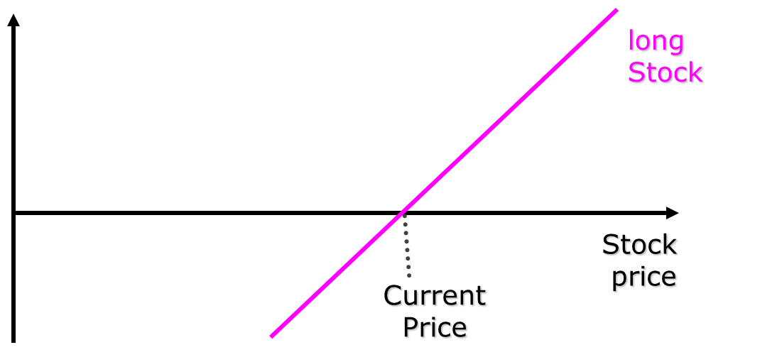
Step 1: Choose a security with which to hedge
Profit & Loss
Profit & Loss
long call
Stock price
Stock price
strike
strike
short call
Profit & Loss
Profit & Loss
short put
Stock price
Stock price
long put
strike
strike

Slide 11
Short calls have the right behavior (also long puts)
Long Stock
Profit & Loss
short call
Total P&L
Strike
Stock price
Current Price

Slide 12
Comparing the total P&L with and without the short call
BETTER OFF
GIVING UP BIG PROFITS
long Stock
LESS LOSS – COULD BE LARGE
Profit & Loss
Total P&L (includes short call)
Strike
Stock price
Current Price

Slide 13
Long puts have the right behavior
Profit & Loss
Long Stock
Current Price
Total P&L
Strike
Stock price
Long put

Slide 14
Comparing the total P&L with and without the long put
Profit & Loss
BETTER OFF
GIVING UP SMALL PROFITS
Long Stock
LESS LOSS
Current Price
Total P&L
Strike
Stock price

Slide 15
Step 2: determine how many securities you need to hedge
I own 100,000 AAPL stocks.
I am bearish - I think that the Stock price may go down.
What type and how many options do I need, in order to counter-balance possible price changes and preserve my portfolio value?

Slide 16
Balancing problem
On expiration day, in-the-money call options and shares change value in a symmetric ($1 to $1) fashion
On any other day it may not be the case. The share goes up by $1, the call may go up by less.

Slide 17
What is Delta?
Delta is a parameter. Roughly, it is the change in an option price when the underlying share price changes by a dollar.
C_{t2} – C_{t1}
S_{t2} – S_{t1}
Example1: we observe that a call option price goes up by $1.60 when a share goes up by $2 in the same period Delta_{call} = +1.60 / +2.00 = +0.8
Example2: a put option is up by $0.5, when the share is down by $1. Delta_{put} = +0.50 / -1.00 = -0.5
Delta_{call} =

Slide 18
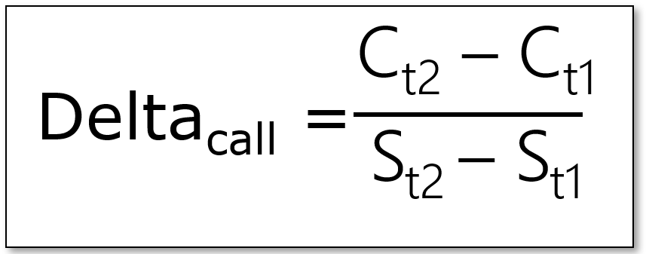
How many short calls are needed to hedge our AAPL position?
Change in value in calls = - Change in value in shares
N_{calls} * (C_{t2}-C_{t1}) = - N_{shares} * (S_{t2}-S_{t1})
N_{calls} = - N_{shares} * (S_{t2}-S_{t1})/(C_{t2}-C_{t1})
N_{calls} = - N_{shares} * 1/Delta_{call}
N_{calls} = - 100,000 * 1/0.8
N_{calls} = - 125,000 i.e., we need 125,000 short calls to make our 100,000 AAPL position price-neutral

Slide 19
Numeric Check: does it work?
We now have 100,000 AAPL & -125,000 Calls on AAPL in our portfolio
Suppose that the APPL share price decreases by $10. What happens to my portfolio?
Delta = Option price change / Share price change = 0.8
so: Option price change = 0.8 * (-$10) = -$8
Change in Total Portfolio Value = 100,000 * (-$10) + (-125,000) * (-$8) =
= -1,000,000 + 1,000,000 = $0
We have a Delta neutral portfolio (yay!)

Slide 21
Homework
Execution

