Slide 1
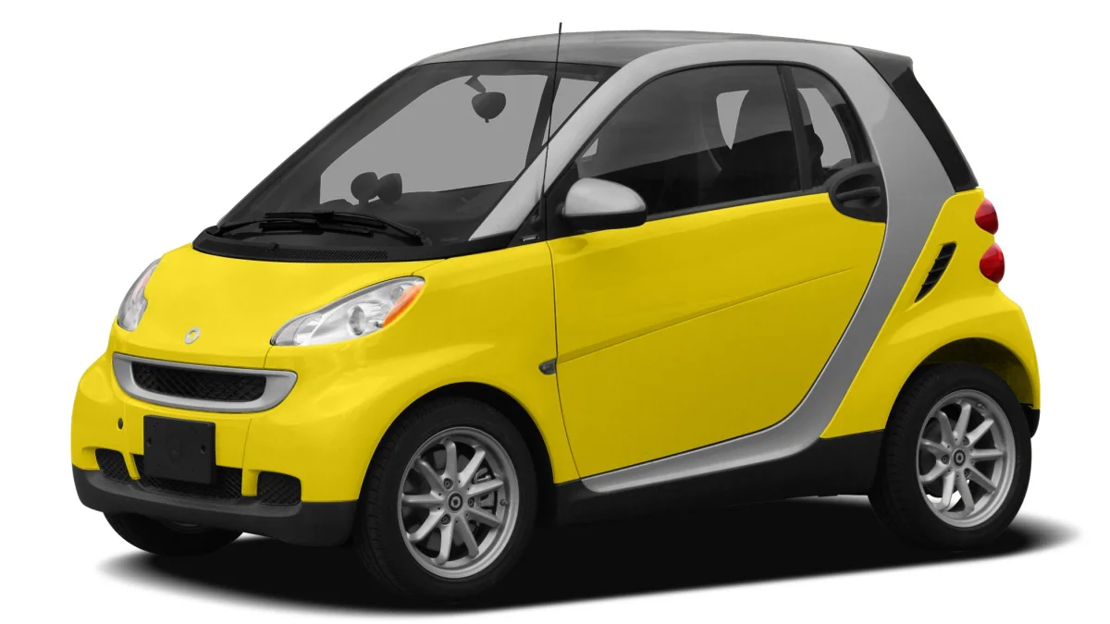
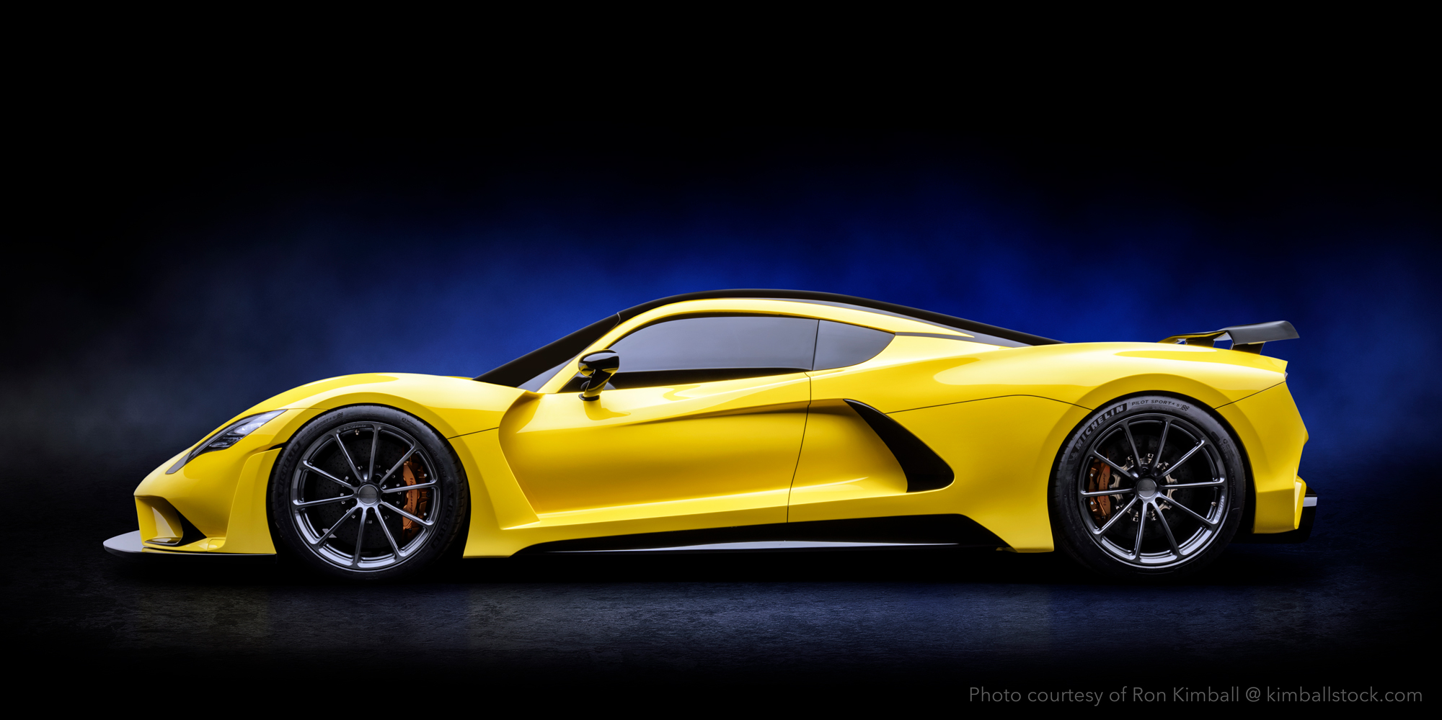
How to do well in the Tournament
Ideas for performance improvements
Notes:
Hennessey venom F5 – fastest street car – 301 mph
$1.6mil
* About a Bugatti Veyron

Slide 2
Rulebook is out
HT runs on demand
  Ask me via MS Teams. Everybody can participate, join/drop anytime.
Next Tue and Thu: no regular class
The SOFTWARE CLINIC is open
  Two mandatory meetings
  sign up outside my door (RRH334)
  Now = lots of timeslots
  Close to the HT = few/none

Slide 3
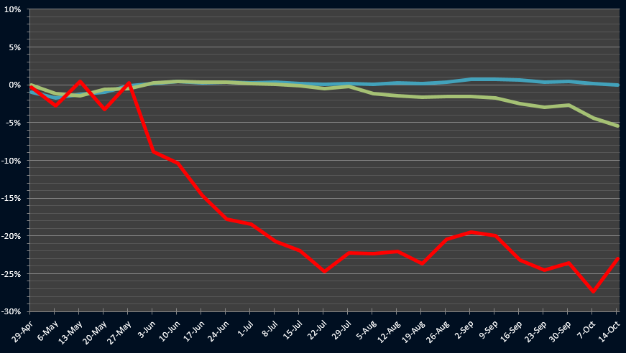
Delta Hedging Weakness
Delta hedging drop

Slide 4
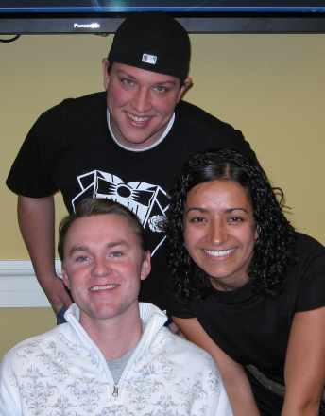
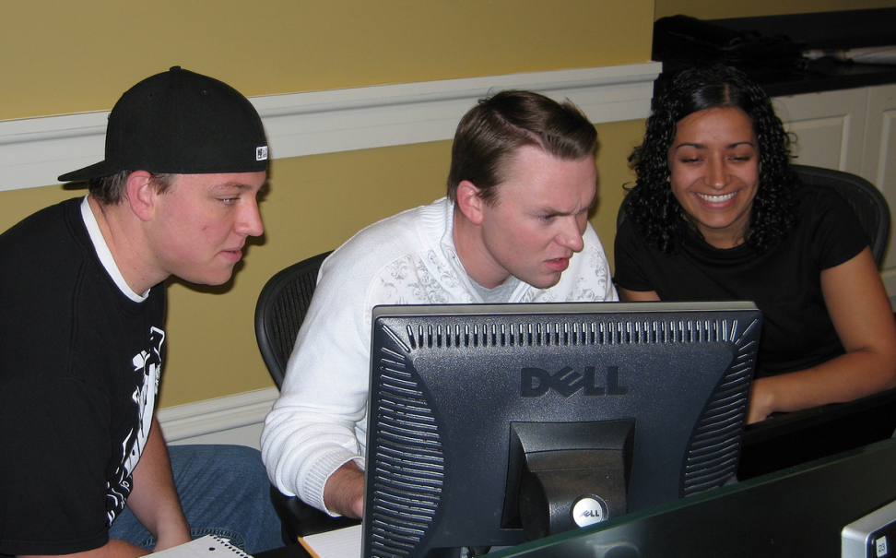
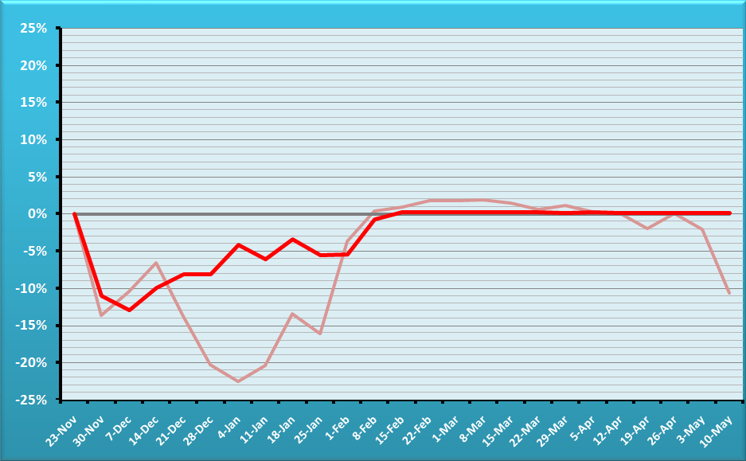
Fall 08 – The Fighters
BUG-FREE
Team
?
AUDITED PERCENT TRACKING ERROR.
Team is in red, reference portfolio semitransparent
OVERALL HT WINNER

Slide 5
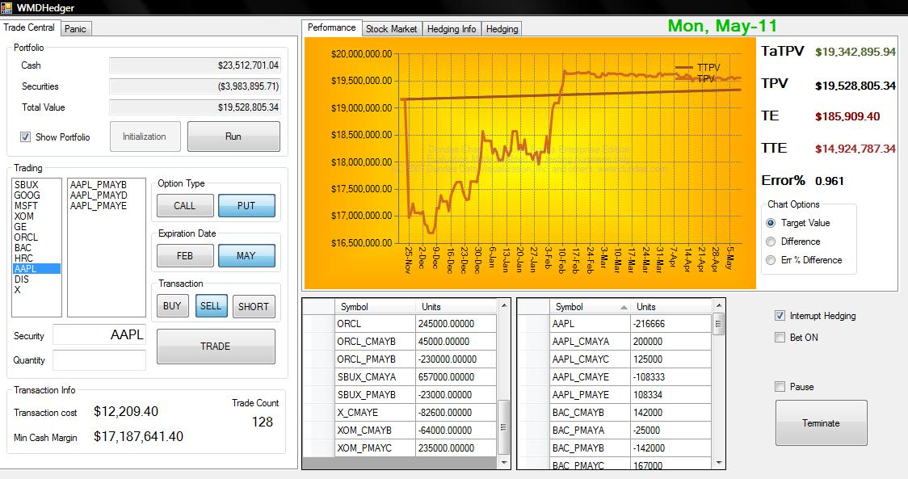

Slide 6
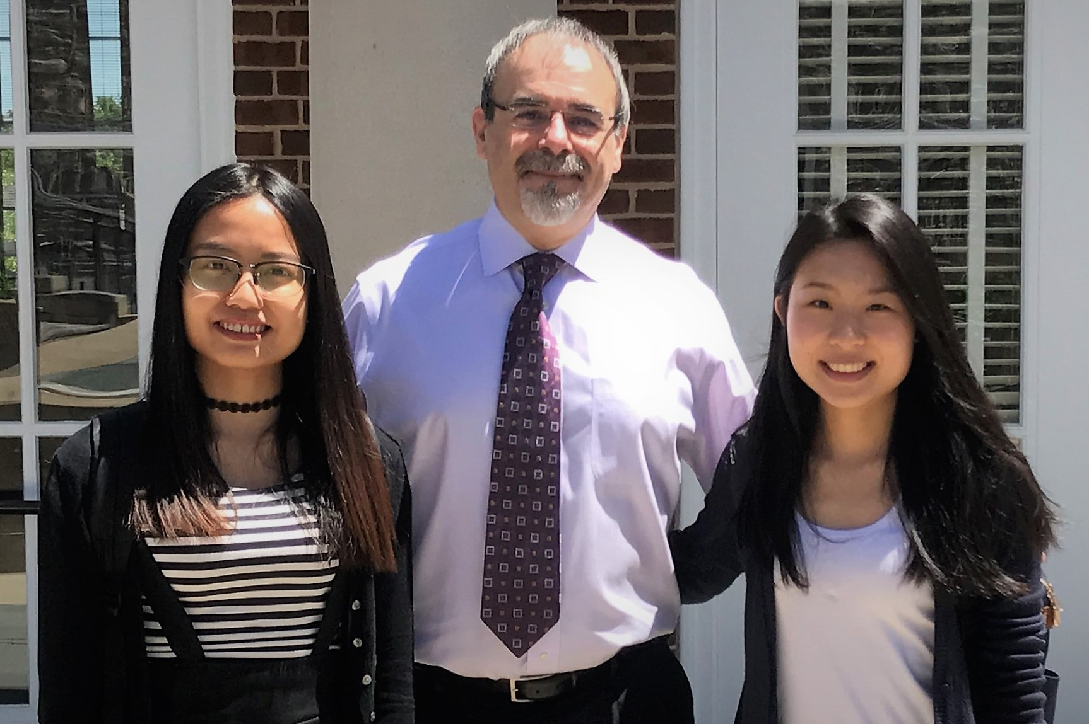
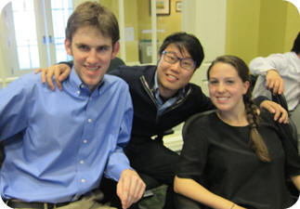
Most of the teams will tweak H24, some will do some optional mini projects, a few will try the dark horses.
OVERALL HT WINNERS 2017
OVERALL HT WINNERS 2013

Slide 7
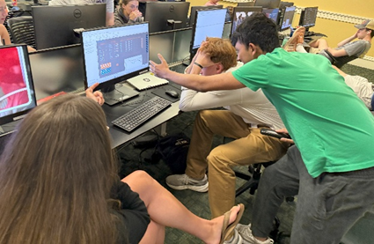
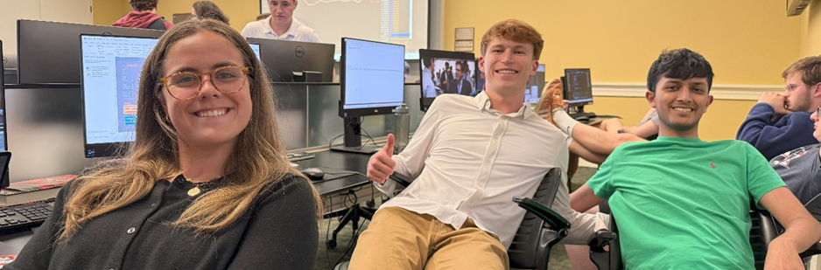
1. Tweaking

Slide 8
EASY parameters to tweak
Frequency of hedging (HedgingToday)
Family Delta threshold (NeedToHedge)
Base scores (CalcCandidateRecScores)
A-E options preferences (scoring rules)
Delta threshold (CalcQtyNeededToHedge)
Family delta target (CalcQtyNeededToHedge)
Available cash cushion (AvailableCashIsLow)
Max buy cushion (MaxPurchasePossible)
Max margin cushion (TooCloseToMaxMargins)
Max short cushion (MaxShortWithinConstraints)

Slide 9
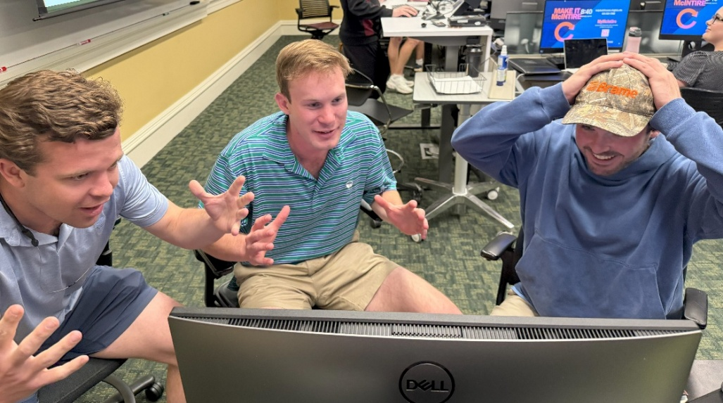
2. Miniprojects

Slide 10

Optional mini-projects
Automatic dividend cashing
Differential thresholds for hedging
Differential family delta targets
Intentional crashes
Edit portfolio on the fly
Bang for the buck
Robo/Sync training
July options
Delta for dividend-paying securities
“Extra profits" button
Error viewer
Dark horses
Gamma hedger (1 and 2)
Synthetics

Slide 11
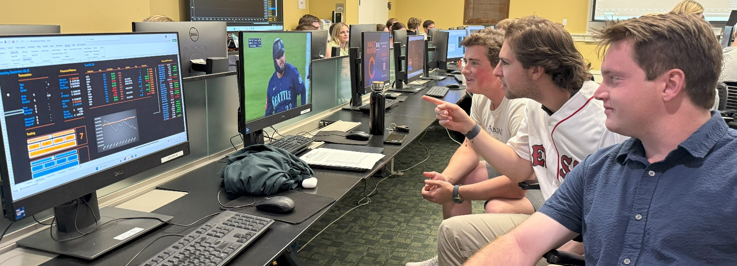
The error log
A recommended optional project

Slide 12
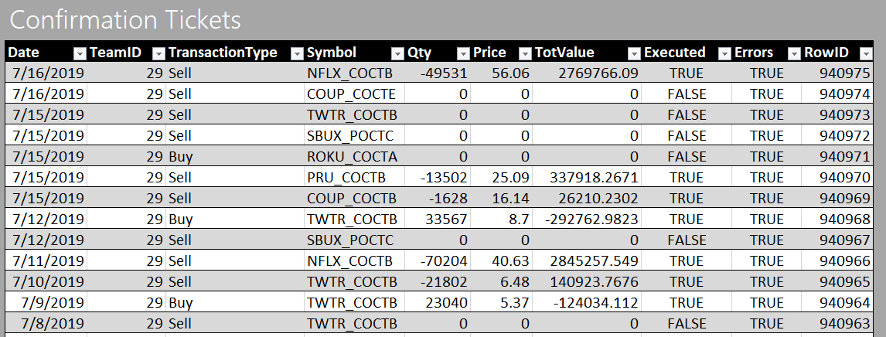
Confirmation tickets
Only produced in the next “day” and only when Athens is running

Slide 13
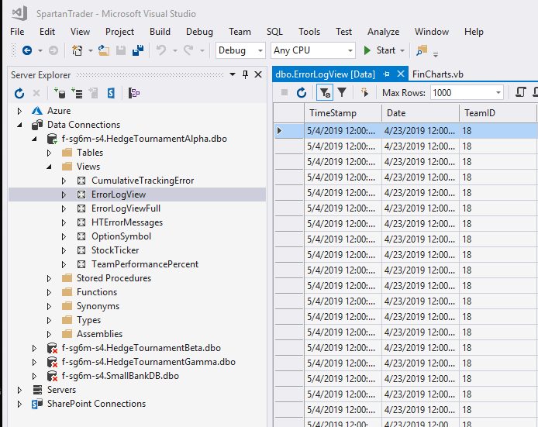
Error log
Each DB has one
Wiped out before each new run

Slide 14
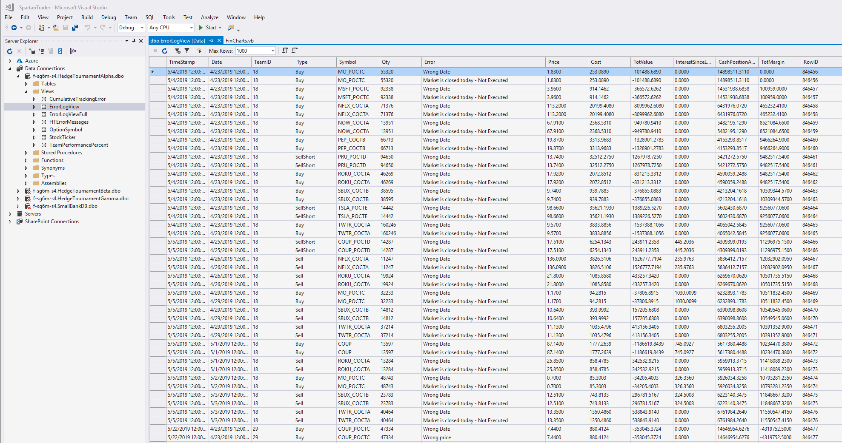

Slide 15
Athens date | Team Date | Tr. Type | Symbol | Qty | Feedback | ROWID
Sunday, May 5, 2019 | Friday, May 3, 2019 | Sell | TWTR_COCTA | 40464 | Wrong Date | 846476
Sunday, May 5, 2019 | Friday, May 3, 2019 | Sell | TWTR_COCTA | 40464 | Market is closed today - Not Executed | 846476
Wednesday, May 22, 2019 | Tuesday, April 23, 2019 | Buy | COUP_POCTC | 47334 | Wrong Date | 846477
Wednesday, May 22, 2019 | Tuesday, April 23, 2019 | Buy | COUP_POCTC | 47334 | Wrong price | 846477
Wednesday, May 22, 2019 | Tuesday, April 23, 2019 | Buy | COUP_POCTC | 47334 | Wrong tot. trans. val. (Excess = -254,344.52) | 846477
Wednesday, May 22, 2019 | Tuesday, April 23, 2019 | Buy | COUP_POCTC | 47334 | Wrong cash position. Excess=179,620.47 | 846477
Wednesday, May 22, 2019 | Tuesday, April 23, 2019 | Buy | COUP_POCTC | 47334 | Transacting twice on the same day - Not Executed | 846477
Wednesday, May 22, 2019 | Tuesday, April 23, 2019 | Buy | MO_POCTC | 32278 | Wrong Date | 846478
Wednesday, May 22, 2019 | Tuesday, April 23, 2019 | Buy | MO_POCTC | 32278 | Wrong price | 846478
Wednesday, May 22, 2019 | Tuesday, April 23, 2019 | Buy | MO_POCTC | 32278 | Wrong tot. trans. val. (Excess = 41,742.72) | 846478
Wednesday, May 22, 2019 | Tuesday, April 23, 2019 | Buy | MO_POCTC | 32278 | Wrong cash position. Excess=-469,512.14 | 846478
Wednesday, May 22, 2019 | Tuesday, April 23, 2019 | Buy | MO_POCTC | 32278 | Transacting twice on the same day - Not Executed | 846478
Wednesday, May 22, 2019 | Tuesday, April 23, 2019 | Buy | MSFT_POCTC | 91466 | Wrong Date | 846479
Wednesday, May 22, 2019 | Tuesday, April 23, 2019 | Buy | MSFT_POCTC | 91466 | Wrong price | 846479
Wednesday, May 22, 2019 | Tuesday, April 23, 2019 | Buy | MSFT_POCTC | 91466 | Wrong tot. trans. val. (Excess = 28,425.35) | 846479
Wednesday, May 22, 2019 | Tuesday, April 23, 2019 | Buy | MSFT_POCTC | 91466 | Wrong cash position. Excess=-515,411.18 | 846479
Wednesday, May 22, 2019 | Tuesday, April 23, 2019 | Buy | MSFT_POCTC | 91466 | Transacting twice on the same day - Not Executed | 846479

Slide 16
Optional mini projects with the confirmation tickets
Write a join that connects your confirmation tickets to the error messages produced by Athens
Create a button to visualize the results of that query

Slide 17
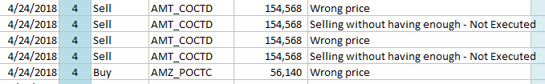
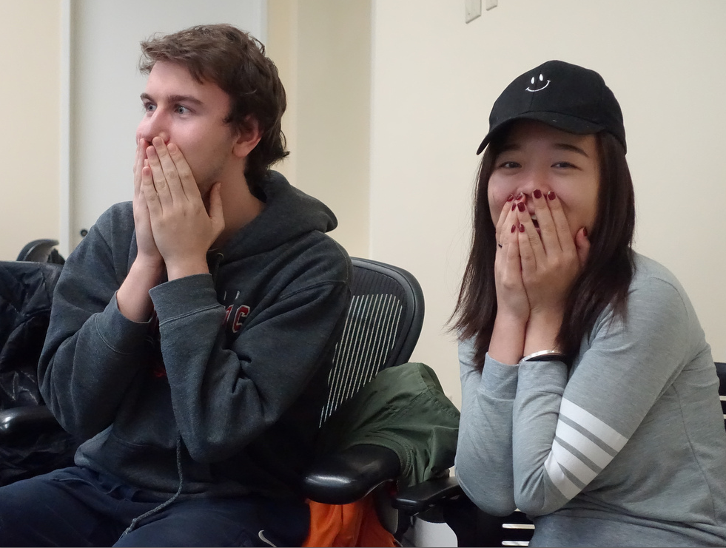
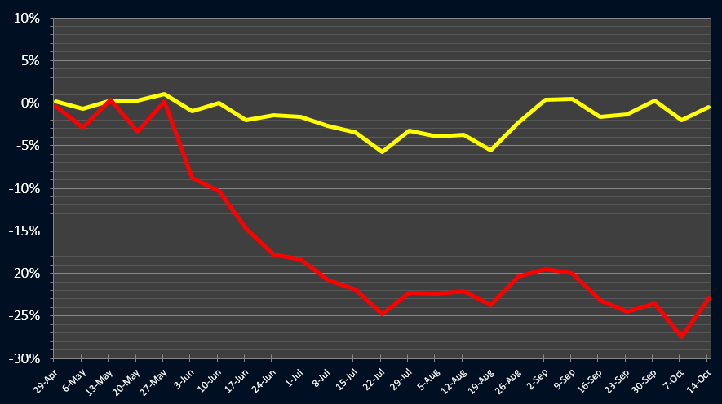

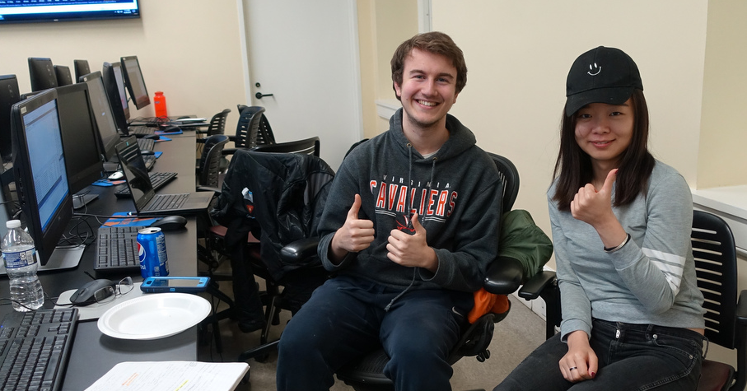
T4 spr18 – The big scare
False start (it might happen to you)
UNDERGRADUATE
RUNNER UP

Slide 18
If you see an error during the tournament
Let’s hope you will not need it

Slide 19
Reversing transactions
Something went wrong in a transaction…
Reversing a transaction that was executed
Reversing a transaction that was NOT executed

Slide 20
Reversing a transaction that was executed
You need to execute on the next day a manual reverse transaction
Example
Buy 1,000 Apple → Sell 1,000 Apple
This will NOT get you back to the exact same place because of the T-costs.

Slide 21
Reversing a transaction that was NOT executed
No need to execute a reverse transaction. You need to manually modify the Acquired Positions Table.
Example
“Buy 1,000 Apple for $102,000” did not go through.
You need to manually subtract 1,000 Apple from AP and
add back $102,000 to your Capital Account.
This will get you back to the exact same place.

Slide 22
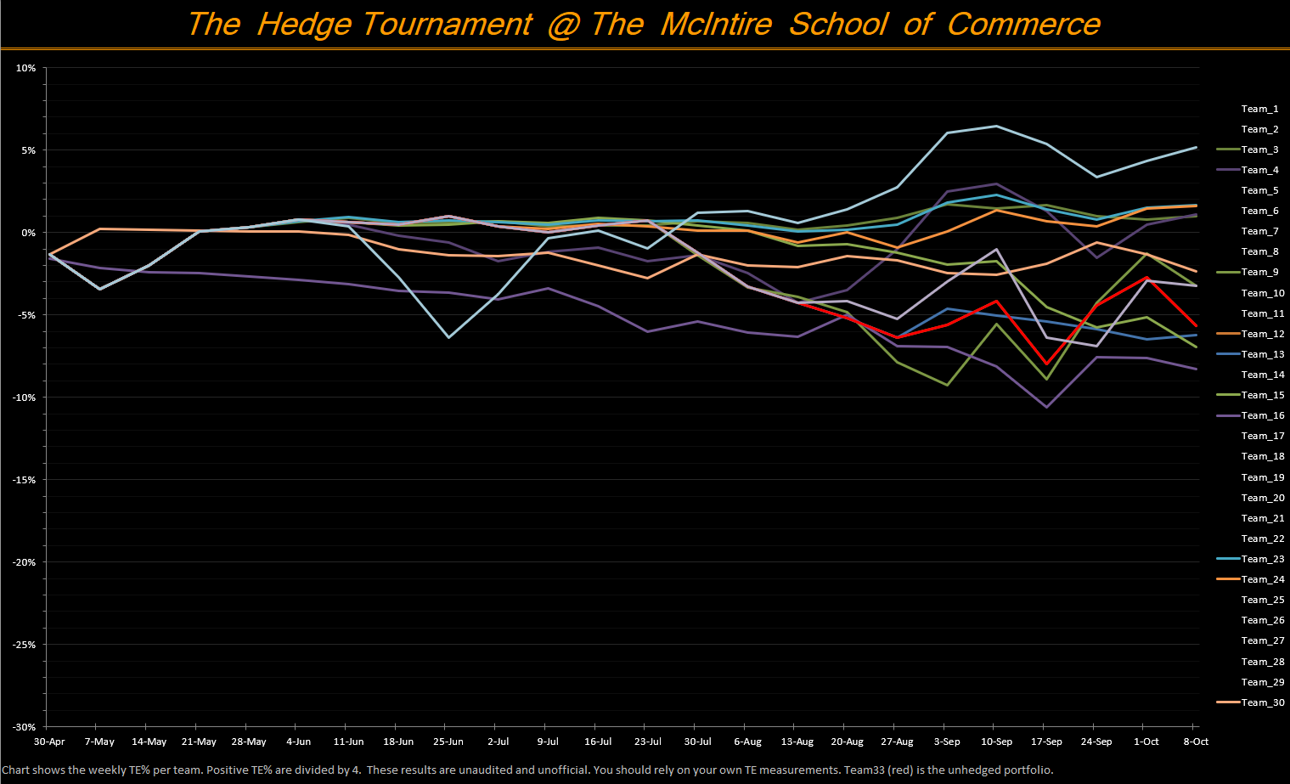
On tournament day…

Slide 23
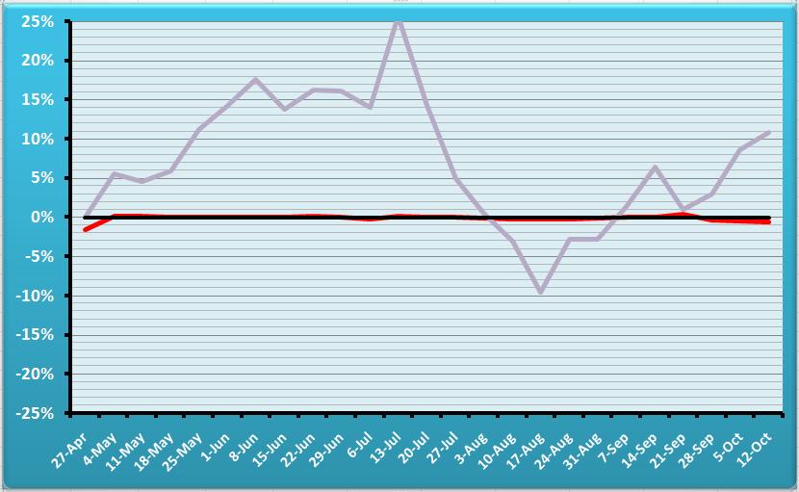
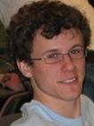
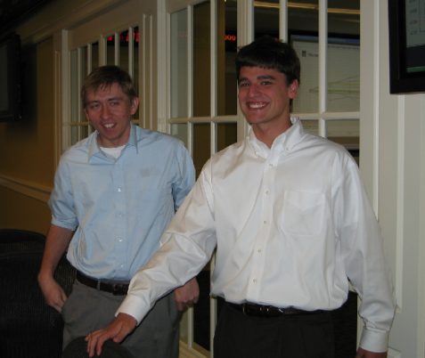
T3 – Gaming The System
PTL (Pardon The Loss)
Mark Paddrik,
Scott Tucker (Ghost) & Michael Ledwith
BUG-FREE
Team
AUDITED PERCENT TRACKING ERROR.
Team is in red, reference portfolio in gray
OVERALL
TOURNAMENT WINNERS

Slide 24
From the rulebook
You cannot trade twice the same ticker or symbol in the same day - i.e., no “money burning.” Both trades will be rejected.

Slide 25
From the rulebook
You may not sell short if you have a long position on the same security.
Example: you can not sellShort 250 GOOG if you hold a long position of 100 GOOG. First you sell the long position, then you go short. You must do so in two separate days.

Slide 26
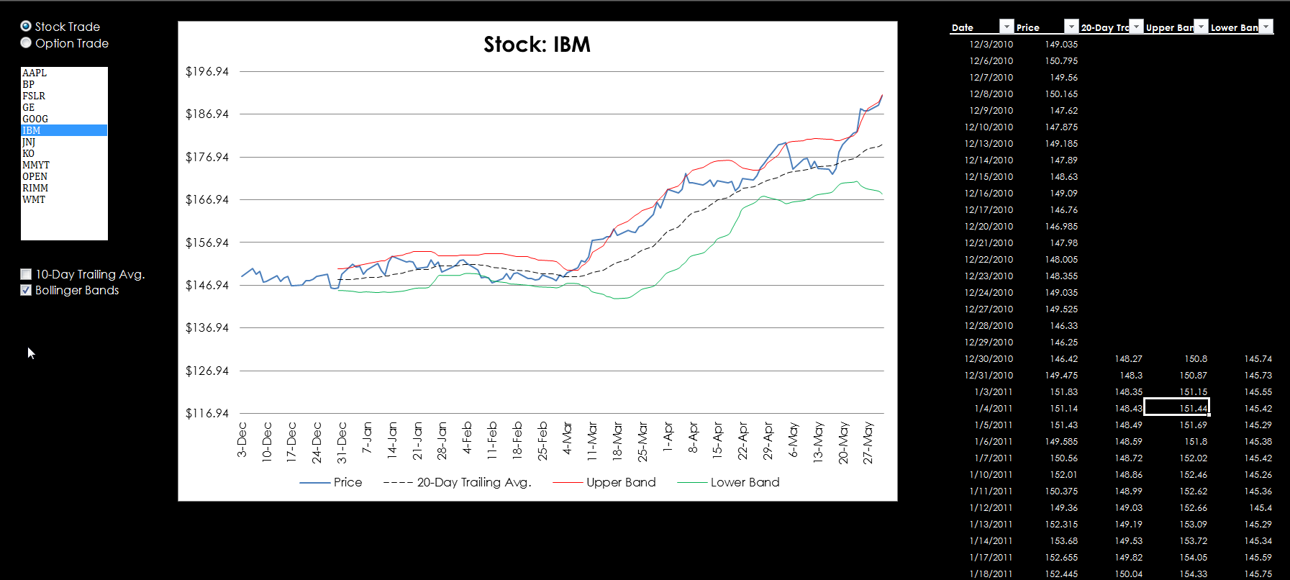

Slide 27
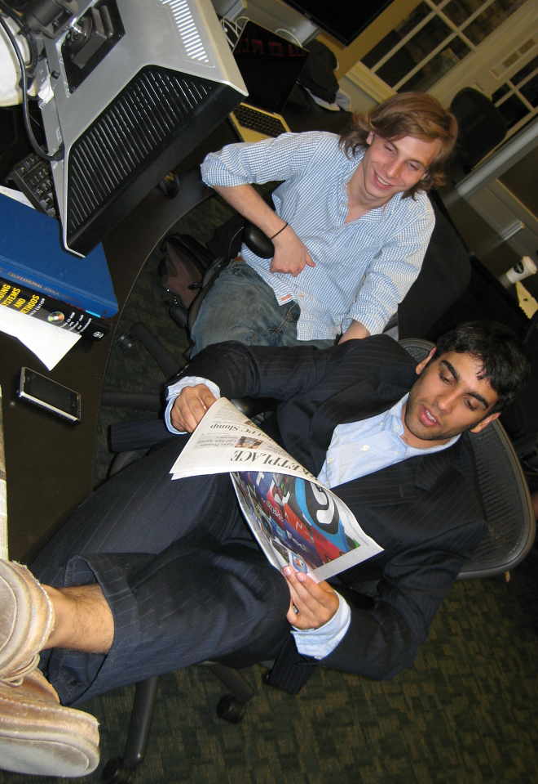
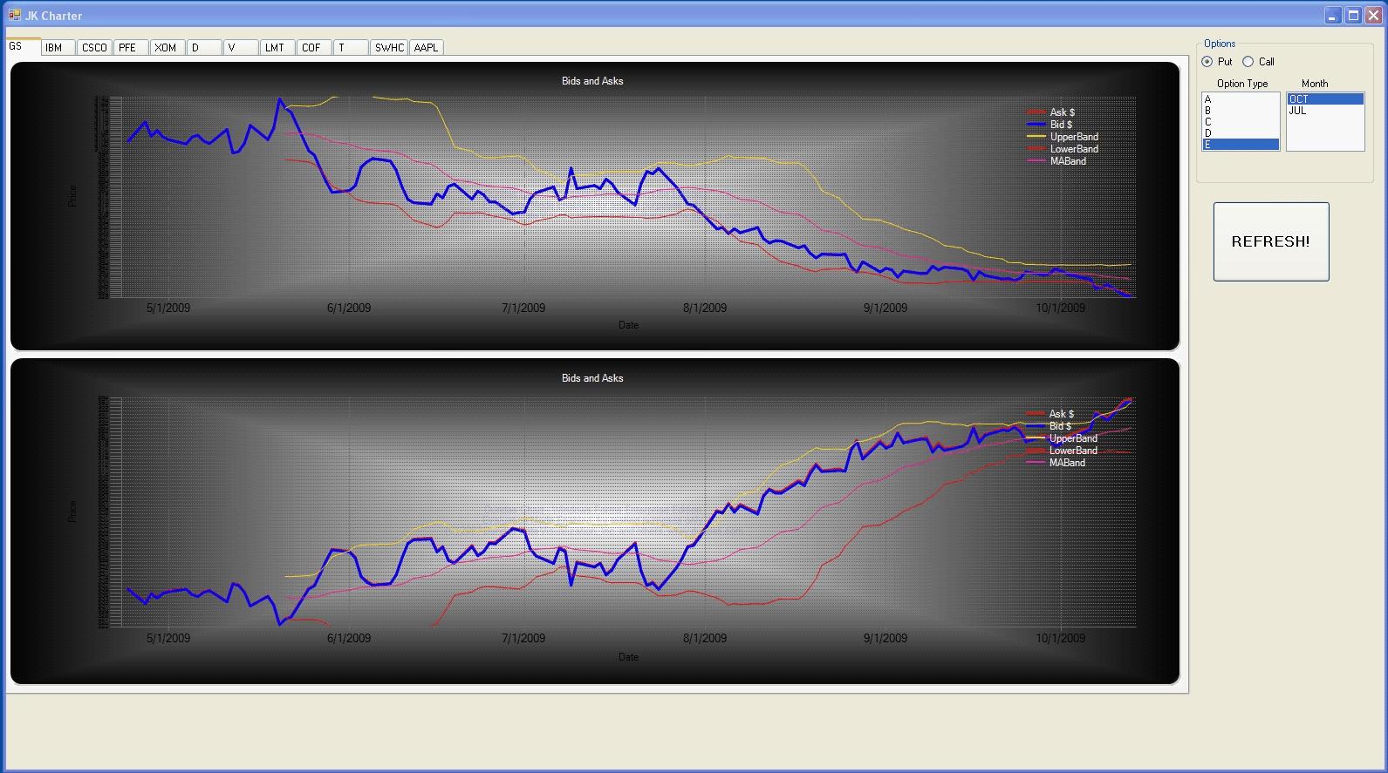
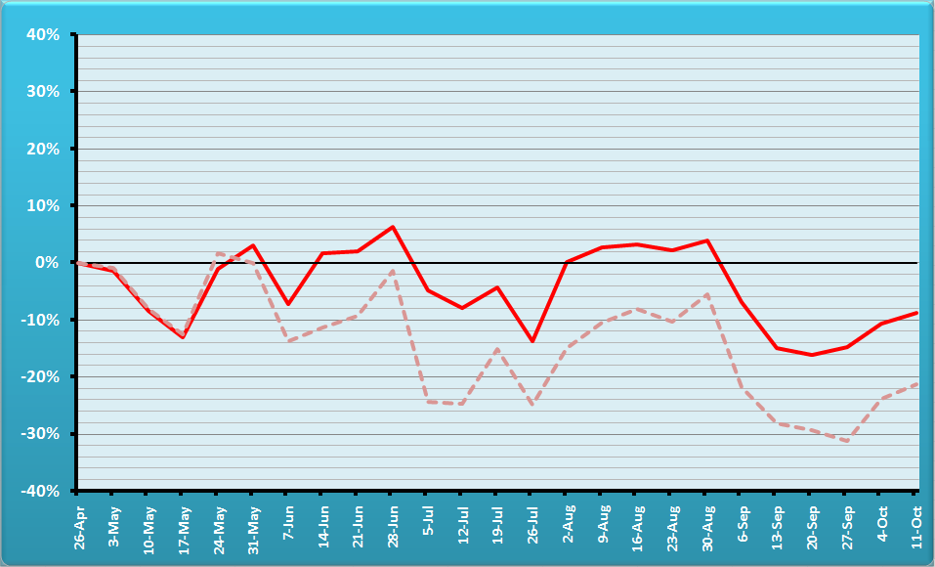
Team 5 – The “Moneymaker”
Jerome Kerviel
Fund Management
AUDITED PERCENT TRACKING ERROR.
Team is in red, reference portfolio semitransparent
Idea: explore new strategies
Notes:
Jérôme Kerviel is a French trader who was convicted in the 2008 Société Générale trading loss for breach of trust, forgery and unauthorized use of the bank's computers, resulting in losses valued at €4.9 billion. (wiki)

Slide 28

3. The Dark Horses
Conditional Gamma
Simultaneous Delta Gamma
Synthetics

Slide 29
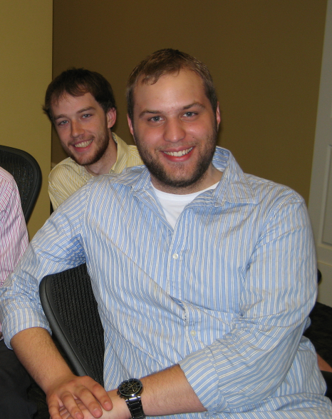
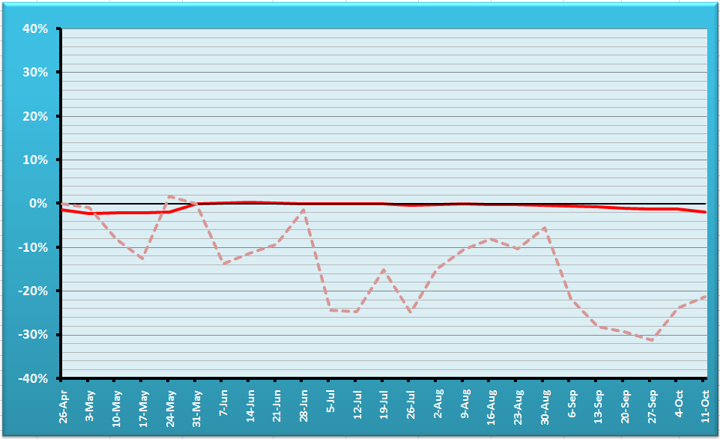
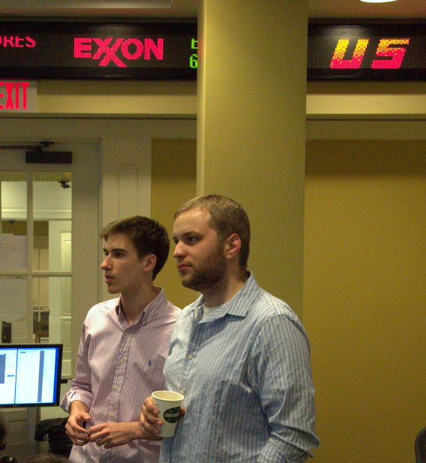
T8 Conditional Gamma
OVERALL HT WINNERS
Bug-free
Team
AUDITED PERCENT TRACKING ERROR.
Team is in red, reference portfolio semitransparent

Slide 30
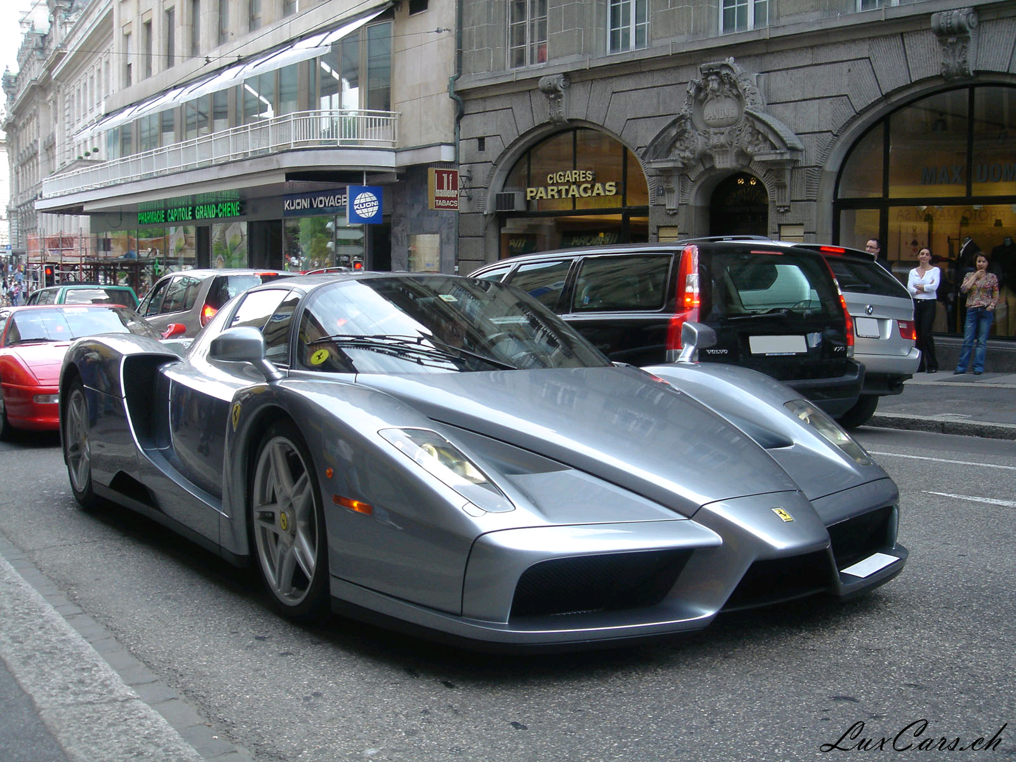
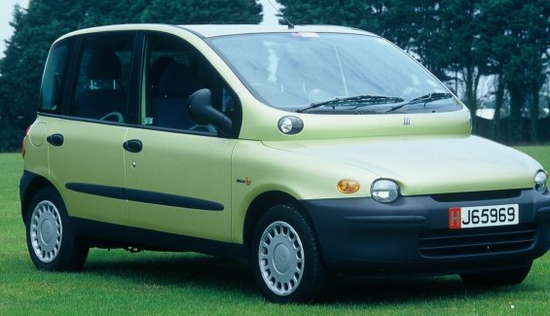
Family Gamma
Family Delta (Δ) measures the change in portfolio value
as the underlier’s price S changes (~speed).
Family Gamma (Γ) measures the rate of change in portfolio value as S changes (~acceleration).

Slide 31
Meaning of Gamma
If Gamma is small (abs.), small changes in S will not affect much Delta (and your portfolio value) ,
so
there is less need to take immediate rebalancing action.
If Gamma is large, small changes in S will affect Delta (and your portfolio value) significantly,
so
there is a stronger need to take immediate rebalancing action.

Slide 32
How to Calculate Gamma
Gamma = N’(d1)
Sσ√ t
N’(d1) = e ^{–(d1)2/2}
√ (2 π)
d1 as in Black Scholes
Gamma
Strike
Stock price S
Notes:
N’ is the prob density function for a standard normal distribution.

Slide 33
Gamma of a Portfolio of Related Securities
Γ_{family} = Σ qty_{i} * γ_{i}

Slide 34
Gamma of a portfolio
During small periods of time t₂-t₁
Δ _{portfolio} = ½ ∗ Γ_{portfolio} ∗ (S₂-S₁)²
Example:
If you do not rebalance, and the underlier price (e.g., GE) drops from $52 to $50, the change of value in a Delta-Neutral Portfolio is approximately
= ½ ∗ Γ ∗ (S₂-S₁)²
= 0.5 * (-10,000) * (52-50)²
= -$20,000
~

Slide 35
Gamma-Neutral Portfolio
More stable than a delta neutral-only.
Cannot use the stock to reach Gamma neutrality because the stock has Gamma = 0
1) Γ_{portfolio} <> 0
2) Γ_{portfolio} + Γ_{x} qty_{x} = 0
3) qty_{x} = -Γ_{portfolio} / Γ_{x}
Warning: Acquiring qty_{x} will disturb Delta neutrality. You will need to rebalance.

Slide 36

Delta Gamma Delta
It’s a financial strategy, not a sorority.
Find out what you need to achieve Delta neutrality. Execute.
Find out what you need to achieve Gamma neutrality. Execute.
Find out what you need to re-achieve Delta neutrality. Stock is ideal because it will not affect Gamma. Execute.

Slide 37
Simultaneous Delta Gamma
Δ_{portfolio} + δ_{x1} qty_{x1} + δ_{x2} qty_{x2} = 0
Γ_{portfolio} + γ_{x1} qty_{x1} + γ_{x2} qty_{x2} = 0
All known except qty x1 and qty x2
{

Slide 38
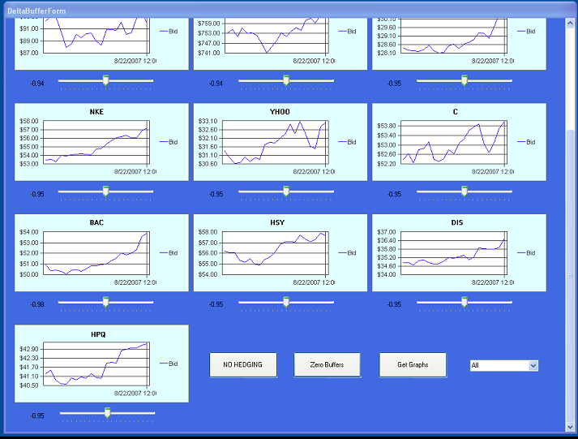
T 14/07
Idea: multiple delta targets

Slide 39
Syntetics

Slide 40
Offset the Position with a
Synthetic Security
Profit & Loss
Perfect hedge, but costly.
Synthetic Short position
Long position
to hedge
Stock price
Total Payoff

Slide 41
Put-Call Parity
For European Ps and Cs that have the same strike K, and expire by the same time t:
P + S = C + K e^{-rt}
We can solve for S, P, or C, effectively synthesizing a security with a combination of the other two and some interest-earning cash.
Example: S = C + Ke^{-rt} – P and
- S = - C - Ke^{-rt} + P

Slide 42
Theta, Vega, and Rho
Conceptually similar to Delta
Theta = change in portfolio value when time changes
Vega = change in portfolio value when the volatility changes
Rho = change in portfolio value when the rate of interest changes

Slide 43

Tip for success
The few mins before and after the beginning of the tournament are critical
Test, test, test and test some more!
Make sure you know what
to do in case of a malfunction

Slide 44
Past performances
May not be indicative of future performances

Slide 45
Transactions per Team 2020
Total transactions = 18,720
Mean transactions per team = 516

Slide 46
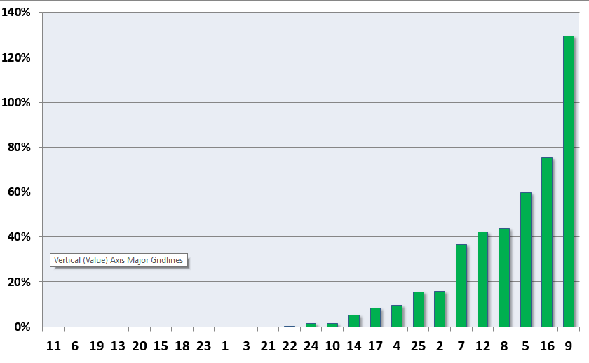
% Errors per Transaction (2016)
Zero bug teams

Slide 47
Cumulative Tracking Error: 2022

Slide 48
Cumulative Tracking Error 2024
Notes:
Orange: MSA
Red: MSComm
Yellow: UG

Slide 50
Honor code
This whole course adheres to the honor code
Simple rule: the code you use in the Tournament must come from the course website or your fingers tapping on your keyboard.

