Slide 1
Algorithmic Trading
Portfolio-family delta hedging: the recommender

Slide 2
Perceived difficulty
New prices (all DBs tonight)
Final IPs soon
Learning Objective: learning how to give hedging recommendations

Slide 3
Name, Major
Better confidence about Fintech?
Things that you like about the class
Things that can be improved
Feeling about the tournament?

Slide 4
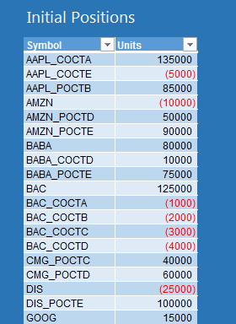
Delta of a portfolio family method
A portfolio family is a set of derivatives with the same underlier
Delta hedging still applies... and it can be made even better!

Slide 5
Delta of an option
Assume that you own a put on GOOG
δ_{put} = -0.5
What does this mean with respect to the stock price?

Slide 6
Delta of a position
Assume that you own 10,000 puts on GOOG
Δ_{position i} = qty_{i} * δ_{i}
What does this mean?
= 10,000 * (-0.5)
= -$5,000

Slide 7
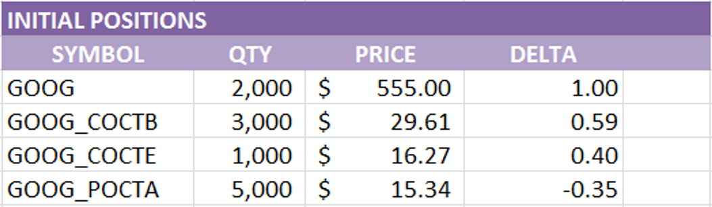
New: Delta of a family
Δ_{family} = Σ (qty_{i} * δ_{i})
Example
2,000 * 1 + 3,000 * 0.59 + 1,000 * 0.40 + 5,000 * (-0.35) = +2,420
long shares
Long calls
Long calls (different strike)
Long puts
“Family” Delta

Slide 8
Delta neutral family
Perfectly hedged family has Family Delta = 0
This means that the sum of the values of the positions in the family does not change as the share price changes.

Slide 9
Key Portfolio Decisions
Family delta = 2,420. So, I need to subtract 2,420 deltas from my GOOG family portfolio, how can I do it?
Sell shares
Sellshort shares
Sell calls (delta > 0)
Sellshort calls
Buy puts (delta < 0)
Buyback short puts
Advantages and disadvantages?

Slide 10
How many securities to a perfect hedge?
Δ_{family} = Σ qty_{i} * δ_{i}
Δ_{family} + qty_{x} * δ_{x} = 0
qty_{x} = − Δ_{family} / δ_{x}
Example using a call with +0.5 delta: -2,420 / +0.5 = -4,840

Slide 11
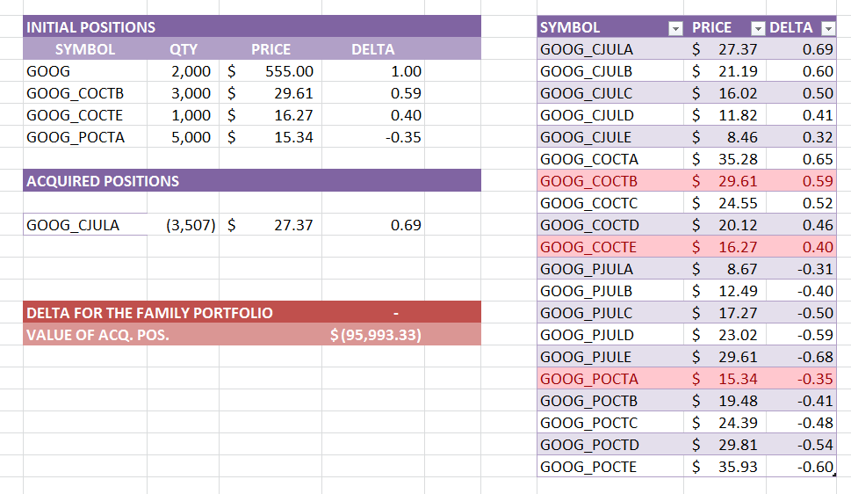
The full example
Delta for the family portfolio of GOOGLE positions: +2,420
0
Capital account: $ 5m
Margin: $ 6m (max. $ 10m)
Pros/cons: cash, horizon, price, tc, stability…

Slide 12
Demo
Portfolio-level Delta Hedging

Slide 14
The Algorithm (homework)
For each of the family portfolios (e.g., GOOG, AAPL, MSFT…)
fill a candidate recommendation list for family_{i}
pick the candidate recommendation with the highest score
store it in the recommendation vector(i)
next
show the recommendation vector contents to the user.
A recommendation is a transaction that has not been executed
To fill a candidate recommendation list for family_{i}
compute the family delta for family_{i}
for each of the 12 possible transactions (buy share, sell share, sell short calls, sell puts…)
find out if it can be used to bring the family delta to zero
assign a base score
compute the needed quantity of the security
find out if it is feasible/adjust the score
insert the candidate recommendation into the recommendation list
next

