Slide 1
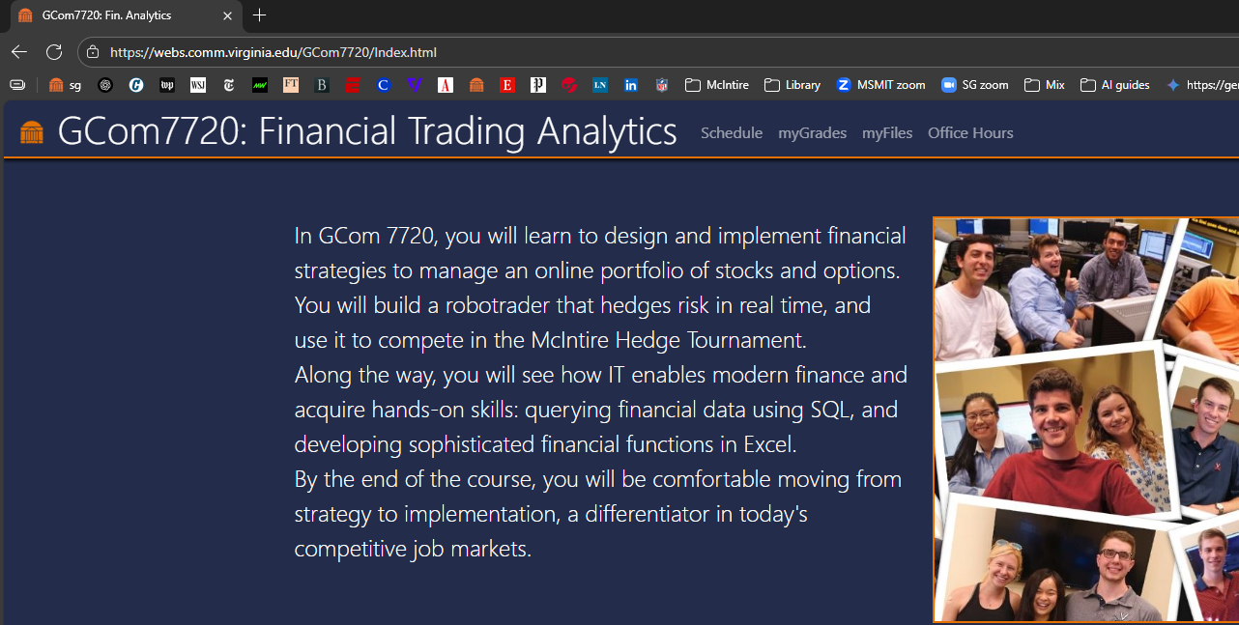
While you wait….
Go to https://webs.comm.virginia.edu/Gcom7720/
Click “myFiles” on the header
Enter your UVA userID and “FinTech!” as password
Complete the
registration to
GCom7720
(We do not
use Canvas)

Slide 2
Financial Trading Analytics
Welcome to the Course!
Stefano Grazioli

Slide 3
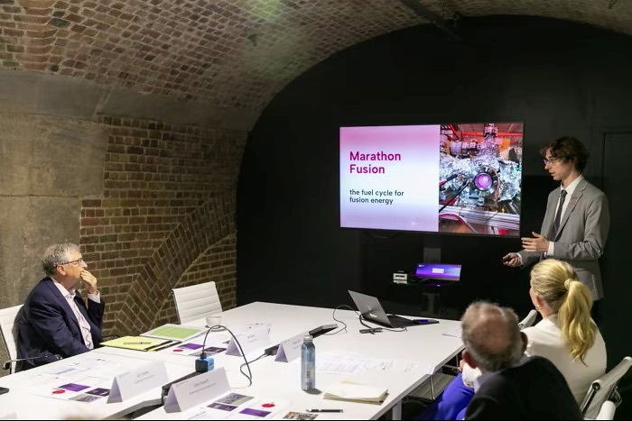



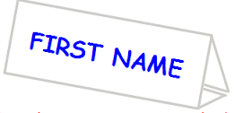


Slide 4

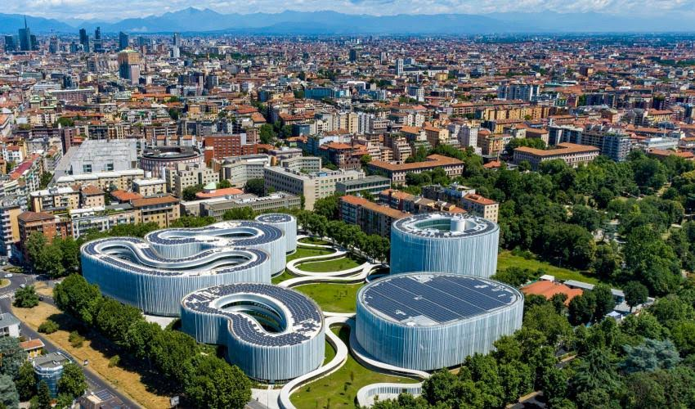

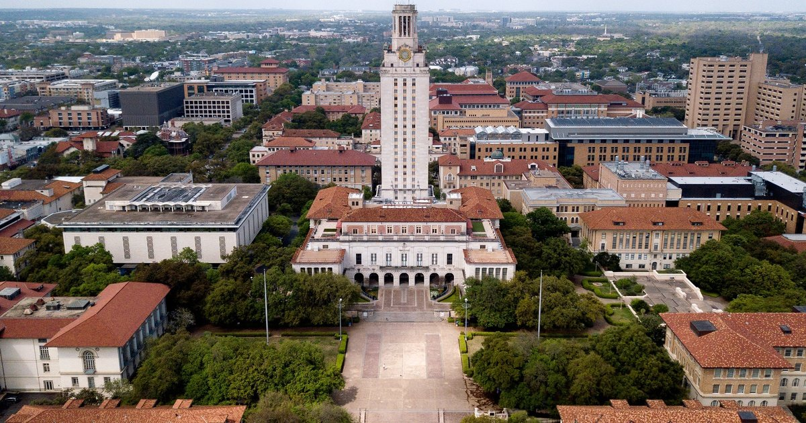

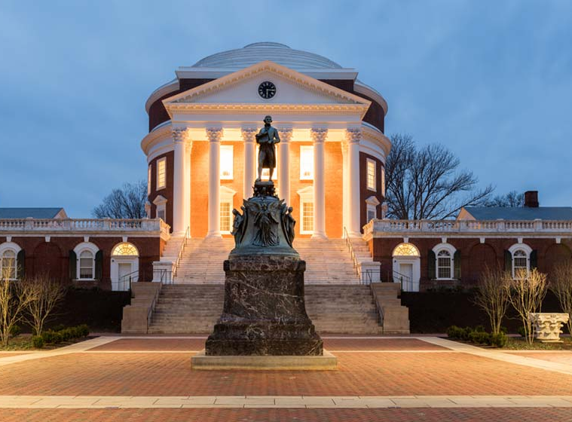


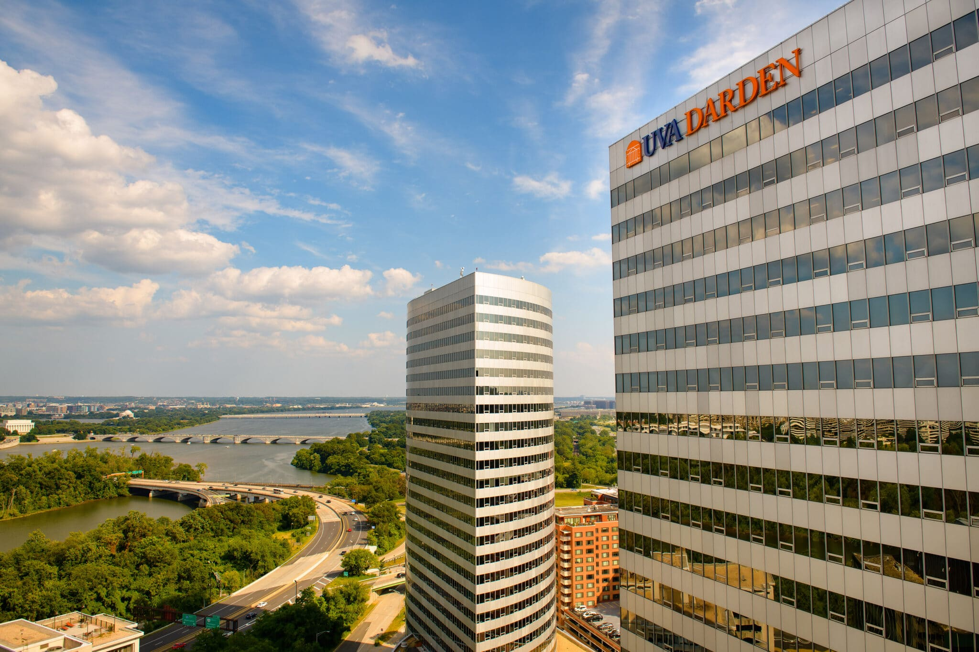

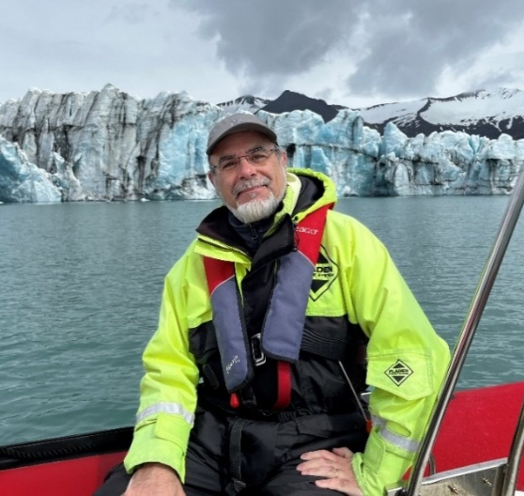




BS Comm & Econ
MS CSci
PhD in MIS
Milano, Italy
Bocconi University
UVA
UT Austin
Mendoza, Argentina
DC Metro - MSMIT

Slide 5
What is the course about?
What skills will I learn that I can put on my CV?
What is the work that I need to do?
What is the Hedge Tournament?

Slide 6
Class Objectives
“I know how to use IT to solve financial problems.”
“I am comfortable around Excel, macros, VBA, and databases.”
“I have acquired valuable skills
in commercial-grade tools.”

Slide 7
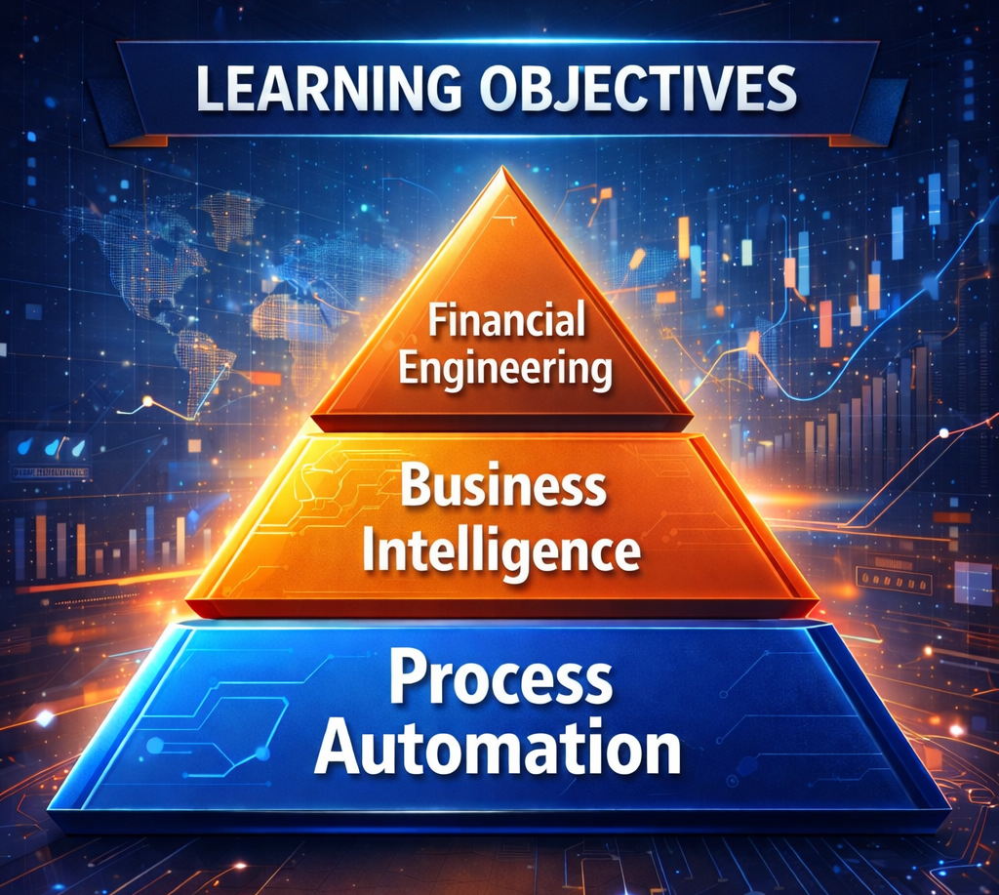
You will learn how to use technology to automate and support financial processes and decision making

Slide 8


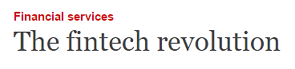

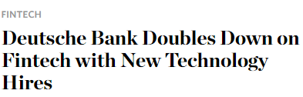
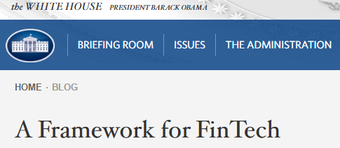

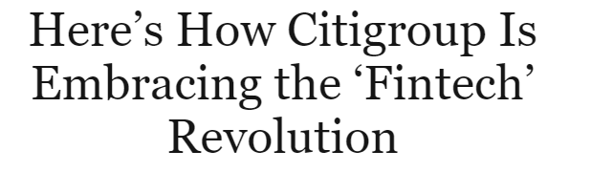

Fintech = Finance + IT

Slide 9
Aspects of Fintech
Fintech
Lending
Lending Club
Investment Management
JPMorgan
Payments
PayPal
InsurTech
Lemonade
RegTech
Deloitte

Slide 10
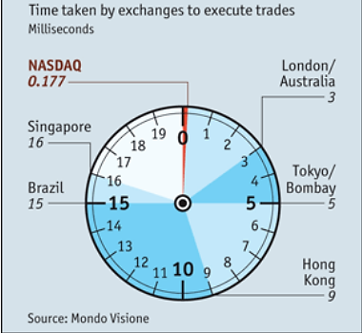

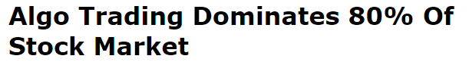
Algorithmic vs. High Frequency Trading (HFT)
60% of trades larger than $10 million in March 2020 were executed by an algorithm
- JP Morgan
Notes:
300/0.177=1,700

Slide 11
What is this course about?
What skills will I learn that I can put on my CV?
What is the work that I need to do?
What is the Hedge Tournament?

Slide 12

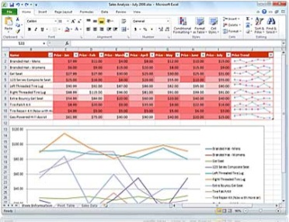




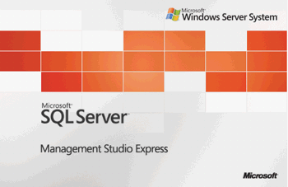

Specific Tools on your CV
Process automation tools: automating repetitive business analysis tasks
- Visual Basic for Applications, Excel Macros,
VSTO: Visual Studio Tools for Office
Automating Business Intelligence tools: extracting & analyzing information from enterprise databases
- Excel-databases, Azure Data Studio, SQL,
SQL Server, Pivot Tables
Financial Engineering tools: designing & implementing financial strategies
- Visual Studio, Hedge Tournament,
Advanced Excel
Pivot tables
Azure Data Studio

Slide 13
What is this course about?
What skills will I learn that I can put on my CV?
What is the work that I need to do?
What is the Hedge Tournament?

Slide 14
Learning by doing

Slide 15
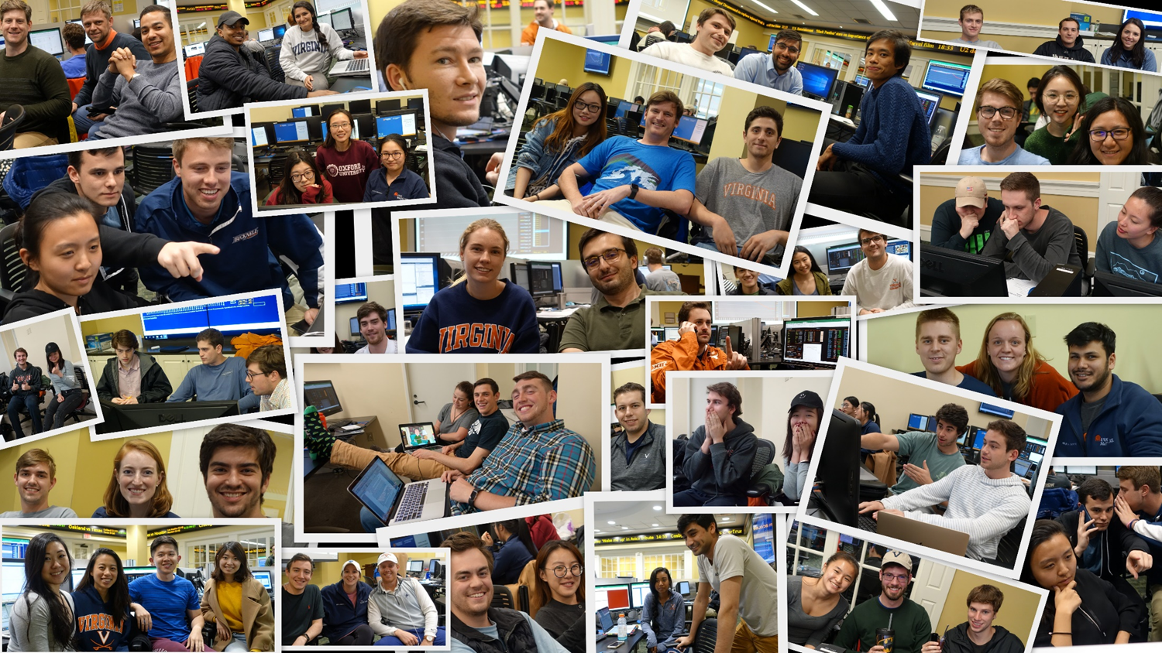
The Hedge Tournament

Slide 16
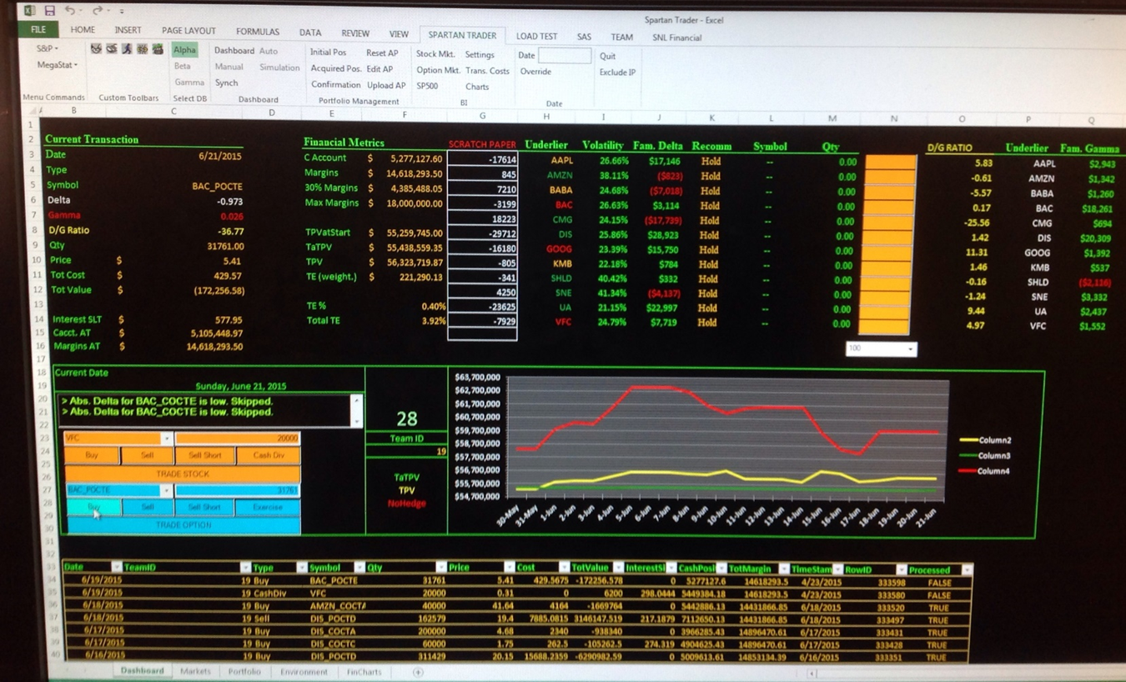
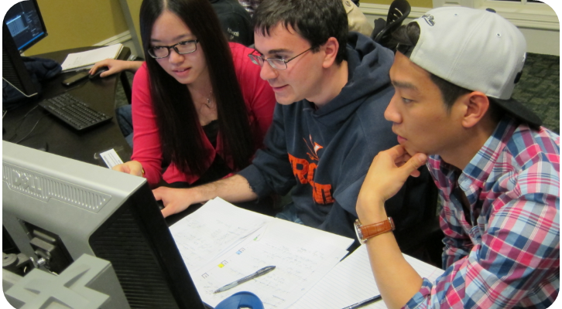
The Hedge Tournament
Hard skills
Experience with IT
project management
A differentiating story
to tell recruiters
Financial Markets
Your app
(gather, analyze, trade, control)
Financial
Data DB
Your portfolio performance
Your financial
decisions

Slide 17
What is this course about?
What skills will I learn that I can put on my CV?
What is the work that I need to do?
What is the Hedge Tournament?

Slide 18
Homework
What, already?

Slide 19

Two Web Sites
Public site
  Google ‘Stefano Grazioli’ and go from there
  Homework, Grading policies
  Office hours, Decks…
Personal site
  Submit your homework, See your grades
  Set your new password today

Slide 20
Homework
VS is one of the most complex
and powerful software ever
built. Some struggle as you learn is inevitable.
Give yourself plenty of time
Enjoy problem solving
No copying/pasting code written by others: it is an honor violation.
Contact me via Teams. See me. Office hours on the web site.

Slide 21
WINIT
What Is New In Technology
Go to the class web site
for instructions
And the first volunteer is...

Slide 22

Join the Fintech Community

Slide 24
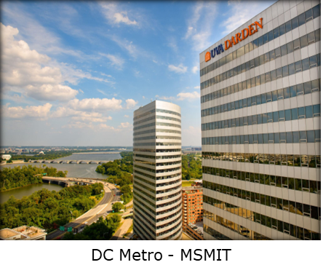
Our network (sample)
Microsoft
Appian
KPMG
Amazon Web Services
U.S. Air Force
US Navy
Freddie Mac
Verisign Inc
Ensemble Health Partners
University of Virginia
R2 Technology Solutions
Google
ICS-NETT
Two Roads Consulting
ICF
Deloitte
Rapid7
CGI Federal
Booz Allen Hamilton
CapTech Consulting
Department of VA
Vanguard
Capital One
Phase2 Technology
General Dynamics Information Technology
Federal Reserve Bank of Richmond
National Security Agency
DRT Strategies
Accenture Federal Services
LVY Consulting

