Slide 1
Process Automation
Stefano Grazioli

Slide 2
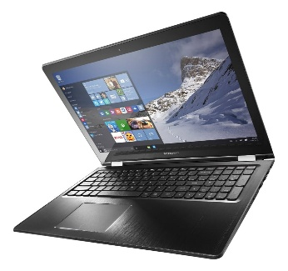
Critical Thinking
Any questions on class, grades, or teams?
Easy meter
Learning objective: learn to use the recorder

Slide 3
Workload by Discipline
Intense!
Finance
Technology
Now
Tournament

Slide 4
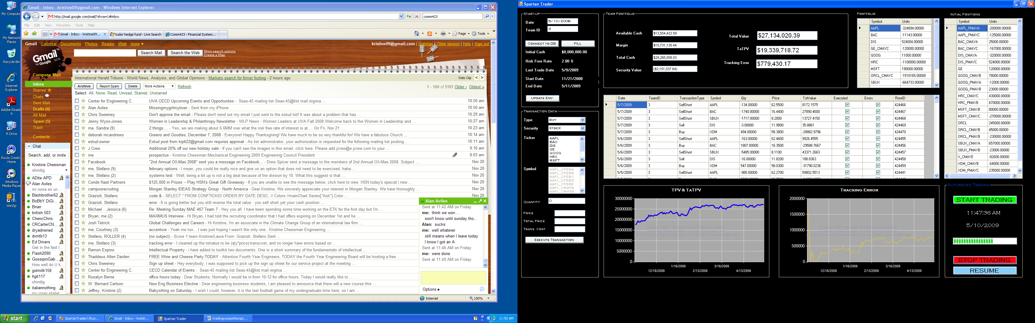

Keep Your Eyes On The Goal!

Slide 5
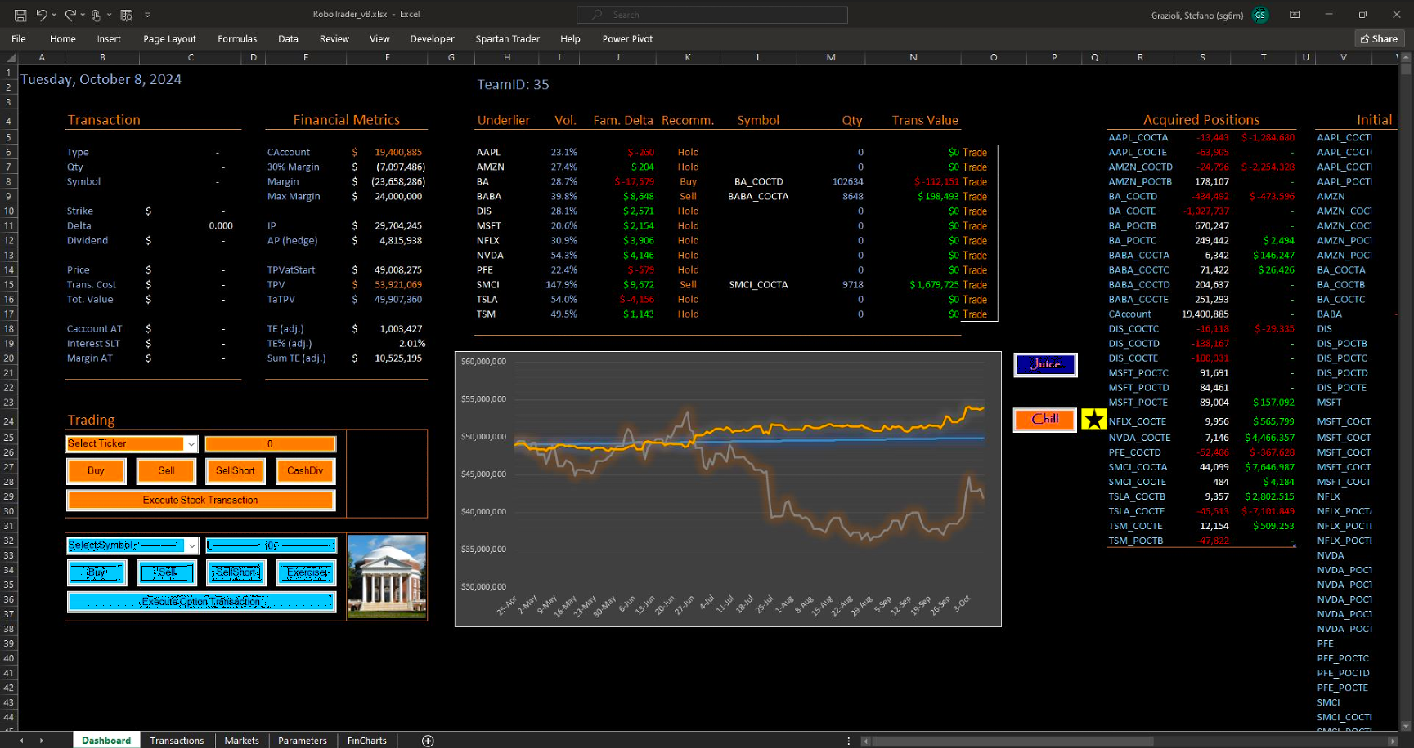

Slide 6
You Do the Talking
Name (slow)
Academics
Comfort with coding
Comfort with finance
First impressions? H01?

Slide 7
“There should be an app for that...”
Part I: process automation

Slide 8
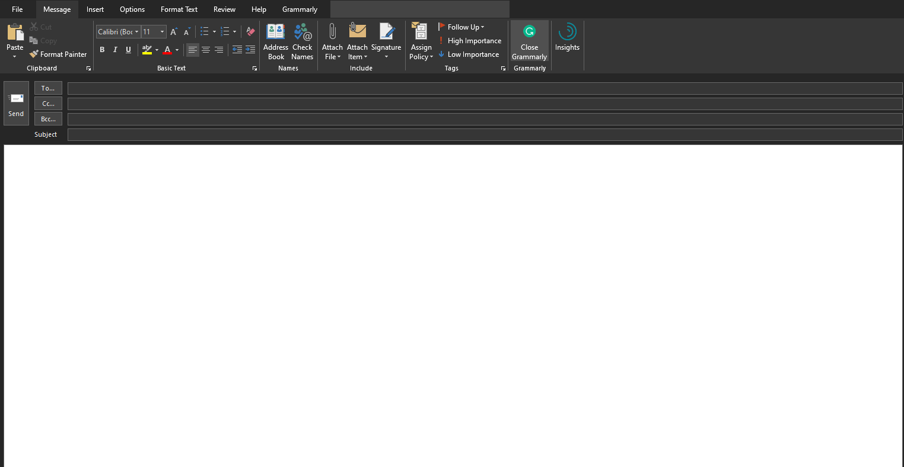
Process automation
MB here, just wanted to send a note to you saying thanks.
Although by no means do I feel like an expert in VBA, the bits I have taken from your course have helped me a ton in my job already. I am working at Sun Tribe Solar here in Charlottesville, and have used some quite simple macros … to do some powerful stuff, impress my boss and coworkers, and make my job easier by automating all of the boring stuff. …

Slide 9
Process automation
…in one of our Employee Benefit Plan auditing procedures, we need to test over 500 investment samples. If we do it manually, it can take over a week. However, to save this time, I wrote a program to pull investment information directly from Yahoo Finance, and finished the whole procedure in an afternoon. Moreover, this is not an one-time procedure. Once I wrote this program, I shared it with my colleagues and we used it for all our clients. This is just the beginning of where I see the potential of technology in the auditing field. “ - YJ

Slide 10

Creating a macro using the Excel recorder
Homework #2

Slide 11
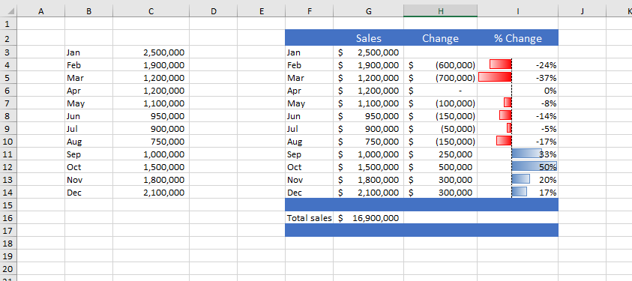
Example: Creating Reports

Slide 12
Other automation examples
Insert boilerplate text. If you need to enter standard text into a range of cells, you can create a macro to do the typing for you.
Automate a task that you perform frequently. For example, you may need to prepare a month-end summary. If the task is straightforward, you can develop a macro to do it for you.
Create a custom command. For example, you can combine several Excel commands so that they’re executed from a single keystroke or from a single mouse click.
Create a simplified “front end” for users who don’t know much about Excel. For example, you can set up a foolproof data-entry template.
Develop a new worksheet function. Although Excel includes a wide assortment of built-in functions, you can create custom functions that greatly simplify your formulas.
Create complete macro-driven applications. Excel macros can display custom dialog boxes and respond to new commands added to the Ribbon.
Source: John Walkenbach, Excel® 2010 Bible

Slide 13
WINIT:
What Is New In Technology

Slide 14
Orange Words
A program is a named series of computer instructions
Computer instructions need to be written in very specific computer languages (e.g., VBA)

Slide 15
VB, VBA, and Macros
Visual Basic is a programming language
Visual Basic for Applications is an extension of the VB language to work with MS apps (example: “Range”).
Macros are VBA programs written using the built-in editor in EXCEL

Slide 16
If I have the recorder, why do I need to learn more tools?
The recorder has severe limitations
It cannot make decisions
It cannot repeat portions of its process (no loops)
Difficult to edit – poor code

Slide 17
In summary: three tools
Visual Studio
Excel editor
Recorder
  IDE: integrated development environment
  Many languages
  Uber powerful: does everything!
  Steeper learning curve, BUT once learned, it is easier than the editor
  Expensive for commercial purposes
  Included in Excel
  One language: VBA
  Maintained, not developed
  Included in Excel
  Very simple to use
  Very limited:
  No loops
  No conditionals

Slide 18
Suggestions
Give yourself plenty of time
to do the homework.
Use teams or office hours (in-person and virtual) if you get stuck.

