Slide 1
Before building it, model it!
Stefano Grazioli

Slide 2

H1 went well overall.
Read the instructions carefully.
Optional VBA resources:
see the readings link
Perceived difficulty ☺
Save your homework as
H02.zip H03.zip ….

Slide 3
Learning Objectives
Reading business process models
  Activity diagrams
Using VBA to implement them
  Variables
  Decisions: IF...THEN

Slide 4
First & last name
Academics
Comfort level with coding
Comfort level with Finance
Goals in taking this course
First impressions

Slide 5
Orange Words
Program
VB
VBA
Macro
Recorder

Slide 6
Business Process
Modeling Tools
Activity Diagrams

Slide 7

Mendoza, Argentina

Slide 8


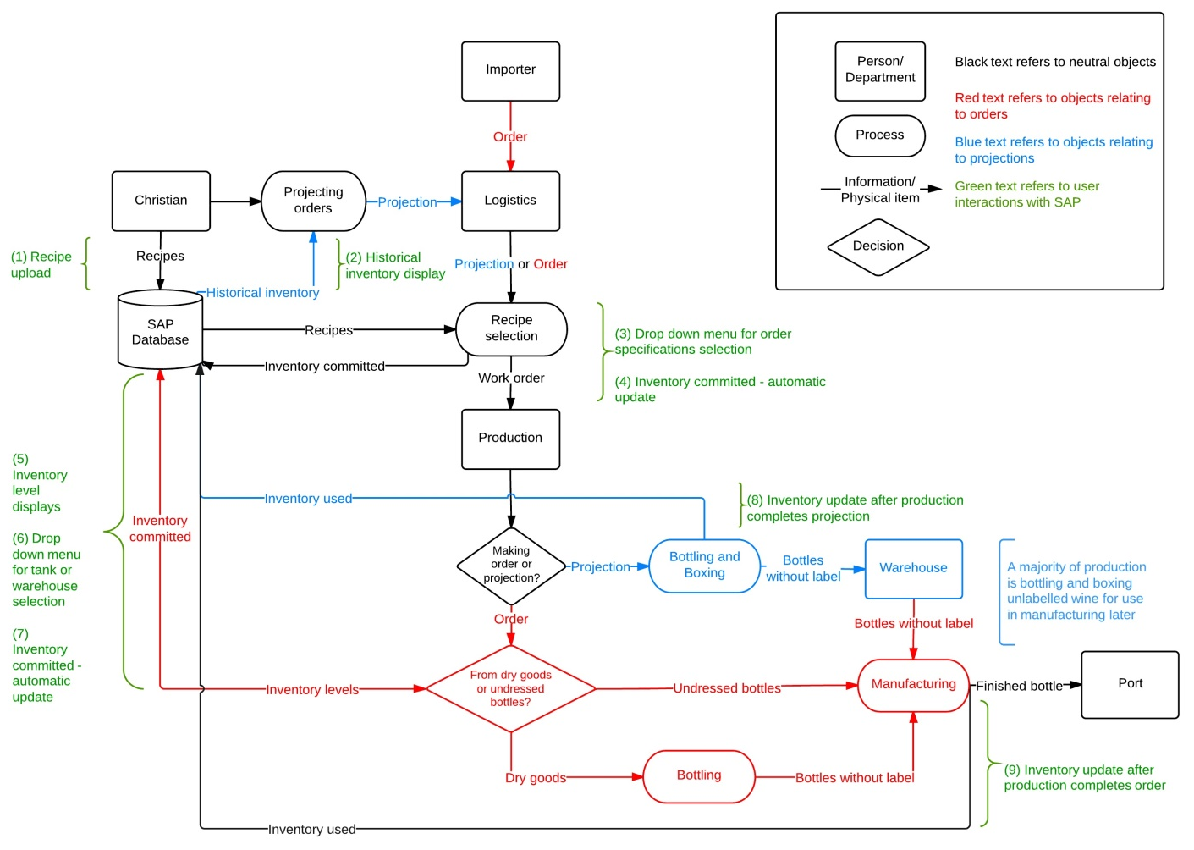


SAP at Renacer

Slide 9
Modeling business processes
Identify the requirements (what needs to be done)
Create a description of the process
Implement the process
using IT
Business Analyst / Consultant
Technical Analyst / Consultant
Developer / Consultant

Slide 10

UML: Unified Modeling Language
International standard: diagramming techniques to describe processes
State
Diagrams
Use Case
Diagrams
State
Diagrams
Use Case
Diagrams
Class
Diagrams
State
Diagrams
Use Case
Diagrams
State
Diagrams
Use Case
Diagrams
Package
Diagrams
Use Case
Diagrams
Activity
Diagrams
Scenario
Diagrams
State
Diagrams
Scenario
Diagrams
State
Diagrams
Deployment
Diagrams
Sequence
Diagrams
Component
Diagrams
Scenario
Diagrams
Component
Diagrams
Scenario
Diagrams
Scenario
Diagrams
Collaboration
Diagrams
Component
Diagrams
Scenario
Diagrams
Statechart
Diagrams

Slide 11
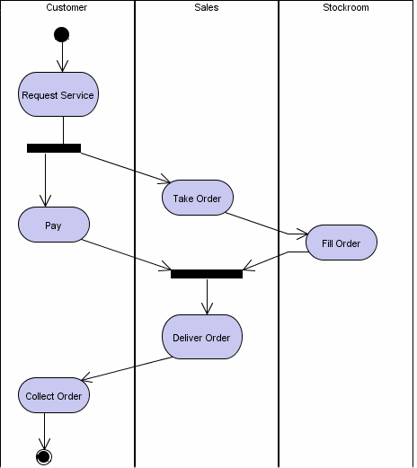
An Activity Diagram
Is a chart that describes a process according to the UML standard.
Uses:
Understand & communicate
Reengineer & change
Specify software
We will use to describe (home) work

Slide 12
Activity Diagram
Starting point
RECEIVING
A/P
VENDOR
Receive goods
Activity
Actor
Swimlane
Inspect content
Return some
goods
Decision Point
[Returned goods]
Receive returns
[Errors]
Notify Vendor
and A/P
Fork
Join
[Guard] Model guards
only if they add value
[OK]
Merge
Update A/R
Accept all
goods
Update A/P
Pay vendor
Reconcile Account
End point

Slide 13
Forks, Joins, and Merges
A join has a single exit point, that is traversed when all the input activities have occurred.
A fork has one entry point and multiple exits to activities that can be done in parallel
A merge (same symbol than the decision point) has a single exit and is traversed when any one of the input activities occurs.

Slide 15
Homework
H3 - DEMO

Slide 16
Activity Diagram H3 - Simple Financial Calculator
User enters principal, years, and interest rate.
User presses button.
Principal <= $0
Error message
Principal missing or NaN
Error message
Years less than 1 or more than 25
Error message
Years
missing or NaN
Error message
Rate less or equal 0
or more than 10
Error message
Interest rate missing or NaN
Error message
Compute and display Interest and Principal+Interest

Slide 17
H3: Financial Math Functions
interest = Principal * [(1+ Interest Rate)^{t} – 1]
interest = principal *
(((1 + interestRate) ^ t) – 1)

Slide 18
From UML to VBA
Introduction to Visual Basic for Applications
(may span two lectures)

Slide 19
Variables
Are named places in memory where you store information.
To create a variable, you declare it (Dim) and you tell the computer what type of info you want to store in it (e.g., an integer, a double, a string, a range, etc.).
Dim myInterest as double = 0
Dim userInput as string = “Stefano”
To change its content, you use the assignment operator “=”
myInterest = 0.05
To use its value, you just write its name
Dim newVariable as double = 0
newVariable = myInterest * 2

Slide 20
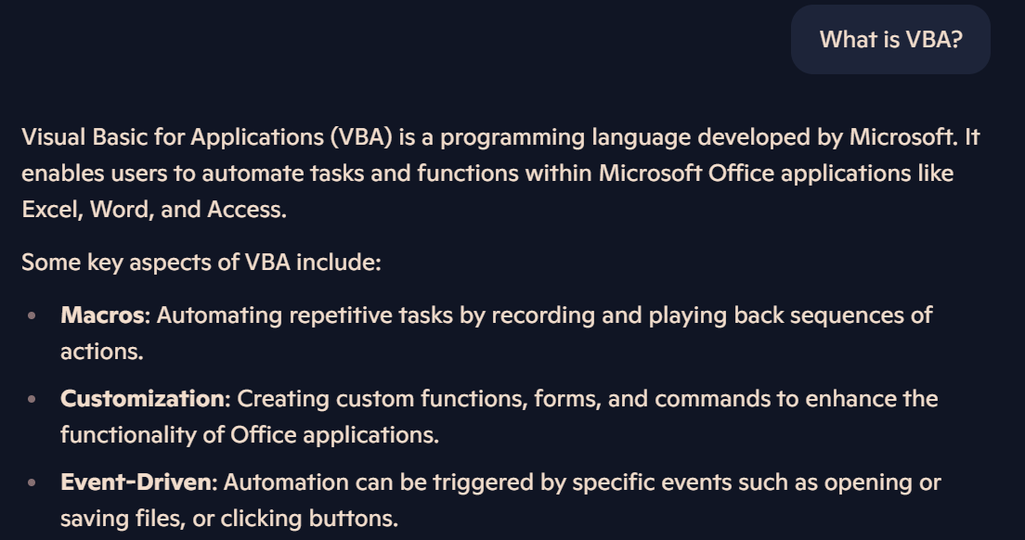

GenAI helps with Orange Words

Slide 21
Excel CELLS
Are objects with properties and behaviors.
No need to pre-specify what kind of info you want to store in them.
Examples:
Range("A1").Value = “My Excellent Calculator”
Range("A1").Font.Bold = True
Range("A1").ColumnWidth = 30
Range("A3").Value = "Interest is"
Range("B3").Columns.NumberFormat =
"$#,##0.00_);[Red]($#,##0.00)"
Range("B3").Value = interest

Slide 22
Once charted with UML, financial processes are easier to implement
Recognize the patterns & follow the examples
VBA

Slide 23
Implementing a Decision
...
Dim creditRange as Double
‘ More instructions…
If creditRate > 0.5 Then
Range("A10").Value = "Approved!"
Else
Range("A10").Value = "Rejected"
End If
creditRate > 50%
Print “Rejected”
Print “Approved”
...

Slide 24
The “else” Is Optional
...
cr. rate > 50%
If creditRate > 0.5 Then
Range("A10").Value = "Approved!"
End If
Print “Approved”
...

Slide 25
Tests
AND:
if (creditRate > 0.5 ) And (age > 21)
OR:
if (creditRate <= 0.5 ) Or (age > 21)
NOT:
if Not (age = 21)
alternatively, you can use
If age <> 21

Slide 26
Implementing a Decision Loop
Ask the user the amount of principal in $
Principal <= $0
Dim inputFromUser As String
Do
inputFromUser = InputBox(“Amount of principal?")
principal = Double.Parse(inputFromUser)
Loop While principal <= 0

Slide 27
GenAI can explain code
You are an expert VBA programmer. Help me understand the following code
Dim inputFromUser As String
Do
inputFromUser = InputBox(“Amount of principal?")
principal = Double.Parse(inputFromUser)
Loop While principal <= 0

Slide 28
GenAI can code for you
You are an expert VBA programmer. Help me code the following: The program asks the user the amount of principal. If the number entered by the user is zero or less than zero, then the program asks again, until the user enters a positive number. At that point, the input from the user is turned into a number and stored.

Slide 29
Implementing a Nested Loop
Task A
Do
‘ Task A
Do
inputFromUser = InputBox(“Principal?")
principal=double.Parse(inputFromUser)
Loop While (inputFromUser <= 0)
‘ Task B
inputFromUser = InputBox(“Want to quit?")
Loop While (inputFromUser <> “y”)
Ask the user the amount of principal in $
Less than / equal to $0
Task B
want to quit (n=no)?
n
y

Slide 30
An alternative to IF…THEN
When There Are Multiple Options to choose from
Select Case textFromUser
Case a
Range(“B5").Value(“This is case a")
‘ More instructions…
Case b
Range(“B5").Value(“This is case b")
‘ More instructions…
Case Else
Range(“B5").Value(“this is the Default")
‘ More instructions…
End Select
Ask the user
a
b
default
Print Output
Print Output
Print Output

Slide 31
Another example
Dim number As Integer
‘other code in here...
Select Case number
Case 1 To 5
Range("A1").Value("Between 1 and 5, inclusive")
Case 6, 7, 8
Range("A1").Value("Between 6 and 8, inclusive")
Case 9 To 10
Range("A1").Value("Equal to 9 or 10")
Case Else
Range("A1").Value("Not between 1 and 10, inclusive")
End Select
Source: MSDN

Slide 32
Suggestions
Be careful about uploading
Consult the extra resources listed in the course readings and schedule
GenAI is your friend
Contact me via Teams/office hours.

