Slide 1
Subs & Functions
Last unit of Part I: Process Automation

Slide 2

Critical thinking
H4 & H5 – no penalty for being late
H3 - if zero may resubmit for late penalty
Use MS Teams for questions (faster)
Perceived difficulty

Slide 3
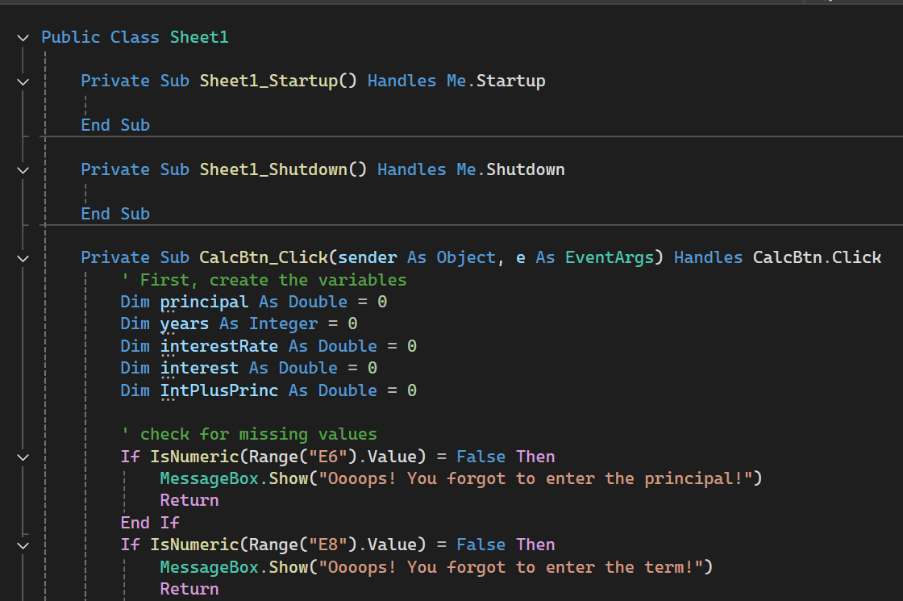

Code and Binary code
Notes:
Actually
VBA > CIL intermediate language > CLR common language runtime > binary

Slide 4


VS is an IDE
Visual Studio
Excel
Requirements:
What needs to be done
VS is an IDE: an Integrated Development Environment
Coding
Compiling
Source code
file in a
computer
language
Runnable
code: .exe,
.dll (i.e., a
program)
C#, VBA, C++, python…

Slide 5
Learning Objectives
Loops
  For … Next
  Do While
Conditionals
  If … Then
  Select Case
VBA (and most other computer languages)
Procedures
  Subs
  Functions
Objects
  Properties
  Methods

Slide 6
You Do The Talking
Name, academics
Learning objectives
Comfort with coding
Comfort with finance

Slide 7
Procedures:
Functions and Subs
Simplify!
Reuse!

Slide 8
Program “A”
Program “B”
Line of code
Longer line of code
Longer line of code
Line
Line
Longer line of code
Longer line of code
Longer line of code
Line
Line
Line
Longer line of code
Much longer line of code
Much longer line of code
Longer line of code
Line
Line
Line
Longer line of code
Longer line of code
Longer line of code
Line
Line
Longer line of code
Much longer line of code
Longer line of code
Line
Line
Longer line of code
Longer line of code
Longer line of code
Line
Line
Much longer line of code
Longer line of code
Line
Line
Line
Longer line of code
Much longer line of code
Longer line of code
Line
Longer line of code
Much longer line of code
Longer line of code
Line
Line
Line
Line
Longer line of code
Much longer line of code Line
Line
Line
Longer line of code
Much longer line of code
Line
Line
Longer line of code
Longer line of code
Longer line of code
Line
Line
Longer line of code
Much longer line of cod
Much longer line of code
Longer line of code
Line
Line
Longer line of code
Much longer line of code
Line of code
Longer line of code
Longer line of code
Line
Call SUB “C”
Line
Longer line of code
Much longer line of code
Much longer line of code
Longer line of code
Line
Line
Call SUB “C”
Longer line of code
Much longer line of code
Longer line of code
Line
Call SUB “C”
Much longer line of code
Longer line of code
Line
Line
Line
Longer line of code
Much longer line of code
Longer line of code
Line
Longer line of code
Much longer line of code
Longer line of code
Line
Line
Line
Line
Longer line of code
Much longer line of code Line
Line
Line
Longer line of code
Much longer line of code
Line
Call SUB “C”
Longer line of code
Much longer line of cod
Much longer line of code
Longer line of code
Line
Line
Longer line of code
Much longer line of code
SUB “C”
Line
Longer line of code
Longer line of code
Longer line of code
Line
Line
End Sub/Return
55 lines of code
20% less writing
No reinventing
Fewer errors
Single location for changes
69 lines of code

Slide 9
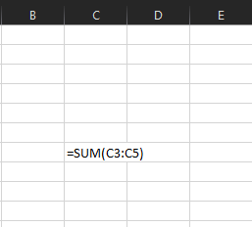
Functions are programs that return values
Example built-in function
Function name
Arguments or parameters

Slide 10
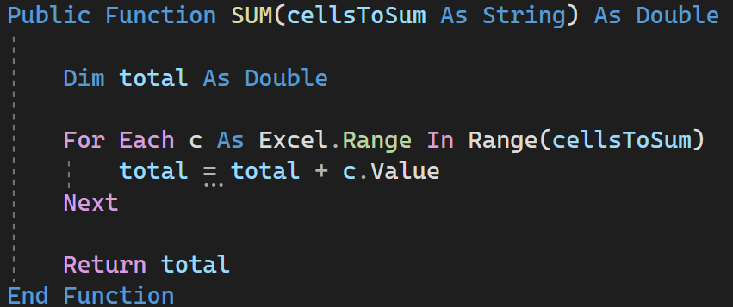

Implementing SUM
Security: private vs. public
Function name
Argument
Type of info returned
Example use of the function in a larger program

Slide 11
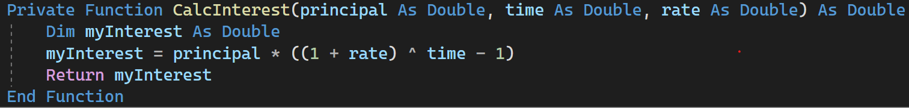
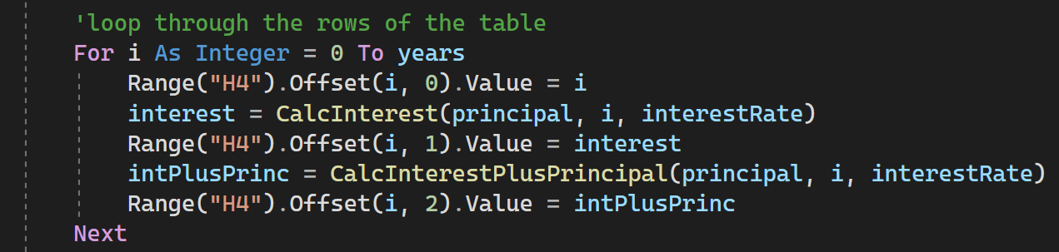
You can create your own functions
Security: private vs. public
Arguments, with arbitrary names
Arbitrary
name
Keyword
Example of use inside a larger program

Slide 12
Binding parameters

Slide 13
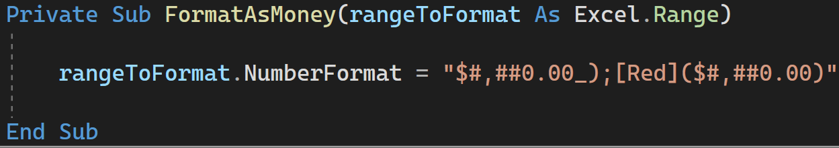
Subs do not always return values
Security: private vs. public
Argument, with arbitrary name
Keyword
Arbitrary
name
Example of use inside a larger program

Slide 14
Variables and Parameters
Variables have a lifecycle / scope
Parameters are a special type of variable: used as input to subs and functions, do not need a DIM
Find the vars and params in here
Private Sub Button1_Click …
Dim inputFromUser As String
inputFromUser = InputBox("Please enter your name")
ShowConfirmation(inputFromUser)
End Sub
Private Sub ShowConfirmation(someText As String)
Range("A1").Value = "You entered: " + someText
End Sub

Slide 15

WINIT
What Is New
In Technology?

Slide 16
H5
The last of the automation series. Congratulations!

Slide 17
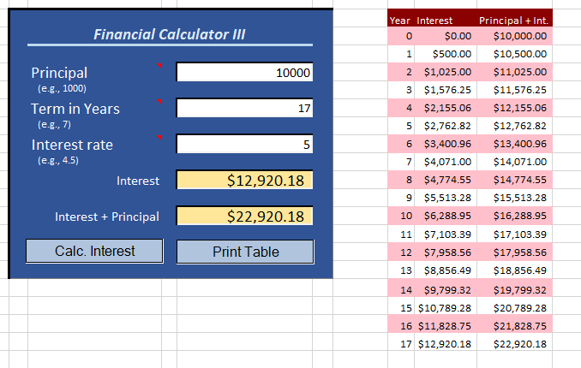
It begins with figuring out what needs to be done
Hey, awesome financial calculator v.2! Can I have the table of results in a choice of colors?

Slide 18
Activity Diagram (part III)
Simple Financial Calculator
User inputs principal, years, and interest rate
Autofit the columns
User presses
“print table” button
Principal, Year, or Rate is missing
Ask the user for a color preference
record preference
Alert the user
Print table header and data
a
b
default
i > number of years
Format the data
Format Table in Red
Format Table in Green
Format Table in Blue
i <= number of years
Print the ith row of data

Slide 19
An alternative to IF…THEN when there are multiple options
Ask the user for a color preference
Select Case textFromUser
Case “a”
‘ More instructions… red paint
Case “b”
‘ More instructions… green paint
Case Else
‘ More instructions… blue paint
End Select
a
b
default
Format Table in Red
Format Table in Green
Format Table in Blue

Slide 20
A More Interesting Case
Dim number As Integer
‘other code in here...
Select Case number
Case 1 To 5
Range("A1").Value("Between 1 and 5, inclusive")
Case 6, 8
Range("A1").Value("Between 6 and 8, inclusive")
Case 9 To 10
Range("A1").Value("Equal to 9 or 10")
Case Else
Range("A1").Value("Not between 1 and 10, inclusive")
End Select
Source: MSDN

Slide 21
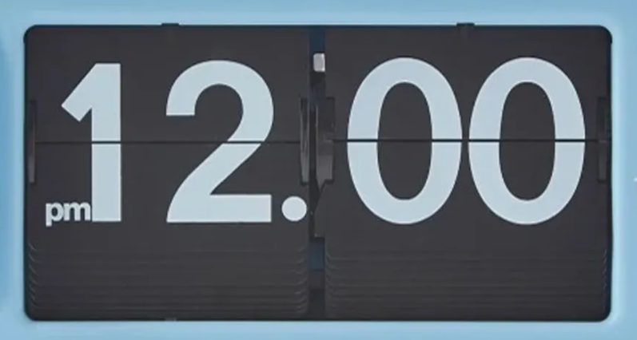
Implementing a nested Loop
Top left cell:
for example, G10
Outer loop (slower) Inner loop (faster)
For r As Integer = 0 To (numberOfRows-1) Step 2
For c As Integer = 0 To (numberOfColumns-1)
topLeftCell.Offset(r, c).Interior.Color = Drawing.Color.Pink
Next
Next
Number of rows = 18
Number of columns = 3

Slide 22
Suggestions
H05 is the capstone for part I of the course.
Not more difficult, but it might take longer to do than the previous homework

