Slide 1
BI: Accessing Enterprise Data
“Canned” queries using Excel, ADO.NET, and SQL

Slide 2

Critical thinking
Going well
Perceived difficulty
Big Shumway lab = no connectivity
What was difficult?

Slide 3
Orange words
Business intelligence
Analytics
Data dictionary
DBMS
SQL Server

Slide 4
Name, Academics
How was SQL coding?
Things you like about the class
GenAI use for this course

Slide 5
Homework
Automating Business Intelligence at LongShort

Slide 6

"There's got to be a better way to do that!"
I like my new job at LongShort, except that every day at the close of business I must access the firm DB and create dozens of updated list of trades for management review. I hate it! It is a super-boring repetitive task.
Mmmm... maybe I can automate it....

Slide 7
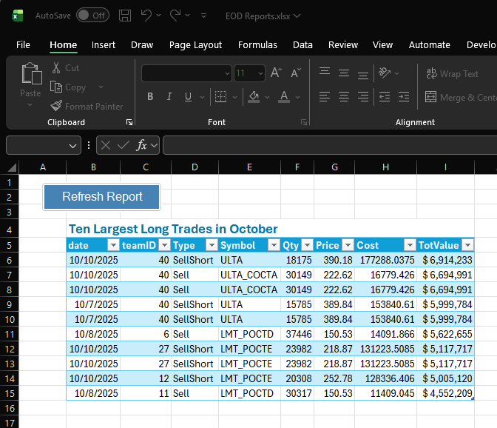
Demo
Canned queries
Picture shows the demo, not the homework

Slide 8
How do I access remote data and show them in Excel? A two-step process
Tables in a DB in the remote DBMS
VB.NET runs a SQL Query
A DATATABLE IN YOUR PC MEMORY
more VB.NET commands
Remote server / Cloud
Your PC
A listobject on your spreadsheet

Slide 9
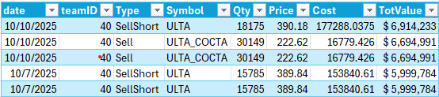
We need five objects
Standard software objects stitched together
ADO.NET ActiveX Data Object. It is a MSFT technology to manage enterprise data (on your CV)
Data Table
Reader
Command
Connection

Slide 10
DB in the cloud
I know how to connect to a remote computer Give me a CONNECTION STRING and I will connect you!
I know how to run a SQL QUERY. I need the QUERY and an open CONNECTION.
SQL Connection
SQL Command
Reader
I know how to store a table of data
I know how to show tables to Excel users. Give me a dataTable and I will visualize it.
Data Table
I know how to stream the results from the SQL Command
LISTOBJECT

Slide 11
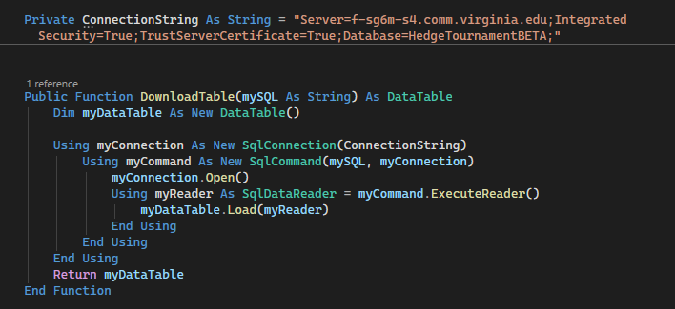
From the cloud to your screen
Connection gets a connection string
Command Runs the query
Connection opens a connection with the DB
Reader reads the results of the query
Listobject visualizes the data
Command gets a connection and a SQL query
DataTable stores the results

Slide 12
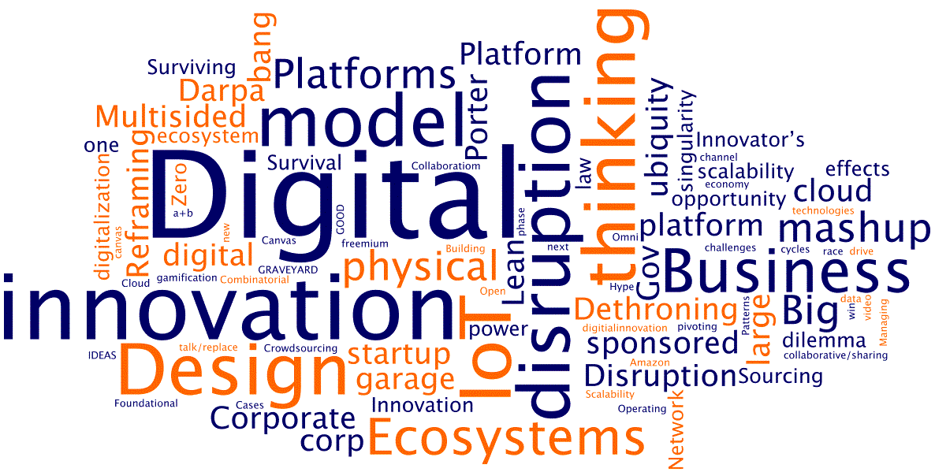
WINIT
What Is New In Technology?

Slide 13
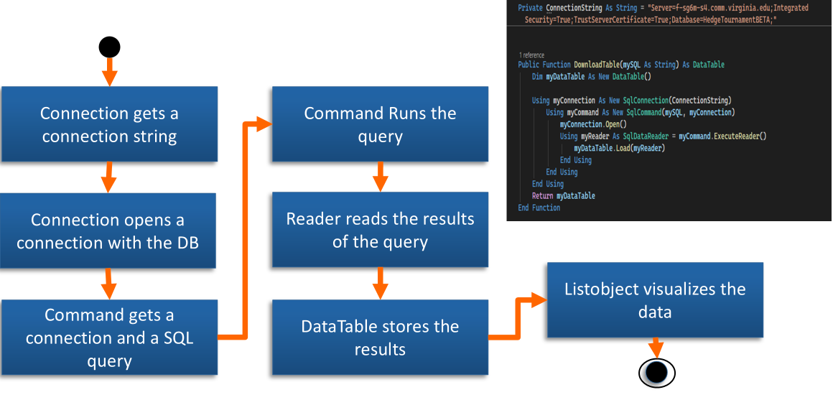
Suggestions
Understand the ADO.NET architecture before coding.

