Slide 1
Dynamic SQL Queries
Stefano Grazioli

Slide 2
Going well
Perceived difficulty

Slide 3
Learning Objectives
BI: Automating SQL
Static (‘Canned’) queries
Dynamic queries
Non-queries
Today

Slide 4
Orange Words
Canned query
ADO.Net

Slide 5
Name, Academics
Use of GenAI for this course
Things you like about the class
Things that can be improved

Slide 6
The Excel object model
And the dot notation

Slide 7
The Excel Object Model
Objects are software ‘bundles’ of methods and properties
Range("A1").value
Range("A1").clear()
property
method
dot notation
BUT we surely have multiple cells “A1” in our computers….

Slide 8
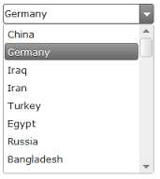
Combo boxes are objects
myCBox
myCBox.Text
Pick a country
myCBox.Items
myCBox.SelectedItem
myCBox.Items.Add(“Italy”)

Slide 9
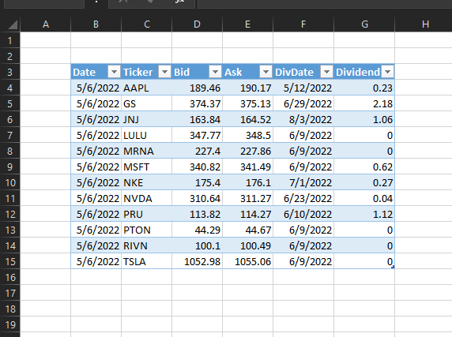
ListObjects are objects
myDataLO
mydataLO.DataRange
myDataLO.TableStyle = "TableStyleMedium3"

Slide 10
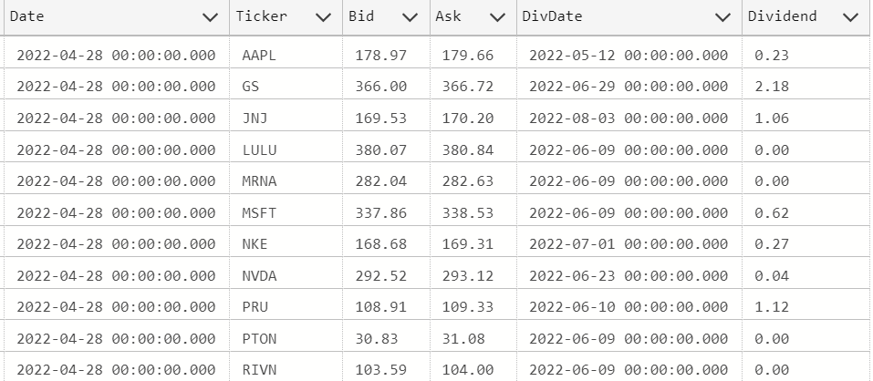
DataTables are objects
myStockDataTbl
myStockDataTbl.Rows

Slide 11
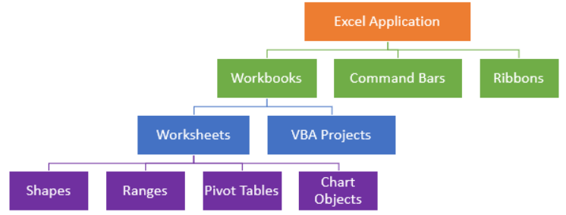
The Excel Object Model
Application.Workbooks.Item("MyWBook.xlsx"). Worksheets.Item(1).Range("A1").Value = "Hi MOM!"
Full names are rarely used
Method to access an element
Excel itself
Collection (s)
Notes:
Source: https://www.automateexcel.com/vba/object-model/

Slide 13
Homework
h08

Slide 14

That Excel app you built is quite useful.
None of my managers uses the old reports anymore. They all use your app to check the largest recent trades.“
I want something like that for our financial advisors. They spend too much time hunting for historical stock data just to answer investor questions.”
I am on it, Boss.

Slide 15
Static (‘Canned’) queries vs Dynamic SQL queries
mySQL = "SELECT * FROM StockMarket where date = '5/2/2023'"
mySQL = "SELECT * FROM StockMarket where date = '" + DateCBox.SelectedItem + "'"

Slide 16
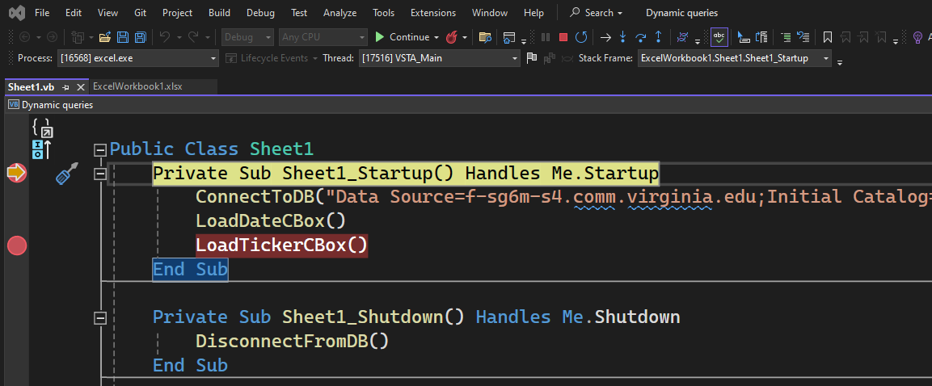
Breakpoints

Slide 17
Suggestions
Make sure that you understand the ADO architecture diagrams before coding.

