Slide 1
Non-queries
Stefano Grazioli

Slide 2
Doing overall well
Perceived difficulty
Tips to avoid losing points
  Avoid overreliance on genAI
  Download your work and double-check it (open Excel =zip incomplete)
  Deadlines: Tue / Thu at midnight (10% and 25% penalties)
  Do not fall behind. Must understand what you are doing.

Slide 3
Name, Academics
Use of GenAi in the course?
Things you like about the class
Things that can be improved and how can I help

Slide 4
Orange words
Static vs dynamic queries
Object (in object-oriented languages such as VBA, VB.NET)

Slide 5

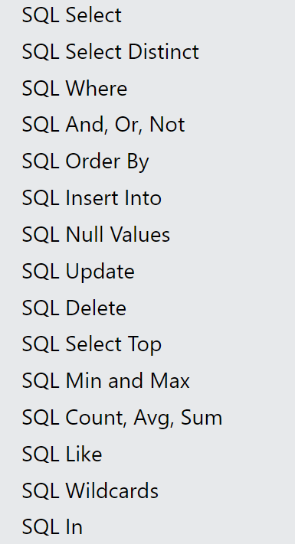
Learning Objectives
SQL “Non queries”
Insert
Delete
Update
Go to https://www.w3schools.com/sql/default.asp
and test the live examples to understand how they work.

Slide 6
Homework
h09

Slide 7

About your last app: the managers now want to be able to change the data stored in our database. They say it would save them a lot of time if they could fix typos or add missing information…
Can you do it?
I am on it, Boss.

Slide 8
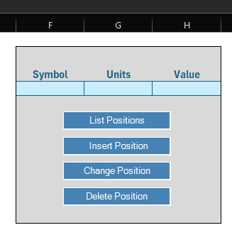
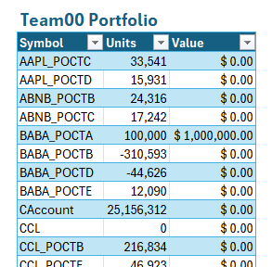
To delete a portfolio position….
4

Slide 9
To insert a portfolio position…
4

Slide 10
To update a portfolio position…
4
You cannot update Symbol with this method

