Slide 1

Options valuation
Stefano Grazioli

Slide 2
Perceived difficulty
Over 35 teams
You need your TeamID to do homework H18.
Check on the DBs whether you can see your PortfolioTeamXX table

Slide 3
Learning Objective
Understand the financial value of option contracts

Slide 4
What is the value of a call?
European options
On expiration day (easy)
On any other day (not so much)
?

Slide 5


What is the value of a call option?
July 21st
Call Option on Apple
Strike: $250 Expiration: July 21st
Spot price: 1 AAPL share is $260
In The Money (ITM)
Transaction costs not included

Slide 6
What is the value of a call?
July 21st
Call Option on Apple
Strike: $250 Expiration: July 21st
Spot price: 1 AAPL share is $250
At The Money (ATM)
Transaction costs not included

Slide 7
What is the value of a call?
July 21st
Call Option on Apple
Strike: $250 Expiration July 21st
Spot price: 1 AAPL share is $240
Out of The Money (OTM)
Transaction costs not included

Slide 8
Option value and Stock value are strongly correlated
There is a positive correlation between the value of a CALL and the spot price of its underlier
Price of the share goes up
Value of the call option goes up

Slide 9
What is the value of a call?
July 21st
What happens if we now change the strike?
Call Option on Apple
Strike: $250 Expiration July 21st
Spot price: 1 AAPL share is $270

Slide 10
What is the value of a call?
July 21st
Call Option on Apple
Strike: $240 Expiration: July 21st
Spot price: 1 AAPL share is $270

Slide 11
Option strike and value are strongly correlated
There is a negative correlation between the value of a CALL and its strike
Value of the call option
Lower strike

Slide 12
Summary so far
On expiration day, value is certain and dependent on the difference between spot and strike
What about any other day?
?

Slide 13
What is the value of a call?
July 21st
June 21st
Call Option on Apple
Strike: $250 Expiration: July 21st
Spot price: 1 AAPL share is $250
Expectation: $260 on July 21st range 210-270

Slide 14
What is the value of a call?
?
On any other day value is not deterministic, because of uncertainty about the future price of the underlier.

Slide 15
Evaluating call options
The current value of a call Option depends on: 1) the current price of the underlier + 2) the strike price - 3) the underlier volatility + 4) the time to expiration + 5) the risk-free interest rate +
Question: what is the value of the option right now?
Bought a call option on META for $30.0, x=600
Call Option: Can buy META for $600
META price is $600
a) META price is $650
b) META price is $550
?
PAST
NOW
EXPIRATION
Notes:
(5) When you buy a call option instead of the actual stock, you're essentially deferring your purchase. The money you would have spent buying the stock sits in your pocket earning interest in the meantime. When interest rates are high, that deferred money earns you more — making the option a more attractive alternative to just buying the stock outright. Higher rates = bigger benefit to waiting = more valuable option. (claude)

Slide 16
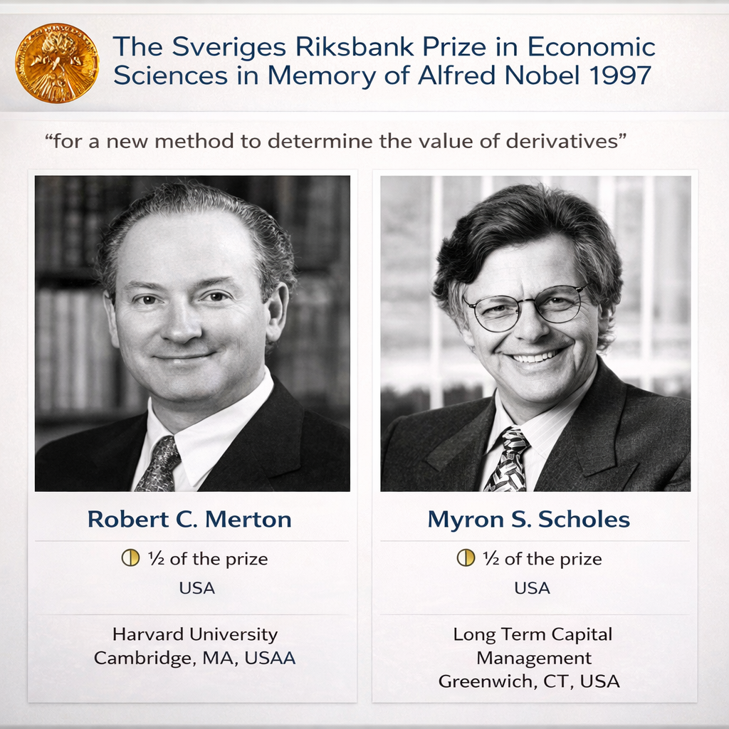
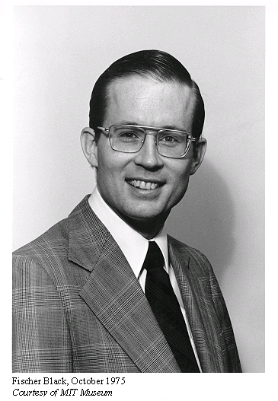
Solving the Option Evaluation Problem

Slide 17
The Black-Scholes Formulas
Price of a Call = S[N(d1)] – Xe^{-rt}[N(d2)]
d1 = {ln(S/X) + (r + σ ²/2)t}
σ√t
d2 = d1 - σ√t
S = current share (mtm) price,
X = option strike price,
t = time to option expiration (in years),
r = riskless rate of interest (per annum),
σ = share volatility (per annum),
N(z) = probability that a standardized normal variable will be less than d. In Excel, this can be calculated using NORMSDIST(z). Delta for a Call = N(d1) Delta for a Put = N(d1) -1

Slide 18
NORMSDIST(z)
z

Slide 19
Why study Black-Scholes?
These formulas are the foundation for the hedging technique called DELTA HEDGING (next time)
Delta for a Call = N(d1) a positive number, between 0 and 1 Delta for a Put = N(d1)-1 a negative number, between -1 and 0

Slide 20
Double-checked Values
Example:
S = $ 42, X = $40 t = 0.5 r = 0.10 (10% p.a.) s = 0.2 (20% p.a.)
Results:
d1 = 0.7693 d2 = 0.6278 N(d1) = 0.7791 N(d2) = 0.7349 C = $4.76 and P=$0.81

Slide 22
Homework
Demo

Slide 23
Black Scholes was so much fun… Let’s do it again!

Slide 24
What is the value of a put?
July 21st
Put Option on NVIDIA
Strike: $190 Expiration: July 21st
Spot price: 1 NVDA share is $190
At The Money (ATM)

Slide 25
What is the value of a put?
July 21st
Put Option on NVIDIA
Strike: $190 Expiration: July 21st
Spot price: 1 NVDA share is $160
In The Money (ITM)

Slide 26
Option value and Stock value are strongly correlated
There is a negative correlation between the value of a PUT and the value of the underlier
Value of the put option
Lower stock price

Slide 27
What is the value of a put?
July 21st
Put Option on Nvidia
Strike: $190 Expiration July 21st
We just found that this put is worth $30
What happens if we now change the strike?
Spot price: 1 NVDA share is $160

Slide 28
What is the value of a put?
July 21st
Put Option on NVIDIA
Strike: $200 (was $190) Expiration: July 21st
Spot price: 1 NVDA share is $160

Slide 29
Option strike and value are strongly correlated
There is a positive correlation between the value of a PUT and its strike
Value of the put option
Higher
strike

Slide 30
What is the value of a put?
On expiration day, value is certain and dependent on the difference between spot and strike
What about any other day?
?

Slide 31
What is the value of a put?
?
On any other day value is not deterministic, because of uncertainty about the future price of the underlier.

Slide 32
Evaluating PUT options
The current value of a Put Option depends on: 1) the current price of the underlier - 2) the strike price + 3) the underlier volatility + 4) the time to expiration + 5) the risk-free interest rate -
Question: what is the value of the option right now?
Bought a put option on LULU for $5 x = $160
Put Option: Can sell LULU for $160
?
LULU price is $160
a) LULU market price is $190
b) LULU market price is $140
PAST
NOW
EXPIRATION
Notes:
Key idea fo 5 is that when rate rises, the present value of the strike price falls — and a put’s value depends positively on the present value of that strike.

Slide 33
The Black-Scholes Formulas
Equilibrium price for a Put = –S[N(–d1)] + Xe^{-rt}[N(–d2)]
d1 = {ln(S/X) + (r + σ²/2)t}
σ√t
d2 = d1 - σ√t
S = current spot price,
X = option strike price,
t = time to option expiration (in years),
r = riskless rate of interest (per annum),
σ = spot return volatility (per annum),
N(z) = probability that a standardized normal variable will be less than z. In Excel, this can be calculated using NORMSDIST(d).

Slide 34
BS assumptions | HT assumptions
Unlimited borrowing and lending at a constant risk-free interest rate. | No. Limits to shorting
The stock price follows a geometric Brownian motion with constant drift and volatility. | Yes.
There are no transaction costs. | No.
The stock does not pay a dividend. | No. Some do.
All securities are perfectly divisible (i.e., it is possible to buy a fraction of a share). | No.
There are no restrictions on short selling. | No. Limits to shorting
The model treats only European-style options. | Yes.

