Slide 1
Non-queries
Stefano Grazioli

Slide 2
Doing well
Easy meter
Lab ~3:30-5:00 Tue/Thu
This weekend I am in DC teaching in MSMIT

Slide 3
Name, Academics
Questions about teams?
Things you like about the class
Things that can be improved

Slide 4
Orange words
Static vs dynamic queries
Object (in object-oriented languages such as VBA)
Object model

Slide 5

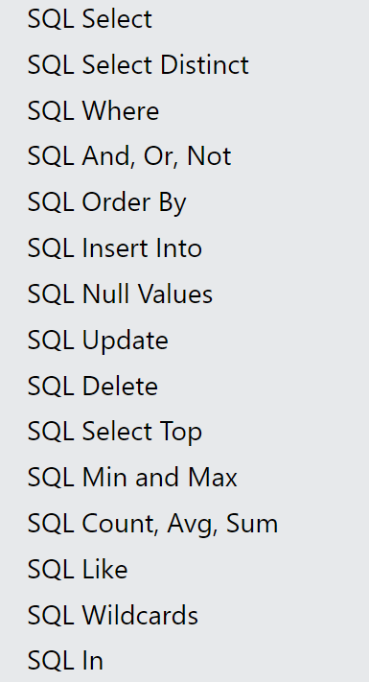
Learning Objectives
SQL “Non queries”
Insert
Delete
Update
Go to https://www.w3schools.com/sql/default.asp
and test the live examples to understand how they work.

Slide 6
Homework
h9

Slide 7

About your customer lists app: the managers now want to be able to change the customer data stored in our database. They say it would save them a lot of time if they could add a customer, or edit a misspelled customer last name or a wrong address right as they speak to the person…
Can you do it?
I am on it, Boss.

Slide 8
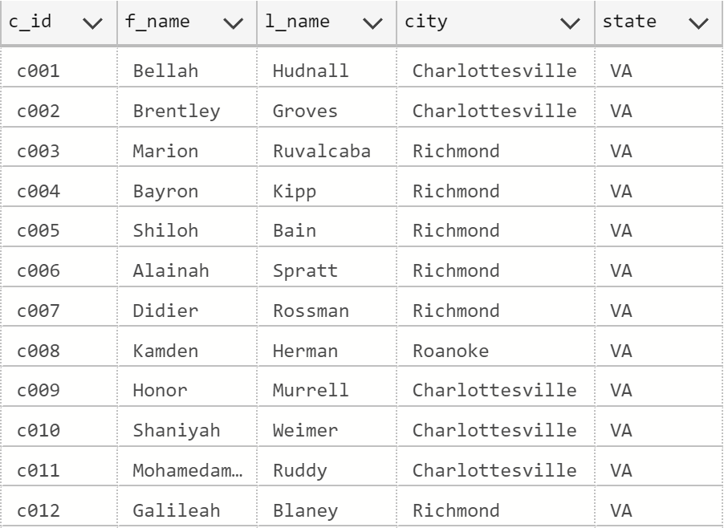
A new customer is enrolled…
‘Customer2’ Table

Slide 9
The SQL
Insert into Customer2
(c_id, f_name, l_name, city, state)
values ('c991', 'Bruce', 'Wayne', 'Gotham', 'NY')
Numbers do not require single quotes

Slide 10
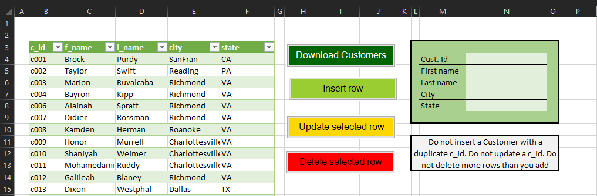
User fills Customer info on screen
Insert into Customer2
(c_id, f_name, l_name, city, state)
values ('c991', 'Bruce', 'Wayne', 'Gotham', 'NY')
User presses
‘Insert row’
System collects info from screen
System creates SQL insert
System Runs non-query
System calls
‘Download Customer’

Slide 11
An old customer leaves…
‘Customer2’ Table

Slide 12
The SQL
Delete from Customer2
where c_id = ‘c008’
Remember to specify the ‘where’!
DEMO

Slide 13
User clicks anywhere in the row to be deleted
User presses
‘Delete selected row’
Delete from Customer2
where c_id = ‘c008’
System collects the selected row number from listobject
System reads c_id column from row that has that row number
System creates and runs a SQL delete
System calls
‘Download Customer’

Slide 14
A customer changes address…
Austin TX

Slide 15
The SQL
Update customer2
set city = ‘Austin’,
state = ‘TX’
where c_id = ‘c005’
Remember to specify the ‘where’
DEMO

Slide 16
User makes changes
(except c_id)
User presses
‘Update selected row’
Update customer2
set
f_name = ‘Ariel’,
L_name = ‘Melton’,
city = ‘Austin’,
state = ‘TX’
where c_id = 137
System collects the selected row number from listobject
System reads all columns from row that has that row number
System creates and runs SQL updates that refresh ALL columns (except C_id)
System calls
‘Download Customer’

Slide 17
WINIT:
What Is New In Technology

