Slide 1

Loops
One of the four fundamental coding construct

Slide 2

H02 went well
Perceived difficulty
Name your next submission H04.zip
For faster help, use MS Teams
Bug bounty

Slide 3
Name, academics…
Comfort with coding
Comfort with finance
Learning goals
Hardest thing so far

Slide 4
Learning Objectives
Loops
For … Next
Do While
Conditionals
If … Then
Select Case
VBA (and most other computer languages)
Procedures
Subs
Functions
Objects
Properties
Methods

Slide 5
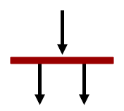
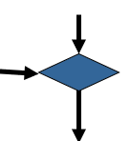
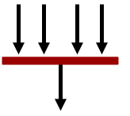
Orange words
Variable
Activity diagram
Fork
Merge
Join

Slide 6
Homework
H4 - Fin Cal Part II

Slide 7
Types of loops
You know how many times you need to repeat certain actions: For … Next
You want certain actions to be applied to all items in a set: For Each … Next
Do certain actions if a test is true – begin with the test: Do While <test> … Loop
Do certain actions if a test is true – begin with the actions: Do … Loop While <test>
Refill the guests until there is coffee
Fill with coffee the six cups on the table
Fill with coffee all the cups on the table
If there is coffee, refill the guests

Slide 8
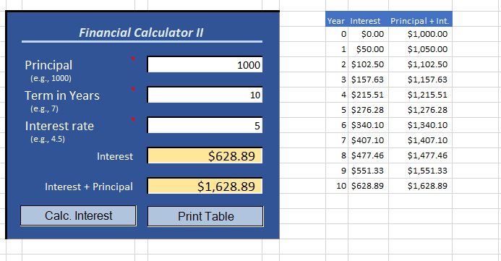
The competency curse
Hey, I really liked your financial calculator! Could you add to it a table that shows interest and principal from year zero to the end?
I am on it, Boss!

Slide 9
Activity Diagram (part II) Simple Financial Calculator
User inputs principal, years, and interest rate
User presses “print table” button
Principal, Year, or Rate is missing
Alert the user
Print and format table header
i > number of years
Format data and autofit the columns
i <= number of years
Print the i^{th} row of data (and increase i by 1)

Slide 10
Implementing a For…Next loop
Print and format table header
This is a fixed number. For the homework, make it a variable.
i > 10
Format data and autofit the columns
i <= 10
Print the i^{th} row of data and increase i
For i As Integer = 0 To 10
‘ Code to Print the i^{th} row of data…
‘ …
Next

Slide 11
Loop demo
For … Next

Slide 12
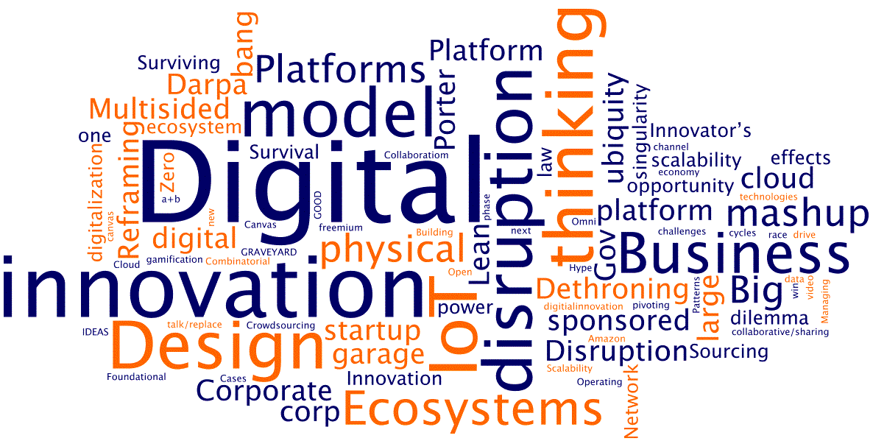
WINIT
What Is New In Technology?

Slide 13
Loops
Loops are control structures that repeat sets of instructions until a certain condition is met

Slide 14
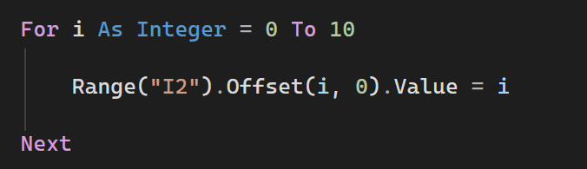
What does this do?

Slide 15
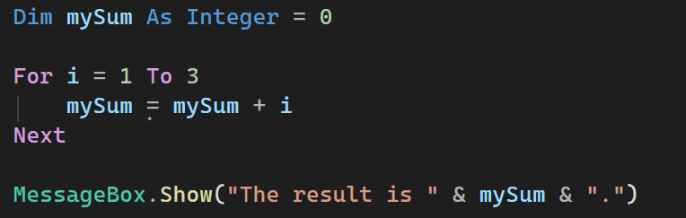
What does this do?

Slide 16
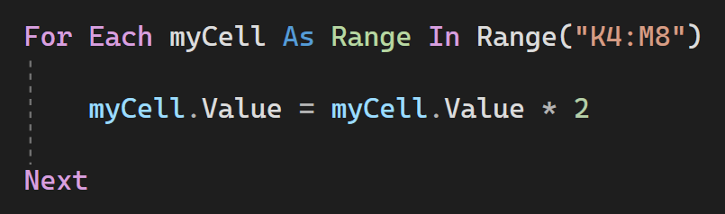
What does this do?

Slide 17
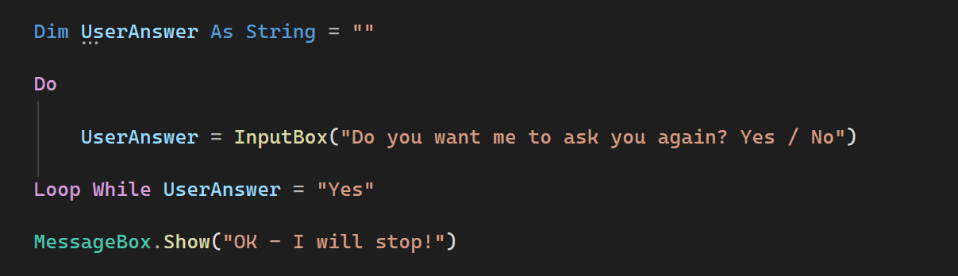
What does this do?

Slide 18
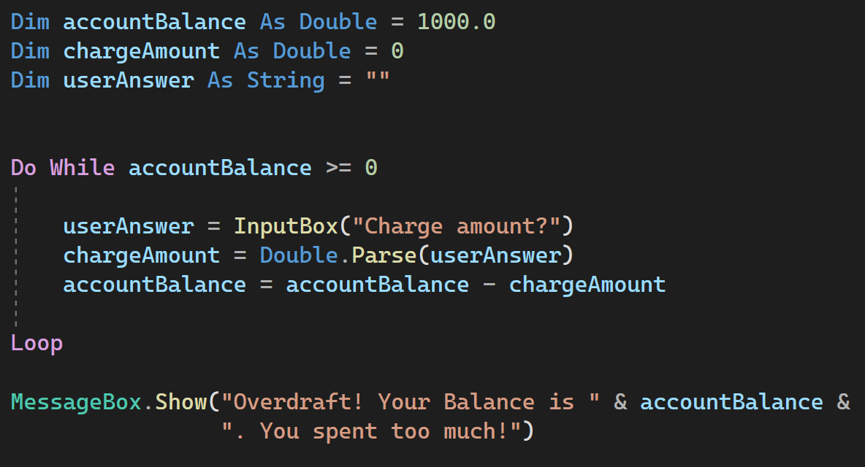
What does this do?

Slide 19
Suggestions
Give yourself plenty of time
Website resources, Teams, GenAI, and Google are your friends
Contact me.

