Slide 1
Database Management Systems and SQL
Stefano Grazioli

Slide 2

Critical thinking
Going well
Perceived difficulty
Part II: Business Intelligence begins today

Slide 3
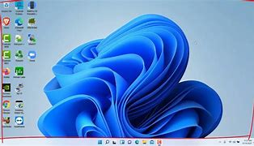

Where is my desktop?
Windows computers have two Desktops
Local: C:\Users\<yourComputingID>\Desktop
Example: C:\Users\sg6m\Desktop
Virtual: C:\Users\<YourComputingID>\OneDrive\Desktop
While you work with VS, put your project folders on your local desktop.

Slide 4
Name, academics…
Comfort with tech and finance
Things I like about the course (so far)
How I use GenAI

Slide 5
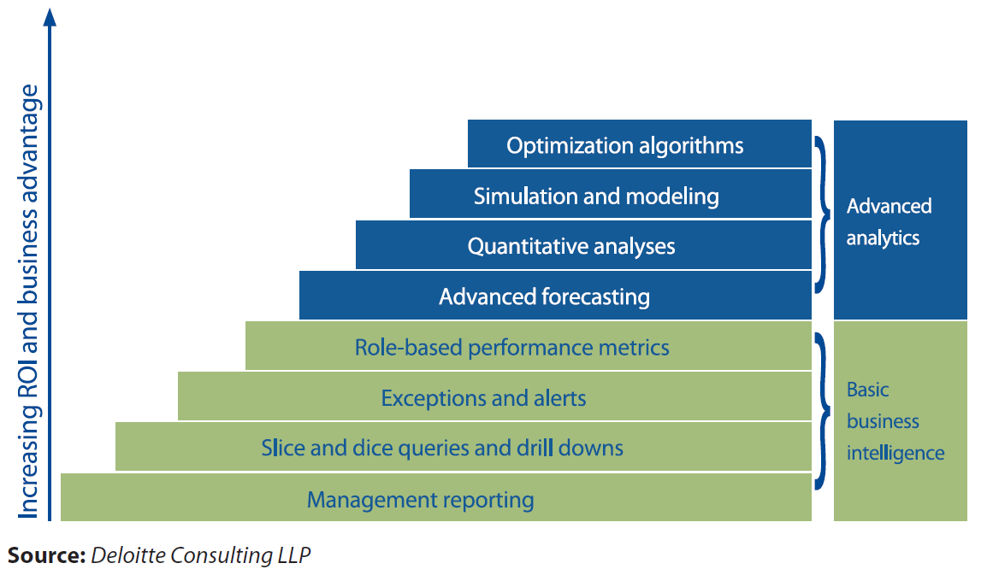
Learning objective: part II
“Business Intelligence refers to the general capability to organize, access and analyze information in order to learn and understand a business.” (Gartner)
Analytics is “the extensive use of data, statistical and quantitative analysis, explanatory and predictive models, and fact-based management to drive decisions and actions” (Davenport and Harris – Competing on Analytics)
In the workplace the difference is blurring
Part III of the course
Part II of the course

Slide 6
Orange words
IDE
Function
Sub

Slide 7

Congratulations! You are hired at LongShort

Slide 8

You are a financial analyst at LongShort
Meet Ms. Penny Tradewell, the Chief Investment Officer
Financial data retrieval tasks

Slide 9
Now what?
1. Figure out where is the data (database, servers, connections…)
2. Understand the data: organization, names, and meanings
3. Create SQL queries to get the answers you seek

Slide 10


First, ask about accessing the DB at LongShort (the DB architecture)
SQL
DataBase Management System: A program
A file
Hedge Tournament Beta
You
SQL Server DBMS
Another DB
Your computer running Visual Studio
Another DB
Window Server
F-sg6m-s4.comm.virginia.edu
Azure Cloud

Slide 11
Step two understand the data: organization, names, meaning

Slide 12
Tables are very common ways to organize business data
Table Name
STOCKMARKET
Column or Field
Row or Record

Slide 13
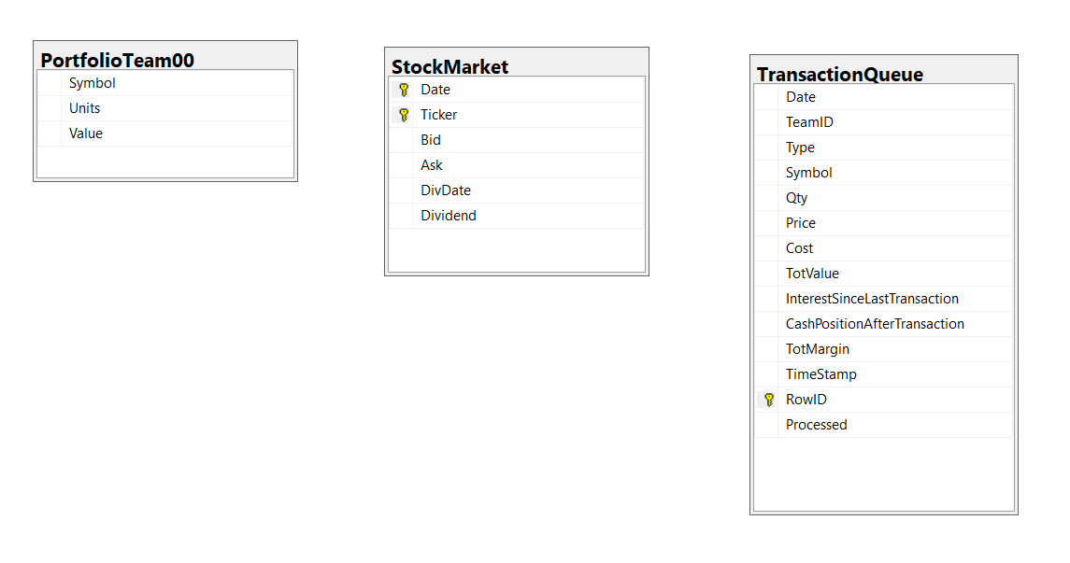
So, at work ask for a DATA MODEL and/or a DATA DICTIONARY
A map of the DB contents
Value = Value of the position
Symbol = symbol or ticker
Cost = Transaction cost
TotValue = qty*price+cost
Ignore for now the last 6 fields in the Transaction Queue

Slide 14
Step three: query the DB using SQL

Slide 15

SQL: an example
SQL (Structured Query Language) is a programming language designed for working with relational databases.
Relational databases are DBs that represent data as Tables.
SELECT * FROM StockMarket
WHERE Ticker = ‘AAPL’
-- SQL is not case sensitive

Slide 16
Accessing the LongShort DB
DEMO

Slide 17
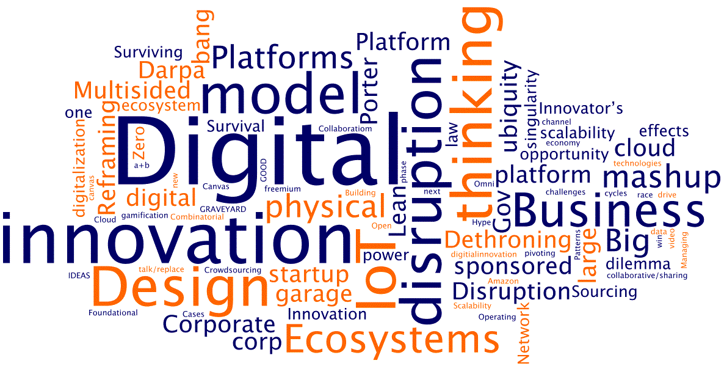
WINIT
What Is New In Technology?

Slide 18

Tools you need to do the job
A DataBase (DB) is an organized collection of data
A DataBase Management System (DBMS) is a software that provides data-related functionality: search, filter, sort…
A DB client (e.g., VS) is a program that connects to a DBMS
DataBase
User location
Data center
YOU
‘Client’ program
DBMS
DataBase file(s)

