Slide 1

Financial
Trading Analytics
Stefano Grazioli

Slide 2
Going overall well
Perceived difficulty
No office hours today – but I will be on MS Teams and Zoom
  Check your teamID
  Submitting hmwk as a team

Slide 3
You do the talking
Name, major…
Comfort with finance?
Use of GenAI in the course?
Do you have a team?
Things you like about the class
Things that can be improved

Slide 4
Architectural principles
‘Thin code’ manages the user interface, visualizes
Coordinates activities
Business logic
Data access
Hedge
Tournament
ALPHA
Compliance Engine
DB Manager
Code behind
User interface
Ribbon
Code behind
Portfolio Manager
WS
Hedge
Tournament
BETA
User
Main Controller
WS
Code behind
WS
Execution Engine
WS
Code behind
Hedge
Tournament
GAMMA
Recom-mender
Code behind
Global variables

Slide 5
Homework H14
All column names in the tables involved in H13
are to be considered orange words.

Slide 6
Stocks and Options FUNdamentals

Slide 7
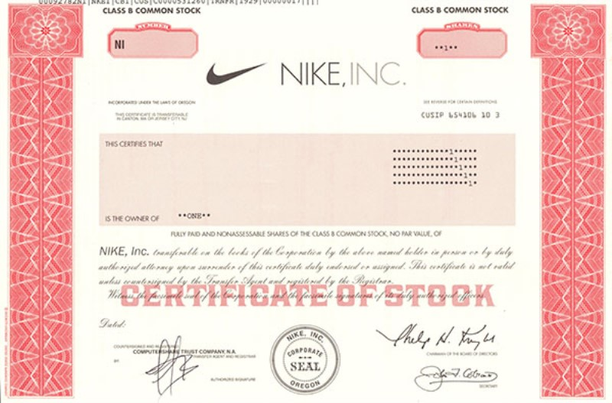
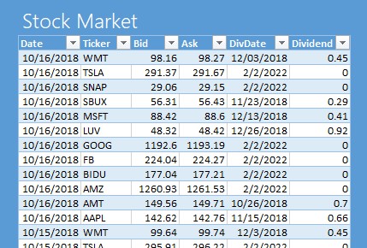
Stocks/Shares
A share of a corporation is a security that represents fractional ownership of the corporation.
Owners of shares - “Shareholders/Stockholders” - may receive dividends, proceeds from liquidation of assets, and may vote on important decisions affecting the corporation.
Shares are bought and sold on stock exchanges by market makers (also known as specialists) and other players. Bid / Ask
Notes:
M maker (e.g. NASDAQ) = firm that buys and sells on its own account. MMs compete among themselves. Electronic market.
Specialist (e.g. NYSE) = monopolist who runs an auction posting bids and asks from the market participants

Slide 8
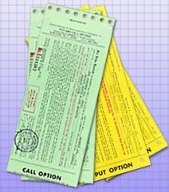
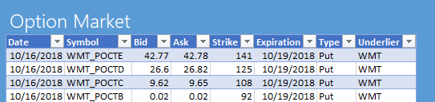
Options are derivatives
An option is a contract giving the buyer the right, but not the obligation, to either buy or sell an underlying asset (e.g., a stock) at a specific price on or before a specified date.
Once created, it may be sold and bought on the market. We do not write options. We buy/sell/sellshort them.
Notes:
R. McDonald Fundamentals of Derivatives Markets – chpt 4
Why use derivatives: 1) to hedge; 2) speculate; 3) avoid trans. Costs 4) to arbitrage regulations

Slide 9
Example Scenario
You just inherited 1,000,000 Apple shares.
@ $250 -> $250,000,000.
You are pretty happy.
But you are also worried. What if the price drops to $200?
You need some kind of insurance against that.
Somebody is willing to commit to buying your Apple shares at $250
(if you want), two years from now.
But she wants $1 per share. Now.
You decide that it is a good deal. So, you buy 1,000,000 contracts that give you the right to sell your shares at $250 two years from now.
You have bought 1,000,000 put options.

Slide 10
Put Options
A put option gives to its holder the right but not the obligation to sell the underlying security at a given price on (or before) a given date.
Think (loosely) “buying insurance”

Slide 11
Nomenclature
underlier
Put Option
can sell 1 TESLA stock
@ $400.00
on 20 May 2026
Bid: $ 20.00
Ask: $ 20.20
TESLA Stock
Bid: $ 400.00
Ask: $ 401.00
Dividend: $ 0
strike price
expiration:
European vs. American

Slide 13
Another Scenario
You are an executive at Netflix.
You make $1,000,000 a year.
You are pretty happy.
The Board wants to make sure that you will do your best to keep the price of the Netflix stock up.
Rather than giving you a well-deserved raise, they offer to you a deal. They promise that in three years they will give you the chance to buy 100,000 shares at $80 each.
Right now the share is valued at $78.
If the company does well, the share price could go as up as $100.
So you think: “In three years I could just get my 100,000 @ $80 and then immediately sell them back to the market for $100....”
You conclude that an extra $2,000,000 in your pocket is a good thing.
You have been given 100,000 call options.

Slide 14
Call Options
A call option gives to its holder the right but not the obligation to buy the underlying security at a given price on or by a given date
Think “deposit to buy later at a fixed price"

Slide 15
Nomenclature
underlier
Call Option
can buy 1 TESLA stock
@ $400.00
on 20 May 2026
Bid: $ 20.00
Ask: $ 20.50
TESLA Stock
Bid: $ 400.00
Ask: $ 401.50
Dividend: $ 0
strike price
expiration:
European vs. American

Slide 16
American vs. European Options
In the HT we use European options only. Why?
Models and theory built on European options
American always at least as expensive
Not optimal to exercise early an American on a non-dividend paying stock (if assumptions hold)
Always possible to trade a European option before expiration.
Source: R. McDonald – Fundamentals of derivative markets

