Slide 1
Financial Metrics
Stefano Grazioli

Slide 2
Welcome back!
Spot checking
Patches
Workload: H15 and H16 are longer
4 tickers for the tournament

Slide 3
You do the talking
Name, major…
Usage of GenAI for the course
Things you like about the class
Things that can be improved

Slide 4
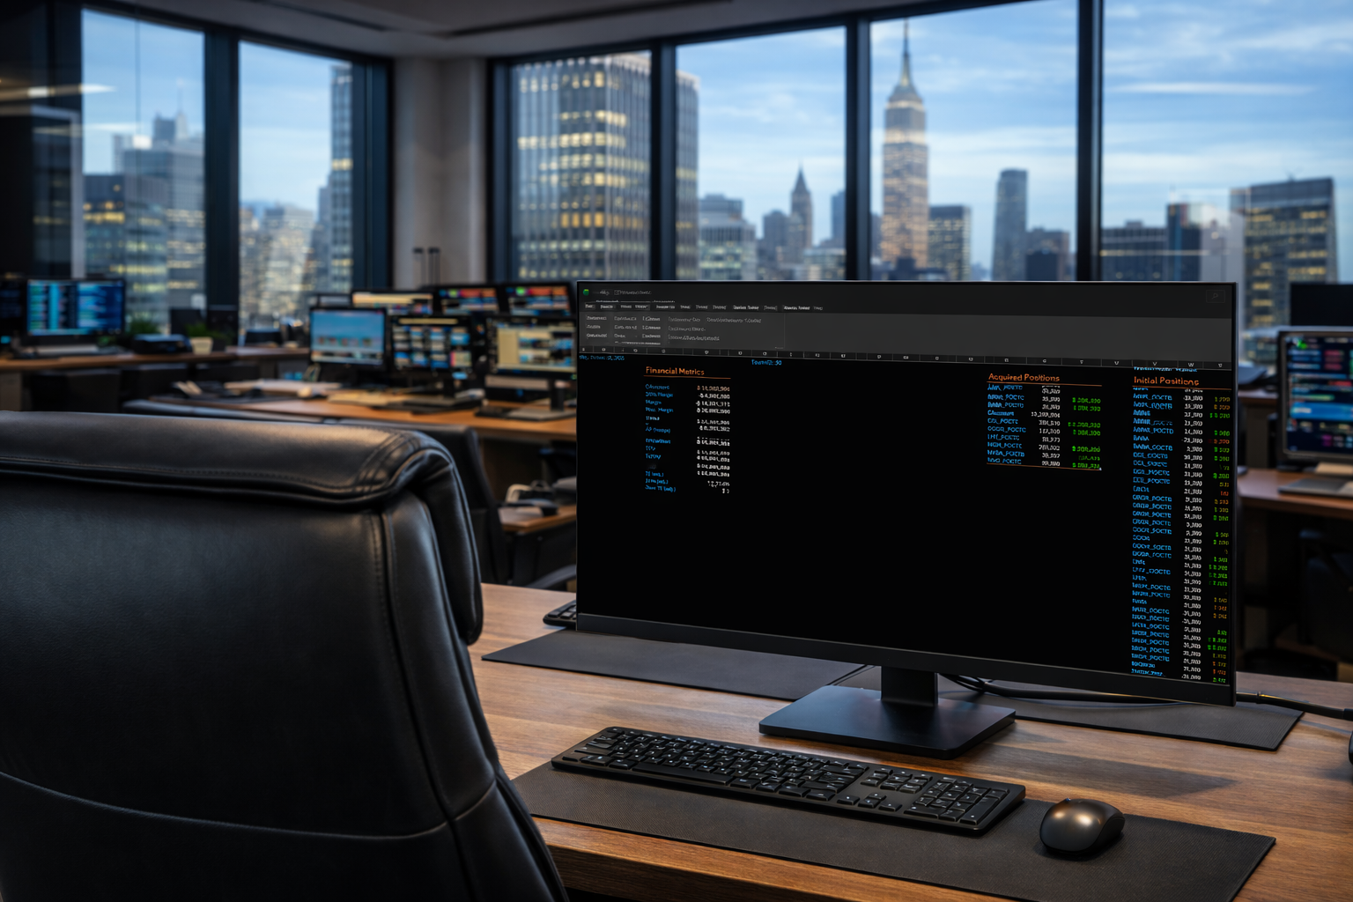
Homework
Financial Metrics

Slide 5
Orange words
Next time I will ask about the metrics on the dashboard and how to check them

