Slide 1




Data Management for Decision Making
Comm3220 – Welcome and Introduction
Stefano Grazioli

Slide 2







Milano, Italy
Bocconi University
UT Austin
Mendoza, Argentina
NoVA

Slide 3
My/Our Network
CGI Federal
Deloitte LLP
Booz Allen Hamilton
CapTech Consulting
ICF
Vanguard
Capital One
Phase2 Technology
U.S. Navy
Amazon Web Services
National Security Agency
DRT Strategies
Rapid7
ICS-NETT
CarMax
Microsoft
Appian
KPMG
U.S. Air Force
Freddie Mac
Verisign Inc
Ensemble Health Partners
R2 Technology Solutions
Google
Two Roads Consulting, LLC
Department of Veterans Affairs
Federal Reserve Bank of Richmond
Accenture Federal Services
General Dynamics Information Technology Inc

Slide 4
What is this course about?
Why am I taking this course?
What skills will I learn that I can put on my CV?
What is the work that I need to do?

Slide 5
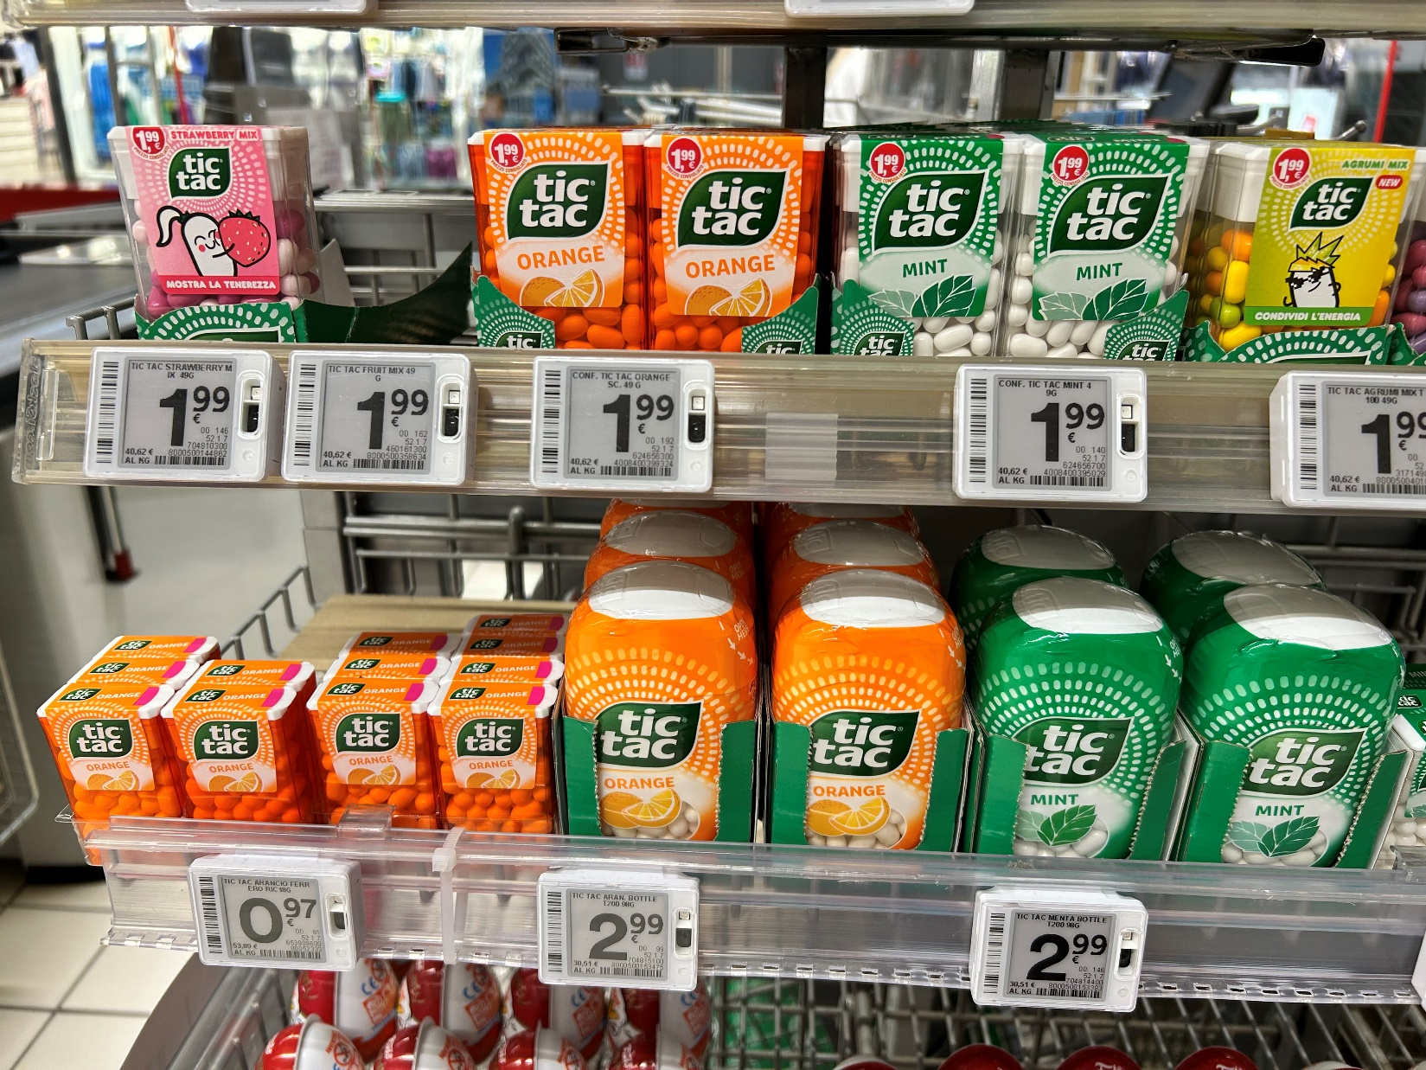
Notes:
25000 skus (15-60K) x 10 prices …

Slide 6

Comm 3220 is about helping you to navigate today’s digital business with confidence
Work with
business data
using SQL
Design and build simple databases using commercial-grade tools
Create dashboards and visualizations
Discuss data security,
quality, privacy,
monetization…
http://webs.comm.virginia.edu/Grazioli/Comm3220/LearningObjectives.html

Slide 7





You will learn key concepts in DM4DM
(the orange words)
DB = an organized collection of data
DBMS = software that manages DBs
Business intelligence = the collection, processing, and analysis of business data

Slide 8
The business world is blurring lines among data disciplines
Data Science
Artificial Intelligence
Data management
Business Intelligence
Business
Analytics
…but they all use data, typically stored in databases

Slide 9
What is this course about?
Why am I taking this course?
What skills will I learn that I can put on my CV?
What is the work that I need to do?

Slide 10
You do the talking
Name (enunciate, so we can learn)
Concentrations/tracks
Career goal
Confidence in information technology?
What I am hoping to learn

Slide 11
What is this course about?
Why am I taking this course?
What skills will I learn that I can put on my CV?
What is the work that I need to do?

Slide 12


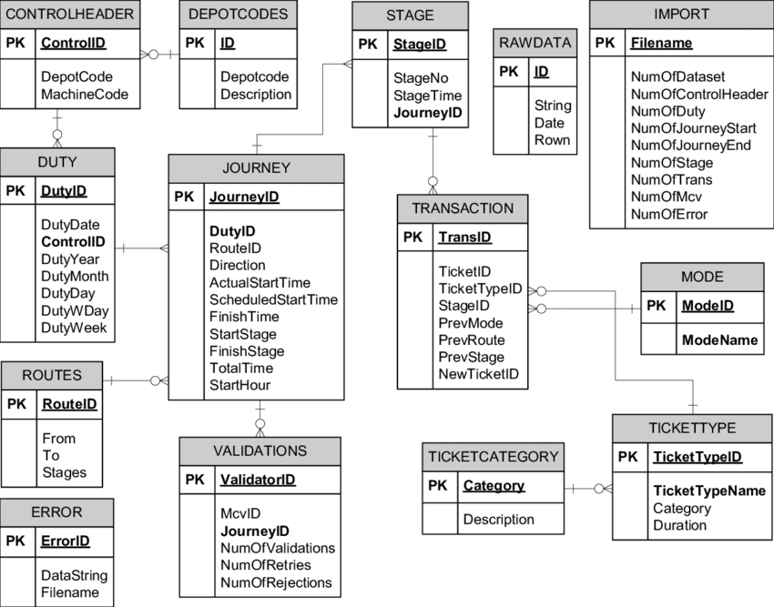






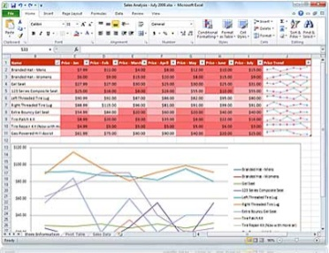


Tools for your CV
Data modeling
  ERD diagramming, Draw.io,
  MySQL Workbench
Database
  SQL, MS SQL Server, Azure Data Studio
Business intelligence: dashboards and visualizations
  Power BI, Power Query, Power Pivot
Azure Data Studio

Slide 13
What is this course about?
Why am I taking this course?
What skills will I learn that I can put on my CV?
What is the work that I need to do?

Slide 14
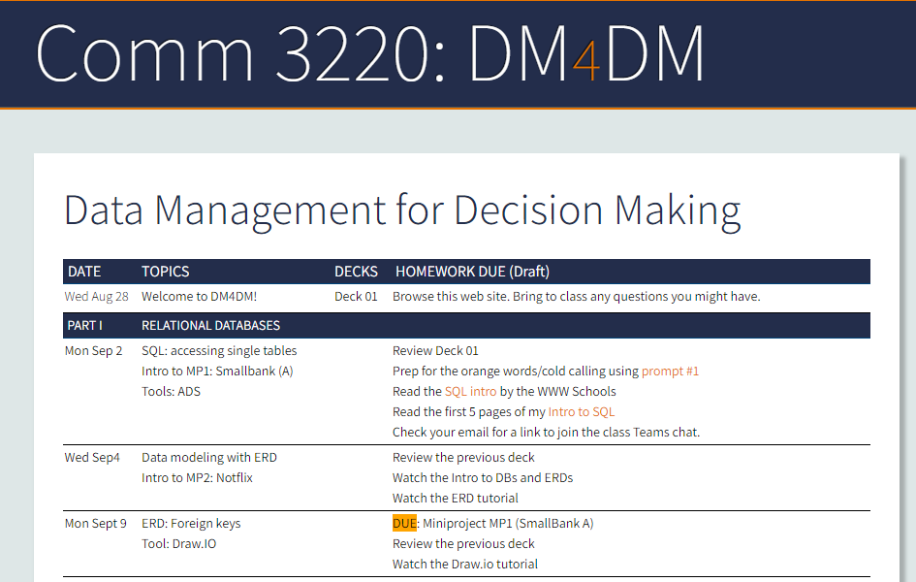
Work to do / assignments
http://webs.comm.virginia.edu/Grazioli/Comm3220/ScheduleUG.html

Slide 15

Grading
No finals, no midterm, no multiple choices.
8 Mini projects (60%)
2 In-class tests (30%)
Participation (10%)
  Orange words
  WINIT
  In-class
  MS Teams

Slide 16


The Orange Words
Let me help you with this…
https://webs.comm.virginia.edu/Grazioli/Comm3220/Prompts.html

Slide 17

WINIT
What Is New In Technology
Instructions https://webs.comm.virginia.edu/Grazioli/Comm3220/Winit.html
And the first
volunteer is...

Slide 18

Check your email

