Slide 1
Data Modeling
Organizing business information with Entity Relationship Diagrams (ERDs)
Notes:
Open AI

Slide 2
Critical thinking
ADS installs?
DB access?
Questions on MP1?
Argentina Jan term course info: this Wed. @ 5pm RRH 225

Slide 3
Orange Words
Data Dictionary
Field in a Table
Record in a Table
Primary key
Select

Slide 4
You do the talking
First, last name
College, major
Career goals
Confidence with IT
What I hope to learn from this course

Slide 5
DB Consulting at Notflix
“What? Already another miniproject?” “No worries. This is due a week after MP1.”
Notes:
Notflix is an Internet startup that plans to compete in the streaming of indie and ULB (Ultra Low Budget) shows - the kind of show that would not be picked by Netflix or Disney+, yet have the potential to achieve cult or viral status.

Slide 6
Your next consulting job: Notflix
We have a new client. It is a startup called Notflix. No, not that. It is spelled ‘Notflix’.
They are developing their movie recommendation engine. They want us to help them with organizing their data.
Who is on the assignment?
You and, if you want, another of our analysts. You decide. Begin by interviewing Bella Moovee, the founder, and help her with drafting a data model for her company.
No problem, boss!
…good thing I took Comm3220...

Slide 7
Building a DB at Notflix
Establish a business case (assume it is done)
Engage a business analyst (you) to organize the data needed by the business. The blueprint for a DB is called a Data Model
Give the Data Model to a technologist so that he/she can build it.

Slide 8
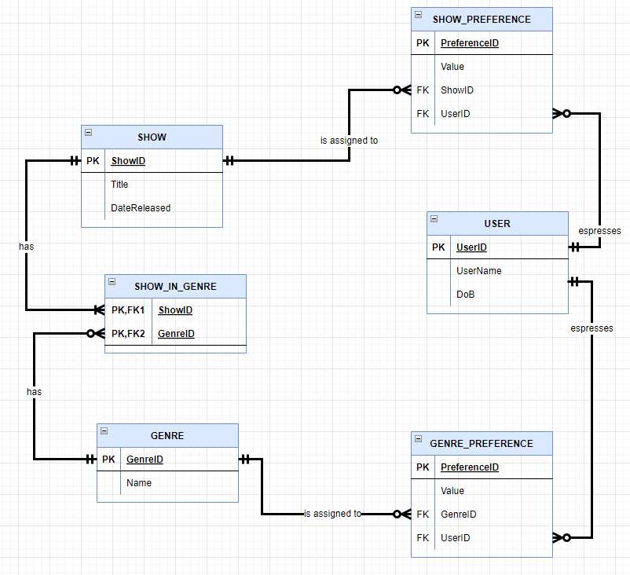
Business data modeling is the task of organizing business information
Description of a business process: interviews, narratives, documents…
A Data model (aka database design)
mmm… I need to go to data modeling school!
Notes:
Easier to erase a line on a piece of paper than partially rebuild an implemented database - think home blueprint
Why can’t we give it to a data scientist to check?

Slide 9
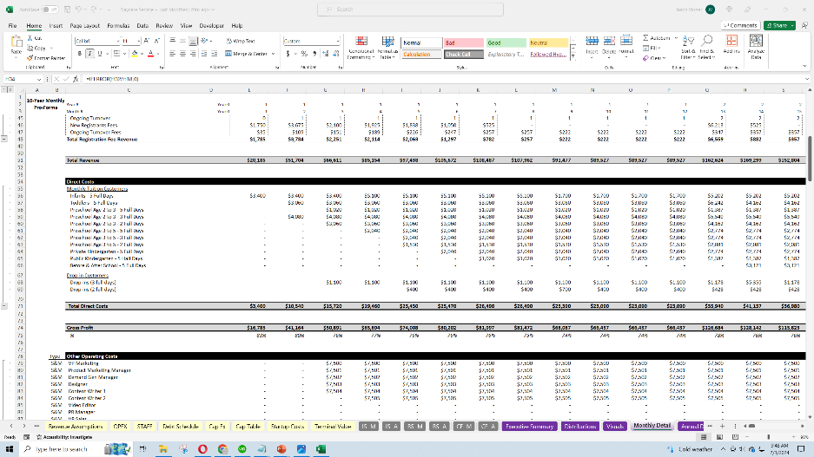
Good news: You are already pretty good at data modeling

Slide 10
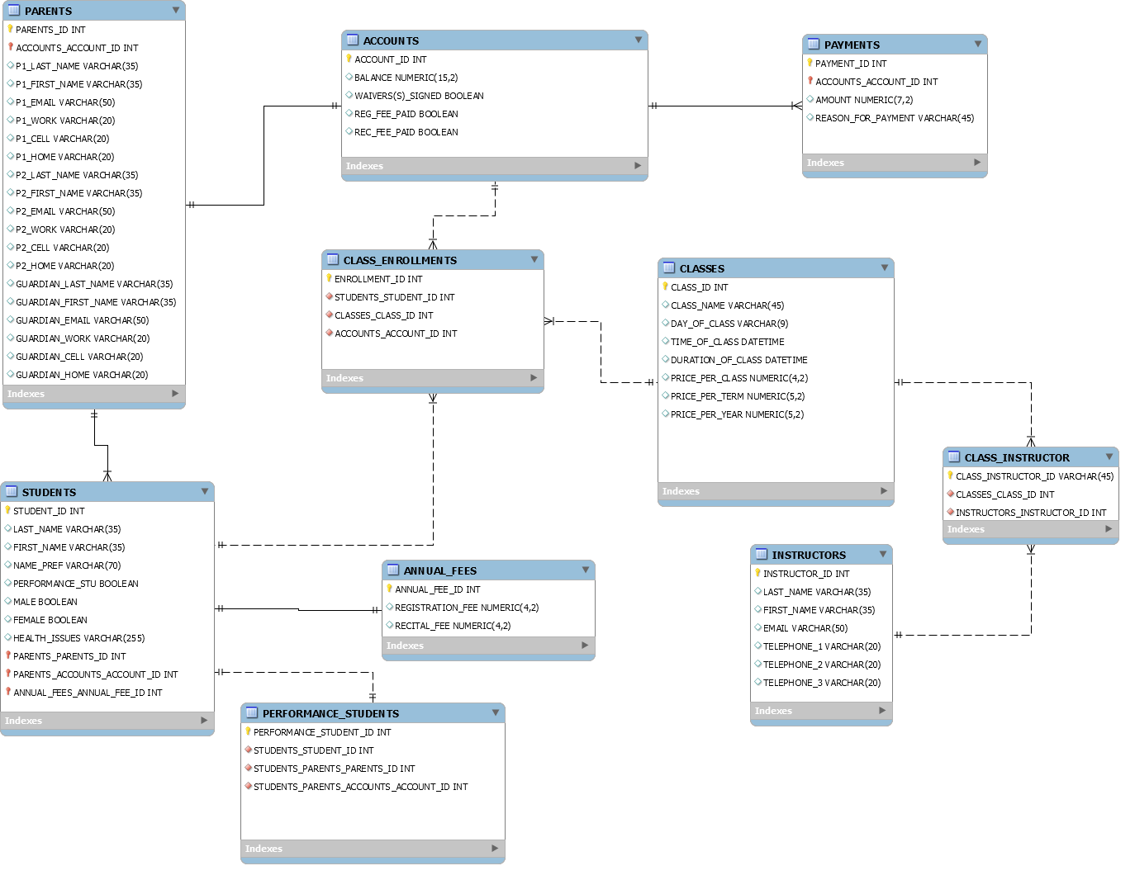
Entity Relationship Diagrams (ERDs) is a popular technique to do data modeling
Peter Chen
Entities (the boxes)
Relationships (the lines)
Notes:
Chen had a background in electrical engineering, and a PhD in computer science. His 1976 work really formalized the entity-relationship modeling ideas and mainstreamed it into academia and later into practice.

Slide 11
Entities are the kind of things that we need to track to run a business
Ask yourself: what is the information that I need to run my target business?
Entities are lists of things of the same kind
Usually entities become tables in the implemented database
Customer
Vendor
Product
Order
Note: Common convention is to have entities and table names in singular form and capitalized

Slide 12
A few entity examples
Pet
Course
Movie
Account
Customer
Student
Professor
Treatment
Customer

Slide 13
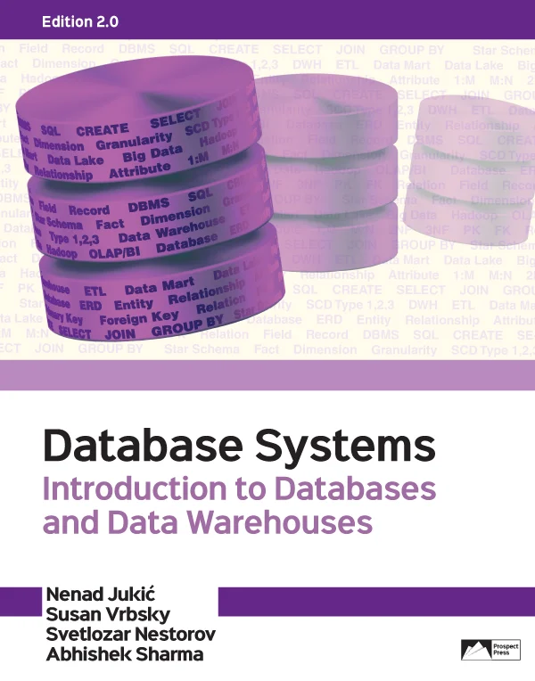
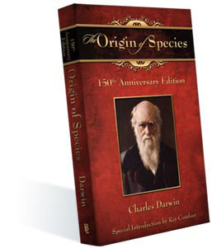
The specific things we track are called instances
In the database, each instance is a row in a table.
Entity
Book
Instances

Slide 14
Instances have attributes
Attributes are features of the instances
In a relational database, attributes are columns (aka fields) in a table.
BOOK
ISBN | Title | Genre
9780199219223 | Origin of Species | Non-Fiction
9780521402378 | Great Gatsby | Adult Fiction
9780143105954 | Moby Dick | Adult Fiction
9781561563081 | Moby Dick | Children’s Lit

Slide 15
To be concise, we use a compact format as a shorthand
a table has columns and rows
An entity has attributes and instances
BOOK
ISBN | Title | Genre
9780199219223 | Origin of Species | Non-Fiction
9780521402378 | Great Gatsby | Adult Fiction
9780143105954 | Moby Dick | Adult Fiction
9781561563081 | Moby Dick | Children’s Lit
BOOK
ISBN
Title
Genre
For us, equivalent representations

Slide 16
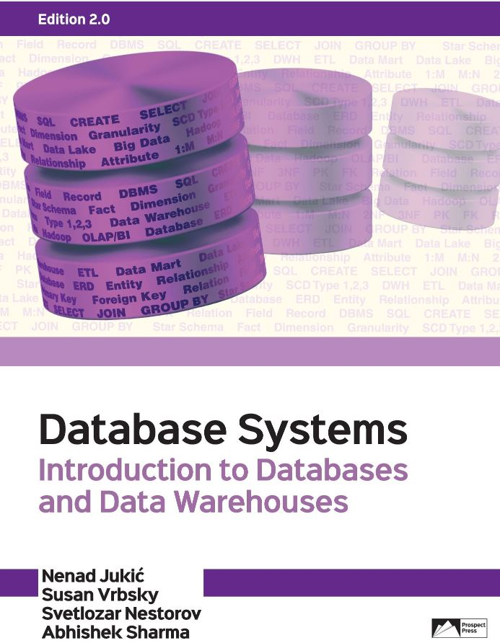
The special attribute(s) that serves as unique identifier for the instances is called primary key in the table
Primary key
Composite key
Candidate key
BOOK
(PK) ISBN
Title
Author Year Published
Publisher
Genre
ISBN
Title
Author Year Published
Publisher
Genre
N. Juckic
978-1943153190
N. Juckic
978-1943153688
Note: Common convention is to designate identifiers by underlining, or by the letters (PK). They are usually listed on top.

Slide 17
WINIT
What is new in IT

Slide 18
Relationships
No, not those.

Slide 19
The Vet needs your help
Customer
CustomerID | First | Last | Mobile
234 | Dorothy | Martin | 434-5634744
235 | Joie | Henney | 434-7524220
236 | Anand | Aguillar | 434-9500328
237 | Annie | Xiong | 434-2378251
… | … | … | …
Pet
PetID | Name | Species
P12 | Rocky | Dog
P64 | Mindy | Cat
P82 | Odin | Cat
P37 | Olaf | Cat
P38 | Wally | Alligator
Add data somewhere so that the Vet can keep track of who owns which pet

Slide 20
Owners and Pets
This will not work well
CustomerID | First | Last | Mobile | PetID
234 | Dorothy | Martin | 434-563744 | P64
235 | Joie | Henney | 434-752422 | P82
236 | Anand | Aguillar | 434-950032 | P12
237 | Annie | Xiong | 434-237825 | P37
… | … | … | …
PetID | Name | Species
P12 | Rocky | Dog
P64 | Mindy | Cat
P82 | Odin | Cat
P37 | Olaf | Cat
P38 | Wally | Alligator
Add one column somewhere so that the clinic can keep track of who owns which pet

Slide 21
Pets and owners
This will work well
CustomerID | First | Last | Mobile
234 | Dorothy | Martin | 434-563744
235 | Joie | Henney | 434-752422
236 | Anand | Aguillar | 434-950032
237 | Annie | Xiong | 434-237825
… | … | … | …
This is a better way to implement the pet/owner relationship
PetID | Name | Species | CustomerID
P12 | Rocky | Dog | 236
P64 | Mindy | Cat | 234
P82 | Odin | Cat | 235
P37 | Olaf | Cat | 237
P38 | Wally | Alligator | 235
Add one column somewhere so that the clinic can keep track of who owns which pet

Slide 22
To relate two rows, we copy in one row the primary key in the other row
PET
Customer
PetID | Name | Species | CustomerID
P12 | Rocky | Dog | 236
P64 | Mindy | Cat | 234
P82 | Odin | Cat | 235
P37 | Olaf | Cat | 237
P38 | Wally | Alligator | 235
CustomerID | First | Last | Mobile
234 | Dorothy | Martin | 434-563744
235 | Joie | Henney | 434-752422
236 | Anand | Aguillar | 434-950032
237 | Annie | Xiong | 434-237825
… | … | … | …
PK
FK
A Foreign Key (FK) is a column that is also a primary key (PK) in another table. FKs are used to relate tables.

Slide 23
Data modeling mistakes
Deciding where to place the Foreign Keys is non-intuitive and may lead to mistakes.
To avoid confusion, there are three simple rules for foreign key placement.

Slide 24
Three Types of Relationships
One-to-One
One-to-Many
Many-to-Many
What is the relationship between states and their state capitals?
State Capital
State
is located in

Slide 25
Three Types of Relationships
One-to-One
One-to-Many
Many-to-Many
What is the relationship between a vet customer and his/her pets?
VET CUSTOMER
PET
owns

Slide 26
Three Types of Relationships
One-to-One
One-to-Many
Many-to-Many
What is the relationship between a person and the jobs she had in her life?
Person
JOB
worked as

Slide 27
There are 3 simple rules to decide the right placement for your FKs…
….we will see them next Monday.
(I know. This will keep you on the edge of your seats for the whole weekend)

Slide 28
https://draw.io/

Slide 29
Summary: There are three types of relationship between entities
One-to-One: When all instances in either entity may have an association with at most one instance in the other entity. (State/Capital example)
One-to-Many: When an instance in an entity may have an association with one or more instances in a second entity, but instances in the second entity can be related to only one instance in the first. (State/Person example)
Many-to-Many: When instances in either entity can be associated to one or more instances in the other entity. (Person/Jobs example)

