Slide 1
Foreign keys
They are PKs in another table

Slide 2
Critical thinking
Congratulations on completing MP 1
Looking for an optional partner for project 2?
Questions?

Slide 3
Orange Words
Business data modeling
Entity
Instance
Composite key
Foreign key
Many-to-many
job interview…
job interview…

Slide 4
MP2 – Notflix ERD
1. Identify entities
2. Assign attributes and PKs
3. Draw relationships and cardinalities
4. Place FKs

Slide 5
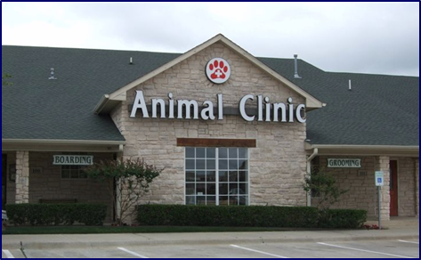
Recap: Foreign Keys (FK)
CustomerID | First | Last | Mobile
234 | Dorothy | Martin | 434-563744
235 | Joie | Haynes | 434-752422
236 | Anand | Aguillar | 434-950032
237 | Annie | Xiong | 434-237825
… | … | … | …
This attribute (column) is called a foreign key
PetID | Name | Species | CustomerID
P12 | Rocky | Dog | 236
P64 | Fluffy | Cat | 234
P82 | Odin | Cat | 235
P37 | Olaf | Cat | 237
P38 | Wally | Alligator | 235
A foreign key is a column in a table that is also a primary key in another table

Slide 6
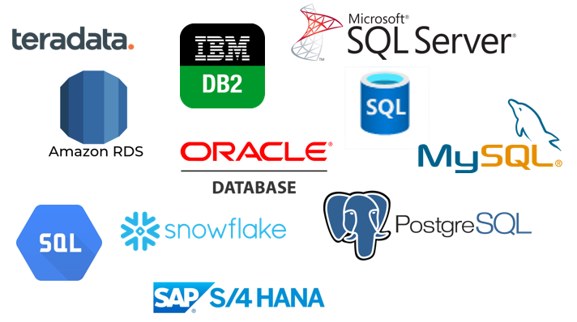
Relational Databases
Foreign Keys are the mechanism that relates information in different tables
Academically speaking, a “relation” is a table in a database, hence the term “relational databases”. It means databases which contain tables.

Slide 7
Recap: Foreign Key Placement
If you know the type of relationship, you can determine where to place the FK.
Three cases = three rules
One to many
One to one
Many to many
Essential knowledge for Project 2

Slide 8
Foreign Key Placement 1
This is a one-to-many relationship
CUSTOMER
ORDER
(PK) CID
First Name
Last Name
(PK) OrderNo Date
ShipTo
Type
places
CUSTOMER
(FK) CID
CID | First Name | Last Name
6810 | Jennifer | Claggett
7220 | Mahi | Dillon
… | … | …
ORDER
OrderNo | Date | ShipTo | Type | CID
O-727 | 4/6/24 | 3, Maine Ave | Online | 7220
O-827 | 4/7/24 | In store | Store | 6810
O-829 | 4/7/24 | In store | Store | 6810
… | … | … | … | …

Slide 9
Rule for one-to-many relationships: copy the PK of the ‘one’ side as a FK on the ‘many’ side.
The ‘one’ side
It is a good idea to use for the FK the same name used for the PK in the other table, but it is not necessary: the DBMS can be instructed to do translations. For example We could have called it “CustNo” inside Order.
The ‘many’ side
CUSTOMER
ORDER
(PK) CID
First Name
Last Name
(PK) OrderNo Date
ShipTo
Type
places
(FK) CID

Slide 10
Foreign Key placement 2
This is a one-to-one relationship
State Capital
State
(PK) Capital Name
Population
(PK) State Code State Name
Area
Nickname
Three alternative solutions
is located in
(FK) State Code
State
State Capital
State
(PK) State Code State Name
Area
Nickname
Capital Name
Population
(PK) Capital Name
Population
(PK) State Code State Name
Area
Nickname
is located in
(FK) Capital Name

Slide 11
Rule for one to one relationships: place the FK in either (not both) table or combine the tables.
State Capital
State
State Capital
State
(PK) Capital Name
Population
(PK) State Code State Name
Area
Nickname
(PK) Capital Name
Population
is located in
(PK) State Code State Name
Area
Nickname
is located in
(FK) State Code
(FK) Capital name
State
(PK) State Code State Name
Area
Nickname
Capital Name
Population
Different methods and tools will recommend different solutions. They will all work. *

Slide 12
You do the talking
Name
Concentration, Track
What I hope to learn from this course
How hard was miniproject 1?

Slide 13
Foreign Key placement 3
This is a many-to-many
CUSTOMER
MOVIE
(PK) CID
First name
…
(PK) ShowID
Title
…
watched
CUSTOMER
CID | First Name | …
C120 | Tom | …
C340 | Mary | …
C100 | Paul | …
… | … | …
SHOW
ShowID | Title | …
S35 | Mr. Magoo | …
S71 | Attack of the Crab Monsters | …
S44 | Santa Claus Conquers the Martians | …
S10 | Rubber: The Killer Tire | …
… | … | …

Slide 14
Many-to-many
Why?
This will not work well
CUSTOMER
CID | First Name | ShowID
C120 | Tom | S44
C340 | Mary | S44
C700 | Paul | S35
… | … | …
SHOW
ShowID | Title | …
S35 | Mr. Magoo | …
S71 | Attack of the Crab monsters | …
S44 | Santa Claus Conquers the Martians | …
S10 | Rubber: the killer tire | …
… | … | …

Slide 15
Many-to-many
Why?
This will not work well
CUSTOMER
CID | First Name | …
C120 | Tom | …
C340 | Mary | …
C700 | Paul | …
… | … | …
SHOW
ShowID | Title | CID
S35 | Mr. Magoo | C120
S71 | Attack of the Crab monsters | C120
S44 | Santa Claus Conquers the Martians | C120
S10 | Rubber: the killer tire | C700
… | … | …

Slide 16
Many-to-many
Why?
This will not work well
CUSTOMER
CID | First Name | ShowID
C120 | Tom | S44
C340 | Mary | S44
C700 | Paul | S35
… | … | …
SHOW
ShowID | Title | CID
S35 | Mr. Magoo | C120
S71 | Attack of the Crab monsters | C120
S44 | Santa Claus Conquers the Martians | C120
S10 | Robert: the killer tire | C700
… | … | …

Slide 18
Association table
RDBMS cannot directly handle many-to-many relationships: only one-to-many.
MOVIES_WATCHED
This will work well
CID | ShowID
C120 | S44
C340 | S44
C700 | S35
C120 | S35
C120 | S71
C700 | S10
… | …
Composite PK: two or more columns that, when considered together, are unique and can act as the primary key.
CUSTOMER
SHOW
CID | First Name | …
C120 | Tom | …
C340 | Mary | …
C700 | Paul | …
… | … | …
ShowID | Title | …
S35 | Mr. Magoo | …
S71 | Attack of the Crab Monsters | …
S44 | Santa Claus Conquers the Martians | …
S10 | Robert: the Killer Tire | …
… | … | …

Slide 19
Association table (2nd take)
Two FKs
MOVIES_WATCHED
ViewingID | CID | ShowID
1 | C120 | S44
2 | C340 | S44
3 | C700 | S35
4 | C120 | S35
5 | C120 | S71
6 | C700 | S10
7 | … | …
An alternative technique without a composite PK
This will work well
CUSTOMER
SHOW
CID | First Name | …
C120 | Tom | …
C340 | Mary | …
C700 | Paul | …
… | … | …
ShowID | Title | …
S35 | Mr. Magoo | …
S71 | Attack of the Crab monsters | …
S44 | Santa Claus Conquers the Martians | …
S10 | Robert: the killer tire | …
… | … | …

Slide 20
Rule for Many-to-many: create an association table that contains the PKs of the contributing tables as FKs (two versions)
Difference between the two solutions: ‘Two composite keys’ solution does not allow for repetition (can be good or bad) ‘Single primary key’ solution allows for repetitions.
MOVIES_WATCHED
CID | ShowID
C120 | S44
C340 | S44
C700 | S35
C120 | S35
C120 | S71
C700 | S10
… | …
CUSTOMER
CID | First Name | …
C120 | Tom | …
C340 | Mary | …
C700 | Paul | …
… | … | …
SHOW
ShowID | Title | …
S35 | Mr. Magoo | …
S71 | Attack of the Crab Monsters | …
S44 | Santa Claus Conquers the Martians | …
S10 | Robert: the Killer Tire | …
… | … | …

Slide 21
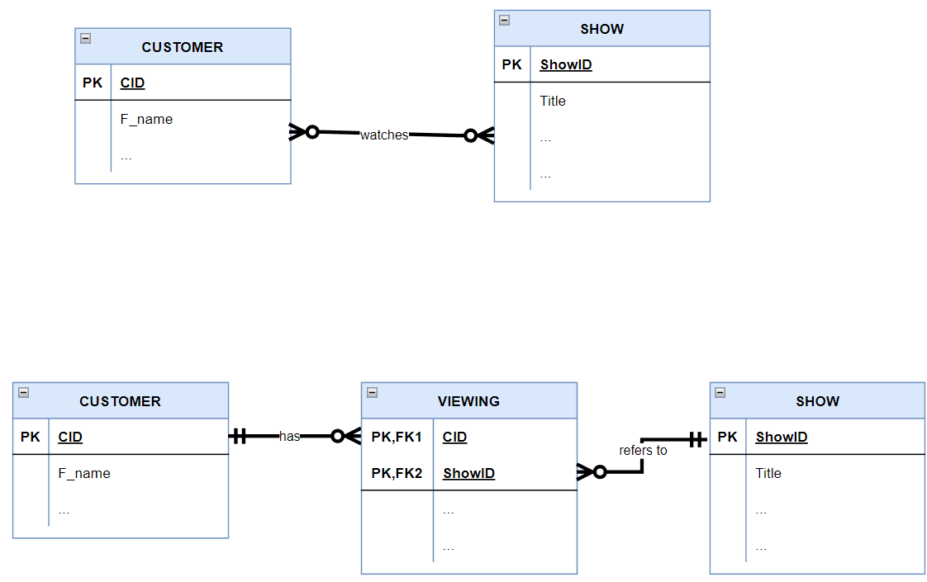
Association table example
Same concepts, just different format
Many to many becomes…
Composite key
May/may not have attributes

Slide 22
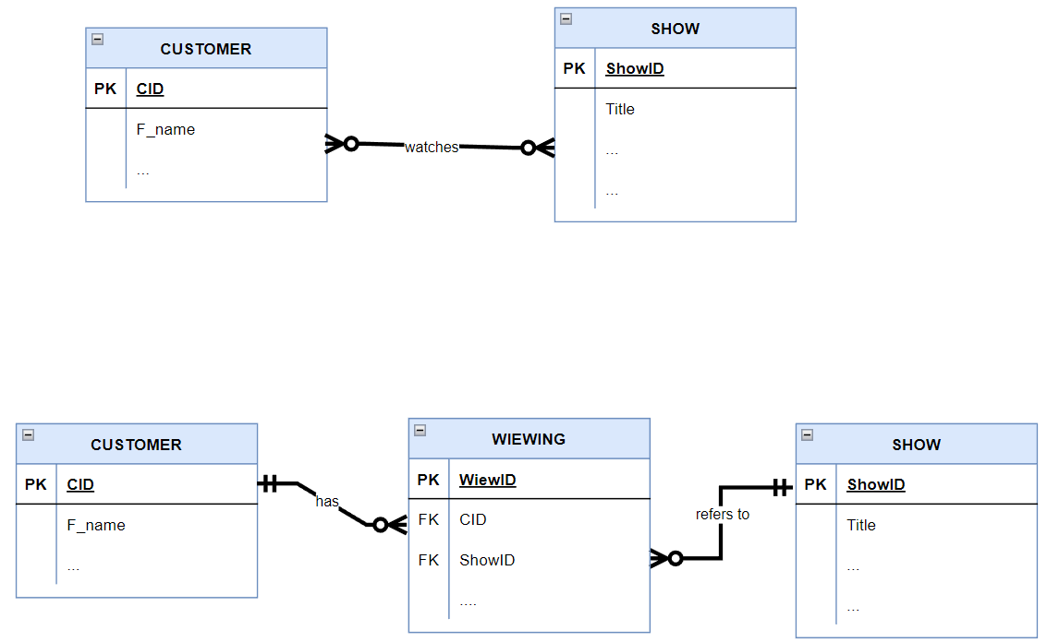
Association table (2nd take)
Same concepts, just different format
Many to many becomes…
May/may not have attributes
No Composite key: One PK and Two FKs

Slide 23
Summary: ERD rules
PK: All entities (tables) have a unique identifier (PK)
An entity must have more than one instance
If an attribute has attributes, it becomes an entity
One-to-many: place the PK of the ‘one’ side as a FK on the ‘many’ side
One-to-one: place one FK in either table, or combine the tables
Many-to-many: create an association table that contains the PKs of the contributing tables as FKs (two versions)

Slide 24
WINIT
What is new in IT

Slide 25
Cardinality: the full story
Cardinality is the minimum and maximum number of instances in one entity that relate to the second entity.
Minimum: called the lower bound
Maximum called the upper bound
One
Zero
One
Many
Read: “one and only one” | Read: “at least one and possibly many”
Read: “zero or one” | Read: “either zero or many”

Slide 26
Examples
Read: “one and only one” | Read: “at least one and possibly many”
Read: “zero or one” | Read: “either zero or many”
1
5
Customer
2
4
Loan Officer
3
is assigned to
7
10
9
8
6
Customer
Loan Officer
is assigned to
CUSTOMER
LOAN OFFICER
plays for
A lower bound of 1 means that the instance is mandatory, 0 means that it is optional.

