Slide 1
SQL: The joins
Central SQL concept & Prep for MP3

Slide 2
Critical Thinking
Questions on MP2?

Slide 3
The Orange Words
Relational database
Relation
Cardinality
Association Table
PROJECT
CONSULTANT
has

Slide 4
1. What is the total lent to Peter Parker? 2. Explain step-by step how you found out
LOAN |  |  |  |  | CUST_IN_LOAN |  |  | CUSTOMER
l id | principal | rate | date due |  | l id | c id |  | c id | f name | l name | city | state
2 | $1,000,000 | 7% | 2022 |  | 2 | c334 |  | c295 | Lex | Luthor | New York | NY
3 | $1,000,000 | 10% | 2024 |  | 3 | c410 |  | c335 | Bruce | Wayne | New York | NY
4 | $3,500,000 | 5% | 2023 |  | 4 | c334 |  | c347 | Bruce | Wayne | Austin | TX
6 | $1,000,000 | 7% | 2025 |  | 6 | c410 |  | c334 | Peter | Parker | New York | NY
8 | $2,000,000 | 5% | 2024 |  | 8 | c334 |  | c400 | Barbara | Gordon | New York | NY
9 | $500,000 | 4% | 2023 |  | 9 | c335 |  | c410 | Lois | Lane | Austin | TX
10 | $2,000,000 | 5% | 2024 |  | 6 | c411 |  | c411 | Clark | Kent | Austin | TX
 |  |  |  |  | 10 | c347
 |  |  |  |  | 10 | c295

Slide 5
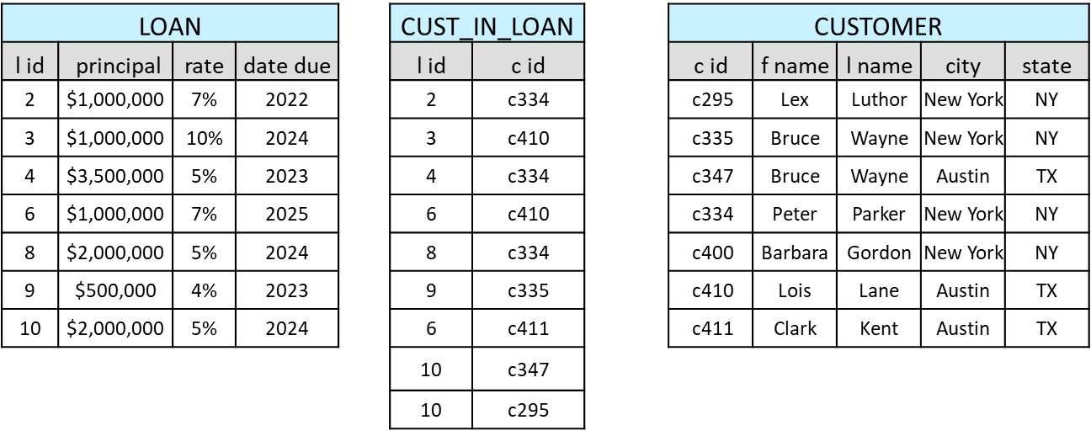
Same, using an ERD
What is the total lent to Peter Parker?
has
has

Slide 6
The SmallBank Database
Can you place four ‘FK’ lables in the right locations?
Can you read it?
purchases
manages

Slide 7
Joins are commonsense
Show me the loan officers and the loans that they manage
How do I tell SQL to connect these tables?...

Slide 8
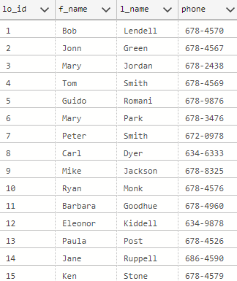
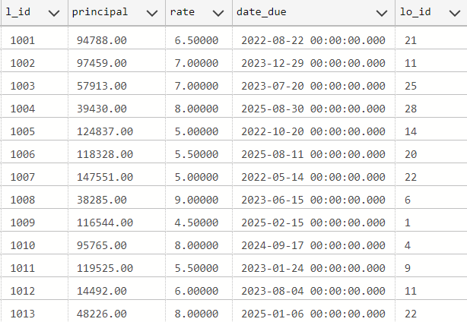
How to JOIN two tables
Each loan officer manages many loans (one to many)
LOAN OFFICER
LOAN
FK

Slide 9
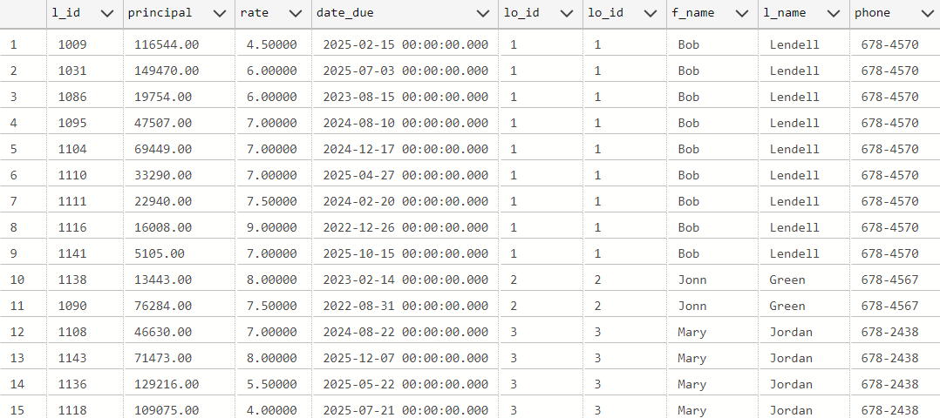
How to JOIN two tables
Select * from LOAN_OFFICER, LOAN
where LOAN_OFFICER.lo_id = LOAN.lo_id
THIS IS FROM LOAN
THIS IS FROM LOAN OFFICER

Slide 10
Alternative syntax
Select * from LOAN_OFFICER join LOAN on LOAN_OFFICER.lo_id = LOAN.lo_id

Slide 11
You do the talking
Name
Concentration, majors, minors
Hoping to get from DM4DM?
How was MP1? First impressions about SQL?

Slide 12
WINIT
What is new in IT

Slide 13
Joins are commonsense
1. Visualize the answer
2. Is the necessary data there?
3. What are the steps to find it?
What is the average rate of the loans managed by Jane Ruppell?

Slide 14
SQL join
What is the average rate of the loans managed by Jane Ruppell?
Select avg(rate)
from LOAN, LOAN_OFFICER
where LOAN_OFFICER.f_name = 'Jane'
and LOAN_OFFICER.l_name = 'Ruppell’
and LOAN_OFFICER.lo_id = LOAN.lo_id
Assumes that J. Ruppel is unique. What if it is not?

Slide 15
Alternative syntax
Select avg(rate) from LOAN join LOAN_OFFICER on LOAN_OFFICER .lo_id = LOAN.lo_id where LOAN_OFFICER .f_name = 'Jane’ and LOAN_OFFICER .l_name = 'Ruppell’
RISK: There might be more than one Jane Ruppell

Slide 16
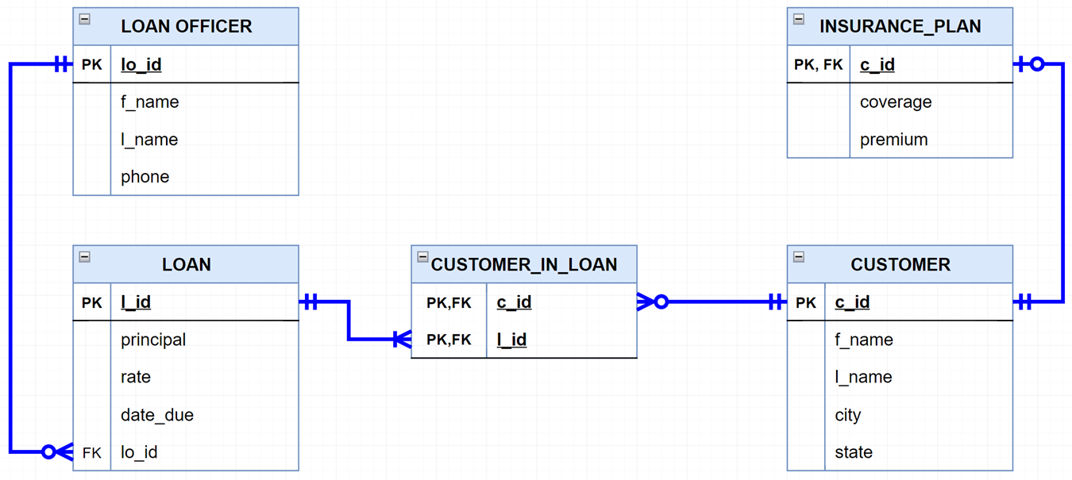
Joins are commonsense
If I give you c_id ‘c010’, can you give me the names and phone numbers of the loan officers for that client?

Slide 17
SQL join
If I give you c_id ‘c010’, can you give me the phone numbers of the loan officers for that client?
Select distinct lo.f_name, lo.l_name, phone
from customer_in_loan cil, loan l, loan_officer lo
Where cil.c_id = ’c010’
And cil.l_id = l.l_id
And l.lo_id = lo.lo_id

Slide 18
Alternative syntax
If I give you c_id ‘c010’, can you give me the phone numbers of the loan officers for that client?
Select distinct lo.f_name, lo.l_name, phone
from loan_officer lo
join loan l
on lo.lo_id = l.lo_id
join customer_in_loan cil
on l.l_id = cil.l_id
where cil.c_id = ’c010'

Slide 19
Joins are commonsense
Show me how many customers are insured by City

Slide 20
SQL join
Show me how many customers are insured by City
Select count(*), city
from customer c, insurance_plan ip
where c.c_id = ip.c_id
group by city

Slide 21
Alternative syntax
Select count(*), city
from customer c
join insurance_plan ip
on c.c_id=ip.c_id
group by city

Slide 22
COUNT can be tricky
Count(*) counts the number of records
Count(c_id) counts the number of c_ids
Count(DISTINCT c_id) counts the number of unique c_ids.
Sometimes these are not the same. Make sure you pick the right one.
Notes:
Not nulls

