Slide 1
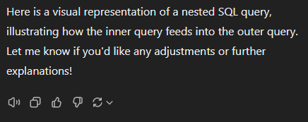
SQL: nested queries, union queries, & ‘Having’
Prep for MP3

Slide 2
Critical Thinking
MP2 went well Mean: 92/100 ERDs in your physical mailbox asap.
More practice today
Office hours on the web site
If you are using GenAI, what for and how good?
Do we need to go to a lab for quizzes?

Slide 3
Nested queries
?
Examples:
Find below-average loans
Show all customers from the city that has the most customers
List products that have not been ordered (“NOT IN”) *
A query placed inside another query
Use it when you want to retrieve data based on the result of another query
* May be done also with a join
Notes:
Source: vector stock

Slide 4
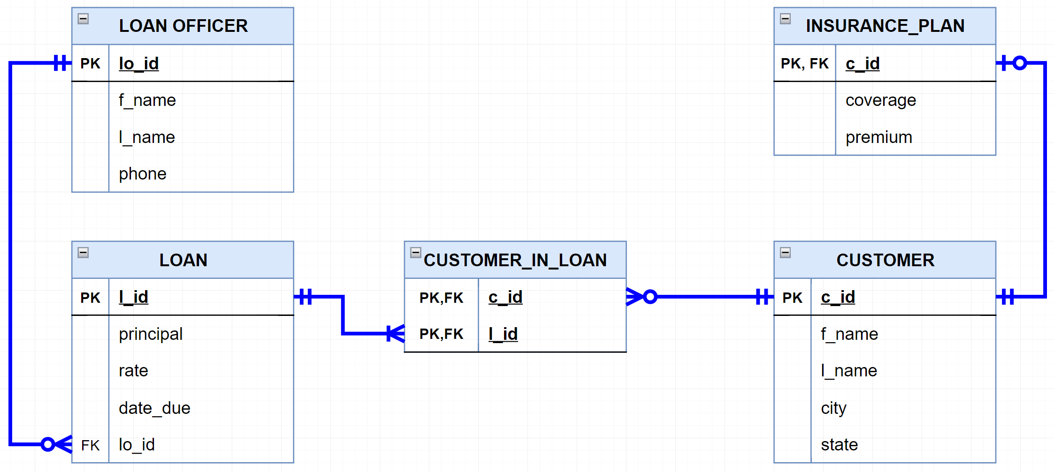
“Find above-average loans”

Slide 5
“Find above-average loans”
select avg(principal)
from LOAN
select *
from LOAN
where principal > 92362.66
select *
from LOAN
where principal > (select avg(principal)
from LOAN)
Inner query
Outer query

Slide 6
“Show all customers from the city that has the most customers ”

Slide 7
“Show all customers from the city that has the most customers”
Select top 1 city
from CUSTOMER
group by city
order by count(*) desc
select *
from Customer
where city = 'Charlottesville’
select *
from Customer
where city = (Select top 1 city
from CUSTOMER
group by city
order by count(*) desc)
Inner query
Outer query

Slide 8
You do the talking
Name
Concentration, Track
In class practice useful?
Things that you like about the class
Things that can be improved

Slide 9
Group by and Having
Group by aggregates rows that have the same values in specified columns. It’s often used with COUNT(), SUM(), AVG(), etc.
Having filters those aggregate results

Slide 10
Group by and Having
“Find the clients who borrowed in total more than $400K from us”

Slide 11
Group by and Having
“Find the clients who borrowed in total more than $400K from us”
select c.c_id, c.l_name, c.f_name, sum(l.principal)
from CUSTOMER c, LOAN l, CUSTOMER_IN_LOAN cil
where c.c_id = cil.c_id
and cil.l_id = l.l_id
group by c.c_id, c.l_name, c.f_name
having sum(l.principal) > 400000
Remember to add columns that are not in an aggregated function (e.g. ‘sum) and that you want to visualize with select

Slide 12
WINIT
What is new in IT

Slide 13
Union statement
Allows you to combine rows returned by two or more queries
Query 1: “List Leo’s cats”
Query 2: “List Leo’s dogs”
Query 1 UNION Query 2
CATS
DOGS
PETS
ID | Name | Fur color
C1 | Olaf | Brown
C2 | Felix | White
ID | Name | Fur color
D1 | Sandy | Black
D2 | Mortimer | Gold
D3 | Fido | Brown
ID | Name | Fur color
C1 | Olaf | Brown
C2 | Felix | White
D1 | Sandy | Black
D2 | Mortimer | Gold
D3 | Fido | Brown
UNION
Notes:
Source: vector stock

Slide 14
Union Example
Select ID, Name, Fur_color
From CAT
Where Owner = ‘Leo’
UNION
Select ID, Name, Fur_color
From DOG
Where Owner = ‘Leo’
ID | Name | Fur color
C1 | Olaf | Brown
C2 | Felix | White
D1 | Sandy | Black
D2 | Mortimer | Gold
D3 | Fido | Brown
UNION only return distinct rows. If you want to see all rows use UNION ALL
The joined tables must have the same number of columns and compatible column content
ORDER BY, if needed, must be placed at the very end of the SELECTs

Slide 15
Union Example
“Show me three customers in Cville, three in Dallas, and three in Richmond”

Slide 16
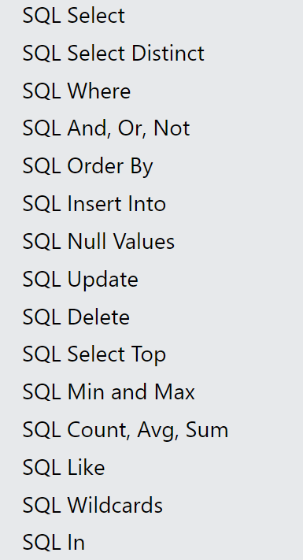
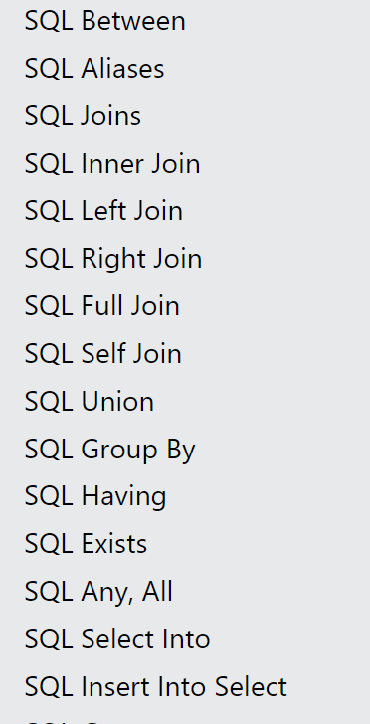
Keywords to learn
Go to https://www.w3schools.com/sql/default.asp
and test the live examples to understand how they work.

Slide 17
The SmallBank Database

Slide 18
More Practice Queries (new)
Q1: List all customers who borrowed above our average loan
Q2: List all customers from Dallas and Richmond who borrowed above the average loan for that city
Q3: List the customers that have the max number of loans at the Bank
Q4: Which are out top three and bottom three loans in terms of principal?

